Slide 1
Git
Everything is local

Slide 2
What’s Git?
Free and Open source
Distributed VCS

Slide 3

Centralized

Slide 4
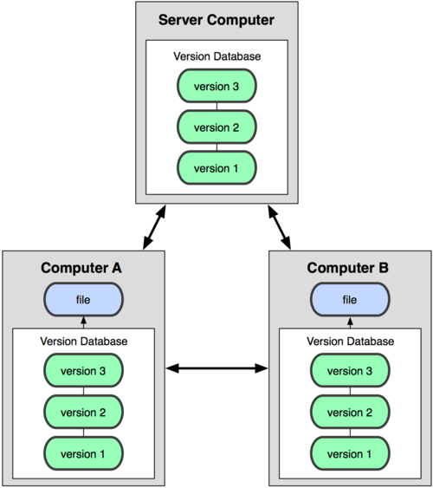
Distributed

Slide 5
Git != Github
https://gitorious.org/
https://bitbucket.org/
https://about.gitlab.com/
https://gitcafe.com/

Slide 6

Git Three States
Committed
Modified
Staged

Slide 7
How to start a new git project?
git init
git clone
git add / git commit
git remote add origin repo_url
git push –u origin master/branch-name
git push --set-upstream origin branch-name

Slide 8
.gitignore
# a comment - this is ignored
# no .a files
*.a
# but do track lib.a, even though you're ignoring .a files above
!lib.a
# only ignore the root TODO file, not subdir/TODO
/TODO
# ignore all files in the build/ directory
build/
# ignore doc/notes.txt, but not doc/server/arch.txt
doc/*.txt
# ignore all .txt files in the doc/ directory
doc/**/*.txt

Slide 9
git log
-p: shows the diff introduced in each commitsx
-2: limits the output of the log
--pretty=oneline: short full fuller
--graph
--since
--after

Slide 10
Undo
git commit –amend
git reset HEAD
git checkout – filename
git reset –hard HEAD

Slide 11
Additional skill
Rename local branch:
git branch –m old_branch_name new_branch_name
Delete local branch: git branch –d branch_name
Rename remote branch: git remote rename old new
Delete remote branch: git push origin :branch_name

Slide 12
Github Tips
T
Network

Slide 13

Q&A

