Slide 1
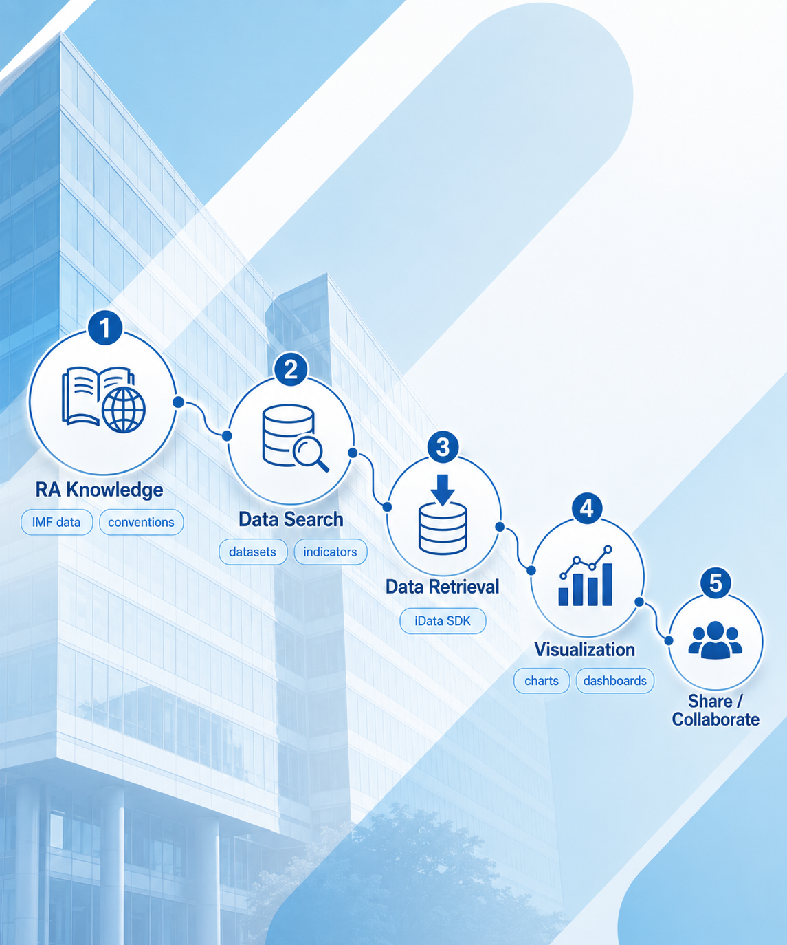
INTERNAL SHOWCASE · 2026
RA Skills
Local AI agents for IMF
Research Analyst workflows.
LOCAL
Runs in the analyst’s local computer
NATIVE
Direct iData SDK integration
INSTITUTIONAL
Encodes general RA knowledge and IMF conventions
Chengyu Huang / Bella Hao / Jamie Yang
SPR AI
Jun 2026
RA Skills · Internal showcase · 2026
Notes:
Welcome. Over the next ten minutes I want to walk you through RA Skills — a small project that takes a big bet. The bet is that today's AI is stuck in a chat window, and the real value comes when it moves out of the chat and into the tools an analyst already uses. So the through-line of this deck is one phrase: from chatbot to colleague.

Slide 2
01 · THE PROBLEM
AI today lives in a chat window
— and the rest of the workflow is stitched together by hand.
CHAT TAB
REAL WORKFLOW
Ask Claude / ChatGPT
Where the work happens
"What's the indicator code for real GDP growth in WEO LIVE?"
Excel
Stata
Python
R
COPY ·
PASTE ·
"Which countries are in the G20?"
RETYPE
No SDK access. No file access.
No memory of what worked yesterday.
"Show me sample Python to call iData…"
No institutional conventions.
THREE CONSEQUENCES
Fragmented workflow
No SDK access
Knowledge stranded
Every query becomes a copy-paste loop.
Chatbot can't see your data or call your tools.
IMF conventions live in heads and email.
RA Skills · Internal showcase · 2026
02 / 10
Notes:
Let's start with the problem we're actually trying to solve. Today, AI for the research analyst lives in a separate browser tab. You ask Claude or ChatGPT a question, you read the answer, and then you copy something out and paste it into iData, or Excel, or Stata, or a Jupyter notebook — that is where the actual work happens. The chatbot can't see your SDK. It doesn't know your country codes. It has no memory of the question you answered the same way last Monday. So every query becomes a fresh copy-paste loop, and institutional knowledge stays stranded in heads and email threads.

Slide 3
02 · THE VISION
From chatbot to colleague
Move from AI you talk to → Agent that does the work.
PILLAR 1
PILLAR 2
PILLAR 3
Local
Native
Institutional
Runs inside the analyst's
Call iData SDK
Encodes WEO group rules,
repo — alongside the SDK,
directly — no copy-paste
LIVE-vs-vintage logic, retired
catalogs, and conventions.
code, no API guessing.
endpoints, frequency conventions.
No cloud round-trip.
Same tools you already use.
Knowledge captured once.
No data leaves the laptop.
Output drops into your repo.
Never re-asked Monday.
Discovery → fetch → tidy → chart. Chained, not stitched.
RA Skills · Internal showcase · 2026
03 / 10
Notes:
The vision is to flip that. Instead of an AI you talk to, an AI that does the work. Three things make this possible. First, it has to be local — running inside the analyst's repo, alongside the SDK and the catalogs, not in a separate tab. Second, it has to speak the SDK natively, so there's no copy-pasting code and no guessing API conventions. And third, it has to encode institutional knowledge — WEO groups, LIVE versus vintage, retired endpoints — so the same question doesn't get re-asked every Monday. The shorthand for all of this is: discovery, fetch, tidy, chart — chained, not stitched.

Slide 4
03 · THE PROJECT
Introducing RA Skills
Plain English in. Real iData out.
WHAT IT IS
HOW IT FLOWS
A family of project-local Claude Code
skills for IMF Research Assistants.
PLAIN ENGLISH REQUEST
“Please Pull real GDP growth data from WEO LIVE…"
Where it lives
.claude/skills/
in the analyst's repo. Auto-loaded.
Input
RA SKILLS AGENT
Natural language.
imf-ra · catalog · data · charts
Output
imf-ra
imf-ra-catalog
imf-ra-data
imf-ra-charts
Refreshable Excel · wide CSV ·
long CSV · (soon) chart.
Built on Anthropic Claude Code + Skills.
Refreshable
Wide / long
Chart
Excel
CSV
Coming soon
RA Skills · Internal showcase · 2026
04 / 10
Notes:
That is what RA Skills is. It is a family of project-local Claude Code skills for IMF Research Assistants. It lives under the .claude/skills directory inside the analyst's repo, so it's auto-loaded only when working in that repo — there is no global install. The input is plain English: pull WEO real GDP growth for G20 countries from 2010 to present. The output is a refreshable Excel, or a wide or long CSV, and soon a chart. It runs on top of Claude Code, so there is no new application to learn — the analyst's existing workspace simply gets smarter.

Slide 5
04 · ARCHITECTURE
Four small skills that chain — not one monolith
Each skill is one folder + one SKILL.md. They reference each other directly.
STEP 01
STEP 02
STEP 03
STEP 04 · WIP
imf-ra
imf-ra-catalog
imf-ra-data
imf-ra-charts
Umbrella +
Natural language →
SDK fetch · LIVE vs
Chart handoff —
shared conventions
Indicator identifier
vintage handling
scaffolded, not wired
DESIGN PRINCIPLE
Siblings, not nested. DRY through cross-references, not orchestration.
One folder + one SKILL.md
Workers reference each other
Umbrella loads conventions
Each skill stays small and inspectable.
No central orchestrator. No glue layer.
No pillar-specific logic at the top.
RA Skills · Internal showcase · 2026
05 / 10
Notes:
Architecturally, RA Skills is four small skills that chain — not one monolith. The umbrella, imf-ra, holds shared conventions: country codes, frequencies, SDK setup. Then imf-ra-catalog turns plain English into the right identifier. imf-ra-data calls the SDK and fetches the data. And imf-ra-charts hands the tidy output to the internal chart tool — that last one is scaffolded but not yet wired up. The design principle is that these are siblings, not nested. The umbrella does not orchestrate. Workers reference each other directly, which keeps each skill small, inspectable, and replaceable.

Slide 6
05 · DATABASE & INDICATOR COVERAGE
What RA-Skills Covers
Broad coverage across iData catalogs and adjacent sources.
Country & Group Intelligence
IMF Statistics
Markets & Finance
Development & Trade
Macro & WEO
WEO based research country-group matrix, IMF member scopes, PRGT groups
WEO Live, WEO vintages, GAS, GEE, etc.
BOP, CPI, GFS, MFS, EER, ER, IIP, FSI, etc.
Bloomberg iData Selected, Haver daily / weekly / monthly databases, etc.
World Bank WDI, WTO-IMF Tariff Tracker
One workflow, many sources. RA-Skills separates source routing, identifier discovery, country/group resolution, and data fetching — from plain-English question to confirmed data pull.
RA Skills · Internal showcase · 2026
06 /10
Notes:
This is what RA Skills covers, including various research country group catalogs and more than 150 non-vintage datasets, align with current iData coverage—
Country & Group is a routing layer that resolves country groups like IMF member countries, AE, EMDE, G20, etc.
For database coverage, you can find the most commonly use datasets like WEO Live, GAS, GEE, Have, Bloomberg, etc. We will expand our database later to enable indicator searching functionality for some external databases like DataStream and Dealogic.

Slide 7
06 · CAPABILITY 1 — DISCOVER
Plain English → the four things you actually need
The catalog skill turns a sentence into a callable identifier.
RA TYPES
RESOLVED TO
QUERY
DATABASE
WEO_LIVE
CATALOG
INDICATOR
NGDP_RPCH
"Pull real GDP growth from WEO LIVE
for G20 countries,
2010 to present."
FREQUENCY
A
(annual)
GEO
G20 → ISO3 list
auto-expanded from country_group.csv
FOUR RULES OF THE ROAD
LIVE vs vintage is explicit
Country groups expand
Latest by default. Say "April 2024 WEO" to lock to a snapshot.
"advanced economies" → straightforward member list.
Ambiguous queries are surfaced
Retired endpoints refused
Candidates listed with distinguishing notes. Never guesses.
EcOS is retired — pointer to the current iData equivalent.
RA Skills · Internal showcase · 2026
07 / 10
Notes:
Now the two capabilities. The first one is discovery: turning plain English into an exact identifier. Take the query, pull WEO real GDP growth for G20 countries from 2010 to present. The catalog skill resolves that to four things — the database WEO_LIVE, the indicator NGDP_RPCH, the frequency annual, and the G20 ISO3 list auto-expanded from the country-group CSV. Four rules of the road. LIVE versus vintage is explicit; the latest is the default but you can lock to April 2024 if you want. Country groups expand by name or code. Ambiguous queries are surfaced as candidates with notes — the skill never guesses. And retired endpoints like EcOS are refused with a pointer to the current iData equivalent.

Slide 8
07 · CAPABILITY 2 — FETCH
Resolved query → tidy time-series, on your machine
Seven-step protocol · pre-built SDK wrapper · three output shapes.
STAGE 01 · CATALOG HANDOFF
STAGE 02 · BUILD iDATA KEY
STAGE 03 · TIDY OUTPUT
Receive the 4-tuple
Resolve every dimension
Call the SDK locally
Database · indicator · frequency · geo
Explore dimensions, lock country list,
Private-access boilerplate handled.
— from the catalog skill.
confirm time range and frequency.
User picks one of three formats.
OUTPUT
OUTPUT
OUTPUT
validated 4-tuple
fetch_idata.py call
file on your laptop
THREE OUTPUT SHAPES — USER PICKS
FORMAT A
FORMAT B
FORMAT C
Refreshable Excel
Wide CSV / Excel
Long CSV / Excel
Enriched: country names, ISO3, IFS codes.
Dates as rows, countries as columns.
One observation per row — analytics-ready.
Data stays local. EcOS retired — iData is the exclusive pathway.
RA Skills · Internal showcase · 2026
08 / 10
Notes:
The second capability is the fetch. Once the four-tuple is resolved, imf-ra-data runs a seven-step protocol: it receives the handoff, explores dimensions, builds the iData key, and calls a pre-built wrapper called fetch_idata.py. There is no ad-hoc SDK code, no re-implementing of the private-access boilerplate. The analyst then picks one of three output shapes: a refreshable Excel that's enriched with country names and IFS codes, a wide CSV with dates as rows, or a long CSV with one observation per row. And crucially, the data stays local. The SDK runs on the analyst's laptop. There is no cloud round-trip for IMF data.

Slide 9
08 · WORKFLOW WALKTHROUGH
One sentence in, tidy panel out
End-to-end, for the same query as before.
1
2
3
END-TO-END
Dynamic
Data
Routing
RA TYPES
CATALOG
DATA
CHARTS (WIP)
RA OPENS
"Pull WEO real
resolves to
fetches
hands off
Excel ready for
GDP growth for
WEO_LIVE
7-step protocol
to internal chart
Stata
Past: Manual indicator lookup and code matching with error risk.
G20, 2010 to
NGDP_RPCH
fetch_idata.py
tool — soon.
chart tool
present."
A · G20-members
→ Refreshable Excel
the next memo
WHAT THE RA DIDN'T HAVE TO DO
Look up an indicator code
Reformat the wide-API response into a long panel
Remember which ISO3 codes are in the G20
Re-ask the same question they asked last Monday
Read the iData SDK docs or set PRIVATE=True
Worry whether they hit the right WEO vintage
RA Skills · Internal showcase · 2026
09 / 10
Notes:
Putting it all together end-to-end takes about thirty seconds. The analyst types the sentence. The catalog resolves it. The data skill fetches. The charts skill — once it's wired up — hands off to the internal chart tool. And the analyst opens the Excel, ready for Stata or the next memo. The interesting list is on the bottom of this slide: what the analyst didn't have to do. They didn't look up an indicator code. They didn't remember which ISO3 codes are in the G20. They didn't read the SDK docs or set the private-access flag. They didn't reformat a wide API response into a long panel. And they didn't re-ask the question they asked last Monday.

Slide 10
09 · WHAT'S NEXT
This is Phase 1. The roadmap turns the chain into a full RA cockpit.
iData Based Indicator Search & Fetch
DONE
Now
Finds, validates, and pulls research data based on iData scope.
More sources beyond iData
PLANNED
Then
Datastream · Dealogic — added as new imf-ra-* workers, no rework of the chain.
imf-ra-charts wiring
COMING SOON
Next
Connect to the internal chart tool — close the discovery → fetch → chart loop end-to-end.
Downstream automation
FUTURE
Future
Notebook templates · reusable modules · scheduled refresh pipelines.
From chatbot to colleague — and the colleague keeps getting better.
RA Skills · Internal showcase · 2026
10 / 10
Notes:
This is Phase 1.
1. Currently, we have finished the 1st step of RA-skillset design to enable the basic indicator finding and data pulling functionality.
2. Where it goes next, in priority order. First, we will add sources beyond iData — Datastream, Dealogic — as additional imf-ra workers.
3. Then we want to wire up imf-ra-charts so the discovery-to-fetch-to-chart loop closes end-to-end. And then downstream automation — notebook templates, reusable modules, scheduled refresh pipelines. The closing thought is the one we started with: from chatbot to colleague — and the colleague keeps getting better. Thank you.

