Slide 1


Project 3
Group 5

Slide 2

Purpose
Analyze state level data to identify the safest and most affordable states to purchase a house based on housing costs, property taxes, population, and crime rates.

Slide 3

About Our Code

Slide 4
Cleaning House Market Data
We started by cleaning and importing our data files
The “Weekly Housing Market Data” was originally a TSV file which we had to convert to CSV format.
Additionally we cleaned the CSV file and dropped any unnecessary columns to condense the file size.
The new DataFrame was saved to a new CSV file.
In order to calculate the average list price per state we used the groupby and mean function and saved this into our CSV file.

Slide 5
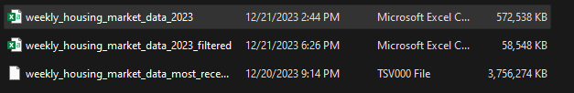
Cleaning House Market Data

Slide 6
Cleaning Crime rate Data
We imported our CSV file containing crime rates.
Then we dropped unnecessary rows and saved the DataFrame to a new CSV file.
We filtered the DataFrame to only include data starting in the year 2022.
In order to get the total of all crime types we created a new column that is the sum of all crime related columns.
A column containing the totals of each crime type was added and displayed in our DataFrame.

Slide 7
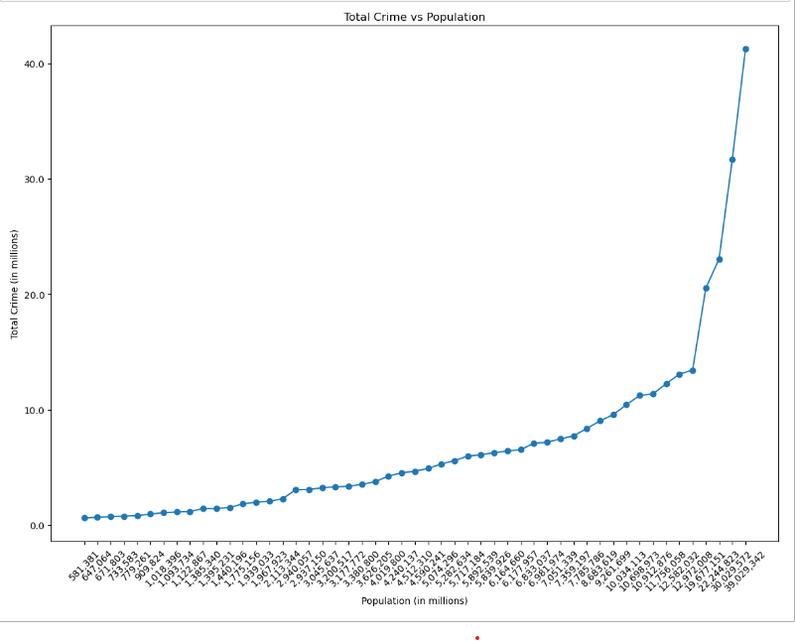
Cleaning Crime rate Data

Slide 8
Data Mining
We imported the necessary libraries including Selenium and BeautifulSoup.
Selenium for web automation and BeautifulSoup for parsing HTML.
Selenium is a library we have not discussed in class. It provides a way for developers to write scripts in various languages to automate interactions with web browsers. Selenium can be used for web scraping, automated tests of applications, and automatig repetitive tasks on websites.

Slide 9
Data Mining Cont..
We set up our WebDriver to control our web browser, in this case, Google Chrome.
The WebDriver then navigates to our specified URL. Which is a site that contains recent Tax-Rate information for each state.
It retrieves the page source HTML from the website using selenium and creates a BeautifulSoup object to parse the HTML content.
Then It uses BeautifulSoup to find a ‘div’ element with the ID attributes set to ‘taxBox’.
It extracts all text content within the identified ‘div’ element.
Finally, it prints the extracted text to the console.

Slide 10
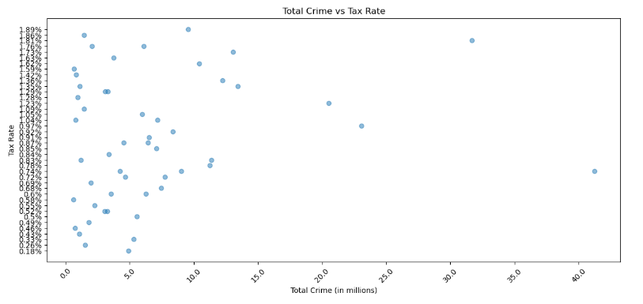
Cleaning Crime rate Data

Slide 11
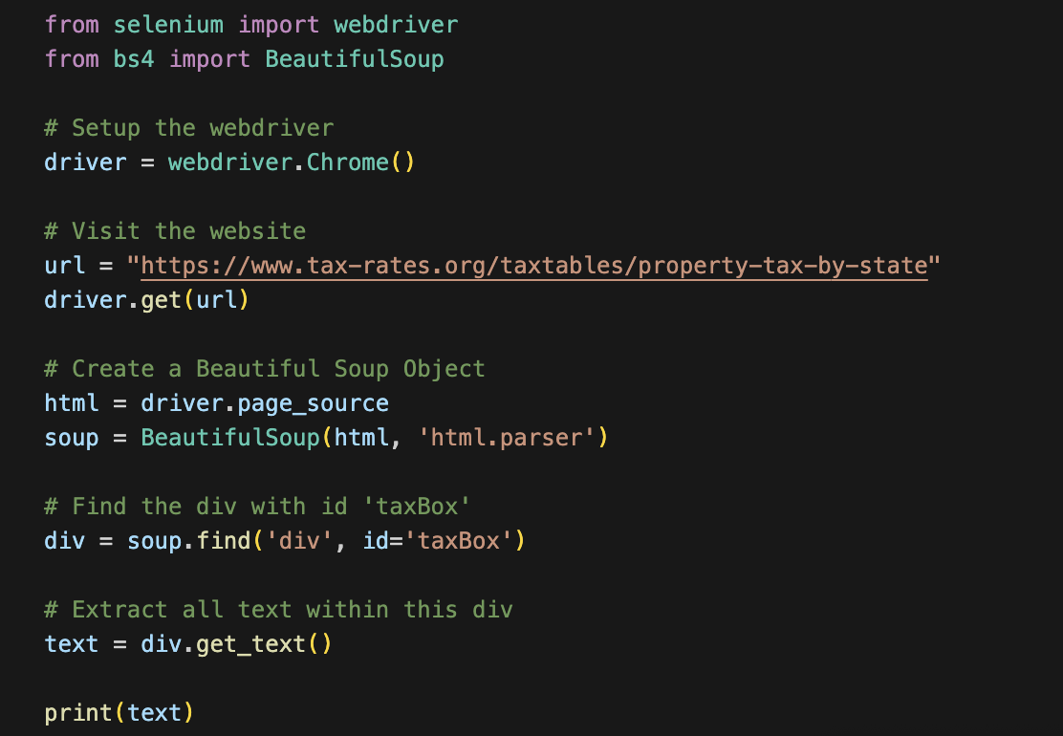

Slide 12

Visualization

Slide 13
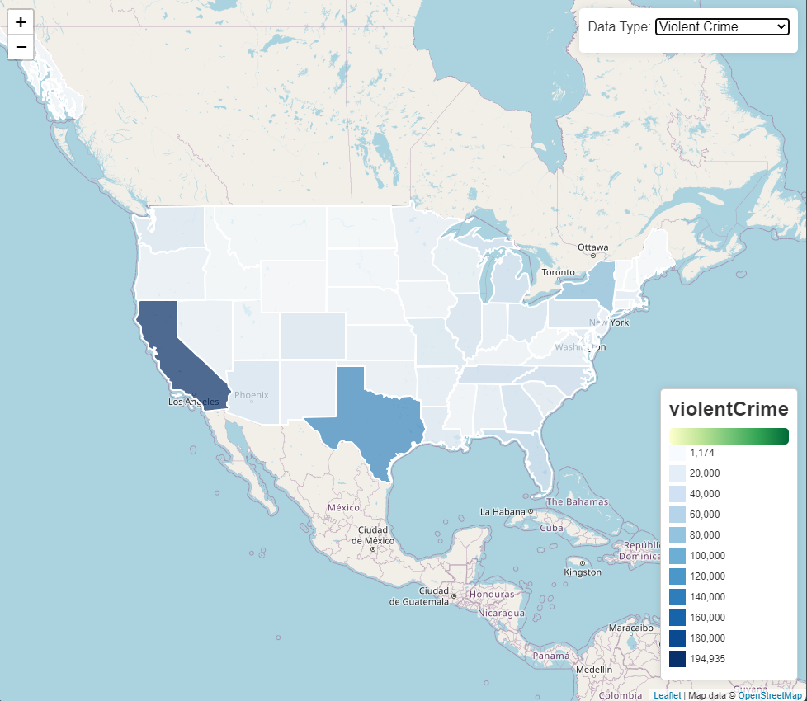
Notes:
Explain ideas and tools used to make site interactive before demonstration

Slide 14

Demonstration
Notes:
Go to site and walk through features

Slide 15
Sources
https://www.tax-rates.org/taxtables/property-tax-by-state
Downloadable Housing Market Data - Redfin
CDE (cjis.gov) – FBI Crime data explorer

Slide 16
Team 5
Joe Johnson
Ryan Hernandez
Marissa Saucedo
William Nzoiwu
Jonathan Rascon

