Slide 1

GitHub
ADVANCED WORKSHOP | 90 MINUTES
GitHub Copilot
for data scientists
Public teaching reference
Issue
-> agent
-> review
From a bounded issue to a reviewed pull request with local VS Code Agent mode
October 7, 2026 | Thomas Johnson
LOCAL VS CODE AGENT MODE
GitHub Copilot for Data Scientists | Gilead DSS
github.com/johnsont1693/scientific-workflow-workshop
Notes:
Timing: 3 minutes.
Thomas Johnson delivers all four workshop sessions on October 7, 2026. The advanced session uses local VS Code GitHub Copilot Agent mode, not Cloud Agent. Prior GitHub experience is expected. The public teaching reference is publicly readable; hands-on work belongs in a provisioned Gilead-managed working repository.

Slide 2
GitHub
WORKSHOP OUTCOMES
You will delegate—and then verify
1
2
3
Bound
Delegate
Review
Write an issue with objective, context, constraints, acceptance criteria, and human questions.
Use local VS Code Agent mode. Inspect the plan and edits before accepting changes.
Inspect the pull request, request Copilot code review, and make the human decision.
VS CODE + GITHUB
GitHub Copilot for Data Scientists | Gilead DSS
github.com/johnsont1693/scientific-workflow-workshop
Notes:
Timing: 2 minutes.
Participants create a bounded issue, use VS Code Agent mode locally, inspect evidence, and retain the human decision. Cloud Agent is not currently enabled at Gilead. Copilot PR review is enabled and distinct from implementation. Do not merge workshop pull requests.

Slide 3
GitHub
GILEAD-SPECIFIC GUIDANCE
Gilead Copilot standards
Protect sensitive data
No Confidential, Secret, Legal Privilege or other sensitive data in AI tools without explicit Gilead ASDS review and approval.
Use approved Copilot
Use Gilead-approved accounts and approved model providers and features only.
Own the result
AI output is a suggestion. Developers own the diff, correctness, tests, security scans and normal PR/peer review.
Never bypass controls
Agents must not bypass access controls, security gates, approvals or validation.
Limit the context
Apply Gilead classification and least privilege to all context, files, tools and repositories.
Cloud Agent is not currently enabled at Gilead. This workshop uses local Agent mode.
GitHub Copilot for Data Scientists | Gilead DSS
github.com/johnsont1693/scientific-workflow-workshop
Notes:
Timing: 5 minutes.
Gilead standards supplied by Kevin Cox on October 2. Treat AI output as a suggestion, never final approval. ASDS must explicitly review and approve sensitive-data use. Local Agent mode edits and runs tools locally, but approved context may still be processed by cloud model services; it is not offline. Copilot PR review remains enabled and separate from Cloud Agent. Use only synthetic workshop content.

Slide 4
GitHub
SHARED WORKFLOW VOCABULARY
Five-minute GitHub catch-up
Repository
Issue
Branch
Commit
Pull request
Review
context
intent
proposal
checkpoint
evidence
decision
Copilot participates in the middle.
Humans define the task, inspect the evidence, and make the decision.
Local edits. Durable evidence. Human decision.
GitHub Copilot for Data Scientists | Gilead DSS
github.com/johnsont1693/scientific-workflow-workshop
Notes:
Timing: 5 minutes.
Move quickly through repository, issue, branch, commit, pull request and review. Copilot assists with local changes; humans define the task and own publication. This is not a browser-only advanced workshop.

Slide 5
GitHub
THE SYNTHETIC SCENARIO
One bounded scientific change
Public teaching reference
Current requirement
scientific-workflow-workshop
Include records where AESEV is exactly SEVERE.
requirements/
what the analysis must do
analysis/
SAS, R, and Python examples
Change request
reference/
controlled terminology
Include both SEVERE and LIFE THREATENING events.
checks/
expected output
tests/
automated evidence
Human questions
workshop/
participant lab instructions
Is the terminology correct? Are expected counts right? What validation still applies?
GitHub Copilot for Data Scientists | Gilead DSS
github.com/johnsont1693/scientific-workflow-workshop
Notes:
Timing: 6 minutes.
Open workshop/vscode-agent-task.md and workshop/02-copilot-vscode-agent-lab.md in the approved working repository. Read requirements/analysis-requirements.md, reference/controlled-terminology.md, all three implementations, checks/expected-output.md and tests/test_ae_summary.py. Baseline AE-3 includes SEVERE only (two records); the task includes LIFE THREATENING too (four records: 003, 004, 006, 007). Preserve output columns/order and synthetic data. Predict the six files to change; scientific appropriateness still requires human review.

Slide 6
GitHub
ISSUE LAB | 5 MINUTES
Agent-ready issues reduce ambiguity
Approved working repo / Issues / New issue
1
Objective
What outcome is needed?
ANALYSIS CHANGE
Context
Which repository evidence matters?
2
[Analysis] Include life-threatening events
3
Constraints
What must stay unchanged?
Objective
Include SEVERE and LIFE THREATENING events.
Context
Requirement, terminology, code, checks, and tests.
4
Acceptance
How will reviewers judge it?
Constraints
Synthetic data; preserve output shape.
5
Human questions
What cannot be delegated?
Acceptance
Four records; consistent files; checks pass.
GitHub Copilot for Data Scientists | Gilead DSS
github.com/johnsont1693/scientific-workflow-workshop
Notes:
Timing: 5 minutes.
Create an Analysis change issue in the approved working repository using a unique pair identifier. Keep it human-owned; do not assign it to Copilot. Transfer objective, context, constraints, acceptance criteria and human questions from workshop/vscode-agent-task.md. Have pairs improve ambiguity before delegation. The reference repository is not a public write target.

Slide 7
GitHub
PROMPTING A LOCAL AGENT | 3 MINUTES
Give the agent a clear job, not a vague wish.
A useful prompt names...
Instead of: "Fix this analysis"
Goal: what should change?
Context: which files are evidence?
Constraints: what must stay fixed?
Success: what output/checks matter?
Checkpoint: plan before edits.
Using the attached task and repo instructions, plan the change to include SEVERE and LIFE THREATENING events.
Preserve output columns/order; use only synthetic data. Identify affected files, expected four records, checks and human questions.
Do not edit files or run commands yet. Wait for my approval.
Iterate: inspect the plan, clarify gaps, approve a bounded change, then review the evidence.
GitHub Copilot for Data Scientists | Gilead DSS
github.com/johnsont1693/scientific-workflow-workshop
Notes:
Timing: 3 minutes.
A prompt should specify goal, evidence, constraints, acceptance criteria and a human checkpoint. Avoid vague asks such as Fix this analysis. Point to the real task instead of inventing context. Explain why the four-record expectation is grounded in the task and synthetic data, not something the model should assume. The next slide shows exactly which three files to attach and which seven evidence files the task names. Ask for a plan first: no file edits or commands yet. Ask what is missing or ambiguous, then refine one bounded request. After approval inspect tool requests, diffs and actual test output. Do not ask the agent to commit, push, open a PR, bypass a check or make the scientific decision. No sensitive context without Gilead approval; local execution is not offline model processing. This slide adds prompt quality; the next slide supplies context, and the local-agent slide puts both into practice.

Slide 8
GitHub
LAB CONTEXT | 4 MINUTES
Exactly what to attach in Copilot Chat
Open your approved working clone in VS Code. Chat > Add Context > Files, or drag files from Explorer.
Attach these three repository files
Ask the agent to read the task evidence
AGENTS.md
.github/copilot-instructions.md
workshop/vscode-agent-task.md
requirements/analysis-requirements.md
reference/controlled-terminology.md
analysis/ae_summary.py, .R and .sas
checks/expected-output.md
tests/test_ae_summary.py
These are in the repo, not separate downloads.
Full walkthrough: workshop/02-copilot-vscode-agent-lab.md (Parts 1-2)
GitHub Copilot for Data Scientists | Gilead DSS
github.com/johnsont1693/scientific-workflow-workshop
Notes:
Timing: 4 minutes.
The task and context are files in the participant's approved local working copy. Open Chat and choose Add Context > Files, or drag the three named files from VS Code Explorer. Ask the agent to read all seven evidence files listed in workshop/vscode-agent-task.md: requirements/analysis-requirements.md; reference/controlled-terminology.md; analysis/ae_summary.py; analysis/ae_summary.R; analysis/ae_summary.sas; checks/expected-output.md; tests/test_ae_summary.py. If it cannot locate any file, attach that file explicitly. Do not assume a GitHub issue link grants access. Paste only synthetic task details. Prompt: Read these instructions and the evidence files. Propose the smallest plan. Identify assumptions and human questions. Do not edit files or run commands yet.

Slide 9
GitHub
LOCAL AGENT LAB | 8 MINUTES
VS Code / Copilot Chat / Agent
Start the agent. Ask for a plan first.
VS Code Agent mode
LOCAL
1
In VS Code Chat, select Agent
Research
Read requirements and repository instructions
2
Attach the three files on the context slide
Plan
Propose scoped edits and validation
3
Request a plan before any file edits
Implement
Edit locally on your existing branch
Approve scope and tool actions deliberately
Handoff
Human commits, pushes and opens PR
4
GitHub Copilot for Data Scientists | Gilead DSS
github.com/johnsont1693/scientific-workflow-workshop
Notes:
Timing: 8 minutes.
Open the approved local clone in VS Code. The human first creates copilot/<pair-id>-ae-summary. Run python scripts/validate.py for the baseline. Open Copilot Chat, choose Agent and an approved model, then attach AGENTS.md, .github/copilot-instructions.md, workshop/vscode-agent-task.md and relevant files. Prompt: Read the bounded task and repository instructions. Research and propose the smallest plan. Do not edit, run commands, create branches, commit, push or open a PR yet. List assumptions and human questions. Wait for my approval. Inspect every tool request. Local execution is not offline: approved context may be sent to the model service. Do not start a cloud coding-agent session.

Slide 10
GitHub
REVIEW BEFORE IMPLEMENTATION
The plan is the first human checkpoint
Scope
Does it name every required file—and only those files?
Refine when needed
Tell the agent what is missing, which constraint was violated, or which file is out of scope.
Consistency
Will SAS, R, Python, requirements, checks, and tests agree?
Validation
Run python scripts/validate.py; inspect real results.
Approve deliberately
Unknowns
Are scientific and terminology questions still visible?
A plausible plan is not enough. It must map to the issue and repository evidence.
GitHub Copilot for Data Scientists | Gilead DSS
github.com/johnsont1693/scientific-workflow-workshop
Notes:
Timing: 5 minutes.
Review the local plan before implementation. Confirm all six affected files and only those files, exact terminology, preserved columns, required validation and unresolved scientific questions. Compare requirement identifiers in headers/docstrings. Refine missing scope. Do not edit or run implementation commands until the participant approves the bounded plan and tools. Then follow the next slide's local implementation and evidence steps.

Slide 11
GitHub
LOCAL LAB | 7 MINUTES
Implement locally. Inspect real evidence.
After the plan is approved
Run in the repository root
Approve only scoped edits and permitted tools.
Read every change in Source Control.
Keep all six task files consistent.
Human owns commit, push and PR.
python scripts/validate.py
python analysis/ae_summary.py
git diff --check
git diff
Task result: 4 records, subjects 003, 004, 006, 007.
Python checks do not run SAS/R or replace required security scans or scientific validation.
GitHub Copilot for Data Scientists | Gilead DSS
github.com/johnsont1693/scientific-workflow-workshop
Notes:
Timing: 7 minutes.
Follow Part 3 of workshop/02-copilot-vscode-agent-lab.md. After explicit human plan approval, implement only the bounded task, preserving columns USUBJID, AETERM, AESEV in order. Compare all six changed files: requirement, three language examples, expected output and tests. Terminology is reference context, not a required changed file. Run python scripts/validate.py, python analysis/ae_summary.py, git diff --check and git diff. Baseline output is two SEVERE records 003 and 006; after the exercise it is four records 003,004,006,007 with SEVERE or LIFE THREATENING. Record actual results. Python tests do not run SAS/R, CodeQL, secret scanning or dependency scans. The teaching Actions workflow is SHA-pinned/read-only but is not proof of Gilead approval or an approved runtime-deployment pipeline. Required Gilead security, peer-review and validation gates remain mandatory. Do not solve the lab in the reference main branch.

Slide 12
GitHub
INSPECT DURABLE EVIDENCE
You publish the reviewed local changes
Illustrative PR in your approved working repository
1
Review
Inspect every local change and actual test result.
OPEN
Include life-threatening events in the AE summary
Commit
Stage intended files; write the commit message.
2
Reviewers
Inspect checks
Example diff - verify actual changes
3
Push
Verify origin; push your branch to the approved repo.
COPILOT REQUEST
Copilot review comment
Open PR
Select the correct base; link your issue.
4
Confirm that every language implementation uses the same exact controlled-terminology values.
5
Evidence
Record checks and open questions. Do not merge.
GitHub Copilot for Data Scientists | Gilead DSS
github.com/johnsont1693/scientific-workflow-workshop
Notes:
Timing: 10 minutes.
The human inspects the local diff, stages only intended files, commits with an intent-focused message and pushes to the approved working repository. Verify the remote and PR base; never push to the reference or upstream by accident. Open the PR, complete its template, link the issue, and record actual commands, results and unresolved scientific questions. The mockup is illustrative, not an existing PR or passing-check claim. Inspect actual checks; if a required gate is unavailable leave the PR open. A facilitator-prepared backup PR may be used if available, not assumed to exist.

Slide 13
GitHub
GITHUB COPILOT CODE REVIEW
Request a second AI perspective
Illustrative PR in your approved working repository
Request Copilot
OPEN
Include life-threatening events in the AE summary
Select Copilot in Reviewers. Keep normal human review.
Reviewers
Inspect checks
Example diff - verify actual changes
COPILOT REQUEST
ADDITIONAL INPUT
Copilot review comment
Confirm that every language implementation uses the same exact controlled-terminology values.
Copilot comments do not remove the need for human review.
GitHub Copilot for Data Scientists | Gilead DSS
github.com/johnsont1693/scientific-workflow-workshop
Notes:
Timing: 8 minutes.
Form a human view of the diff first. Request GitHub Copilot PR code review from Reviewers where available in the approved repository. Kevin confirms this capability is enabled at Gilead. If unavailable for this repository, record the limitation and use a permitted facilitator demonstration or human review checklist; do not change policy or activate Cloud Agent. AI comments never replace required peer review, scans or approvals.

Slide 14
GitHub
TRIAGE BEFORE ACTION
Not every AI comment is right
Useful
Plausible
Not relevant
Supported by the requirement and repository evidence.
Act after confirming the suggestion preserves scope.
Worth investigating, but missing evidence.
Ask for a source or involve a domain expert.
Does not match the task, context, or intended behavior.
Do not apply it merely because Copilot suggested it.
GitHub Copilot for Data Scientists | Gilead DSS
github.com/johnsont1693/scientific-workflow-workshop
Notes:
Timing: 4 minutes.
Classify comments as useful, plausible-but-unverified or irrelevant. Act only when evidence supports the suggestion and it preserves task scope. Do not maximize accepted suggestions or weaken tests to obtain a green result.

Slide 15
GitHub
CONTROLLED ITERATION
Fix -> inspect -> check -> review again
Choose
Fix
Inspect
Check
Review
valid comment
edit in VS Code
new diff
rerun checks
human decision
A review comment creates another change cycle—not an automatic answer.
GitHub Copilot for Data Scientists | Gilead DSS
github.com/johnsont1693/scientific-workflow-workshop
Notes:
Timing: 4 minutes.
Triage one justified review comment, then fix manually or with local VS Code Agent mode. Do not use Fix with Copilot if it starts the disabled Cloud Agent. Reinspect the diff and rerun tests; the human commits and pushes. Required checks and human review are not bypassed.

Slide 16
GitHub
RECORD THE DECISION
The final checkpoint is human
Ready for further validation
Request changes
Reject
1
2
3
Appropriately scoped and supported by the available evidence.
Incomplete, too broad, or based on an unsupported assumption.
Does not match the requirement or introduces unacceptable uncertainty.
DO NOT MERGE WORKSHOP PULL REQUESTS
GitHub Copilot for Data Scientists | Gilead DSS
github.com/johnsont1693/scientific-workflow-workshop
Notes:
Timing: 3 minutes.
Record a human decision with rationale linked to the issue, diff, actual checks and remaining scientific questions. Ready for further validation is not production approval. Leave workshop PRs unmerged.

Slide 17
GitHub
LEVERAGE WITH CONTROL
Local Agent mode, end to end
Issue
Local plan
Branch
Pull request
AI review
Human review
bound intent
review scope
local edits
evidence
second view
decision
Automation compresses the work.
GitHub preserves the evidence. Humans retain accountability.
GitHub Copilot for Data Scientists | Gilead DSS
github.com/johnsont1693/scientific-workflow-workshop
Notes:
Timing: 2 minutes.
Recap issue, reviewed local plan, human branch, local edits/tests, human-created PR, Copilot review and final human decision. Ask for one bounded local-agent task and one decision that cannot be delegated.

Slide 18
GitHub
KEY TAKEAWAY
Bound the task.
Inspect the evidence.
Keep the decision human.
Public teaching reference
github.com/johnsont1693/scientific-workflow-workshop
Reference
docs.github.com/copilot
Questions?
GitHub Copilot for Data Scientists | Gilead DSS
github.com/johnsont1693/scientific-workflow-workshop
Notes:
Timing: 1 minutes.
Close with the three takeaways. The public teaching reference is https://github.com/johnsont1693/scientific-workflow-workshop. Use the Gilead-approved working copy for exercises. Capture licensing/configuration questions without bypassing policy. The original Gilead Day 2 feedback QR slide follows, with its design unchanged.
The closing minute includes transition to the unchanged Day 2 feedback QR slide.

Slide 19
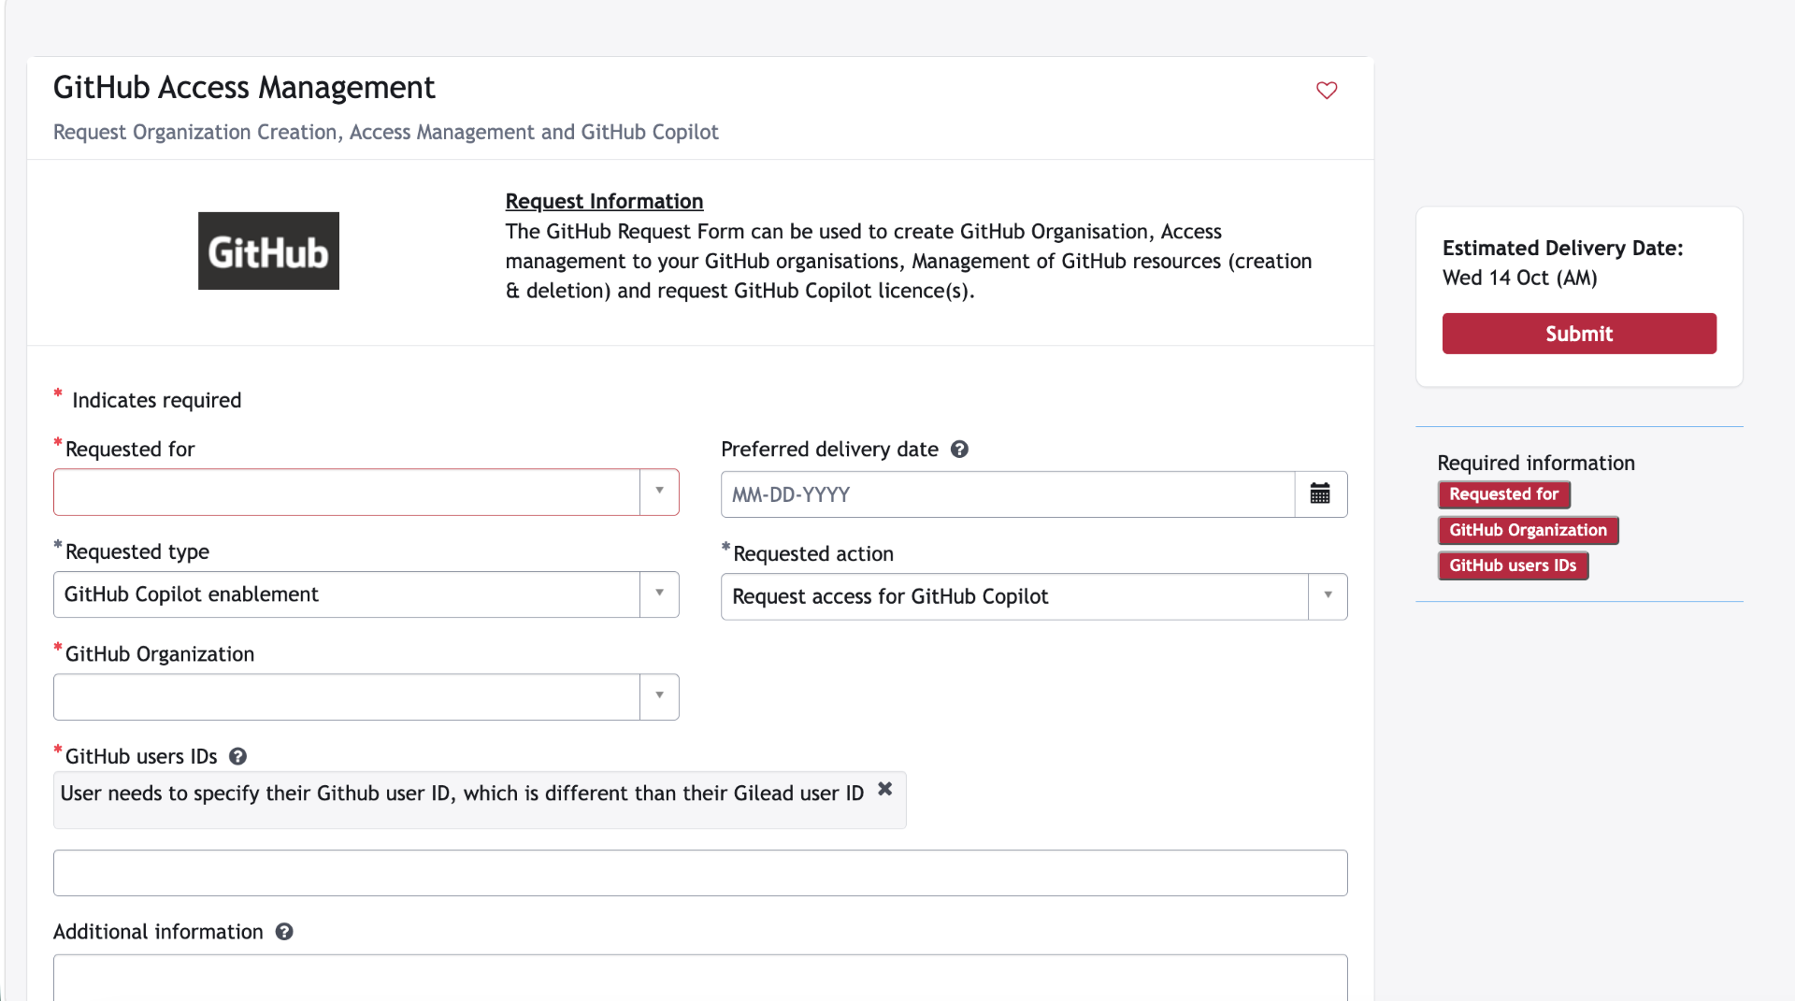
Notes:
Screenshot provided by the presenter. Show the GitHub Access Management form for GitHub Copilot enablement. The form requests a GitHub user ID, which differs from the Gilead user ID. The displayed estimated delivery date is part of the supplied screenshot, not a promise of current fulfillment time.

Slide 20


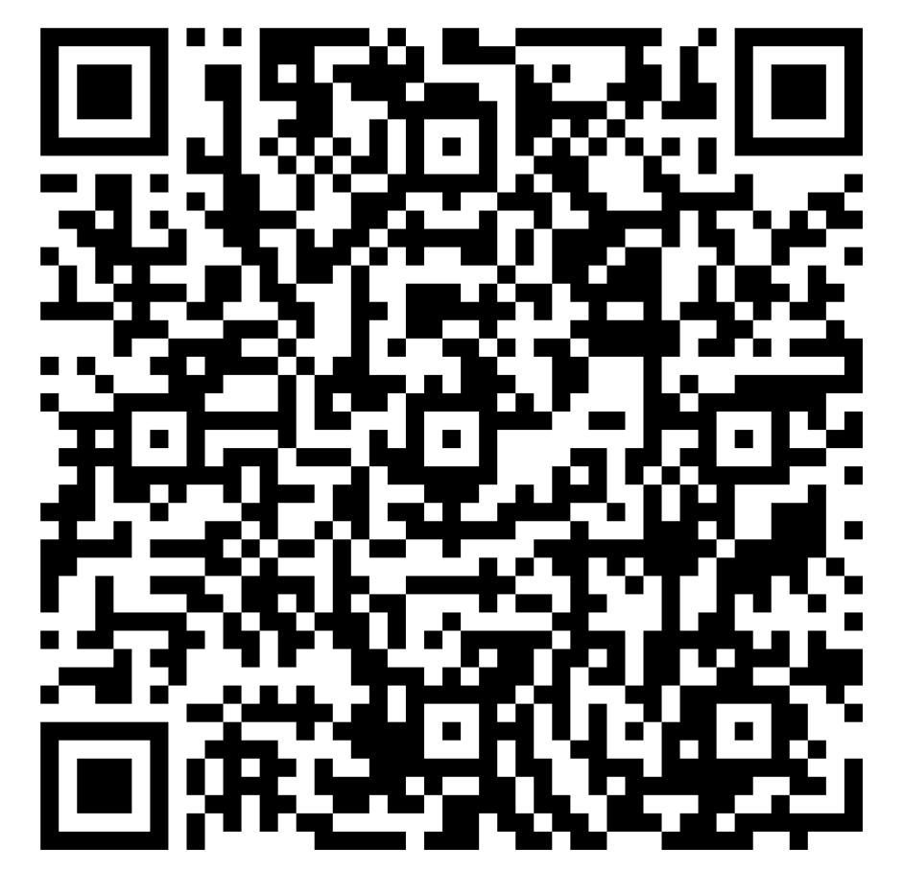


Data Science
SYMPOSIUM Day 2 Feedback
Notes:
In 309 C

