Slide 1

GitHub
BEGINNER WORKSHOP | 90 MINUTES
GitHub Foundations
for scientific work
Public teaching reference
Requirement
-> change
-> review
From copied study files to a visible, reviewable history
October 7, 2026 | Thomas Johnson
BROWSER-FIRST WORKSHOP
GitHub Foundations | Gilead DSS
github.com/johnsont1693/scientific-workflow-workshop
Notes:
Timing: 3 minutes.
Thomas Johnson delivers all four workshop sessions on October 7, 2026.
Welcome the group. Confirm everyone has the workshop repository open in a browser.
Say: No command line, IDE, or local setup is required. Today you will perform the workflow directly on GitHub.com.
Work only in the approved Gilead-managed working repository; the public teaching reference is not the participant write target. Use approved identities and synthetic data. Do not bypass EMU or access controls with personal accounts or public forks. Pair or observe if access is unavailable.

Slide 2
GitHub
WORKSHOP OUTCOMES
You will do the workflow—not just watch it
1
2
3
Navigate
Propose
Review
Find requirements, analysis code, reference material, and expected output.
Create a branch and commit one focused change in the browser.
Open a pull request, inspect the diff, and leave an evidence-based comment.
GITHUB.COM ONLY
GitHub Foundations | Gilead DSS
github.com/johnsont1693/scientific-workflow-workshop
Notes:
Timing: 2 minutes.
Set expectations: this is a hands-on browser workshop.
Ask attendees to keep the repository open in a second browser tab.
Work only in the approved Gilead-managed working repository; the public teaching reference is not the participant write target. Use approved identities and synthetic data. Do not bypass EMU or access controls with personal accounts or public forks. Pair or observe if access is unavailable.

Slide 3
GitHub
WHY SOURCE CONTROL
The problem is not saving files
It is proving which change was reviewed.
ae_summary_final.sas
Requirement
Commit
Review
History
ae_summary_final_v2.sas
why
what
decision
record
ae_summary_final_v2_AB.sas
Source control turns memory into evidence.
ae_summary_FINAL_USE_THIS.sas
You can see what changed, why it changed, and how people responded.
GitHub Foundations | Gilead DSS
github.com/johnsont1693/scientific-workflow-workshop
Notes:
Timing: 8 minutes.
Ask the room which filename patterns they recognize.
Do not criticize current SOPs. Frame GitHub as a way to make existing review intent visible and durable.
Work only in the approved Gilead-managed working repository; the public teaching reference is not the participant write target. Use approved identities and synthetic data. Do not bypass EMU or access controls with personal accounts or public forks. Pair or observe if access is unavailable.

Slide 4
GitHub
PLAIN-LANGUAGE MENTAL MODEL
Three tools. Three different jobs.
1
2
3
Git
GitHub
Copilot
VERSION HISTORY
COLLABORATION
AI ASSISTANCE
Records versions and lets us compare changes over time.
Hosts the repository and adds permissions, review, discussion, and automation.
Helps understand, propose, and review work inside the GitHub workflow.
Copilot assists inside the workflow. It does not replace Git or GitHub.
GitHub Foundations | Gilead DSS
github.com/johnsont1693/scientific-workflow-workshop
Notes:
Timing: 6 minutes.
Keep this conceptual and browser-oriented.
Reinforce that Copilot does not replace Git or GitHub. It assists inside the workflow they provide.
Work only in the approved Gilead-managed working repository; the public teaching reference is not the participant write target. Use approved identities and synthetic data. Do not bypass EMU or access controls with personal accounts or public forks. Pair or observe if access is unavailable.

Slide 5
GitHub
GILEAD-SPECIFIC GUIDANCE
Gilead source-control and security standards
Keep secrets out
Remediate findings
Never commit passwords, API keys, tokens, certificates or secrets. Exclude local/config files with .gitignore; use approved secret management.
Review and remediate CodeQL/static-analysis, secret-scanning and Dependabot/dependency findings.
Retain peer review
Use approved delivery
Normal PR controls, security scans and validation remain required before acceptance.
Build and deploy to runtime environments with Gilead-approved CI/CD pipelines.
Secure the supply chain
Respect Gilead boundaries
Use approved Actions/dependencies and least privilege. Direction: SHA-pinned dependencies and centrally governed rulesets.
Follow GVault policy for all third-party dependencies. Gilead code/data stay in Gilead-managed repos; EMU aims to prevent public sharing.
Synthetic workshop data only. GitHub does not replace Gilead SOPs or formal approval.
GitHub Foundations | Gilead DSS
github.com/johnsont1693/scientific-workflow-workshop
Notes:
Timing: 5 minutes.
Kevin's requested standards: never commit passwords, API keys, tokens, certificates or other secrets. Keep local/configuration files that should not be versioned out of commits with .gitignore; use approved secret-management mechanisms. .gitignore does not erase existing commits or untrack files. Review and remediate CodeQL/static analysis, secret scanning and Dependabot/dependency findings. Keep normal peer review, PR controls, required scans and validation. Use Gilead-approved CI/CD for runtime builds/deployments. Use approved Actions/dependencies and least privilege; Gilead's direction includes SHA-pinned dependencies and centrally governed rulesets. Follow the open-source policy documented in GVault for every third-party dependency. Gilead source/data belong in appropriate Gilead-managed repositories; EMU migration is intended to prevent public sharing.

Slide 6
GitHub
PARTICIPANT ACCESS
Read the reference. Fork for today's lab.
Reference
Working repository
Browser-first
Thomas's teaching repo is public.
Anyone can read it; public does not mean write access.
Today: fork the synthetic teaching repo to an approved account or organization.
Work on a branch in your fork; target your own fork with the lab PR.
Foundations needs only an approved browser and repo access.
No local IDE, Git runtime or Copilot license required.
Fork only where policy permits. If blocked, use an approved internal copy or pair/observe.
GitHub Foundations | Gilead DSS
github.com/johnsont1693/scientific-workflow-workshop
Notes:
Timing: 5 minutes.
The current public teaching reference is https://github.com/johnsont1693/scientific-workflow-workshop. Today Thomas is using a fork-based exercise. Public visibility grants read access, not unrestricted write access. On GitHub choose Fork, choose an organization-approved owner, and create the fork. Verify the owner/repository before editing. A fork is a separate repository, not a branch. Inside your fork create foundations/<pair-id>-review-note, commit the lab note, and open a PR whose base is YOUR fork/main, not the source repository. Choose compare across forks or change the base repository if GitHub defaults to upstream. Do not submit the workshop change upstream. Only the supplied synthetic material is allowed. Forking is not a policy exception: EMU accounts may be unable to fork an external repository; use the facilitator's approved internal copy or pair/observe rather than a personal-account bypass. Existing lab references to an approved working copy mean your approved fork for today's exercise. The public reference still must not receive learner writes.

Slide 7
GitHub
FORKS, BRANCHES AND TODAY'S LAB | 4 MINUTES
Branch inside a repo. Fork to a separate repo.
BRANCH | Usual enterprise teamwork
FORK | Today's teaching exercise
A separate line of work in the same repository.
The team already has approved write access.
One home for issues, pull requests and centrally managed controls.
A separate repository linked to the source.
Your own writable copy of the synthetic lab.
No contributor access to the teaching repo; independent practice without changing its baseline.
Fork (approved owner) > branch in your fork > edit + commit > PR to your fork/main
Enterprise policy still applies. If external forks are blocked, use an approved copy or pair/observe.
GitHub Foundations | Gilead DSS
github.com/johnsont1693/scientific-workflow-workshop
Notes:
Timing: 4 minutes.
A branch is a named line of development within the same repository. A fork is a separate repository under an account or organization, linked to the upstream repository; it can have its own branches. In a shared enterprise team we usually prefer branches in the approved repository because authorized colleagues collaborate under one set of repository controls, reviews, issues and audit history. Branches are not a security boundary and do not automatically enforce governance: configured permissions and rulesets do. Forks can also be legitimate in enterprises when policy permits, for example cross-team or upstream contributions. Today a fork gives each pair a writable synthetic teaching copy without adding every attendee as a contributor to Thomas's reference. We still branch INSIDE that fork and use a pull request. Target the lab PR to the fork's own main so we practice review without changing upstream. Never move Gilead code/data to a public fork or use a personal account to bypass EMU restrictions. Public availability does not prove that every attendee's identity is permitted to fork. Provide an approved internal copy or pair/observer fallback.

Slide 8
GitHub
BROWSER ORIENTATION
A repository connects the work
Public teaching reference
Find the evidence
scientific-workflow-workshop
1
Requirement
What must happen?
requirements/
what the analysis must do
analysis/
SAS, R, and Python examples
2
Analysis
How is it implemented?
reference/
controlled terminology
Reference
Which terms are valid?
3
checks/
expected output
tests/
automated evidence
4
Checks
What output is expected?
workshop/
browser lab instructions
GitHub Foundations | Gilead DSS
github.com/johnsont1693/scientific-workflow-workshop
Notes:
Timing: 6 minutes.
Have attendees navigate the repository with you.
Open the requirement, the three language examples, controlled terminology, expected output, and Foundations lab.
State clearly: do not add patient data, credentials, or unapproved sensitive material.
Work only in the approved Gilead-managed working repository; the public teaching reference is not the participant write target. Use approved identities and synthetic data. Do not bypass EMU or access controls with personal accounts or public forks. Pair or observe if access is unavailable.

Slide 9
GitHub
FROM EDIT TO EVIDENCE
A commit captures a reasoned checkpoint
checks/expected-output.md
What changed
-
Expected record count: 2
One focused review note was added to the expected-output document.
+
Expected record count: 2
Reviewers should confirm the count against the approved requirement before accepting a change.
+
Why it changed
Commit message: Document the human count-verification step
A commit is more than Save.
It connects the difference to an explanation.
GitHub Foundations | Gilead DSS
github.com/johnsont1693/scientific-workflow-workshop
Notes:
Timing: 10 minutes.
Demonstrate the browser edit from the Foundations lab.
Slow down when reading the diff. Red and green show removal and addition, not scientific correctness.
Explain why the commit message describes intent rather than saying only 'update'.
Work only in the approved Gilead-managed working repository; the public teaching reference is not the participant write target. Use approved identities and synthetic data. Do not bypass EMU or access controls with personal accounts or public forks. Pair or observe if access is unavailable.

Slide 10
GitHub
BROWSER LAB 1 | 12 MINUTES
1. Navigate to github.com/johnsont1693
2. Click Repositories
3. Click scientific-workflow-workshop

Slide 11
GitHub
BROWSER LAB 1 | 12 MINUTES
Approved working repo / checks/expected-output.md
Make one focused change
Commit changes
1
Open workshop/01-foundations-browser-lab.md
Commit message
Document the human count-verification step
2
Edit checks/expected-output.md
3
Create foundations/<pair-id>-review-note
CREATE A NEW BRANCH
OK
One change
4
Commit with an intent-focused message
Unique branch
OK
OK
Intent in the message
GitHub Foundations | Gilead DSS
github.com/johnsont1693/scientific-workflow-workshop
Notes:
Timing: 12 minutes.
Attendees complete the browser lab. Circulate rather than presenting.
Do not introduce local Git. Help attendees only with GitHub.com navigation and branch naming.
Work only in the approved Gilead-managed working repository; the public teaching reference is not the participant write target. Use approved identities and synthetic data. Do not bypass EMU or access controls with personal accounts or public forks. Pair or observe if access is unavailable.

Slide 12
GitHub
PROTECT THE REVIEWED BASELINE
A branch is a safe proposed path
YOUR PROPOSED CHANGE
main
REVIEWED BASELINE
Your branch can change without changing main.
Review happens before the proposal becomes accepted history.
GitHub Foundations | Gilead DSS
github.com/johnsont1693/scientific-workflow-workshop
Notes:
Timing: 6 minutes.
Use attendees' branch names as examples.
Avoid branching-strategy jargon. The key distinction is reviewed baseline versus proposed path.
Work only in the approved Gilead-managed working repository; the public teaching reference is not the participant write target. Use approved identities and synthetic data. Do not bypass EMU or access controls with personal accounts or public forks. Pair or observe if access is unavailable.

Slide 13
GitHub
PROPOSAL + EVIDENCE + DISCUSSION
The pull request is the human checkpoint
Illustrative PR in your approved working repository
Intent
OPEN
Document the human count-verification step
Why does this proposal exist?
Conversation
Commits 1
Checks
Files changed 1
Evidence
What changed
+2 lines in checks/expected-output.md
What changed and which checks ran?
+ Reviewers should confirm the count against the approved requirement before accepting a change.
Decision
Approve, request changes, or comment?
GitHub Foundations | Gilead DSS
github.com/johnsont1693/scientific-workflow-workshop
Notes:
Timing: 6 minutes.
Orient attendees to title, description, commits, checks, diff, and review.
Say: The pull request gathers evidence. It does not prove scientific correctness.
Work only in the approved Gilead-managed working repository; the public teaching reference is not the participant write target. Use approved identities and synthetic data. Do not bypass EMU or access controls with personal accounts or public forks. Pair or observe if access is unavailable.

Slide 14
GitHub
BROWSER LAB 2 | 8 MINUTES
Open the proposal. Review the evidence.
Illustrative PR in your approved working repository
Add a review comment
1
Open a pull request
Complete the template.
Which approved requirement should the reviewer use to confirm this count?
2
Exchange links
Pair with another attendee.
3
Inspect the diff
Read every changed line.
4
Leave a comment
Tie it to evidence.
EVIDENCE-BASED
SPECIFIC
ACTIONABLE
GitHub Foundations | Gilead DSS
github.com/johnsont1693/scientific-workflow-workshop
Notes:
Timing: 8 minutes.
Attendees open their pull requests and review a partner's change.
Reward comments that ask for evidence or clarify risk. Discourage comments that only express preference.
Work only in the approved Gilead-managed working repository; the public teaching reference is not the participant write target. Use approved identities and synthetic data. Do not bypass EMU or access controls with personal accounts or public forks. Pair or observe if access is unavailable.

Slide 15
GitHub
FOUR QUESTIONS BEFORE ACCEPTANCE
Review like a scientist
1
Intent
Does the proposal match the written requirement?
REQUIREMENT
2
Difference
Can you explain every changed line?
DIFF
3
Evidence
Which checks or expected results support it?
CHECKS
4
Risk
What still requires scientific or validation review?
RISK
CAREFUL QUESTIONS > FAST APPROVAL
GitHub Foundations | Gilead DSS
github.com/johnsont1693/scientific-workflow-workshop
Notes:
Timing: 5 minutes.
Debrief the partner review with these four questions.
Reinforce that approval in GitHub is not the same as final scientific or regulatory approval.
Work only in the approved Gilead-managed working repository; the public teaching reference is not the participant write target. Use approved identities and synthetic data. Do not bypass EMU or access controls with personal accounts or public forks. Pair or observe if access is unavailable.

Slide 16
GitHub
END-TO-END WORKFLOW
One change. One visible chain of evidence.
Requirement
Branch
Commit
Pull request
Review
History
why
safe space
checkpoint
proposal
decision
record
GitHub makes the work easier to inspect, discuss, and recover.
People still own the scientific judgment and the approval.
GitHub Foundations | Gilead DSS
github.com/johnsont1693/scientific-workflow-workshop
Notes:
Timing: 3 minutes.
Retell the workshop as one story and ask attendees where similar control points exist today.
Work only in the approved Gilead-managed working repository; the public teaching reference is not the participant write target. Use approved identities and synthetic data. Do not bypass EMU or access controls with personal accounts or public forks. Pair or observe if access is unavailable.

Slide 17
GitHub
KEY TAKEAWAY
Make the intent clear.
Make the change visible.
Keep the decision human.
GitHub supports
History, recovery, collaboration, permissions, checks, and review evidence.
GitHub does not replace
Gilead SOPs, validation, data controls, scientific judgment, or formal approval.
Next: use local VS Code Agent mode, then review the proposed change.
GitHub Foundations | Gilead DSS
github.com/johnsont1693/scientific-workflow-workshop
Notes:
Timing: 1 minutes.
Invite one or two questions, then direct advanced attendees to the Copilot workshop.
Work only in the approved Gilead-managed working repository; the public teaching reference is not the participant write target. Use approved identities and synthetic data. Do not bypass EMU or access controls with personal accounts or public forks. Pair or observe if access is unavailable.
The advanced session now requires approved VS Code, Git, Python 3.10+ and Copilot Agent mode; Cloud Agent is not currently enabled at Gilead. No local tools are required for Foundations. The original Gilead Day 2 feedback QR slide follows, with its design unchanged.
The closing minute includes transition to the unchanged Day 2 feedback QR slide.

Slide 18

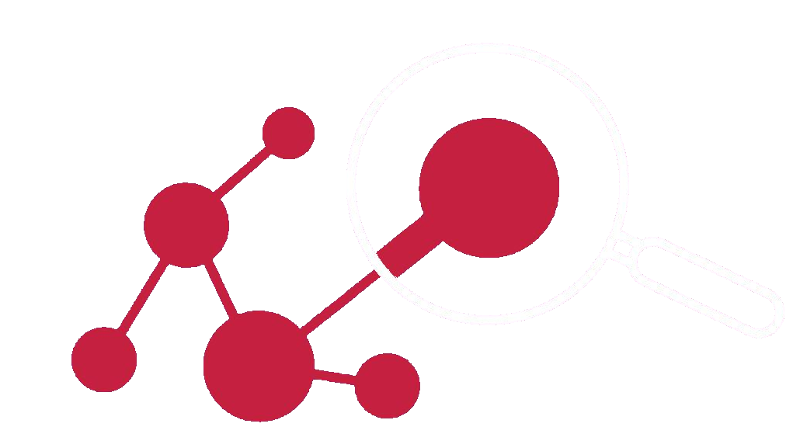
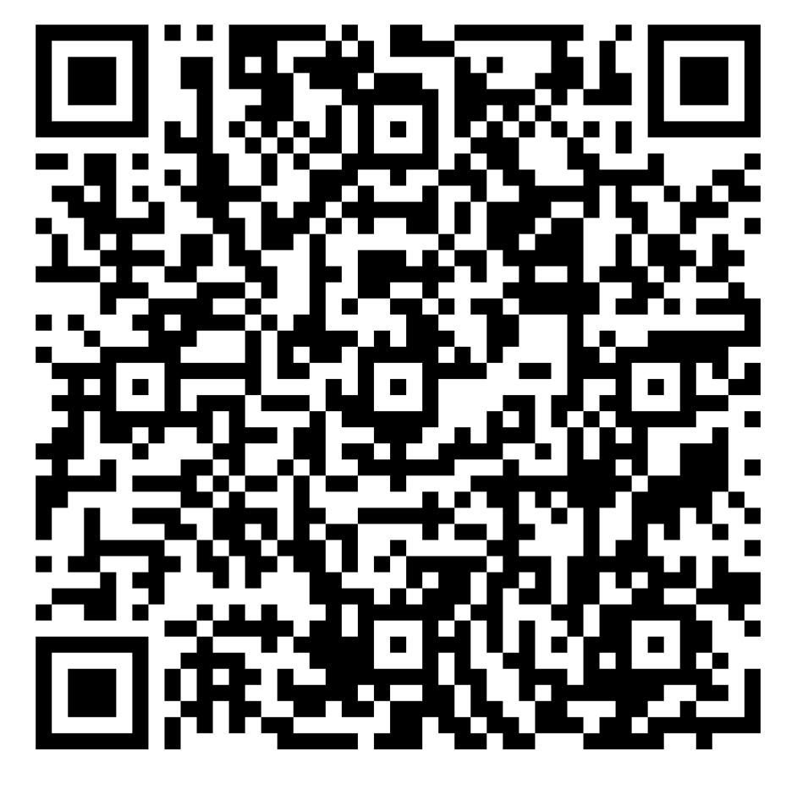


Data Science
SYMPOSIUM Day 2 Feedback
Notes:
In 309 C

