Slide 1
Welcome!

Slide 2
Today's Activities
Introduction by Ryan Johnson
Syllabus
Install help
Intro to git and bash
Python data types
Please bear with us as we fully expect some speed bumps today!

Slide 3
Is Your System 32 bit or 64 bit?
Your computer is either 32 bit or 64 bit.
64 bit can run 32 bit programs but not vice versa
You need to install 64 bit if you have it to avoid problems later.
You will need to install either 32 bit or 64 bit files
If you are a PC user and don't have Windows 10+ let your instructor know
If you are a Mac User and 32-bit let your instructor know!
This Mac Links is for 64 bit only!
`uname –m` command in terminal will show you
Windows 10 Users Click Here
Mac Users Click Here

Slide 4
Tool Installation
Please read and follow installation instructions carefully.
This may take a while and there may be issues...
Tools to install:
Python 3.8+
Anything older or super new may have compatibility issues. It's your call though.
Python 2.X will not work.
Pip
Python's package manager. Only needed if it doesn’t come with Python
Git-bash
Version control and a linux terminal emulator. (Macs already have Terminal)
VSCode
Popular text editor. I will not be using this right away, but I will transition in a few weeks.
Pip/brew installs
Install Jupyter and Jupyter lab

Slide 5
Install Git, Python, and Jupyter notebook
Open the installs docs in our Canvas and follow along.

Slide 6

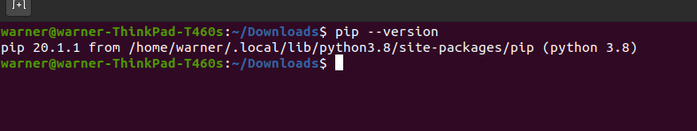

Pip Installs
Windows Git-Bash
Pip should come with your Python installation
Windows
Open Git Bash Terminal and type 'pip --version'
If you get an error let Alexis know
Mac:
Open Terminal:
Type 'pip3 --version' and hit enter
If you get an error let Alexis know
Mac Terminal

Slide 7
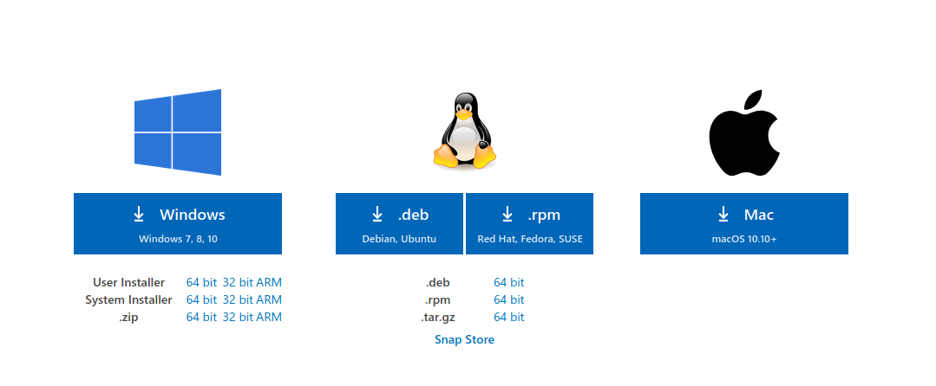
Install Visual Studio Code
See this link
Choose your machine type.
Suggest "System Installer"

Slide 8
Congratulations!
Installs are rarely fun but you made it!
If you haven't finished the installs please work with your instructor after class.

Slide 9
Course Structure
You will learn:
Git
Python and many modules
SQL
ETL/ELT
Data Modeling
Data Visualization
Supervised and Unsupervised Machine Learning model creation and tuning
The class will be structured as follows:
Warm-up question you are expected to code or attempt to code at the beginning of class
Lecture on concept (if applicable) in ppt
Live coding by me with expected participation by you
Exercises for you to complete in class (sometimes group and sometimes solo)

Slide 10
Expectations
You ask for help when needed
You understand learning a programming language is hard and is similar to learning a new language. It is best studied in blocks as opposed to a little bit each day.

Slide 11
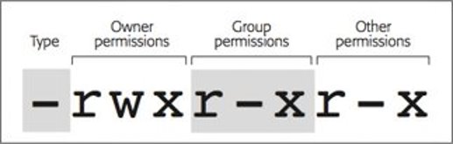
Intro to Git and bash
cd
ls
touch
mkdir
aliases​
ls –l <file name> to see permissions and ownership

Slide 12
Git clone the Repo
Git allows us to have multiple versions of directories and text files and keep them neatly organized
Allows for easy sharing of source code
Git is meant for text files however it can handle some binary files (.docx, .ppt, .jpg etc..)
Create a folder called “data-science-class" on your computer
Open git-bash/terminal and run the following command
Cd into directory you want:x
Cd somefolder/anotherfolder/anotherfolder/
Type 'mkdir data-science-class' and hit enter
‘cd data-science-class/'
'git clone …....'
Windows users can open Explorer and right click in a directory to 'git bash here'

Slide 13
Git practice
Make a directory to store all your homework assignments in (or just for the first homework- up to you!)
Create a repo for your first homework assignment
I suggest creating one on github and then cloning it
Think about where you should be cloning it to (many right answers and some wrong ones)
Create the repo with a readme.md file
Edit the readme.md file with your name and a title
Push your changes to github
Git add .
OR Git add readme.md
Git commit –m “<your message>”
Git push

Slide 14
Stretch Break

Slide 15
Python Data types
Python Data Types
Numeric
Dictionary
Boolean
Set
Sequences
Integer
Float
String
List
Tuple
Complex Number
Notes:
https://www.geeksforgeeks.org/python-data-types/ yeah “integer” is spelled wrong

Slide 16
Python Flow control
If… elif… else
for
While
Range (if we have time)
There’s a lot more to this, but we’re just going over the basics today!

Slide 17
Practice Flow Control
#whats wrong with this code? (Hint: there are 4 issues)
#what is it doing?
num = str(input("Enter a number: "))
if num % 2 = 0:
print("Even")
else
print("Odd)

Slide 18
Homework
Install anything that hasn't been installed
Readings: Chapter 1-2 and some suggested readings listed in the assignment on Canvas.
Homework Assignment
Save a copy of your homework assignment OUTSIDE of your git repo until you feel comfortable with git.
Suggest creating a folder called "homework"
If it's inside the git repo you will run into issues.

