Slide 1
NDN SNAMP NDNS

Slide 2
NDN
Named Data Networking

Slide 3
References
[1] L. Zhang et al., “Named data networking (NDN) project,” NDN, Tech. Rep. NDN-0001, October 2010.
[2] Deploying Key Management on NDN Testbed

Slide 4
Background
TCP/IP:
  deliver data to given destination address
  communication oriented
  communication driven by sender
NDN:
  fetch data by name
  distribution oriented
  communication driven by receiver

Slide 5
Architecture
Packet Format
Forwarding
Names
Security

Slide 6
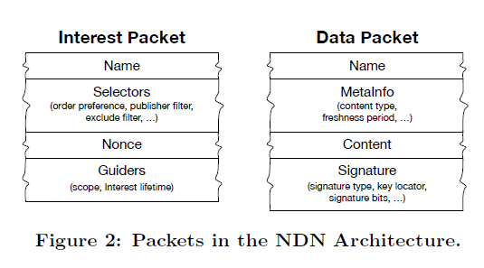
Packet Format
Two types of packet:
  Interest and Data

Slide 7
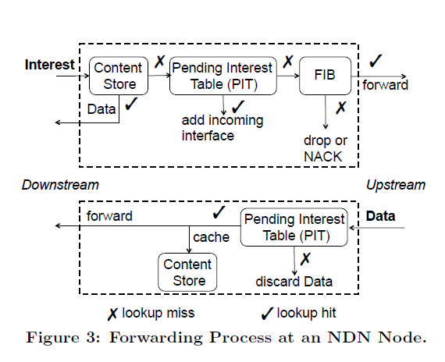
Forwarding
NDN routers
  maintain 3 data structures:
    FIB (Forwarding Information Base)
    PIT (Pending Interest Table)
    CS (Content Store)
  Forwarding Strategy module
Forwarding Process

Slide 8
Forwarding (Cont'd)
Forwarding Strategy module:
  based on FIB
  interest-interface mapping
  max PIT entries, priority of interests
  load balancing, choose alternative paths
PIT:
  discard looping packets, loop free

Slide 9
Names
names attribute no meaning to routers, i.e. names are opaque to network
dynamic names must be deterministically constructed by consumer
  by using interest selector (rather than deteministic algorithm shared by consumer and producer)
namespace management (parellel with NDN architecture bc point #1)

Slide 10
Security
integrity: publisher's signature ensures integrity of data
trust:
  hierachical trust model [2]
  web-of-trust
ac:
  encryption
  distribute keys as NDN data
multipath forwarding:
  mitigates prefix hijacking

Slide 11
SNAMP
Secure NAmespace MaPping

Slide 12
References
SNAMP: Secure Namespace Mapping to Scale
NDN Forwarding
S. Deering, “The map & encap scheme for scalable IPv4 routing with portable site prefixes,” Presentation Xerox PARC, 1996.

Slide 13
Background
Forwarding scalability concern, i.e. to keep the size of FIB under control
ip forwarding scalability solution:
  aggregation by allocation
  map and encap

Slide 14
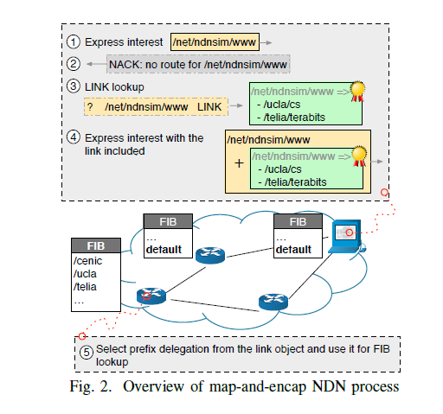
Overview
built upon map and encap idea
mapping information maintained in and looked up from NDNS
used only when necessary
process:

Slide 15
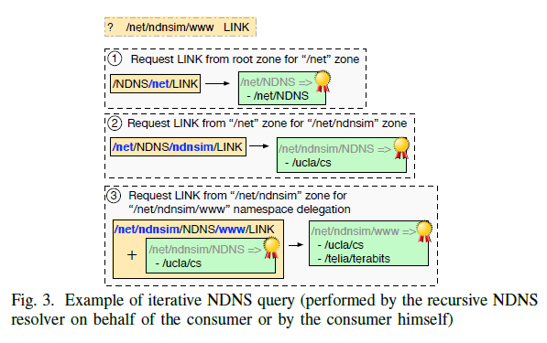
Design
globally routed prefixes: a managable subset of prefixes in the DFZ
link object:
  establish associations between globally routed prefixes and name prefix
  original namespace N₀ delegates its namespace to N₁... N_{n}
discovery of link object:
  through NDNS

Slide 16
NDNS
NDN Service
--- DNS for NDN

Slide 17
References
[1] Addressing Operational Challenges in Named Data Networking Through NDNS Distributed Database

