Slide 1
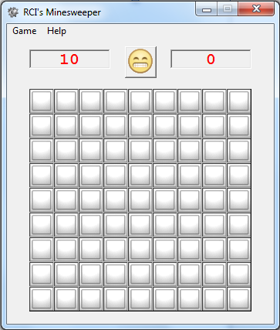
Minesweeper
Table of Contents
Introduction
Objective
Getting Started
How to Play
Instructions
Special Features
Exiting The Game
About the Game
Credits
Johnson Zhu Mr.Zambazis
ICS4U June 2, 2012

Slide 2
Introduction
Hello User! Welcome to Minesweeper. Minesweeper is a computer game developed by Curt Johnson for OS/2 and transferred to Microsoft Windows by Robert Donner. It was first officially released in 1990 as a part of the Microsoft Entertainment Pack 1, and has since expanded into every version of Windows excluding 8.
This manual covers everything from the basics of Minesweeper to the extra features incorporated in the game. In this manual, you will learn how the game works, what the objective of the game is, how to play the game, how to use of advanced strategies such as marking, the various difficulties, and finally, the high scores, By the time you are done reading through the manual, you will be a certified expert at the game! So what are you waiting for? Flip through these pages to learn more about the game!

