Slide 1
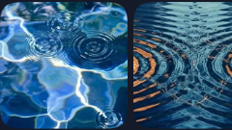
Reflective-Surface Harmonic Field
A speculative visual framework for Deep-Sea Marine Biology audiences — inspired by bioluminescence, caustic optics, and non-visible signal imagination.

Slide 2
Why Deep-Sea Biology?
Limited visibility
Human sight fails; other readings take over.
Deep-sea environments are defined by limited human visibility, unusual light behavior, bioluminescence, transparency, reflection, particle scattering, and unknown signal interpretation. RSHF uses those themes as conceptual inspiration rather than empirical explanation.
Unusual optics
Refraction, scatter, and caustic light behavior.
Bioluminescence
Living glow as a native signal medium.
Unknown signals
Interpretation without established ground truth.

Slide 3
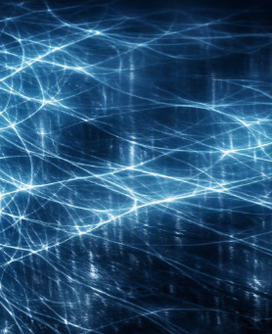
The Speculative Visual Model
RSHF is framed as a surface-bound, optical-first visualization model. It imagines light-interference-inspired lattices appearing across seafloor planes, shells, translucent bodies, reflective surfaces, or instrument glass.
Surface-bound No readable surface, no visible field.
Optical-first Light behavior carries the pattern.
Density-driven Weave tightness reads as intensity.

Slide 4
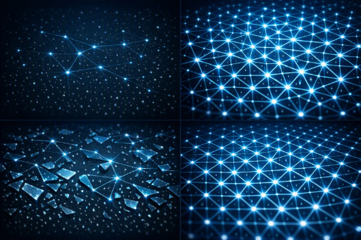
Bioluminescence-Inspired Pattern Language
The tighter the lattice appears, the more intense the visual expression is interpreted to be. Broken, sparse, dense, and uniform patterns become a speculative language for glow, shadow, reflection, and underwater visibility.
Pattern State | Interpretive Reading
High-density lattice | High interpreted intensity
Low-density lattice | Low interpreted intensity
Broken lattice | Visually unstable expression
Uniform lattice | Visually stable expression

Slide 5
Deep-Sea Disruption Events
Currents, sediment clouds, passing organisms, submersible lights, shell surfaces, and reflective tools act as visual interruptions. Each interruption is represented as a local change in the lattice that spreads outward as a visible fracture or soft distortion.
Currents
Sediment clouds
Passing organisms
Submersible light
Shell surfaces
Reflective tools

Slide 6
Hypothetical Caretaker Hierarchy
If an organizing hierarchy were imagined within the WakeForms framework, these entities could be interpreted as hypothetical caretakers — each associated with a different relationship to the visible field. What might such caretakers look like?
Warner
Combs
Zann
Marduk
Associated with stabilizing; even, continuous lines.
Associated with disruption; angular gaps and brightness spikes.
Associated with balancing; breathing, even mesh.
Associated with governing; imposed geometric order.

Slide 7
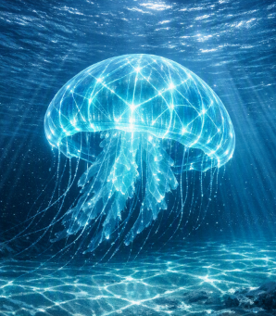
Resonance Jellies and Caustic Optics
Resonance Jellies translate the model into an underwater form: imagined energy enters, the medium appears to respond, and bioluminescence-inspired light becomes visible as caustic geometry across the body, water column, and seafloor.
System rule
Energy enters → medium responds → light reveals the response.

Slide 8
Closing: A Marine-Facing Concept Portfolio
RSHF becomes a marine-facing concept portfolio piece: a speculative optical channel where imagined resonance is read through light, density, fracture, reflection, water, and bioluminescence-inspired visibility.
Light
Density
Fracture
Reflection
Water
Visibility
Disclaimer: A speculative, theoretical concept model. References to resonance, frequency-inspired behavior, optical fields, quantum-adjacent perception, bioluminescence, and dimensional visibility are conceptual and interdisciplinary framing devices — not claims of established marine biology, organism behavior, physics, or quantum science unless supported by independent empirical research.

