Slide 1
WORDPRESS DATABASE OVERVIEW

Slide 2
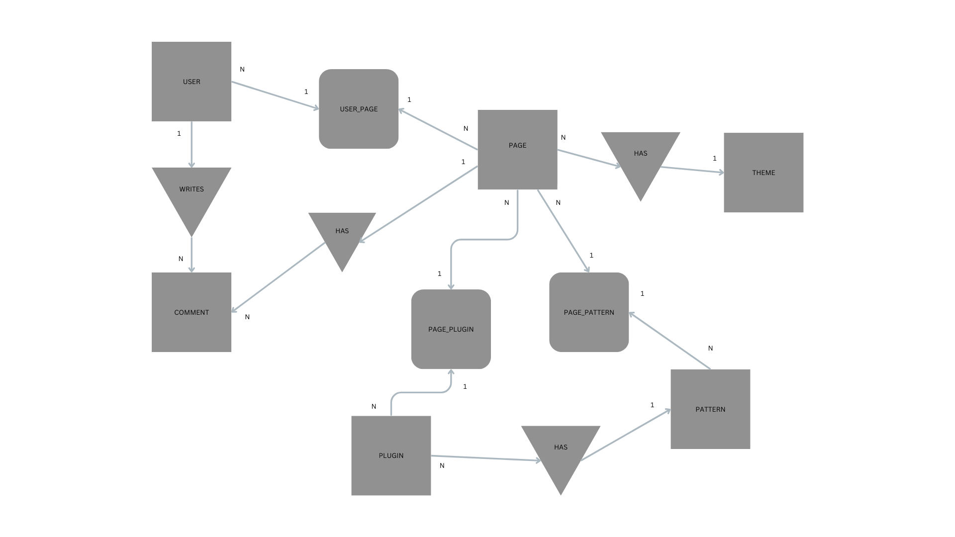
ER DIAGRAM

Slide 3
ENTITIES AND THEIR ATTRIBUTES
Page : PAGE_ID(INT, PK), TITLE(VARCHAR), THEME_ID(FK)
User : USER_ID(INT, PK), USERNAME(VARCHAR), EMAIL(VARCHAR)
Comment : COMMENT_ID(INT, PK), PAGE_ID(IN, FK), USER_ID(INT, FK)
Plugin : PLUGIN_ID(INT, PK), NAME(VARCHAR), DETAILS(TEXT)
Theme : THEME_ID(INT, PK), NAME(VARCHAR), DESCRIPTION(TEXT)
Pattern : PATTERN_ID(INT, PK), NAME(VARCHAR)

Slide 4
ENTITY RELATIONSHIPS
Many-to-One:
Comment and User
Comment and Page
Page and Theme
Plugin and Pattern
Many-to-Many:
User and Page
Page and Plugin
Page and Pattern

Slide 5
SUPPORT BOARDS
For the Many-to-Many relationships support boards must be created:
User and Page:
User_Page: USER_PAGE_ID(INT, PK), USER_ID(INT, FK), PAGE_ID(INT,FK)
Page and Plugin:
Page_Plugin: PAGE_PLUGIN_ID(INT, PK),PAGE_ID(INT,FK),PLUGIN_ID(INT,FK)
Page and Pattern:
Page_Pattern: PAGE_PATTERN_ID(INT,PK), PAGE_ID(INT,FK), PATTERN_ID(INT,FK)

Slide 6

Q&A

