Slide 1

Azure Speech, Neural Voice and Open AI Service
John Staveley MVP
29/04/2025
https://uk.linkedin.com/in/johnstaveley/
@johnstaveley

Slide 2
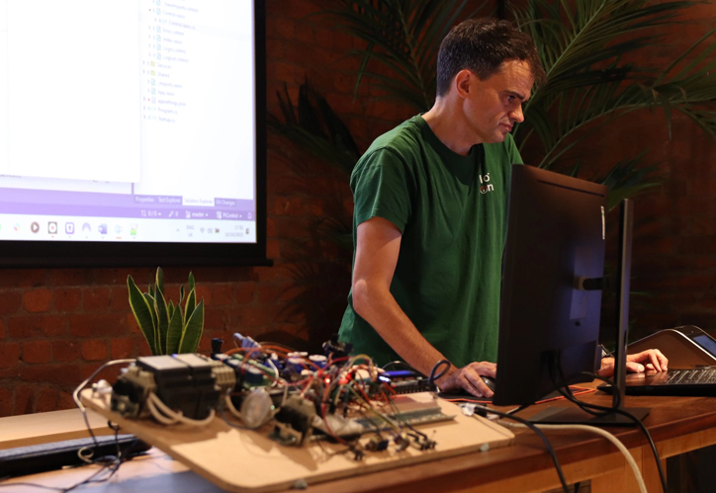
About Me
John Staveley MVP
IT Contractor in C#, Mvc, Sql Server, Angular, Azure and IoT
Organise LeedsSharp, Leeds Data science and AIoTHub etc
Interests: Sailing, Triathlon etc

Slide 3
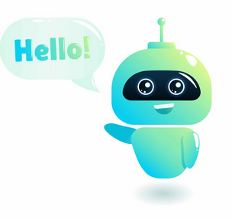
How to build a meetup assistant?
Text to speech
Speech to text
Azure Open AI service (Chatgpt)
Meetup assistant - JaaS

Slide 4
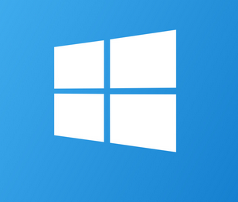
Windows voice synthesiser
Install-Package System.Speech
Windows only
3 voices by default, but, extensible with language packs
DEMO: Code examples

Slide 5

Azure Text to Speech
Setup Speech service in Azure
Install-Package Microsoft.CognitiveServices.Speech
DEMO: Code examples

Slide 6
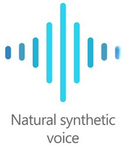
Azure Neural voice
Extension to Azure Speech service
Disclaimers, terms, voice approval….
Pricing: Standard tier
Lite (50 utterances) vs Pro (300 utterances) plan
Record utterances
Train and publish the model
DEMO: Speech studio
DEMO: Code examples

Slide 7
Training and Deployment
Pricing: Standard plan
~£45/compute hr for training (~1.5 hrs)
~£20 text to speech for 1 million characters
~£3.50 hosting endpoint per hour
https://azure.microsoft.com/en-gb/pricing/details/cognitive-services/speech-services/
Press train (~1.5 hrs)
Publish endpoint (~10 minutes)

Slide 8
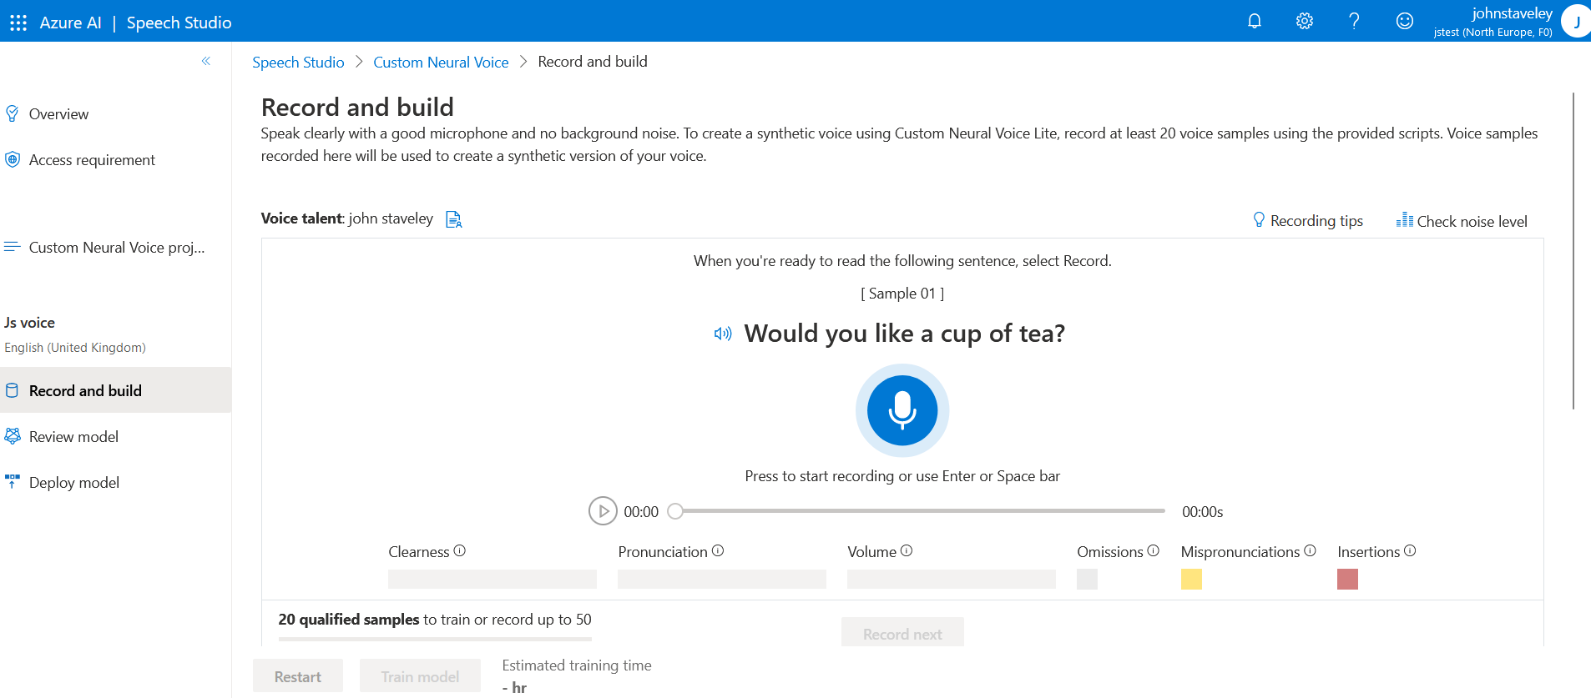

Slide 9
Windows speech recognition
Install-Package System.Speech
Grammar prompt
DEMO: Audio and Code examples

Slide 10
Azure Speech to text
Setup Speech service in Azure
Install-Package Microsoft.CognitiveServices.Speech
DEMO: Code examples

Slide 11
Large Language Models
Content generation
Text summarisation
Sentiment analysis
Personalised recommendations
Q&A chat bot

Slide 12
Problems with LLMs
Hallucination
Prompt injection
Plagiarism/ Copyright
Ethical Issues
Incorrect prompting example: Canadian airlines

Slide 13
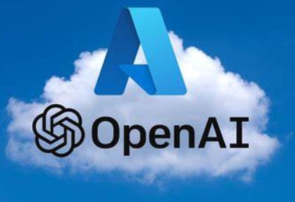
Azure Open AI service
Setup Azure Open AI service in Azure
Keys and endpoint
Manage Deployments
Azure Open AI Foundry
Chat playground
System message
Prompting
Temperature
MaxTokens
PromptFlow and RAG
DEMO: Azure OpenAI service
Install-Package Azure.AI.OpenAI
DEMO: Code examples

Slide 14
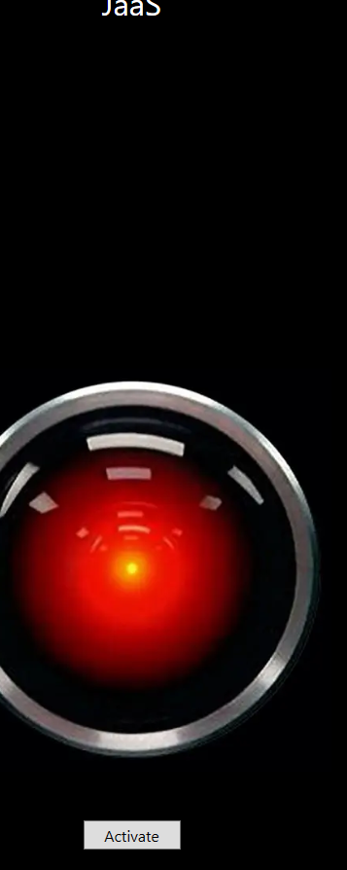
JaaS – meetup assistant
Wpf and .Net 8
Recognises voice to Azure Speech to Text service
Speaks using Azure Text to Speech service
Rules based
ChatGpt for everything else

Slide 15
How did we build a meetup assistant?
Windows speech recogniser/synthesiser
Azure text to speech and speech to text
Azure Neural voice
Azure Open AI

Slide 16

Any Questions?
Connect: https://uk.linkedin.com/in/johnstaveley/

