Slide 1

Azure Speech, Neural Voice and Open AI Service
John Staveley MVP
14/03/2024
https://uk.linkedin.com/in/johnstaveley/
@johnstaveley

Slide 2
About Me
John Staveley MVP
IT Contractor in C#, Mvc, Sql Server, Angular, Azure and IoT
Organise LeedsSharp, Leeds Data science and IoTNorth (AIoT) etc

Slide 3
What we will cover:
Text to speech
Speech to text
Azure Open AI service (Chatgpt)

Slide 4
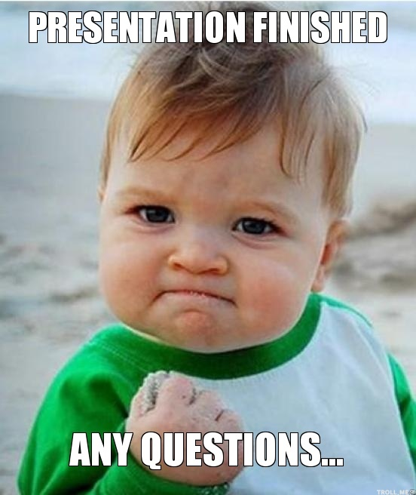
Any Questions?
Connect: https://uk.linkedin.com/in/johnstaveley/
@johnstaveley

