Slide 1

Azure Speech, Neural Voice and Open AI Service
John Staveley MVP
14/03/2024
https://uk.linkedin.com/in/johnstaveley/
@johnstaveley

Slide 2
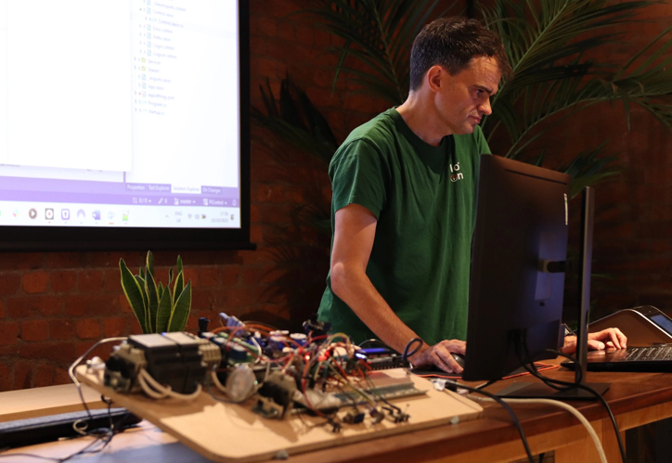
About Me
John Staveley MVP
IT Contractor in C#, Mvc, Sql Server, Angular, Azure and IoT
Organise LeedsSharp, Leeds Data science and IoTNorth (AIoT) etc

Slide 3

What we will cover:
Text to speech
Speech to text
Azure Open AI service (Chatgpt)
Meetup assistant - JaaS

Slide 4
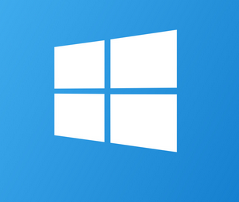
Windows voice synthesiser
Install-Package System.Speech
Windows only
3 voices by default, but, extensible with language packs
DEMO: Code examples

Slide 5
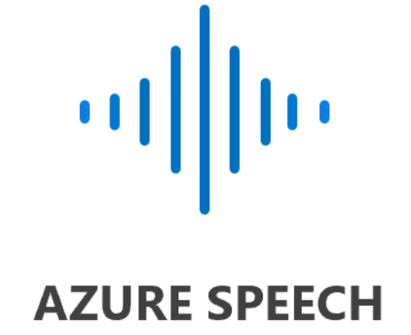
Azure Text to Speech
Setup Speech service in Azure
Install-Package Microsoft.CognitiveServices.Speech
DEMO: Code examples

Slide 6
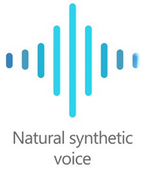
Azure Neural voice
Extension to Azure Speech service
Not GA – apply for access: User agreements and disclaimers
Pricing: Standard tier
Lite vs Pro plan
Load and train the model
DEMO: Speech studio
DEMO: Code examples

Slide 7
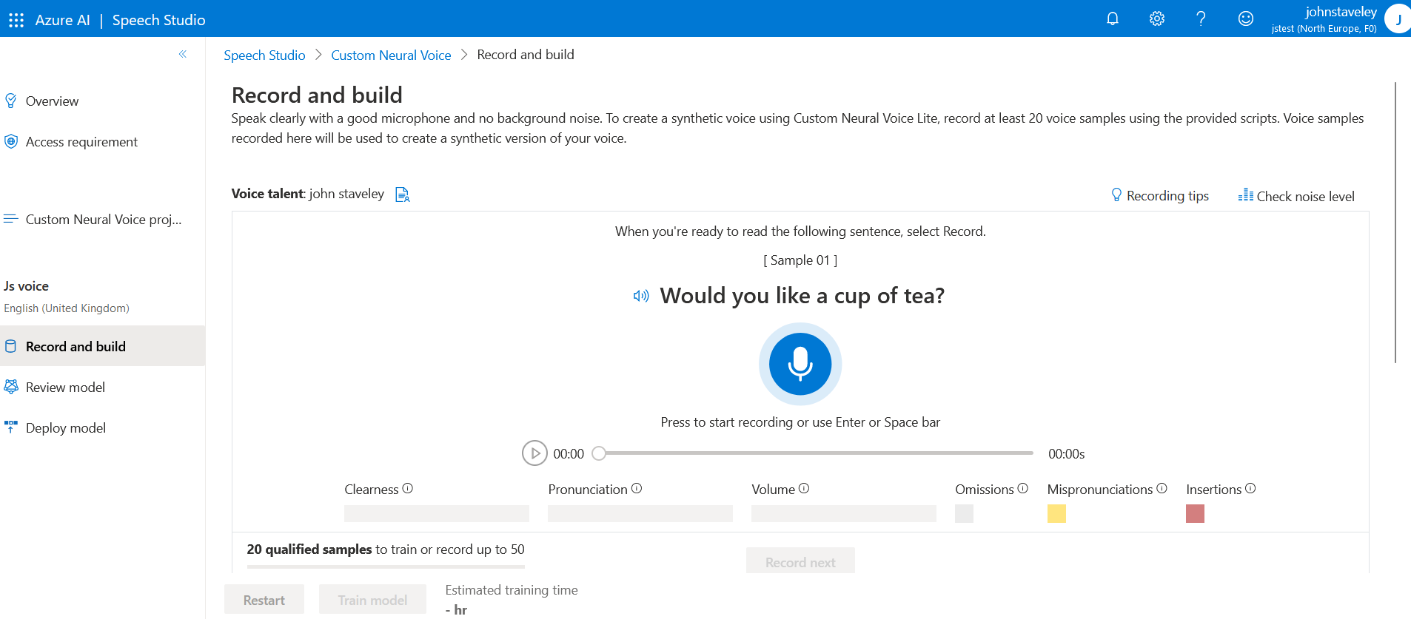

Slide 8
Windows speech recognition
Install-Package System.Speech
Grammar prompt
DEMO: Code examples

Slide 9
Azure Speech to text
Setup Speech service in Azure
Install-Package Microsoft.CognitiveServices.Speech
DEMO: Code examples

Slide 10
LLMs
Content generation
Text summarisation
Sentiment analysis
Personalised recommendations
Q&A chat bot
DEMO: Azure Open AI studio

Slide 11
Problems with LLMs
Hallucination
Prompt injection
Incorrect prompting example: Canadian airlines

Slide 12
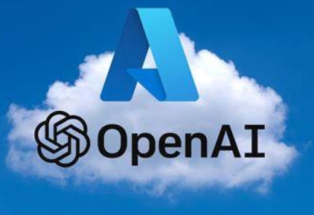
Azure Open AI service
Setup Azure Open AI service in Azure
Deployment
Azure Open AI studio
Chat playground
Prompting
Temperature
MaxTokens
PromptFlow and RAG
Install-Package Azure.AI.OpenAI
DEMO: Code examples

Slide 13
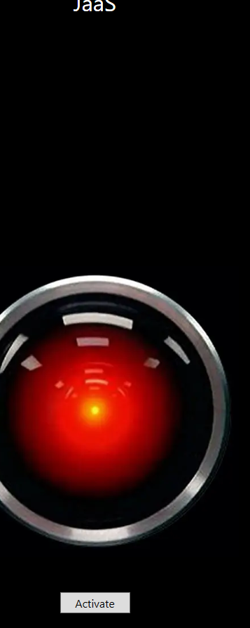
JaaS
Wpf and .Net 8
Recognises voice to Azure Speech to Text service
Speaks using Azure Text to Speech service
ChatGpt

Slide 14

Any Questions?
Connect: https://uk.linkedin.com/in/johnstaveley/
@johnstaveley

