Slide 1

Azure Speech, Neural Voice and Open AI Service
John Staveley MVP
14/03/2024
https://uk.linkedin.com/in/johnstaveley/
@johnstaveley

Slide 2
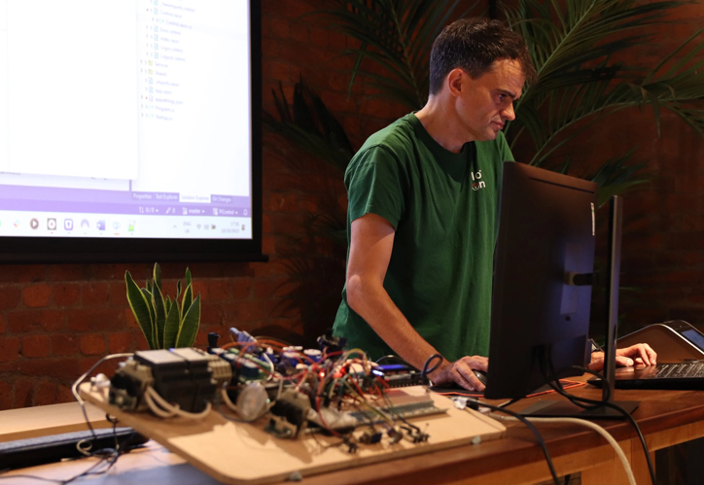
About Me
John Staveley MVP
IT Contractor in C#, Mvc, Sql Server, Angular, Azure and IoT
Organise LeedsSharp, Leeds Data science and IoTNorth (AIoT) etc

Slide 3

What we will cover:
Text to speech
Speech to text
Azure Open AI service (Chatgpt)
Meetup assistant - JaaS

Slide 4
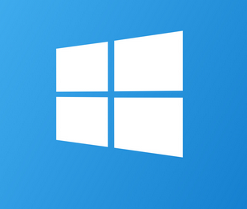
Windows voice synthesiser
Install-Package System.Speech
Windows only
3 voices by default, but, extensible with language packs
DEMO: Code examples

Slide 5
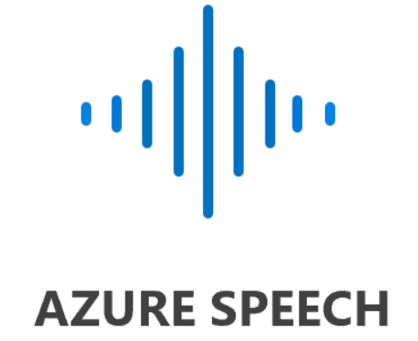
Azure Text to Speech
Setup Speech service in Azure
Install-Package Microsoft.CognitiveServices.Speech
DEMO: Code examples

Slide 6
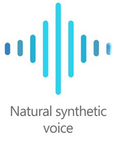
Azure Neural voice
Extension to Azure Speech service
Not GA – apply for access: User agreements
Pricing: Standard tier
Lite vs Pro plan
Load and train the model
DEMO: Speech studio
DEMO: Code examples

Slide 7
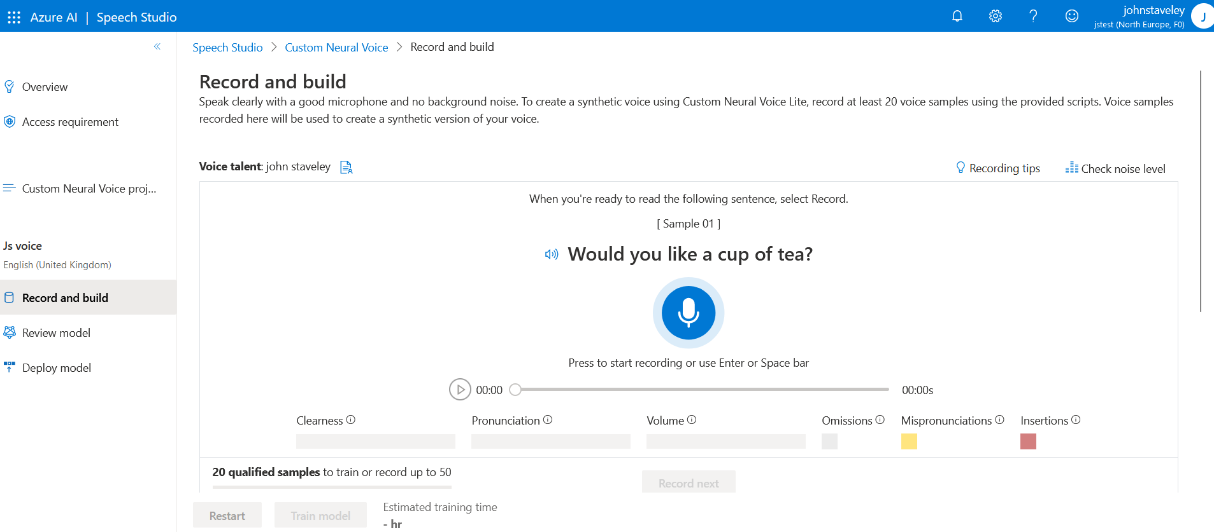

Slide 8
Windows speech recognition
Install-Package System.Speech
Grammar prompt
DEMO: Code examples

Slide 9
Azure Speech to text
Setup Speech service in Azure
Install-Package Microsoft.CognitiveServices.Speech
DEMO: Code examples

Slide 10
LLMs
Content generation
Text summarisation
Sentiment analysis
Personalised recommendations
Q&A chat bot
DEMO: Azure Open AI studio

Slide 11
Problems with LLMs
Hallucination
Prompt injection
Incorrect prompting example: Canadian airlines

Slide 12
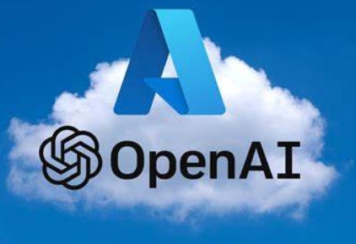
Azure Open AI service
Setup Azure Open AI service in Azure
Keys and endpoint
Manage Deployments
Azure Open AI studio
Chat playground
System message
Prompting
Temperature
MaxTokens
PromptFlow and RAG
Install-Package Azure.AI.OpenAI
DEMO: Code examples

Slide 13
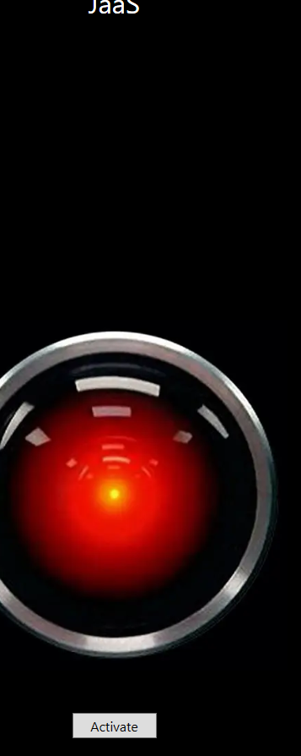
JaaS
Wpf and .Net 8
Recognises voice to Azure Speech to Text service
Speaks using Azure Text to Speech service
Rules based
ChatGpt for everything else

Slide 14

Any Questions?
Connect: https://uk.linkedin.com/in/johnstaveley/
@johnstaveley

