Slide 1




◂ Roadmap
IGCSE ICT · DATABASES
Building Databases with Access
Relational Databases, Forms, Queries & Reports
A step-by-step guide to designing, building and querying databases, with hands-on, workable examples.
Structure
Data
Reports
Notes:
Title — Building Databases with Access
Teaching notes: Open the unit. Explain that a database is an organised store of data, and that this course builds from tables and data types through to forms, queries and reports in Access, with hands-on examples at every step.
Key questions
What are the main objects in an Access database?
Why do we store data in tables rather than a plain list?
What will you be able to build by the end of the course?

Slide 2
YOUR LEARNING JOURNEY
Teams Assignment
Course Roadmap
Build your skills module by module — and across the course you’ll build one real project: the Dodgy Dave’s Motors database.
1
LESSON 1
Database Foundations
Jump ▸
Fields, records, files and tables explained.
2
LESSON 2
Structure & Key Fields
Jump ▸
Flat-file, relational databases and key fields.
3
LESSON 3
Data Types & Tables
Jump ▸
Data types, importing a CSV and entering data.
4
LESSON 4
Data Entry Forms
Jump ▸
Building, editing and designing data forms.
5
LESSON 5
Searches & Queries
Jump ▸
Selecting records with queries and criteria.
6
LESSON 6
Calculations & Summaries
Jump ▸
Calculated fields, and sum, average and count.
7
LESSON 7
Reports & Review
Jump ▸
Producing, formatting and sorting reports.
Each module adds one more piece to your Dodgy Dave’s database.
Notes:
Course Roadmap
Teaching notes: Walk through the modules: database foundations, data types and tables, key fields and validation, queries, forms, then reports and review. Each card is a clickable jump point and links to a worked example and a hands-on task.
Key questions
Which module introduces queries?
In what order do we learn tables and forms?
How does each module build towards the exam?

Slide 3


◂ Roadmap
MODULE 1 · THE BUILDING BLOCKS
Database Foundations
How every database is built
Fields
Records
Tables
We explore how fields, records and tables combine to store the data you use every day.
Try it: open a database and view a table
Tip: a database is an organised collection of related data.
Notes:
Module 1 opener — Database Foundations
Teaching notes: Introduce how fields and records combine to form a table, and how tables make up a database. Have pupils open Access so they can see that a table is simply rows and columns of stored data.
Key questions
What is a database?
What is the difference between a field and a record?
Why do we structure data in tables?

Slide 4

◂ Roadmap
MODULE 1 · THE BUILDING BLOCKS
DATABASES
The Building Blocks of Data
Every database is built from a few simple parts, each with its own job in storing data.
The Field
One detail
A field holds one piece of data about an item, such as a car's make or price. It is a single column.
The Record
One item
A record gathers all the fields about one item, such as a single car. It is a single row in the table.
The Table
The collection
A table is a collection of records of the same type, arranged as rows and columns of data.
Why Structure Data?
Best practice
Organising data into fields, records and tables makes it easy to search, sort, update and reuse.
REMEMBER
A field is one detail, a record is one item, and a table is the whole collection.
The same data can be searched and sorted in many different ways.
Notes:
The Building Blocks of Data
Teaching notes: Explain fields (columns), records (rows) and the table that holds them. Stress the reason for structuring data: it prevents duplication, keeps data consistent, and lets you search, sort and report on it easily.
Key questions
What is the difference between a field and a record?
What does a table store?
Why structure data instead of using a plain list?

Slide 5
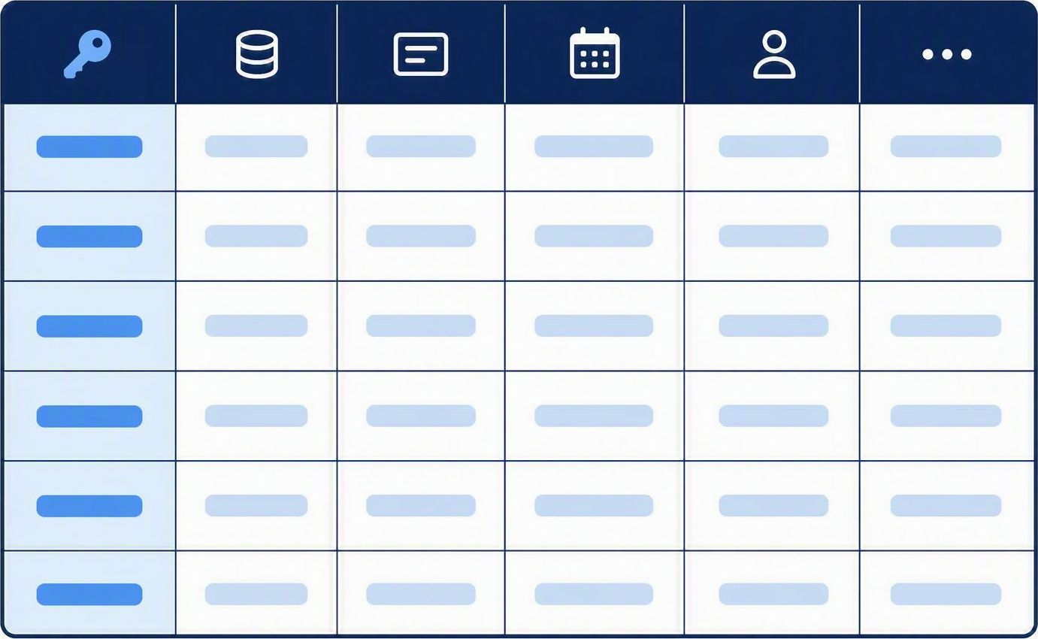
◂ Roadmap
MODULE 2 · THE BASIC STRUCTURE
Explore
Anatomy of a Database Table
Every table shares the same shape. Learn where each part goes, then plan a table of your own.
Rows & Columns
THE GRID
Each column is a field that holds one type of data.
Each row is a record describing one single item.
The cell where a row and column meet holds one value.
Field Names & Types
PLANNING A TABLE
Each field is given a clear name, such as CarID, Make or Price.
Each field is set to a data type that suits the data it stores.
GOLDEN RULE
Give every record a unique key field, so no two records can ever be confused.
TRY IT
Plan a Cars table: list the fields you would need, such as CarID, Make, Model, Year and Price.
Notes:
Anatomy of a Database Table
Teaching notes: Model the parts of a table: fields as columns, records as rows, and the primary key that uniquely identifies each record. Have pupils open a table in Datasheet View and point to each part.
Key questions
What is stored in a column versus a row?
What does the primary key do?
Why must each record be unique?

Slide 6

MODULE 2 · FIELDS & DATA TYPES
Data Basics
Data Types: The Essentials
A data type tells the database what kind of value a field holds. Choosing the right one keeps data accurate.
TEXT
Stores letters, symbols and short strings, such as a car's make or model. Also called Short Text.
NUMBER
Stores whole numbers or decimals you can calculate with, such as a car's mileage.
CURRENCY
Stores money values with a symbol and two decimal places, such as a car's price.
DATE/TIME
Stores calendar dates and times, such as the date a car was first registered.
YES/NO
Stores one of two values, such as whether a car has been sold. Also called Boolean.
AUTONUMBER
A unique number the database adds automatically, ideal for a key field such as CarID.
YOUR TASK · CARS TABLE
1 CREATE FIELDS
Add fields for CarID, Make, Model, Year and Price in a new table.
2 SET DATA TYPES
Set each field to a suitable data type, with CarID as AutoNumber.
3 SAVE THE TABLE
Save the table as tblCars — the heart of your Dodgy Dave's database.
TIP
The wrong data type can stop you sorting or calculating with a field later.
Always check each field's data type before entering data.
Change a field's type in Design View if you get it wrong.
Notes:
Data Types: The Essentials
Teaching notes: Teach the common Access data types: Short Text, Number, Currency, Date/Time, Yes/No and AutoNumber, and why the right type keeps data valid. Pupils choose a data type for each field in a Cars table.
Key questions
Which data type suits a price?
Why choose Date/Time for a date field?
What does AutoNumber do for a primary key?

Slide 7

◂ Roadmap
MODULE 2 · KEY FIELDS
Keys & Links
Key Fields & Relationships
A key field gives every record a unique identity and lets separate tables be linked together.
Primary Key
Unique identifier
A field whose value is unique for every record, such as CarID. No two records can share it.
Foreign Key
The link
A field in one table that matches the primary key of another, linking the two tables together.
Flat-file
One single table
Stores everything in one large table. Simple, but data is often repeated and harder to keep consistent.
Relational
Linked tables
Splits data across linked tables joined by keys, reducing repetition and mistakes.
WHY IT MATTERS
A relational design avoids repeating data, saves space and keeps every record consistent.
REMEMBER: A primary key must be unique and can never be left empty.
Notes:
Key Fields & the Primary Key
Teaching notes: The primary key uniquely identifies each record so no two rows are the same. Cover how to choose a suitable key, why AutoNumber is a safe choice, and how a foreign key links one table to another.
Key questions
What does a primary key guarantee?
Why is AutoNumber a safe primary key?
What does a foreign key do?

Slide 8
◂ Roadmap
MODULE 2 · FIELD PROPERTIES
Set & Check
Field Properties & Validation
Field properties control how data is stored and checked, keeping every entry accurate and tidy.
Field Size
How much fits
Limits how many characters a text field can hold, saving space and stopping over-long entries.
Format
How it looks
Controls how a value is displayed, such as a date as dd/mm/yyyy or currency with a symbol.
Default Value
A head start
Fills a field automatically with a common value, saving typing when most records match.
Required
No blanks
Forces a field to be filled in, so important data can never be left empty.
Validation Rule
Sensible values
Checks that an entry meets a rule, such as a price greater than zero, before it is accepted.
Input Mask
A fixed pattern
Forces data into a set pattern, such as a date or a registration plate, as it is typed.
TIP
Validation stops silly mistakes, but it cannot catch data that is wrong yet still sensible.
Notes:
Field Properties & Validation
Teaching notes: Introduce field properties: field size, format, default value, and validation rules with validation text. Stress that a validation rule checks data as it is entered, for example Year must not be in the future.
Key questions
What does the Format property change?
What does a validation rule check?
When would validation text appear?

Slide 9




MODULE 2 · ACCURATE DATA ENTRY
Teams Assignment
Validation & Verification
Validation rules automatically check that data is sensible, while verification confirms it has been entered accurately.
Validation: Rules that Check Data
Verification: Confirming Accuracy
Checks data is sensible before it is stored
Range, type, length and format checks are common
A presence check stops a field being left empty
Set in the field properties when you design a table
Double entry types the same data twice to compare
✓
✓
Visual checks proofread against the original source
✓
Catches typing mistakes validation cannot spot
✓
Used with validation for reliable, trustworthy data
Together validation and verification keep your Dodgy Dave's records accurate and trustworthy.
Key vocabulary
Validation: an automatic check that data is reasonable.
Verification: confirming data was typed in correctly.
FRAMEWORK LINKS FOR THIS TASK
Objectives
Success Criteria
Vocabulary
National Identity
Meta-thinking
Linking
AI Concepts
Notes:
Validation & Verification
Teaching notes: Validation checks that data is sensible using rules, input masks and required fields; verification checks that data was entered correctly, for example double entry or proofreading. Neither can prove the data is actually true.
Key questions
What is the difference between validation and verification?
Give an example of a validation rule.
Can validation prove data is correct?

Slide 10
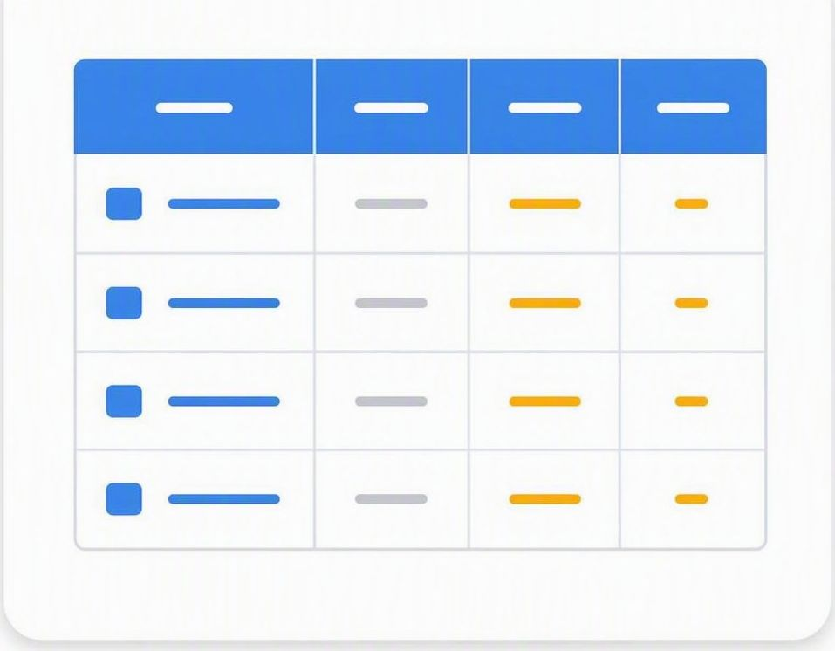


◂ Roadmap
MODULE 3 · STRUCTURING DATA
Building
Tables
Organising information in fields and records
From a single flat table to a structured design with keys, data types and indexes.
Table
Field
Record
Key
Type
Index
Notes:
Module 3 opener — Building Tables
Teaching notes: Introduce building tables in Access to organise data into fields and records, from a simple structure to a full table with a primary key and a chosen data type for every field.
Key questions
What are the two views for building a table?
What do you set for each field?
Why set a primary key?

Slide 11
MODULE 3 · STEP BY STEP
Skills Toolkit
Building a Table, Step by Step
Follow these four steps in order and any Access table becomes easy to build.
1 · CREATE THE TABLE
In Design View, create a new table and give it a clear name such as tblCars.
2 · ADD THE FIELDS
Type each field name into its own row, e.g. CarID, Make, Model, Year and Price.
3 · SET DATA TYPES
Choose a data type for every field, such as Text, Number, Currency or Date/Time.
4 · SET THE PRIMARY KEY
Select CarID and set it as the primary key so every record stays unique.
REMEMBER Sketch your Cars table on paper first. List the fields and their data types before you build it in Access.
Notes:
Building a Table, Step by Step
Teaching notes: Model the steps in order: open Design View, name each field, choose its data type, set the primary key, then switch to Datasheet View to enter data. Encourage pupils to sketch the Cars table and list its fields before typing.
Key questions
Which view lets you set data types?
What do you set on the CarID field?
How do you switch to entering data?

Slide 12
MODULE 3 · WORKED EXAMPLE
Worked Example 4
Worked Example: The Cars Table
Make | Price
Ford | $8,500
Toyota | $12,000
Honda | $9,750
Nissan | $6,400
Mazda | $7,200
TABLE NAME
tblCars stores every vehicle Dodgy Dave has in stock, one record per car.
Relational table structure · fields, records and a primary key
How do you turn this list into a well-structured Access table?
1 · NAME THE TABLE
Give the table a clear name such as tblCars so it is easy to find in Access.
2 · THE FIELD NAMES
The top row holds the field names Make and Price. Each field describes one detail of a car.
3 · THE RECORDS
Every car is one record: a single row holding the values for each field.
4 · THE PRIMARY KEY
Add a CarID primary key so every record can be identified uniquely.
Notes:
Worked Example — The Cars Table
Teaching notes: Build tblCars live: CarID as an AutoNumber primary key, then Make and Model as Short Text, Year as Number and Price as Currency. Save with a clear name and enter a few records.
Key questions
Which field is the primary key?
What data type suits Price?
Why name the table tblCars?

Slide 13

MODULE 3 · REFINING TABLES
Class Activity
Refining Fields & Properties
These field properties give you full control over how your data is stored and shown.
FIELD SIZE
Limit how many characters a Text field can hold to keep data tidy.
FORMAT
Control how values display, e.g. Currency or a short date format.
CAPTION
Set a friendly caption so forms show a clear label instead of the field name.
DEFAULT VALUE
Fill a field automatically with a common value to speed up data entry.
INDEXED
Index a field so searches and sorts run faster on large tables.
REQUIRED
Make a field required so a record cannot be saved while it is empty.
PRACTISE
BUILD
Build your Dodgy Dave's Cars table: set a field size for Make, then format Price as Currency.
INDEX
Index the Make field so searches for a manufacturer run quickly.
STYLE
Add a validation rule and a Required setting so your data stays clean.
TIP
Field properties are set for each field separately in the lower pane of Design View.
Illustrative photograph · for classroom reference
Try setting a Default Value to see how new records fill in automatically.
Notes:
Refining & Editing Tables
Teaching notes: Show how to refine a table: insert, rename and reorder fields, change data types safely, set field sizes and formats, and add or delete records. Pupils tidy the Cars table and add a new field.
Key questions
How do you add a new field to a table?
How do you change a field's data type?
How do you set a field's size or format?

Slide 14

◂ Roadmap
MODULE 4 · WORKING WITH DATA
Queries, Forms & Reports
QUERY
REPORT
Finding and presenting the data you need
Extract answers with queries, capture input with forms and present results as reports.
Queries
Forms
Reports
Notes:
Module 4 opener — Working with Data
Teaching notes: Introduce the objects that put a database to work: queries to search and filter records, forms to enter data, and reports to present it.
Key questions
What does a query do?
What is a form used for?
What is a report used for?

Slide 15









MODULE 4 · QUERIES
Teams Assignment
Building a Query
A query asks Access a question and returns only the records that match your criteria.
Every Query Needs
SEE IT IN ACTION
Fields
The columns you want to see.
Criteria
The condition records must meet.
Sort order
How to arrange the results.
Source table
The table the data comes from.
Price > 10000 · sort ascending
YOUR TASK · ALL STUDENTS COMPLETE EVERY ACTIVITY
Open Query Design and add the tblCars table as the data source.
Drag the fields you need into the grid: Make, Model and Price.
Add a condition in the Criteria row, for example >10000 under Price.
Sort the Price field ascending, then click Run to see the matching cars.
FRAMEWORK LINKS FOR THIS TASK
Independent
Learning Ladders
Research
Numeracy Link
Hard-working
Creating
Realising
Data Literacy
Notes:
Building a Query
Teaching notes: A query searches a table and returns only the records you want. Build one in Query Design: add tblCars, choose the fields to show, then type criteria such as >10000 under Price.
Key questions
What does a query return?
How do you add a table to a query?
Where do you type the criteria?

Slide 16

◂ Roadmap
MODULE 4 · QUERY CRITERIA
Research Bank
Query Criteria & Operators
Criteria tell a query which records to return. Combine operators and wildcards to filter your data precisely.
COMPARISON OPERATORS · test one value against another
> and < — Greater than or less than, e.g. Price > 10000.
>= and <= — Includes the boundary value in the match too.
<> — Not equal to, e.g. Make <> 'Ford'.
Between — A value range, e.g. Between 2015 And 2020.
TEXT & WILDCARDS · match words and patterns
Like — Pattern match on text, e.g. Like 'Toy*'.
* and ? — * matches any characters; ? matches one character.
COMBINING CONDITIONS · use And / Or to refine results
And — Both conditions must be true, on the same row.
Or — Either condition can be true, on the next row.
Well-chosen criteria return exactly the records you need.
Notes:
Query Criteria & Operators
Teaching notes: Criteria filter the records a query returns. Cover the operators greater than, less than and equals, plus AND and OR across the criteria rows, and text criteria in quotes. Show wildcards with Like, for example cars over 10,000 or a chosen Make.
Key questions
Which operator finds prices over 10,000?
What is the difference between AND and OR criteria?
How do you match text with a wildcard?

Slide 17
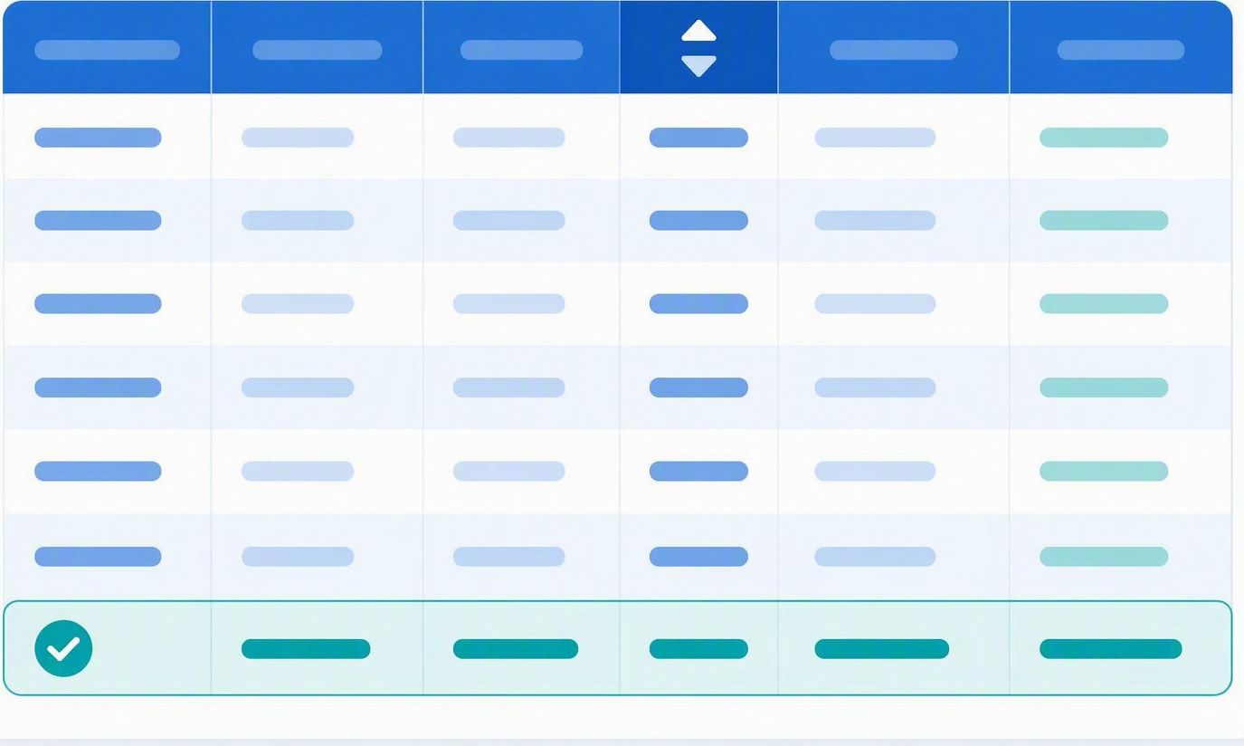
◂ Roadmap
MODULE 4 · QUERIES
Query Toolkit
Sorting & Summarising Data
Beyond simple filters, queries can sort, summarise and calculate to turn raw records into answers.
Sort
Order results
Set Ascending or Descending in the Sort row to order your records.
Show
Display or hide
Untick the Show box to filter on a field without displaying it in results.
Totals
Summarise data
Turn on Totals to Count, Sum or Average records grouped by a field.
Calculated
New fields
Create a calculated field, e.g. Profit: [Price]-[Cost], right in the grid.
SAVING
Save each query with a clear name, e.g. qryCarsOver10000.
Names starting with qry keep queries easy to find.
A saved query shows live data, so re-running it reflects the latest records.
Notes:
Sorting & Summarising Data
Teaching notes: Queries can sort results ascending or descending and summarise them with Totals: Count, Sum, Average, Max and Min. Show sorting cars by Price and counting how many records meet a criterion.
Key questions
How do you sort query results?
Which Total adds up a column of values?
How would you count the matching records?

Slide 18

MODULE 5 · FORMS
Worked Example
Forms: Entering Data with Ease
TWO WAYS TO BUILD
The Form Wizard builds a form fast.
Design View gives you full control.
Both edit the same underlying form.
1 · CHOOSE THE SOURCE
Set tblCars as the record source so the form shows the car fields.
2 · PICK THE FIELDS
Add Make, Model, Year and Price to the form layout.
3 · ARRANGE CONTROLS
Line up labels and text boxes so the form is clear and easy to read.
4 · ADD NAVIGATION
Use the record buttons to move through, add and save cars.
Notes:
Forms: Entering Data with Ease
Teaching notes: A form shows one record at a time in a friendly layout, making data entry easier and safer than typing straight into a table. The Form Wizard builds a form from tblCars in a few clicks.
Key questions
Why use a form instead of a table for data entry?
What does the Form Wizard build from?
How many records does a form show at once?

Slide 19
◂ Roadmap
MODULES 5 & 6 · FORMS & REPORTS
Forms & Reports
FORM
REPORT
Capture data cleanly with forms, then present it professionally with reports.
Design forms for easy data entry, then build reports to group, summarise and print.
Entry
Grouping
Printing
Notes:
Modules 5 & 6 opener — Forms & Reports
Teaching notes: Introduce entering data through forms, then presenting it with reports that group, sort and total records ready for printing.
Key questions
What is a form used for?
What does a report let you do?
Why group and total a report?

Slide 20
◂ Roadmap
MODULE 5 · FORMS
Define It
Form Controls & Properties
Forms give you a friendly window for adding, editing and viewing records one at a time.
TEXT BOX
Bound control
Displays and edits one field from the table, such as Make or Price.
LABEL
Caption
Fixed text that names a field so users know what to type.
COMBO BOX
Drop-down
Lets users pick a value from a list instead of typing it.
RECORD SOURCE
The table
The table or query the form reads and writes, such as tblCars.
COMMAND BUTTON
Actions
Runs an action such as Save Record or move to the next record.
FORM PROPERTIES
Fine-tuning
Set titles, tab order and default view to make data entry quick and clear.
REMEMBER
Bind each control to the right field, or your data will save to the wrong place.
Notes:
Form Controls & Properties
Teaching notes: A form is built from controls: text boxes bound to fields, labels, buttons and combo boxes. Cover editing controls in Design or Layout View, setting their properties, and adding navigation buttons. Test the form by adding a record.
Key questions
What is a bound text box linked to?
Which view lets you edit form controls?
How do you move between records on a form?

Slide 21

MODULE 6 · REPORTS
Teams Assignment
Ways to Build a Report
Reports turn your data into a printable, professional document. Access gives you several ways to build them.
Report Wizard
Guides you step by step to pick fields, grouping and layout.
Design View
Build a report by hand for full control over every section.
From a Query
Base a report on a query so it shows only the records you need.
Grouping
Group records, such as by Make, to organise the printout.
Sorting
Order records, such as Price low to high, before printing.
Totals
Add counts and sums in the group or report footer.
KEY VOCABULARY
Detail section
Shows one row per record from the table or query.
Group header
Labels each group, such as a Make like Toyota.
Report footer
Holds grand totals, such as the total number of cars.
TRY IT · BUILD A CARS REPORT
Use the Report Wizard on tblCars and group the records by Make.
Access lays out every car neatly under its Make heading.
Add a total in the footer to count how many cars are in stock.
Notes:
Ways to Build a Report
Teaching notes: A report can be made with the one-click Report tool, the Report Wizard, or from scratch in Design View. The wizard wins for most tasks because it groups, sorts and totals in a few steps. Build a report on tblCars grouped by Make.
Key questions
What are the three ways to build a report?
Why is the Report Wizard usually best?
How do you group a report by Make?

Slide 22

MODULE 6 · WORKED EXAMPLE
Worked Example
Worked Example: A Grouped Cars Report
See how a grouped report is built from tblCars. Study the layout and the callout, then follow the steps below.
How to Build It
Select tblCars as the record source.
In the Report Wizard, group the records by Make.
Sort the detail rows by Price.
Add a count in each group footer.
rptCars
Grouped by Make, sorted by Price, with a count of cars shown in each group footer.
THE STRUCTURE
How is every report organised?
Every report has the same sections:
1. Header — The report header shows the title, such as Cars in Stock.
2. Groups — Each group header names a Make and starts a new block.
3. Detail — The detail section lists each car under its Make.
4. Footer — Group and report footers hold counts and totals.
Key sections: Report header · Group header · Detail · Group footer · Report footer
Challenge: which section would show the total number of cars?
Notes:
Worked Example — A Grouped Cars Report
Teaching notes: Walk through the sections of a grouped report: the report header for the title, a group header for each Make, the detail band for every car, a group footer with a subtotal, and the report footer with a grand total.
Key questions
Which section holds the report title?
What appears in the detail section?
Where does the grand total sit?

Slide 23
◂ Roadmap
MODULE 6 · REPORT DESIGN
Sequence It
Report Formatting & Layout
A few key settings control how tidy and readable your printed report looks.
PAGE SETUP
Size & margins
Choose portrait or landscape and set margins so nothing is cut off.
COLUMN WIDTHS
Fit the data
Widen columns so long values like Model names are not clipped.
GROUPING
Organise
Group records by a field, such as Make, to break up the list.
SORTING
Order
Sort within each group, such as Price from low to high.
PAGE NUMBERS
Navigation
Add page numbers and a date in the page footer.
TOTALS
Summaries
Show counts and sums in group and report footers.
TIP
Check Print Preview before you print so every column fits neatly on the page.
Notes:
Report Formatting & Layout
Teaching notes: Improve a report's readability: set fonts, sizes and alignment, adjust column widths, add a logo and page numbers, and use consistent colours so the printed report is clear and easy to read.
Key questions
Which view lets you adjust a report's layout?
How do you make columns line up neatly?
What can you add to a page header or footer?

Slide 24
◂ Roadmap
MODULE 6 · REPORT TOTALS
Compare It
Calculations & Totals in Reports
Reports can calculate totals and summaries automatically, so you never add up figures by hand.
SUM
=Sum([Price])
Adds up a number field, such as the total value of all cars.
COUNT
=Count(*)
Counts how many records fall in a group or the whole report.
AVERAGE
=Avg([Price])
Works out the mean value, such as the average car price.
MAX & MIN
=Max([Price])
Finds the highest or lowest value in the group.
GROUP TOTALS
In each footer
Place a total in a group footer to summarise just that group.
GRAND TOTAL
Report footer
Put a total in the report footer to summarise every record.
PRACTISE
Add =Count(*) to the report footer to show how many cars are in the Dodgy Dave's Motors database.
Notes:
Calculations & Totals in Reports
Teaching notes: Reports can calculate: a group footer can subtotal each group and the report footer can hold a grand total. Use an expression such as =Sum([Price]) to add up a field and =Count(*) to count records. Pupils add a subtotal per Make and a grand total.
Key questions
Which expression adds up a field?
Where does a group subtotal go?
Where does the grand total go?

Slide 25
◂ Roadmap
TOOLKIT · STARTER STEPS
Follow Along
Starter Steps for Your Cars Database
Work through each block in Access, then change the makes, models and prices to build your own Dodgy Dave's Motors database.
1 · CREATE THE TABLE — save as tblCars
Create Table > Design View
Add field: CarID (AutoNumber)
Set CarID as the Primary Key
Add field: Make (Short Text)
Add field: Model (Short Text)
Add field: Year (Number)
Add field: Price (Currency)
Save the table as tblCars
2 · QUERY — cars over £10,000
Create > Query Design
Add tblCars, then add the fields
Show: Make, Model, Price
Criteria under Price: > 10000
Run, then save as qryCarsOver10000
3 · FORM — add records with ease
Select tblCars, then Create > Form Wizard
Add all fields, then save the form as frmCars
4 · REPORT — grouped and totalled
Create > Report Wizard
Base it on tblCars, group by Make
Sort the detail rows by Price
Add =Count(*) to the group footer
Add =Sum([Price]) to the report footer
Preview, then save the report as rptCars
Done — a complete Cars database!
Notes:
Starter Steps — Build Your Cars Database
Teaching notes: Use this slide with Years 10 and 11 as scaffolding for the build. Pupils follow each step in Access, save the object with the right name, then adapt it. Model creating and saving the database file before they start.
How to use each step
Step 1 (Create the table): use Create then Table Design, add the fields and data types, set CarID as the primary key, and save as tblCars.
Step 2 (Query): use Create then Query Design, add tblCars, and type the criteria under the Price field to find the pricier cars.
Step 3 (Form and report): use the Form Wizard to build frmCars, then the Report Wizard on tblCars grouped by Make with a total.
Common mistakes to watch for
Forgetting to set a primary key, or choosing the wrong data type for a field such as Price.
Typing criteria in the wrong query column, or not saving objects with clear names.

Slide 26
◂ Roadmap
MODULE 7 · COURSEWORK BRIEF
Coursework
Dodgy Dave's Motors Database
This is your coursework: build a working database for Dodgy Dave's Motors. Plan your table first, then build each object one at a time.
YOUR BRIEF · DODGY DAVE'S MOTORS
Build a working database for Dodgy Dave's Motors: a table of cars with the right data types, a form to add records, a query to find cars over a set price, and a grouped, totalled report. Use sensible object names throughout.
HOW TO BUILD IT
Create tblCars in Design View: CarID (AutoNumber, primary key), Make, Model, Year and Price with correct data types.
Build frmCars with the Form Wizard so staff can add and edit car records one at a time.
Design qryCarsOver10000 to show Make, Model and Price for every car priced over £10,000.
Build rptCars grouped by Make, sorted by Price, with a count in each group and a grand total at the end.
STRETCH · GO FURTHER
Add a validation rule so Year cannot be in the future, and a second query that sorts cars from newest to oldest.
FRAMEWORK LINKS FOR THIS TASK
Objectives
Vocabulary
Success Criteria
Analysing
Linking
AI Concepts
Notes:
Coursework — Dodgy Dave's Motors Database
Teaching notes: Pupils plan their table first, then build carefully. Create tblCars, a data-entry form, a query for cars over £10,000 and a grouped report with totals. Stretch: add a validation rule on Year and a second query sorting newest to oldest.
Key questions
Which fields does the Cars table need?
What criteria find cars over £10,000?
What does the stretch task add?

Slide 27
◂ Roadmap
MODULE 7 · COURSEWORK CHECKLIST
Checklist
Your Cars Database Build Checklist
Tick each box as you finish it. Print this page and keep it beside your work as you build.
OBJECTS TO BUILD
☐ tblCars — correct fields, data types and a primary key
☐ frmCars — a form to add and edit car records
☐ qryCarsOver10000 and rptCars — a query and a grouped report
STYLE & FINISH
☐ Field validation and sensible input masks applied
☐ Query criteria and sort order return the right records
☐ Report grouped, sorted and totalled correctly
☐ Saved in one database file with clear object names
BEFORE YOU HAND IN
Open each query and report to check the records are right, then compact and save the database before you hand in.
FRAMEWORK LINKS FOR THIS TASK
Objectives
Vocabulary
Success Criteria
Analysing
Linking
AI Concepts

Slide 28
◂ Roadmap
MODULE 7 · MARKING RUBRIC
Rubric
How Your Cars Database Is Marked
Check your work against this before you hand in. The build is marked out of 20.
WHAT WE MARK
6 Table — correct fields, data types and a primary key
6 Query & form — a working form and a query that filters correctly
6 Report — grouped, sorted and totalled the right way
2 Care & accuracy — validation, tidy layout, sensible object names
MARK BANDS
Secure (17–20) table, form, query and report all correct and well named.
Developing (11–16) most objects work, with minor query or report gaps.
Emerging (1–10) only a table built or the report still incomplete.
TOTAL · 20 MARKS
Aim for Secure: a well-built table, a working form, a filtered query and a grouped, totalled report.
FRAMEWORK LINKS FOR THIS TASK
Objectives
Vocabulary
Success Criteria
Analysing
Linking
AI Concepts

Slide 29
◂ Roadmap
MODULE 7 · QUICK QUIZ
Quick Quiz
Quick Quiz: Check Your Understanding
Try these exam-style questions from memory. The marks are shown for each one, and the answers are in the teaching notes.
SECTION A · RECALL · 1 MARK EACH
Which data type would you use to store a car's price?
What is the job of a primary key in a table?
Which database object is used to enter and edit records?
SECTION B · SHORT ANSWER
Name two suitable data types for the fields in tblCars. (2 marks)
Give one reason a validation rule is useful when entering data. (2 marks)
Name three sections you find in an Access report. (3 marks)
Explain what a query does to the records in a table. (2 marks)
CHALLENGE · YOUR CARS DATABASE
For your Cars database, write the query criteria that shows only cars priced over £10,000, then describe which report section would hold the =Sum([Price]) grand total.
FRAMEWORK LINKS FOR THIS TASK
Objectives
Vocabulary
Success Criteria
Analysing
Linking
AI Concepts
Notes:
Quick Quiz — Check Your Understanding
Teaching notes: Run this as a short recall check for Years 10 and 11. Give about eight minutes, let pupils answer from memory, then reveal the mark scheme below and mark in pairs. Total: 14 marks.
Mark scheme — Section A (recall, 1 mark each)
1. Currency.
2. It uniquely identifies each record.
3. A form.
Mark scheme — Section B (short answer)
1. Any two of Short Text, Number, Currency or Date/Time (1 mark each).
2. It checks that entered data is sensible or within allowed limits, which reduces input errors (2 marks).
3. Report header, group header, detail, group footer, report footer (any three, 1 mark each).
4. It searches a table and returns only the records that match the criteria (2 marks).
Mark scheme — Challenge (5 marks)
Criteria: greater than 10000 under the Price field (3 marks) — accept >=10000 with a note. The grand total =Sum([Price]) sits in the report footer (2 marks).

Slide 30
MODULE 7 · REVIEW
Teams Assignment
3-2-1: What You’ve Learned
Look back across the module — the tables, data types, queries, forms and reports you have practised in Access.
Three database objects you can now build with confidence, for example a table, a query and a report.
3
Two data types you would choose for fields in tblCars, and why each one fits.
2
One thing you would like to build next with a database of your own.
1
Notes:
Review — 3-2-1: What You've Learned
Teaching notes: Close the unit: pupils name three database objects they can now build, two data types they would use in the Cars table, and one database they would like to build next.
Key questions
Which three database objects can you build?
Which two data types suit the Cars table fields?
What will you build next?

Slide 31
◂ Roadmap
MODULE 8 · YOUR NEXT CHALLENGE
The Paws & Claws Vet Clinic
Now design a database of your own
Pets
Owners
Visits
A busy vet clinic needs to track its pets, their owners and every visit — now it is your turn to build the database that stores it all.
Your mission: design and build it from scratch
Tip: plan your table and data types on paper before you build.

Slide 32
◂ Roadmap
MODULE 8 · CHALLENGE BRIEF
Challenge
Paws & Claws Vet Clinic Database
This is your challenge: design and build a working database for the Paws & Claws vet clinic. Plan your table first, then build each object one at a time.
YOUR BRIEF · PAWS & CLAWS VETS
Build a working database for Paws & Claws vets: a table of pets with the right data types, a form to add records, a query to find pets due a check-up, and a grouped, counted report. Use sensible object names throughout.
HOW TO BUILD IT
Create tblPets in Design View: PetID (AutoNumber, primary key), PetName, Species, Owner, DateOfBirth and LastVisit with correct data types.
Build frmPets with the Form Wizard so staff can add and edit pet records one at a time.
Design qryDueCheckup to show PetName, Species and Owner for every pet not seen in the last 12 months.
Build rptPets grouped by Species, sorted by PetName, with a count in each group and a grand total at the end.
STRETCH · GO FURTHER
Add a validation rule so DateOfBirth cannot be in the future, and a second query that lists only dogs, sorted by Owner.
FRAMEWORK LINKS FOR THIS TASK
Objectives
Vocabulary
Success Criteria
Analysing
Linking
AI Concepts

Slide 33
◂ Roadmap
MODULE 8 · CHALLENGE CHECKLIST
Checklist
Your Vet Clinic Database Checklist
Tick each box as you finish it. Print this page and keep it beside your work as you build.
OBJECTS TO BUILD
☐ tblPets — correct fields, data types and a primary key
☐ frmPets — a form to add and edit pet records
☐ qryDueCheckup and rptPets — a query and a grouped report
STYLE & FINISH
☐ Field validation and sensible input masks applied
☐ Query criteria and sort order return the right records
☐ Report grouped, sorted and totalled correctly
☐ Saved in one database file with clear object names
BEFORE YOU HAND IN
Open each query and report to check the records are right, then compact and save the database before you hand in.
FRAMEWORK LINKS FOR THIS TASK
Objectives
Vocabulary
Success Criteria
Analysing
Linking
AI Concepts

