Slide 1




◂ Roadmap
IGCSE ICT · SPREADSHEETS, GRAPHS & CHARTS
Spreadsheets, Graphs & Charts
Data Models, Formulae, Functions & Data Visualisation
A step-by-step guide to building spreadsheet models and turning data into clear graphs and charts, with hands-on IGCSE tasks.
Models
Formulae
Charts
Notes:
Title — Spreadsheets, Graphs & Charts
Teaching notes: Open the unit. Explain that a spreadsheet is a grid of cells used to model data, and that this unit builds from cells and formulae, through functions and cell referencing, to choosing and labelling graphs and charts, with hands-on IGCSE tasks at every step.
Key questions
What is a spreadsheet model used for?
Why does every formula start with an = sign?
What will you be able to build by the end of the unit?

Slide 2
YOUR LEARNING JOURNEY
Teams Assignment
Course Roadmap
Build your skills lesson by lesson — from your first spreadsheet model to polished graphs and charts ready for the exam.
1
LESSON 1
Spreadsheet Foundations
Jump ▸
Cells, rows, columns and simple data models.
2
LESSON 2
Formulae & Operators
Jump ▸
Arithmetic operators and the BIDMAS order of operations.
3
LESSON 3
Cell Referencing
Jump ▸
Relative and absolute references, and replicating formulae.
4
LESSON 4
Functions
Jump ▸
SUM, AVERAGE, ROUND and COUNTIF in your models.
5
LESSON 5
Choosing a Chart
Jump ▸
Pick pie, bar or line charts to suit the data.
6
LESSON 6
Building & Labelling
Jump ▸
Create charts and add full, clear labels.
7
LESSON 7
Exam Practice & Review
Jump ▸
A spreadsheet scenario, quiz and review.
Each lesson adds one more skill towards your IGCSE spreadsheet and charts work.
Notes:
Course Roadmap
Teaching notes: Walk through the lessons: spreadsheet foundations, formulae and operators, cell referencing, functions, choosing a chart, building and labelling charts, then exam practice and review. Each card is a clickable jump point that links to a worked example and a hands-on task.
Key questions
Which lesson introduces functions?
In what order do we learn formulae and cell referencing?
How does each lesson build towards the exam practice?

Slide 3


◂ Roadmap
MODULE 1 · SPREADSHEET FOUNDATIONS
Spreadsheet Foundations
How every spreadsheet model is built
Cells
Formulae
Models
We explore how cells, formulae and simple models let you explore ‘what if’ scenarios with data.
Try it: open a blank workbook and enter data into cells
Tip: a spreadsheet model lets you change data and instantly see the results.
Notes:
Module 1 opener — Spreadsheet Foundations
Teaching notes: Introduce how cells, rows and columns combine to form a worksheet, and how a spreadsheet model lets you change a value and instantly see the results. Have pupils open a blank workbook and enter data into cells.
Key questions
What is a cell?
What is the difference between a row and a column?
Why is a spreadsheet called a model?

Slide 4

◂ Roadmap
MODULE 1 · SPREADSHEET FOUNDATIONS
SPREADSHEETS
The Building Blocks of a Spreadsheet
Every spreadsheet is built from a few simple parts, each with its own job in storing and calculating data.
The Cell
One box
A cell is a single box that holds one value, label or formula. Its address comes from its column and row, such as B2.
Rows & Columns
The grid
Columns run down (A, B, C) and rows run across (1, 2, 3), giving every cell a unique address.
The Worksheet
One sheet
A worksheet is a full grid of cells. Many worksheets can be held together inside one workbook.
The Data Model
The purpose
A model uses cells and formulae so you can change data and instantly see ‘what if’ results.
REMEMBER
A cell is one box, rows and columns form the grid, and a worksheet is the whole sheet.
The same data can be recalculated instantly when you change a value.
Notes:
The Building Blocks of a Spreadsheet
Teaching notes: Explain the cell (one box holding a value, label or formula), the rows and columns that give every cell an address such as B2, and the worksheet that holds them. Note that many worksheets can sit inside one workbook.
Key questions
What does a single cell hold?
How is a cell address such as B2 made up?
What is the difference between a worksheet and a workbook?

Slide 5

MODULE 2 · FORMULAE & OPERATORS
Formula Basics
Formulae & Arithmetic Operators
A formula always starts with an = sign. Arithmetic operators tell the spreadsheet how to calculate with your cells.
ADD ( + )
Adds two values together, e.g. =B2+B3 gives the total of cells B2 and B3.
SUBTRACT ( - )
Takes one value from another, e.g. =B2-B3 finds the difference.
MULTIPLY ( * )
Multiplies values, e.g. =B2*B3. Use the star symbol, never the letter x.
DIVIDE ( / )
Divides one value by another, e.g. =B2/B3.
INDICES ( ^ )
Raises to a power, e.g. =B2^B3 sets B2 to the power of B3.
CELL REFERENCES
Formulae point to cells, so results update whenever the cell values change.
YOUR TASK · NUMBER MODEL
1 ENTER TWO NUMBERS
Put 4 in cell B2 and 2 in cell B3 as your test values.
2 ADD FORMULAE
In B5 to B9 enter =B2+B3, =B2-B3, =B2*B3, =B2/B3 and =B2^B3.
3 TEST IT
Change B2 or B3 and watch every result recalculate automatically.
TIP
Using operators is the most efficient way to calculate — check every formula starts with an equals sign.
Notes:
Formulae & Arithmetic Operators
Teaching notes: Every formula starts with an = sign. Teach the arithmetic operators + - * / and ^, using cell references such as =B2+B3. Stress that multiply is a star (*), never the letter x, and that referencing cells keeps results live when the values change.
Key questions
What must every formula start with?
Which symbol is used to multiply?
Why use cell references instead of typing numbers?

Slide 6

◂ Roadmap
MODULE 2 · ORDER OF OPERATIONS
BIDMAS
The Order of Operations: BIDMAS
When a formula mixes operators, the spreadsheet follows a fixed order. Remember it with BIDMAS.
Brackets
Do these first
Anything inside brackets is worked out before the rest, e.g. (6+3) is done first.
Indices
Powers & roots
Powers and roots come next, e.g. 5^2 is done before any multiply or add.
Divide & Multiply
Equal rank
Worked left to right, so =6*25/5 is done in reading order.
Add & Subtract
Done last
Worked left to right once everything else is complete.
WORKED EXAMPLE
7 + (6 × 5^2 + 3) = 160 — brackets and indices first, then multiply, then add.
REMEMBER: change the order and you change the answer — always follow BIDMAS.
Notes:
The Order of Operations: BIDMAS
Teaching notes: When a formula mixes operators, the spreadsheet follows a fixed order — BIDMAS: Brackets, Indices, Divide and Multiply (equal rank, worked left to right), then Add and Subtract. Use brackets to force the order you want, e.g. =(B2+B3)*C1.
Key questions
What does BIDMAS stand for?
Which is worked out first, multiply or add?
How can you force an addition to happen first?

Slide 7
◂ Roadmap
MODULE 3 · CELL REFERENCING
Copy & Fill
Relative & Absolute References
How you write a cell reference decides what happens when you replicate (copy) the formula to other cells.
Relative Reference
It moves
A plain reference like A3 shifts as you copy it down, so it becomes A4 in the next row.
Absolute Reference
It stays fixed
Dollar signs like $A$1 lock a reference so it never changes when the formula is copied.
Mixed Reference
Part locked
=$A$1*A3 keeps A1 fixed but lets A3 move as you fill down.
The Fill Handle
Replicate fast
Drag the small square at a cell’s corner to copy a formula across many cells.
Why It Matters
Fewer errors
Absolute references stop a shared value, such as a tax rate, being lost when copied.
Spot the $
Read carefully
The $ sign fixes whatever comes straight after it — the column, the row, or both.
TIP
Before you fill a formula down, ask which references must stay fixed and add $ signs to them.
Notes:
Relative & Absolute References
Teaching notes: How a reference is written decides what happens when a formula is copied. A relative reference (A3) shifts, an absolute reference ($A$1) stays fixed, and a mixed reference locks only part of it. Show the fill handle and ask which references must stay fixed before filling down.
Key questions
What happens to a relative reference when you copy it down?
What do the dollar signs in $A$1 do?
When would you use a mixed reference?

Slide 8




MODULE 4 · FUNCTIONS
Functions
Functions: Built-in Calculations
A function has a reserved name, such as SUM, that carries out a calculation on a range of cells for you.
Six Functions to Know
Nested & External Functions
=SUM(B4:B8) adds every value in a range (gives 80)
=AVERAGE(B4:B8) finds the mean of a range (gives 16)
=MAX(B4:B8) returns the largest value (gives 26)
=MIN(B4:B8) returns the smallest value (gives 4)
=ROUND(B2,2) rounds a value to a set number of places
=COUNTIF(B2:B7,>100) counts cells that meet a condition
✓
Nest functions inside each other, e.g. =ROUND(AVERAGE(B2:B7),2)
✓
Reference another sheet to pull in external data
✓
Named ranges make functions readable, e.g. =SUM(Sold)
✓
Functions recalculate automatically when data changes
Together, formulae and functions turn raw numbers into a working model.
Key vocabulary
Formula: any calculation starting with = .
Function: a built-in, named operation such as SUM or AVERAGE.
FRAMEWORK LINKS FOR THIS TASK
Objectives
Success Criteria
Vocabulary
National Identity
Meta-thinking
Linking
AI Concepts
Notes:
Functions: Built-in Calculations
Teaching notes: A function is a named, built-in calculation that works on a range of cells. Cover SUM, AVERAGE, ROUND and COUNTIF, e.g. =SUM(B2:B7). Distinguish a formula (any calculation starting with =) from a function (a named operation such as SUM or AVERAGE).
Key questions
What does the SUM function do?
What is the difference between a formula and a function?
Which function counts cells that meet a condition?

Slide 9
MODULE 4 · LOGICAL FUNCTIONS
Logic
Logical Functions: IF & COUNTIF
A logical function tests a condition and gives one answer when it is true and a different answer when it is false.
IF & Nested IF
COUNTIF: Count with a Condition
=IF(C3>=10,"Very experienced","Not experienced") tests one condition
=IF(C3>=10,"Very experienced",IF(C3>=5,"Experienced","Not experienced")) nests a second test
The condition uses = > < >= <= to compare two values
Text answers must be typed inside double quotation marks
=COUNTIF($B$3:$B$21,"Director") counts every Director in the range
✓
✓
=COUNTIF($C$3:$C$21,"<5") counts values under 5 (gives 7)
✓
=COUNTIF($C$3:$C$21,">=10") counts values of 10 or more (gives 5)
✓
Lock the range with $ signs so it stays fixed when copied
IF and COUNTIF let a model make decisions and summarise data automatically.
Key vocabulary
Condition: a test such as C3>=10 that is either true or false.
Nested IF: an IF placed inside another to test more than two outcomes.
FRAMEWORK LINKS FOR THIS TASK
Objectives
Success Criteria
Vocabulary
National Identity
Meta-thinking
Linking
AI Concepts

Slide 10
MODULE 4 · LOOKUP FUNCTIONS
Lookups
Lookups: VLOOKUP & XLOOKUP
A lookup function searches a table for a value and returns matching data from another row or column.
Three Lookups to Know
How a Lookup Works
=HLOOKUP(B6,$B$2:$H$3,2) reads across a horizontal table
=VLOOKUP(B3,client.csv!$A$2:$B$8,2,FALSE) reads down a vertical table
=XLOOKUP(B3,client1.csv!$B$2:$B$8,client1.csv!$A$2:$A$8,"Not found") is the newer, flexible lookup
FALSE forces an exact match; a lookup can even read from another file
The lookup value is what you search for, e.g. a client ID in B3
✓
✓
The table array is the range that holds the data, locked with $ signs
✓
The column or row number says which value to return
✓
XLOOKUP can show a "Not found" message when there is no match
Lookups pull the right data from large tables without searching by hand.
Key vocabulary
Lookup value: the item the function searches for in the table.
Exact match: FALSE (or 0) returns only a perfect match, not the nearest.
FRAMEWORK LINKS FOR THIS TASK
Objectives
Success Criteria
Vocabulary
National Identity
Meta-thinking
Linking
AI Concepts

Slide 11
MODULE 4 · WORKED LOOKUP
Lookups
Worked Lookup: VLOOKUP in Action
PRICE LIST (LOOKUP TABLE)
SPREADSHEET VIEW
Code | Item | Price
C01 | Pen | £1.20
C02 | Ruler | £0.80
C03 | Folder | £2.50
C04 | Binder | £4.50
C05 | Stapler | £6.00
ƒx =VLOOKUP(B3,$A$2:$C$8,3,FALSE)
Look up cell B3 = C04
Returns £4.50 — Binder
1 · LAY OUT THE TABLE
Put the lookup list in its own block — codes in the first column, items and prices beside them.
2 · WRITE THE LOOKUP
In the answer cell type =VLOOKUP(B3,$A$2:$C$8,3,FALSE) to fetch the price for the chosen code.
3 · LOCK THE RANGE
Add $ signs around the table range so it stays fixed when you fill the formula down the column.
4 · CHECK THE RESULT
FALSE forces an exact match; a missing code returns #N/A, so check every answer looks right.

Slide 12
MODULE 4 · STEP BY STEP
Skills Toolkit
Build a Data Model, Step by Step
Follow these four steps to build a times-table model that works for any number you enter.
1 · ENTER A VALUE
Put a number, such as 2, in cell A1 — this drives every calculation.
2 · LIST THE ROWS
Type 1 and 2 in A3 and A4, then fill down to A12 for the numbers 1 to 10.
3 · WRITE THE FORMULA
In B3 enter =A3*$A$1, mixing a relative and an absolute reference.
4 · FILL IT DOWN
Drag the formula to B12; $A$1 stays fixed while A3 moves down each row.
AVOID THESE MISTAKES
#DIV/0! — Divisor is zero or blank
#N/A — Lookup value not found
#REF! — Reference was deleted
#VALUE! — Wrong data type used
#NAME? — Fix the name spelling
#NUM! — Use a valid number
#NULL! — Add a comma between ranges
Colours match the Formula Quick Reference cheat sheet.
REMEMBER Change the number in A1 and the whole times table recalculates instantly.
Notes:
Build a Data Model, Step by Step
Teaching notes: Model the four steps for a times-table: enter a value in A1, list the row numbers 1 to 10, write =A3*$A$1 in B3 (mixing a relative and an absolute reference), then fill down to B12. Change A1 and show the whole table recalculate instantly.
Key questions
Which cell drives every calculation in the model?
Why is $A$1 written with dollar signs?
What happens when you change the value in A1?

Slide 13
MODULE 4 · WORKED EXAMPLE
Worked Example
Worked Example: Sales Bonus Model
Staff | Sold
Amir | 14
Suki | 9
Lena | 22
Tom | 6
Mia | 11
NAMED RANGES
Cell B1 is named Unit (the bonus paid per sale). The list of sales figures is named Sold, so every formula reads clearly.
Named ranges make spreadsheet formulae clear and easy to copy
How do you build a bonus model that updates when the rate changes?
1 · NAME THE CELLS
Name B1 Unit and the sales figures Sold so formulae are easy to read.
2 · WRITE THE FORMULA
Bonus = Sold * Unit, using the named cell so the rate never changes when copied.
3 · USE A FUNCTION
Add =SUM(Sold) to find the total items sold by all staff.
4 · TEST WHAT IF
Change Unit and every bonus updates — the model answers ‘what if the rate rises?’
Notes:
Worked Example — Sales Bonus Model
Teaching notes: Build a sales bonus model live from the staff and units-sold table (Amir 14, Suki 9, Lena 22, Tom 6, Mia 11). Enter one bonus rate in a fixed cell, then use =Sold*$rate with an absolute reference so the formula fills down correctly for every member of staff.
Key questions
Which cell holds the bonus rate?
Why must the bonus rate be an absolute reference?
How do you work out each person’s bonus?

Slide 14
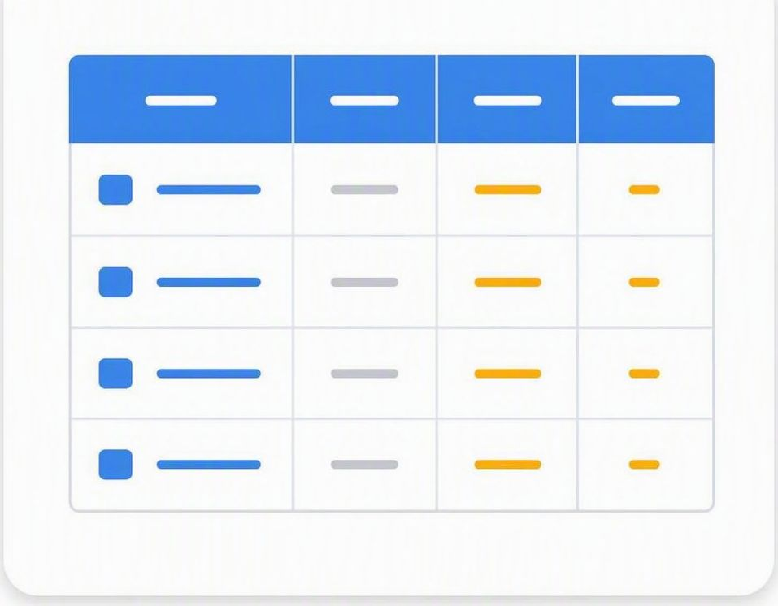


◂ Roadmap
MODULE 5 · PRESENTING DATA
Graphs & Charts
Turning spreadsheet data into clear visuals
From choosing the right chart type to adding full labels, learn to present data so it tells a clear story.
Pie
Bar
Line
Axes
Labels
Legend
Notes:
Module 5 opener — Graphs & Charts
Teaching notes: Open the charts module. Explain that a chart turns spreadsheet numbers into a clear visual story, and that this module covers choosing the right chart type, building it, and labelling it fully so it needs no explanation.
Key questions
Why turn spreadsheet data into a chart?
Which three chart types will you compare?
What makes a chart easy to read?

Slide 15









MODULE 5 · CHART TYPES
Chart Choice
Choosing the Right Chart
The choice is usually between a pie chart, a bar (column) chart and a line graph. Pick the one that suits the data.
Match Chart to Purpose
SEE IT IN ACTION
Pie chart
Compares parts of a whole, e.g. % of staff in each job type.
Bar / column chart
Compares separate values, e.g. number of staff per job.
Line graph
Shows trends over time, e.g. rainfall across the months.
Keep it simple
Avoid 3-D and clutter — a simple chart is clearer.
Column chart · staff by job type
YOUR TASK · CHOOSE AND CREATE
Open employees.csv. Highlight the JobType and Number of staff columns, then use Insert ▸ Charts to create a 2-D column chart. Explain why a column chart suits this data.
FRAMEWORK LINKS FOR THIS TASK
Independent
Learning Ladders
Research
Numeracy Link
Hard-working
Creating
Realising
Data Literacy
Notes:
Choosing the Right Chart
Teaching notes: The choice is usually between a pie chart (parts of a whole), a bar or column chart (separate values), and a line graph (trends over time). Pick the chart that suits the data, and keep it simple by avoiding 3-D effects and clutter.
Key questions
Which chart shows parts of a whole?
Which chart best shows a trend over time?
Why avoid 3-D effects on a chart?

Slide 16

◂ Roadmap
MODULE 5 · CHART TYPES
Compare
Chart Types Compared
Each chart type tells a different story. Match the chart to the question you want your data to answer.
PIE CHARTS · show parts of a whole
Best for percentages — shows how a total splits into slices, e.g. favourite drinks.
One data series — use a single set of values that add up to 100%.
Label each sector — add sector labels and percentage values so it is easy to read.
Avoid too many slices — a few clear sectors read better than many thin ones.
BAR & COLUMN CHARTS · compare separate values
Compare categories — column charts use vertical bars; bar charts run across.
Clear axis labels — label the category axis and the value axis with units.
LINE GRAPHS · show change over time
Show trends — ideal for data recorded over a period, e.g. temperature.
Two variables — a line graph plots one value against another, such as time.
The right chart makes the pattern in your data obvious at a glance.
Notes:
Chart Types Compared
Teaching notes: Compare pie, bar/column and line charts side by side. A pie shows one series that adds up to 100%; a bar or column compares separate values; a line shows change over time. Match the chart to the question the data should answer.
Key questions
Which chart type uses a single series that adds to 100%?
When is a line graph the best choice?
Why should a pie chart avoid too many slices?

Slide 17

MODULE 6 · CREATE A CHART
Worked Example
Create a Chart, Step by Step
TWO WAYS TO START
Use Recommended Charts for a quick suggestion, or the Insert ▸ Charts gallery to pick the exact type. Both build from your highlighted data.
1 · HIGHLIGHT THE DATA
Select the labels and values you want, e.g. A1:B8. Hold Ctrl to pick non-adjacent columns such as A1:A8 and C1:C8.
2 · INSERT THE CHART
On the Insert tab, open Charts and choose a 2-D pie, column or line chart to suit the data.
3 · CHECK THE TYPE
Make sure the chart suits the data; change it if it is misleading.
4 · SAVE YOUR WORK
Save the chart in the spreadsheet, e.g. as task16a, ready for labelling.
Notes:
Create a Chart, Step by Step
Teaching notes: Model creating a chart: highlight the labels and values, insert a pie, bar or line chart from the Insert tab (or use Recommended Charts), check the type suits the data, then save. Stress that a chart always builds from the highlighted data.
Key questions
What must you do to the data before inserting a chart?
Where do you find the Charts gallery?
Why check the chart type after inserting it?

Slide 18
◂ Roadmap
MODULE 6 · LABELLING A CHART
Label It
Labelling a Chart Clearly
Every chart must be fully labelled so a reader understands it without asking any questions.
CHART TITLE
What it shows
Click the words Chart Title and type a title that describes the data.
AXIS TITLES
Name each axis
Tick Axis Titles on the (+) menu, then name each axis, e.g. Rainfall.
VALUE AXIS SCALE
The numbers
Set a sensible minimum, maximum and step in the Format Axis pane.
CATEGORY LABELS
The groups
The names along the bottom, such as days or job types.
DATA LABELS
Exact values
Tick Data Labels on the (+) menu to show the value on each bar or slice.
LEGEND
The key
Explains each colour or series — only needed when there is more than one.
REMEMBER
A chart with no title or axis labels cannot gain full marks in the exam.
Notes:
Labelling a Chart Clearly
Teaching notes: A chart must be fully labelled so a reader understands it without asking questions. Cover a clear chart title, category and value axis titles, a sensible value-axis scale, category and data labels, and a legend when there is more than one series.
Key questions
What should a chart title describe?
What do the axis titles tell the reader?
When is a legend needed on a chart?

Slide 19
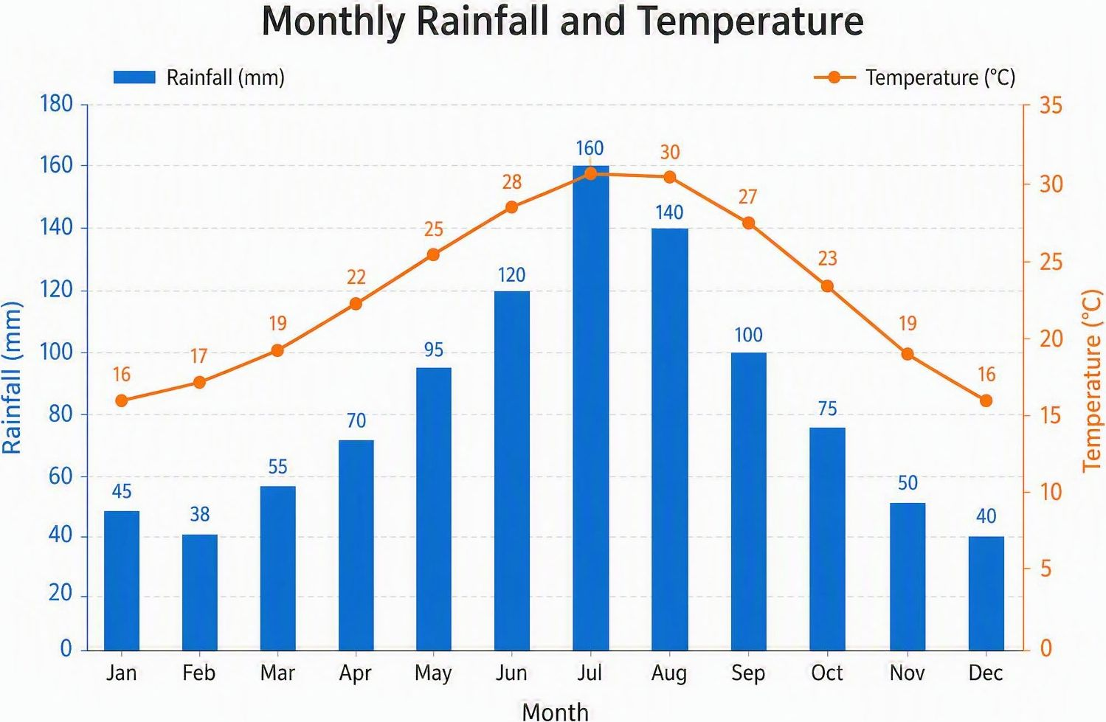
MODULE 6 · SECONDARY AXES
Combo Charts
Using a Secondary Axis
When two data sets use very different scales, a combo chart with a secondary axis makes both readable.
WHY USE ONE
Plot two series with different scales, e.g. rainfall and temperature.
COMBO CHART
Combine a column series and a line series on one chart.
PRIMARY AXIS
The left axis, scaled for the first data series.
SECONDARY AXIS
The right axis, scaled for the second series.
SET THE SCALE
Set the left axis 0–250 in steps of 50; scale the right axis to suit.
LABEL BOTH AXES
Name the left and right axes so readers know each scale.
KEY VOCABULARY
Combo chart
A chart mixing two chart types, such as column and line.
Secondary axis
A second value axis, usually on the right-hand side.
Series
One set of related data values plotted on the chart.
TRY IT · RAINFALL & TEMPERATURE
Chart rainfall as columns and temperature as a line, then move temperature to a secondary axis and label both.
Use Insert ▸ Combo Chart ▸ Create Custom Combo Chart, then set the left axis 0–250 (step 50) and scale the right axis to the temperatures.
Notes:
Using a Secondary Axis
Teaching notes: When two data sets use very different scales, a combo chart with a secondary axis makes both readable. Use a column series for one data set and a line for the other, scale the primary (left) and secondary (right) axes sensibly, and label both. Model it with rainfall and temperature.
Key questions
When do you need a secondary axis?
Which chart types are combined in a combo chart?
Why must both axes be labelled?

Slide 20

MODULE 6 · CLASS ACTIVITY
Class Activity
Class Activity: Build & Label a Chart
Use your spreadsheet data to create, label and improve a chart of your own.
OPEN DATA
Open employees.csv with job types and staff numbers.
PIE CHART
Chart the percentage of staff in each job type.
COLUMN CHART
Chart the number of staff in each job type.
ADD LABELS
Add a clear title, axis titles and data labels.
EXTRACT A SECTOR
Pull out one pie sector and recolour it to stand out.
COMPARE
Decide which chart shows the data most clearly, and why.
PRACTISE
BUILD
Create both a pie chart and a column chart from the same data.
LABEL
Fully label each chart so it needs no explanation.
STYLE
Keep it simple — remove clutter and avoid 3-D effects.
TIP
Charts are created from highlighted spreadsheet data — select carefully before you insert.
Illustrative photograph · for classroom reference
Try extracting a single pie sector to see how it draws attention to that value.
Notes:
Class Activity — Build & Label a Chart
Teaching notes: Pupils open the employees data, then build both a pie chart (percentage of staff per job type) and a column chart (number per job type) from the same data. They label each chart fully, extract one pie sector to make it stand out, and decide which chart tells the story most clearly.
Key questions
Which chart shows the percentage of staff in each job type?
How do you make one pie sector stand out?
How do you decide which chart is clearest?

Slide 21

◂ Roadmap
EXAM PRACTICE · SPREADSHEET SCENARIO
Exam Practice
Sunrise Café Takings Model
This is your exam-style task: build a spreadsheet model for the Sunrise Café so the owner can explore ‘what if’ pricing.
YOUR SCENARIO · SUNRISE CAFÉ
The Sunrise Café sells five items. You are given the price of each item and the number sold on each day of one week. Build a model that finds the daily and weekly income, and lets the owner test new prices.
WHAT TO BUILD
Enter the items, their prices and the daily sales figures.
Use =Price*Quantity for each item’s income, with the price as an absolute reference.
Use SUM to total the daily and weekly takings.
Use AVERAGE for the mean daily income and ROUND it to 2 decimal places.
Create a labelled column chart of income by item and a line graph of daily takings.
STRETCH · GO FURTHER
Use COUNTIF to count the days takings passed £500, and add conditional formatting to highlight the best-selling item.
FRAMEWORK LINKS FOR THIS TASK
Objectives
Vocabulary
Success Criteria
Analysing
Linking
AI Concepts
Notes:
Exam Practice — Sunrise Café Takings Model
Teaching notes: Pupils build a spreadsheet model for the Sunrise Café. They enter five items, their prices and daily sales, use =Price*Quantity with the price as an absolute reference, total takings with SUM, find the mean with AVERAGE and ROUND it to 2 decimal places, then chart income by item and daily takings. Stretch: COUNTIF the days over £500 and add conditional formatting.
Key questions
Which functions will the café model use?
Why is the item price entered as an absolute reference?
What do the stretch tasks add to the model?

Slide 22
◂ Roadmap
EXAM PRACTICE · CHECKLIST
Checklist
Sunrise Café Model Checklist
Tick each box as you finish it. Print this page and keep it beside your work as you build.
MODEL TO BUILD
☐ Items, prices and daily sales entered accurately
☐ =Price*Quantity income formulae using an absolute price reference
☐ SUM totals for daily and weekly takings
☐ AVERAGE daily income, ROUNDed to 2 decimal places
CHARTS & FINISH
☐ Column chart of income by item, fully labelled
☐ Line graph of daily takings with title and axis labels
☐ Currency formatting applied to all money values
☐ Your name shown on the printout
BEFORE YOU HAND IN
Show the formulae view to check your calculations, then print both the values and the formulae.
FRAMEWORK LINKS FOR THIS TASK
Objectives
Vocabulary
Success Criteria
Analysing
Linking
AI Concepts

Slide 23
◂ Roadmap
EXAM PRACTICE · QUICK QUIZ
Quick Quiz
Quick Quiz: Check Your Understanding
Try these exam-style questions from memory. The marks are shown for each one, and the answers are in the teaching notes.
SECTION A · RECALL · 1 MARK EACH
What symbol must every formula start with?
What does the $ sign do in a cell reference?
Which chart type best shows change over time?
SECTION B · SHORT ANSWER
Write a formula to add cells B2 to B7. (1 mark)
Explain the difference between a relative and an absolute reference. (2 marks)
Give one reason to label the axes of a chart. (1 mark)
CHALLENGE · SUNRISE CAFÉ
Write the formula that multiplies an item's price in B$1 by its quantity in C4, and say why the price reference is absolute.
FRAMEWORK LINKS FOR THIS TASK
Objectives
Vocabulary
Success Criteria
Analysing
Linking
AI Concepts
Notes:
Quick Quiz — Check Your Understanding
Teaching notes: Run this as a short recall check for Years 10 and 11. Give about eight minutes, let pupils answer from memory, then reveal the mark scheme below and mark in pairs. Total: 12 marks.
Mark scheme — Section A (recall, 1 mark each)
1. The = sign.
2. It fixes (locks) a cell reference so it does not change when the formula is copied.
3. A line graph.
Mark scheme — Section B (short answer)
1. =SUM(B2:B7) (1 mark).
2. A relative reference changes when it is copied, adjusting to its new position; an absolute reference has dollar signs and stays fixed (2 marks).
3. So the reader knows what each axis represents, e.g. the category and the value with its units (1 mark).
Mark scheme — Challenge (5 marks)
=B$1*C4 (3 marks) — accept =C4*B$1. The price is absolute because the row is locked with $, so it stays on the price row when the formula is filled down the quantities (2 marks).

Slide 24
EXAM PRACTICE · REVIEW
Review
3-2-1: What You’ve Learned
Look back across the unit — the models, formulae, functions and charts you have built.
Three chart types you can now choose between with confidence: pie, bar and line.
3
Two functions you would use in a spreadsheet model, and why each one fits.
2
One ‘what if’ question you could answer by changing a value in your own model.
1
Notes:
Review — 3-2-1: What You've Learned
Teaching notes: Close the unit: pupils name three chart types they can now choose between (pie, bar, line), two functions they would use in a spreadsheet model and why each fits, and one ‘what if’ question they could answer by changing a value in their own model.
Key questions
Which three chart types can you now choose between?
Which two functions would you use in a model, and why?
What ‘what if’ question could you answer with your own model?

Slide 25
REFERENCE · FORMULA SUMMARY
Cheat Sheet
Formula Quick Reference
Every function from the tasks, plus common error messages, with a worked example and its result.
Function | What it does | Example
SUM | Adds all values in a range | =SUM(B4:B8) → 80
AVERAGE | Finds the mean of a range | =AVERAGE(B4:B8) → 16
MAX / MIN | Largest / smallest value | =MAX(B4:B8) → 26
COUNT | Counts cells holding numbers | =COUNT(B4:B8) → 5
COUNTA | Counts all non-empty cells | =COUNTA(B3:B21) → 19
ROUND | Rounds to set decimal places | =ROUND(D3,2)
IF | Tests a condition, gives one of two answers | =IF(C3>=10,"Yes","No")
COUNTIF | Counts cells that meet a condition | =COUNTIF($B$3:$B$21,"Director")
HLOOKUP | Looks along a row to fetch a value | =HLOOKUP(B6,$B$2:$H$3,2)
VLOOKUP | Looks down a column to fetch a value | =VLOOKUP(B3,$A$2:$B$8,2,FALSE)
XLOOKUP | Modern, flexible exact-match lookup | =XLOOKUP(B3,$B$2:$B$8,$A$2:$A$8)
COMMON ERROR MESSAGES
#DIV/0! | Dividing by zero or an empty cell | =A1/0
#N/A | A lookup found no matching value | =VLOOKUP(B3,$A$2:$B$8,2,FALSE)
#REF! | A referenced cell was deleted or moved | =SUM(A1,#REF!)
#VALUE! | Text used where a number is needed | =A1+"text"
#NAME? | A function or range name is misspelt | =SUUM(B4:B8)
#NUM! | A calculation produces an invalid number | =SQRT(-1)
#NULL! | Ranges in a formula do not intersect | =SUM(A1:A3 C1:C3)

