Slide 1
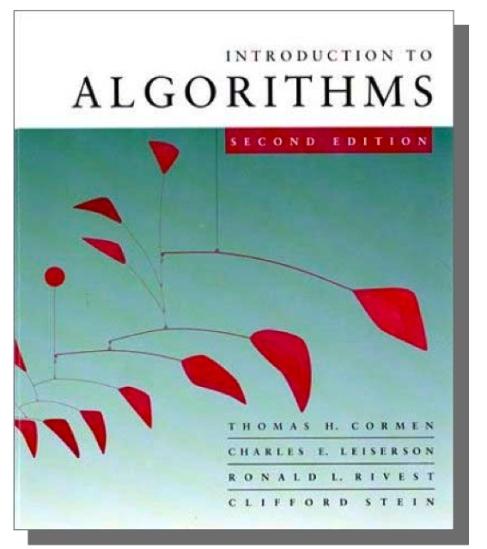
Advanced Algorithms
Greedy algorithm
  Job-select problem
  Greedy vs DP

Slide 2
Learning outcomes
Able to write greedy algorithms for the problems discussed in the class
able to analyse the complexity of the algorithms

Slide 3
Greedy Approach
Also for optimization problem
Best choice at any moment
It makes a locally optimal choice in hopes of achieving a globally optimal solution.
Do not always yield optimal solutions, but for many problems they do
Examples: Activity selection problem, Fractional knapsack problem, Huffman coding, mst, SS shortest path.

Slide 4
Change-Making Problem
Given an amount A and set of denominations
d₁, d₂, …, d_{n} find a minimum number of coins.
E.g A=18, d1=1, d2=5 d3=10
require 1 coin of 10, 1 coin of 5, and 3 coins of 1.
This is optimal.
Now let A=12 and d1=1, d2=6, d3=10
Using the same approach, it requires
1 coin of 10 and 2 coins of 1. This is not optimal.

Slide 5
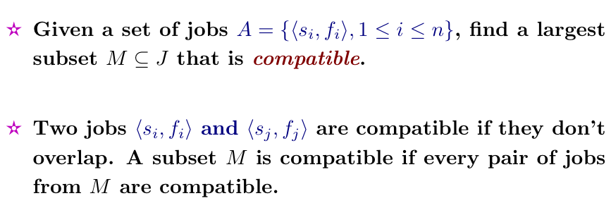
Activity-selection Problem

Slide 6
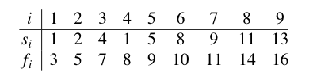
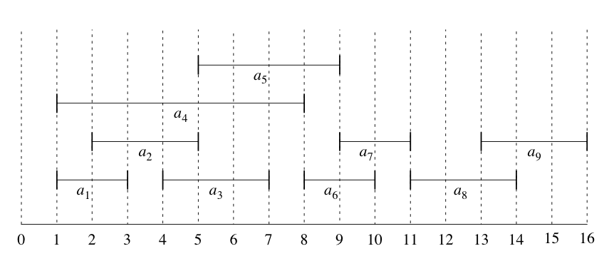
Example:
A :

Slide 7
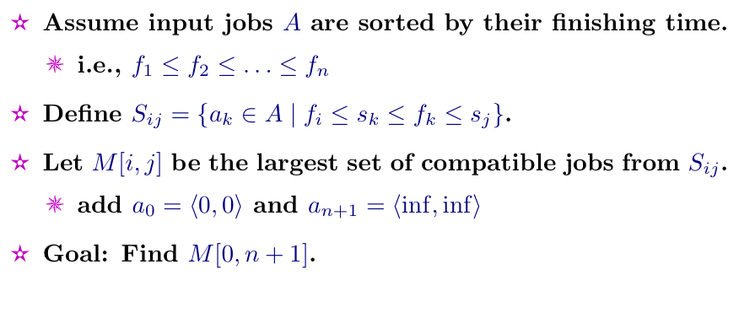
Define the Problem

Slide 8
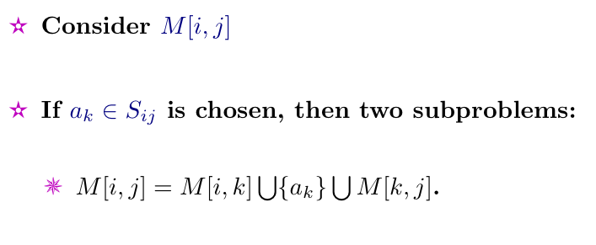
Optimal Substructure Property

Slide 9
DP Approach
Can continue with DP algorithm
Time complexity:
  Build 2D DP table
  O (n^3)
But can do better!

Slide 10
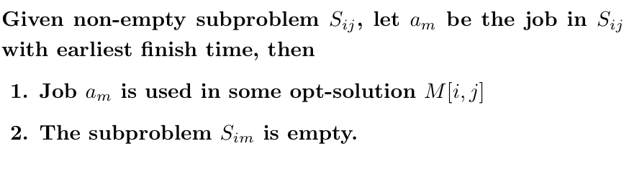
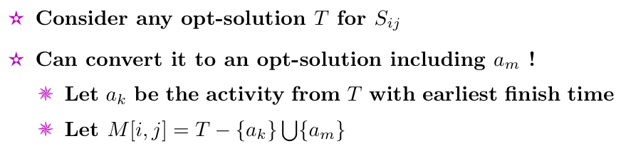
Theorem
Proof for (1):

Slide 11


Use of Theorem
DP:
Greedy:
Before theorem
After
theorem
#choices
to make
j - i -1
1
#subproblem
for each choice
2
1

Slide 12
Top-down Greedy Algorithm
Goal: to compute max activity
Pseudo-code
  Rec-Job-Select( s,f, i, n )
  m = i + 1
  while (m ≤ n) and ( < )
  do m = m + 1
  if m ≤ n
  return { } ∪ Rec-Job-Select(s, f, m, n)
  else return Φ
s
f
m
i
a
m

Slide 13
Example

Slide 14
Remarks
Top-down rather than bottom-up
  Inductively
Time complexity
  Sorting time + O (n)
Opt-solution not unique
  But one can be found using greedy approach

Slide 15
Elements of Greedy Strategy
For previous example
  We first follow DP
  Then show that instead we can make a greedy choice
In general
  Cast opt-problem as one in which we make one choice and are left with one subproblem to solve
  Prove greedy step + opt-sub-problem will lead to one opt-solution
Greedy-choice property
Optimal substructure property

Slide 16
Remarks
Greedy => DP
Top-down rather than bottom-up
Greedy algorithm developed does not necessarily lead to opt-solution

Slide 17
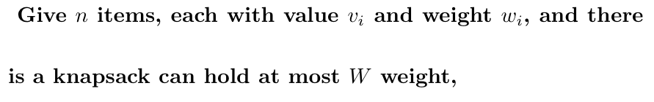
Knapsack Problem
0-1 knapsack problem:
  How to fill the knapsack with best total value w/o breaking each item
Fractional knapsack problem:
  How to fill the knapsack with best total value

Slide 18
Solution
DP for 0-1 knapsack
Greedy for fractional knapsack
  Compute value per pound (VPP) for each item
  Take as much as possible of the item with largest VPP
  Continue till reach weight limit

Slide 19
Example
30
20
--
30
Knapsack: hole weight 50
20
10
20
$60
$100
$120
10
VPP:
6
5
4

Slide 20
Greedy Fails for 0-1 Knapsack
30
30
30
20
10
20
20
$60
$100
$120
10
10
VPP:
6
5
4
$160
$180
$220

Slide 21
Summary
Greedy algorithm:
  Job-select problem
  Follow the thinking of DP
  Or directly construct
More examples in the course later

