Slide 1
Greedy Algorithms
Analysis of Algorithms

Slide 2
Greedy Algorithms
A greedy algorithm always makes the choice that looks best at the moment
  Everyday examples:
    Walking to the school
    Playing a bridge hand
  The hope: a locally optimal choice will lead to a globally optimal solution
  For some problems, it works
Dynamic programming can be overkill; greedy algorithms tend to be easier to code
Analysis of Algorithms

Slide 3
Activity-Selection Problem
Problem: get your money’s worth out of a carnival
  Buy a wristband that lets you onto any ride
  Lots of rides, each starting and ending at different times
  Your goal: ride as many rides as possible
    Another, alternative goal that we don’t solve here: maximize time spent on rides
This is an activity selection problem
Analysis of Algorithms

Slide 4
Activity-Selection Problem
Input: a set S ={1, 2, …, n} of n activities
  si = Start time of activity i,
  fi = Finish time of activity i
  Activity i takes place in [s_{i}, f_{i} )
Aim: Find max-size subset A of mutually compatible activities
  Max number of activities, not max time spent in activities
  Activities i and j are compatible if intervals [s_{i}, f_{i} ) and [s_{j}, f_{j} ) do not overlap, i.e., either s_{i} ≥ f_{j} or s_{j} ≥ f_{i}
Analysis of Algorithms

Slide 5
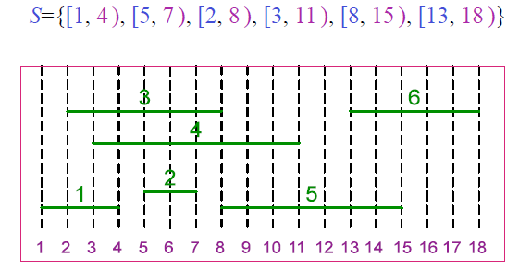
Activity-Selection Problem - Example
Analysis of Algorithms

Slide 6
Activity Selection: Optimal Substructure
Theorem: Let k be the activity with the earliest finish time in an optimal solution A ⊆ S then A-{k} is an optimal solution to sub-problem S_{k}´ = {i∈S: s_{i} ≥ f_{k} }
  In words: once activity #1 is selected, the problem reduces to finding an optimal solution for activity-selection over activities in S compatible with #1
Proof (by contradiction):
Let B´ be an optimal solution to S_{k}´ and
|B´| > | A-{k}| = |A| - 1
Then, B = B´ ∪ {k} is compatible and
|B| = |B´|+1 > |A|
Contradiction to the optimality of A Q.E.D.
Analysis of Algorithms

Slide 7
Activity Selection: Repeated Subproblems
Consider a recursive algorithm that tries all possible compatible subsets to find a maximal set, and notice repeated subproblems:
S
1∈A?
yes
no
S’
2∈A?
S-{1}
2∈A?
yes
no
yes
no
S’’
S’-{2}
S’’
S-{1,2}
Analysis of Algorithms

Slide 8
Greedy Choice Property
Repeated sub-problems and optimal substructure properties hold in activity selection problem
Greed choice property:
a sequence of locally optimal (greedy) choices
⇒ an optimal solution
Some problems (such as activity selection) has greedy choice property, we can use a greedy algorithm for those problems.
  We may use dynamic programming (or memoize) approch for them too, but it will be cumbersome.
If a problem does not have greedy choice property, we may not use a greedy algorithm for that problem, but we can still use a dynamic programming approach.
Assume (without loss of generality) f₁ ≤ f₂ ≤ … ≤ f_{n}
– If not sort activities according to their finish times in nondecreasing order
Analysis of Algorithms

Slide 9
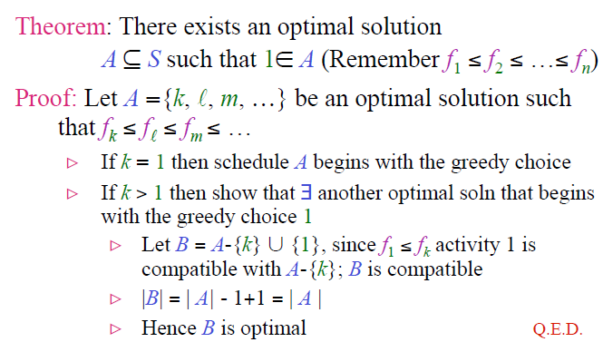
Greedy Choice Property in Activity Selection
Analysis of Algorithms

Slide 10
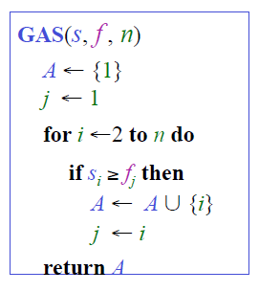

Activity Selection: A Greedy Algorithm
So actual algorithm is simple:
  Sort the activities by finish time
  Schedule the first activity
  Then schedule the next activity in sorted list which starts after previous activity finishes
  Repeat until no more activities
Intuition is even more simple:
  Always pick the shortest ride available at the time
Analysis of Algorithms

Slide 11
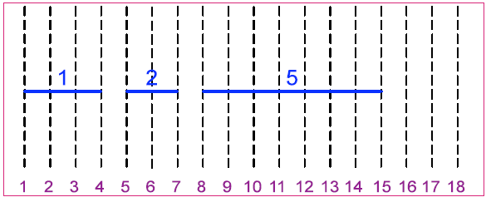
Activity Selection Problem: An Example
S={[1, 4 ), [5, 7 ), [2, 8 ), [3, 11 ), [8, 15 ), [13, 18 )}
  ➔ A={1, 2, 5}
Analysis of Algorithms

Slide 12
Greedy vs Dynamic Programming
Optimal substructure property exploited by both Greedy and DP strategies
Greedy Choice Property: A sequence of locally optimal choices ⇒ an optimal solution
  – We make the choice that seems best at the moment
  – Then solve the subproblem arising after the choice is made
DP: We also make a choice/decision at each step, but the choice may depend on the optimal solutions to subproblems
Greedy: The choice may depend on the choices made so far, but it cannot depend on any future choices or on the solutions to subproblems
DP is a bottom-up strategy
Greedy is a top-down strategy
  each greedy choice in the sequence iteratively reduces each problem to a similar but smaller problem
Analysis of Algorithms

Slide 13
Proof of Correctness of Greedy Algorithms
Examine a globally optimal solution
Show that this solution can be modified so that
  1) A greedy choice is made as the first step
  2) This choice reduces the problem to a similar but smaller problem
Apply induction to show that a greedy choice can be used at every step
Showing (2) reduces the proof of correctness to proving that the problem exhibits optimal substructure property
Analysis of Algorithms

Slide 14
Elements of Greedy Strategy
How can you judge whether a greedy algorithm will solve a particular optimization problem?
Two key ingredients
– Greedy choice property
– Optimal substructure property
Greedy Choice Property: A globally optimal solution can be arrived at by making locally optimal (greedy) choices
In DP,we make a choice at each step but the choice may depend on the solutions to subproblems
In Greedy Algorithms, we make the choice that seems best at that moment then solve the subproblems arising after the choice is made
  – The choice may depend on choices so far, but it cannot depend on any future choice or on the solutions to subproblems
DP solves the problem bottom-up
Greedy usually progresses in a top-down fashion by making one greedy choice after another reducing each given problem instance to a smaller one
Analysis of Algorithms

Slide 15
Key Ingredients: Greedy Choice Property
We must prove that a greedy choice at each step yields a globally optimal solution
The proof examines a globally optimal solution
Shows that the soln can be modified so that a greedy choice made as the first step reduces the problem to a similar but smaller subproblem
Then induction is applied to show that a greedy choice can be used at each step
Hence, this induction proof reduces the proof of correctness to demonstrating that an optimal solution must exhibit optimal substructure property
Analysis of Algorithms

Slide 16
Key Ingredients: Optimal Substructure
A problem exhibits optimal substructure if an optimal solution to the problem contains within it optimal solutions to subproblems
Example: Activity selection problem S
If an optimal solution A to S begins with activity 1 then the set of activities
A´ = A-{1}
is an optimal solution to the activity selection problem
S´ = {i∈S: s_{i} ≥ f₁ }
Analysis of Algorithms

Slide 17
Key Ingredients: Optimal Substructure
Optimal substructure property is exploited by both greedy and dynamic programming strategies
Hence one may
  – Try to generate a dynamic programming solution to a problem when a greedy strategy suffices
  – Or, may mistakenly think that a greedy solution works when in fact a DP solution is required
Example: Knapsack Problems(S, w)
Analysis of Algorithms

Slide 18
Knapsack Problems
The 0-1 Knapsack Problem(S, W)
– A thief robbing a store finds n items S ={I₁, I₂, …, I_{n}}, the i^{th} item is worth v_{i} dollars and weighs w_{i} pounds, where v_{i} and w_{i} are integers
– He wants to take as valuable a load as possible, but he can carry at most W pounds in his knapsack, where W is an integer
– The thief cannot take a fractional amount of an item
The Fractional Knapsack Problem (S, W)
– The scenario is the same
– But, the thief can take fractions of items rather than having to make binary (0-1) choice for each item
Analysis of Algorithms

Slide 19
0-1 and Fractional Knapsack Problems
Both knapsack problems exhibit the optimal substructure property
The 0-1Knapsack Problem(S, W)
– Consider a most valuable load L where W_{L}≤W
– If we remove item j from this optimal load L
The remaining load
L_{j}´ = L -{I_{j}}
must be a most valuable load weighing at most
W_{j}´ = W - w_{j}
pounds that the thief can take from
S_{j}´ = S -{I_{j}}
– That is, L_{j}´ should be an optimal solution to the
0-1 Knapsack Problem(S_{j}´, W_{j}´)
Analysis of Algorithms

Slide 20
0-1 and Fractional Knapsack Problems
The Fractional Knapsack Problem(S, W)
– Consider a most valuable load L where W_{L} ≤ W
– If we remove a weight 0< w ≤ w_{j} of item j from optimal load L
The remaining load
L_{j}´ = L -{w pounds of I_{j}}
must be a most valuable load weighing at most
W_{j}´ = W - w
pounds that the thief can take from
S_{j}´ = S -{I_{j}}∪{w_{j} - w pounds of I_{j}}
– That is, L_{j}´ should be an optimal solution to the
Fractional Knapsack Problem(S_{j}´, W_{j}´)
Analysis of Algorithms

Slide 21
Knapsack Problems
Although the problems are similar, and both knapsack problems exhibit the optimal substructure property
The Fractional Knapsack Problem is solvable by Greedy strategy
  The Fractional Knapsack Problem has a greedy search property.
Whereas, the 0-1 Knapsack Problem is NOT solvable by Greedy strategy
  The 0-1 Knapsack Problem does not have a greedy search property.
Analysis of Algorithms

Slide 22
Greedy Solution to Fractional Knapsack
1) Compute the value per pound vi /wi for each item
2) The thief begins by taking, as much as possible, of the item with the greatest value per pound
3) If the supply of that item is exhausted before filling the knapsack he takes, as much as possible, of the item with the next greatest value per pound
4) Repeat (2-3) until his knapsack becomes full
• Thus, by sorting the items by value per pound the greedy algorithm runs in O(n lg n) time
Analysis of Algorithms

Slide 23
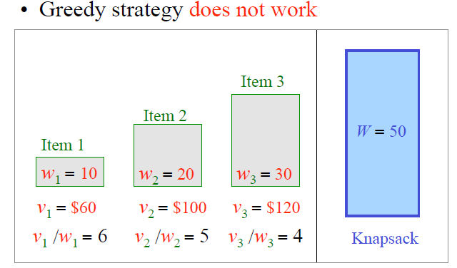
0-1 Knapsack Problem
Analysis of Algorithms

Slide 24
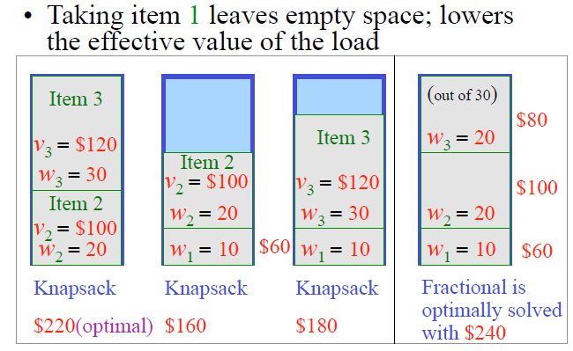
0-1 Knapsack Problem
Analysis of Algorithms

Slide 25
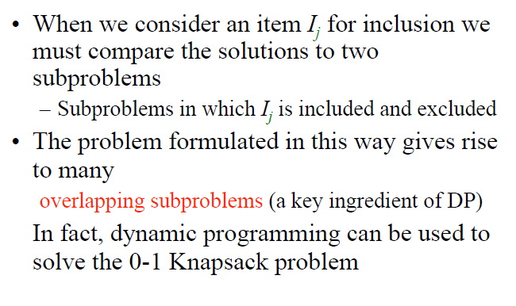
0-1 Knapsack Problem
Analysis of Algorithms

Slide 26
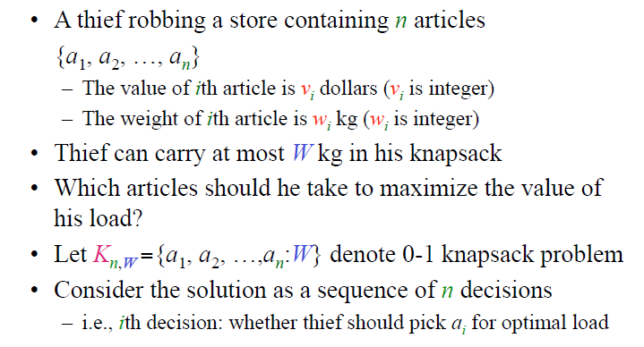
0-1 Knapsack Problem
Analysis of Algorithms

Slide 27
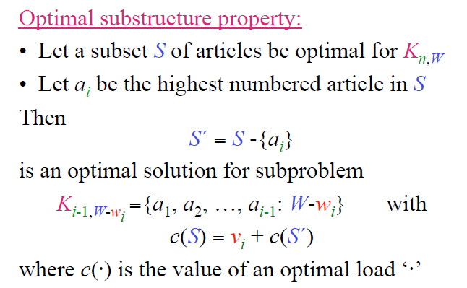
0-1 Knapsack Problem
Analysis of Algorithms

Slide 28
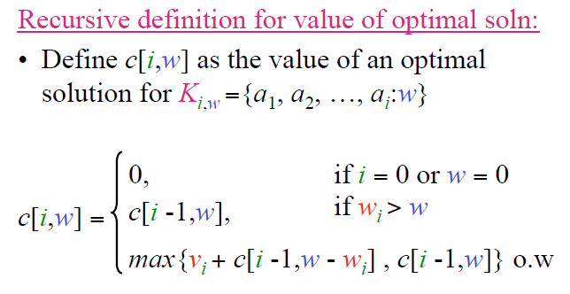
0-1 Knapsack Problem
Analysis of Algorithms

Slide 29
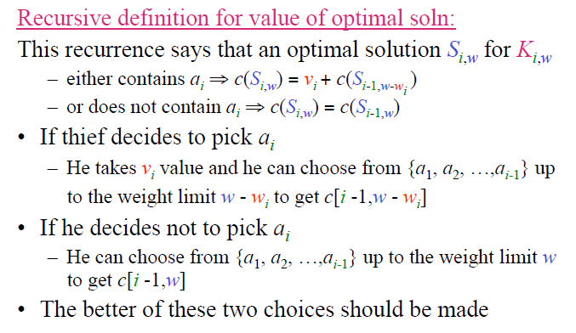
0-1 Knapsack Problem
Analysis of Algorithms

Slide 30
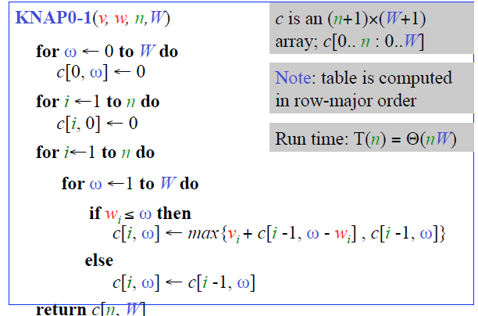
DP Solution to 0-1 Knapsack Problem
Analysis of Algorithms

Slide 31
Finding the Set S of Articles in an Optimal Load
SOLKNAP0-1(a, v, w, n,W,c)
i ← n ; ω ← W
S ← ∅
while i > 0 do
if c[i, ω] = c[i -1, ω] then
i ← i -1
else
S ← S ∪ {a_{i}}
ω ← ω - w_{i}
i ← i -1
return S
Analysis of Algorithms

