Slide 1
Design and Analysis of Algorithms
Greedy Algorithms

Slide 2
Review: Dynamic Programming
Summary of the basic idea:
  Optimal substructure: optimal solution to problem consists of optimal solutions to subproblems
  Overlapping subproblems: few subproblems in total, many recurring instances of each
  Solve bottom-up, building a table of solved subproblems that are used to solve larger ones
Variations:
  “Table” could be 3-dimensional, triangular, a tree, etc.

Slide 3
Greedy Algorithm - Overview
Like dynamic programming, used to solve optimization problems.
Problems exhibit optimal substructure (like DP).
Problems also exhibit the greedy-choice property.
  When we have a choice to make, make the one that looks best right now.
  Make a locally optimal choice in hope of getting a globally optimal solution.

Slide 4
Greedy Algorithms
A greedy algorithm always makes the choice that looks best at the moment
  My everyday examples:
    Walking to the Corner
    Playing a bridge hand
    Invest on stocks
    Choose a university
  The hope: a locally optimal choice will lead to a globally optimal solution
  For some problems, it works

Slide 5
It works best when applied to problems with the greedy-choice property:
  a globally-optimal solution can always be found by a series of local improvements from a starting configuration.
Dynamic programming can be overkill; greedy algorithms tend to be easier to code.

Slide 6

Making Change
Problem: Accept n dollars, to return a collection of coins with a total value of n dollars.
Configuration: A collection of coins with a total value of n
Objective function: Minimize number of coins returned.
Greedy solution: Always return the largest coin you can
Example 1: Coins are valued $.32, $.08, $.01
  Has the greedy-choice property, since no amount over $.32 can be made with a minimum number of coins by omitting a $.32 coin (similarly for amounts over $.08, but under $.32).
  For a certain amount (y) over a coin dimension (x), if we can reach it using coins (<x) with a total n coins, then we can also use coin x with ≤ n coins.
Example 2: Coins are valued $.30, $.20, $.05, $.01
  Does not have greedy-choice property, since $.40 is best made with two $.20’s, but the greedy solution will pick three coins (which ones?)

Slide 7
Activity-Selection Problem
Problem: get your money’s worth out of a carnival
  Buy a wristband that lets you onto any ride
  Lots of rides, each starting and ending at different times
  Your goal: ride as many rides as possible
    Another, alternative goal that we don’t solve here: maximize time spent on rides
Welcome to the activity selection problem

Slide 8
Activity-Selection
Formally:
  Given a set S of n activities
  s_{i} = start time of activity i
  f_{i} = finish time of activity i
  Find max-size subset A of compatible activities
3
4
6
2
1
5
  Assume (wlog) that f₁ ≤ f₂ ≤ … ≤ f_{n}

Slide 9
Activity Selection:
Optimal Substructure
Let k be the minimum activity in A (i.e., the one with the earliest finish time). Then A - {k} is an optimal solution to S’ = {i ∈ S: s_{i} ≥ f_{k}}
  In words: once activity #1 is selected, the problem reduces to finding an optimal solution for activity-selection over activities in S compatible with #1
  Proof: if we could find optimal solution B’ to S’ with |B| > |A - {k}|,
    Then B U {k} is compatible
    And |B U {k}| > |A|

Slide 10
Activity Selection:
A Greedy Algorithm
So actual algorithm is simple:
  Sort the activities by finish time
  Schedule the first activity
  Then schedule the next activity in sorted list which starts after previous activity finishes
  Repeat until no more activities
Intuition is even more simple:
  Always pick the shortest ride available at the time

Slide 11
An Activity Selection Problem
(Conference Scheduling Problem)
Input: A set of activities S = {a₁,…, a_{n}}
Each activity has start time and a finish time
  a_{i}=(s_{i}, f_{i})
Two activities are compatible if and only if their interval does not overlap
Output: a maximum-size subset of mutually compatible activities

Slide 12
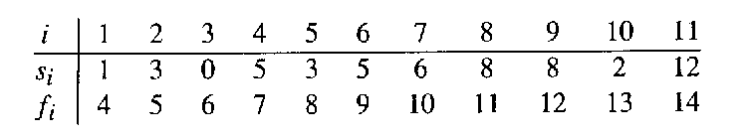
The Activity Selection Problem
Here are a set of start and finish times
What is the maximum number of activities that can be completed?
  {a₃, a₉, a₁₁} can be completed
  But so can {a₁, a₄, a_{8’} a₁₁} which is a larger set
  But it is not unique, consider {a₂, a₄, a_{9’} a₁₁}

Slide 13
Interval Representation

Slide 14
0 1 2 3 4 5 6 7 8 9 10 11 12 13 14 15

Slide 15
0 1 2 3 4 5 6 7 8 9 10 11 12 13 14 15

Slide 16
0 1 2 3 4 5 6 7 8 9 10 11 12 13 14 15

Slide 17
0 1 2 3 4 5 6 7 8 9 10 11 12 13 14 15

Slide 18
Early Finish Greedy
Select the activity with the earliest finish
Eliminate the activities that could not be scheduled
Repeat!

Slide 19
0 1 2 3 4 5 6 7 8 9 10 11 12 13 14 15

Slide 20
0 1 2 3 4 5 6 7 8 9 10 11 12 13 14 15

Slide 21
0 1 2 3 4 5 6 7 8 9 10 11 12 13 14 15

Slide 22
0 1 2 3 4 5 6 7 8 9 10 11 12 13 14 15

Slide 23
0 1 2 3 4 5 6 7 8 9 10 11 12 13 14 15

Slide 24
0 1 2 3 4 5 6 7 8 9 10 11 12 13 14 15

Slide 25
0 1 2 3 4 5 6 7 8 9 10 11 12 13 14 15

Slide 26
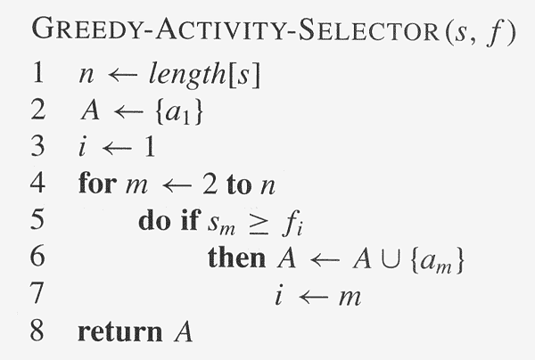
Assuming activities are sorted by finish time

Slide 27
Why it is Greedy?
Greedy in the sense that it leaves as much opportunity as possible for the remaining activities to be scheduled
The greedy choice is the one that maximizes the amount of unscheduled time remaining

Slide 28
Why this Algorithm is Optimal?
This algorithm uses the following properties
  The problem has the optimal substructure property
  The algorithm satisfies the greedy-choice property
Thus, it is Optimal

Slide 29
Greedy-Choice Property
Show there is an optimal solution that begins with a greedy choice (with activity 1, which as the earliest finish time)
Suppose A ⊆ S in an optimal solution
  Order the activities in A by finish time. The first activity in A is k
    If k = 1, the schedule A begins with a greedy choice
    If k ≠ 1, show that there is an optimal solution B to S that begins with the greedy choice, activity 1
  Let B = A – {k} ∪ {1}
    f₁ ≤ f_{k} → activities in B are disjoint (compatible)
    B has the same number of activities as A
    Thus, B is optimal

Slide 30
Optimal Substructures
  Once the greedy choice of activity 1 is made, the problem reduces to finding an optimal solution for the activity-selection problem over those activities in S that are compatible with activity 1
    Optimal Substructure
    If A is optimal to S, then A’ = A – {1} is optimal to S’={i ∈S: s_{i} ≥ f₁}
    Why?
      If we could find a solution B’ to S’ with more activities than A’, adding activity 1 to B’ would yield a solution B to S with more activities than A ➔ contradicting the optimality of A
  After each greedy choice is made, we are left with an optimization problem of the same form as the original problem
    By induction on the number of choices made, making the greedy choice at every step produces an optimal solution

Slide 31
Elements of Greedy Strategy
An greedy algorithm makes a sequence of choices, each of the choices that seems best at the moment is chosen
  NOT always produce an optimal solution
Two ingredients that are exhibited by most problems that lend themselves to a greedy strategy
  Greedy-choice property
  Optimal substructure

Slide 32
Greedy-Choice Property
A globally optimal solution can be arrived at by making a locally optimal (greedy) choice
  Make whatever choice seems best at the moment and then solve the sub-problem arising after the choice is made
  The choice made by a greedy algorithm may depend on choices so far, but it cannot depend on any future choices or on the solutions to sub-problems
Of course, we must prove that a greedy choice at each step yields a globally optimal solution

Slide 33
Optimal Substructures
A problem exhibits optimal substructure if an optimal solution to the problem contains within it optimal solutions to sub-problems
  If an optimal solution A to S begins with activity 1, then A’ = A – {1} is optimal to S’={i ∈S: s_{i} ≥ f₁}

Slide 34
Review:
The Knapsack Problem
The famous knapsack problem:
  A thief breaks into a museum. Fabulous paintings, sculptures, and jewels are everywhere. The thief has a good eye for the value of these objects, and knows that each will fetch hundreds or thousands of dollars on the clandestine art collector’s market. But, the thief has only brought a single knapsack to the scene of the robbery, and can take away only what he can carry. What items should the thief take to maximize the haul?

Slide 35
Review: The Knapsack Problem
More formally, the 0-1 knapsack problem:
  The thief must choose among n items, where the ith item worth v_{i} dollars and weighs w_{i} pounds
  Carrying at most W pounds, maximize value
    Note: assume v_{i}, w_{i}, and W are all integers
    “0-1” b/c each item must be taken or left in entirety
A variation, the fractional knapsack problem:
  Thief can take fractions of items
  Think of items in 0-1 problem as gold ingots, in fractional problem as buckets of gold dust

Slide 36
Review: The Knapsack Problem
And Optimal Substructure
Both variations exhibit optimal substructure
To show this for the 0-1 problem, consider the most valuable load weighing at most W pounds
  If we remove item j from the load, what do we know about the remaining load?
  A: remainder must be the most valuable load weighing at most W - w_{j} that thief could take from museum, excluding item j

Slide 37
Solving The Knapsack Problem
The optimal solution to the fractional knapsack problem can be found with a greedy algorithm
  How?
The optimal solution to the 0-1 problem cannot be found with the same greedy strategy
  Greedy strategy: take in order of dollars/pound
  Example: 3 items weighing 10, 20, and 30 pounds, knapsack can hold 50 pounds
    Suppose item 2 is worth $100. Assign values to the other items so that the greedy strategy will fail

Slide 38
The Knapsack Problem:
Greedy Vs. Dynamic
The fractional problem can be solved greedily
The 0-1 problem cannot be solved with a greedy approach
  As you have seen, however, it can be solved with dynamic programming

Slide 39
Knapsack Problem
One wants to pack n items in a luggage
  The ith item is worth v_{i} dollars and weighs w_{i} pounds
  Maximize the value but cannot exceed W pounds
  v_{i} , w_{i}, W are integers
0-1 knapsack → each item is taken or not taken
Fractional knapsack → fractions of items can be taken
Both exhibit the optimal-substructure property
  0-1: If item j is removed from an optimal packing, the remaining packing is an optimal packing with weight at most W-w_{j}
  Fractional: If w pounds of item j is removed from an optimal packing, the remaining packing is an optimal packing with weight at most W-w that can be taken from other n-1 items plus w_{j} – w of item j

Slide 40
Greedy Algorithm for Fractional Knapsack problem
Fractional knapsack can be solvable by the greedy strategy
  Compute the value per pound v_{i}/w_{i} for each item
  Obeying a greedy strategy, take as much as possible of the item with the greatest value per pound.
  If the supply of that item is exhausted and there is still more room, take as much as possible of the item with the next value per pound, and so forth until there is no more room
  O(n lg n) (we need to sort the items by value per pound)
  Greedy Algorithm?

Slide 41
O-1 knapsack is harder!
0-1 knapsack cannot be solved by the greedy strategy
  Unable to fill the knapsack to capacity, and the empty space lowers the effective value per pound of the packing
  We must compare the solution to the sub-problem in which the item is included with the solution to the sub-problem in which the item is excluded before we can make the choice
  Dynamic Programming

Slide 42
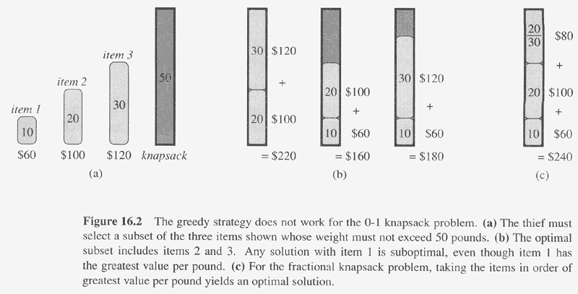

Slide 43

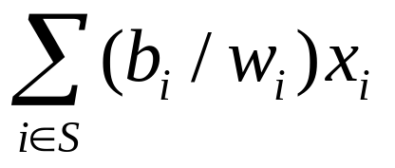
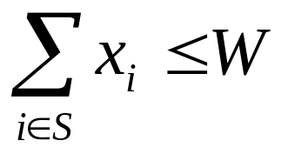
The Fractional Knapsack Problem
Given: A set S of n items, with each item i having
  b_{i} - a positive benefit
  w_{i} - a positive weight
Goal: Choose items with maximum total benefit but with weight at most W.
If we are allowed to take fractional amounts, then this is the fractional knapsack problem.
  In this case, we let x_{i} denote the amount we take of item i
  Objective: maximize
  Constraint:

Slide 44

Example
Given: A set S of n items, with each item i having
  b_{i} - a positive benefit
  w_{i} - a positive weight
Goal: Choose items with maximum total benefit but with weight at most W.
“knapsack”
Solution:
1 ml of 5
2 ml of 3
6 ml of 4
1 ml of 2
Items:
1
2
3
4
5
Weight:
4 ml
8 ml
2 ml
6 ml
1 ml
Benefit:
$12
$32
$40
$30
$50
10 ml
Value:
3
4
20
5
50
($ per ml)

Slide 45
The Fractional Knapsack Algorithm
Greedy choice: Keep taking item with highest value (benefit to weight ratio)
  Use a heap-based priority queue to store the items, then the time complexity is O(n log n).
Correctness: Suppose there is a better solution
  there is an item i with higher value than a chosen item j (i.e., v_{j}<v_{i}) , if we replace some j with i, we get a better solution
  Thus, there is no better solution than the greedy one
Algorithm fractionalKnapsack(S, W)
Input: set S of items w/ benefit b_{i} and weight w_{i}; max. weight W Output: amount x_{i} of each item i to maximize benefit with weight at most W
for each item i in S
  x_{i} ← 0
  v_{i} ← b_{i} / w_{i} {value}
  w ← 0 {current total weight}
  while w < W
  select item i with highest v_{i}
  x_{i} ← min{w_{i} , W − w}
  w ← w + min{w_{i} , W − w}

