Slide 1
Dynamic Programming
An algorithm design paradigm like divide-and-conquer
“Programming”: A tabular method (not writing computer code)
Divide-and-Conquer (DAC): subproblems are independent
Dynamic Programming (DP): subproblems are not independent
Overlapping subproblems: subproblems share sub-subproblems
In solving problems with overlapping subproblems
  • A DAC algorithm does redundant work
    – Repeatedly solves common subproblems
  • A DP algorithm solves each problem just once
    – Saves its result in a table
Analysis of Algorithms

Slide 2
Optimization Problems
• DP typically applied to optimization problems
• In an optimization problem
  – There are many possible solutions (feasible solutions)
  – Each solution has a value
  – Want to find an optimal solution to the problem
    • A solution with the optimal value (min or max value)
  – Wrong to say “the” optimal solution to the problem
    • There may be several solutions with the same optimal value
Analysis of Algorithms

Slide 3
Development of a DP Algorithm
Characterize the structure of an optimal solution
Recursively define the value of an optimal solution
Compute the value of an optimal solution in a bottom-up fashion
Construct an optimal solution from the information computed in Step 3
Analysis of Algorithms

Slide 4
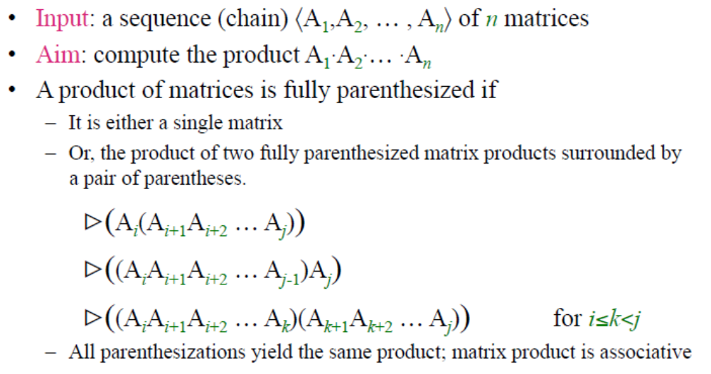
Example: Matrix-chain Multiplication
Analysis of Algorithms

Slide 5
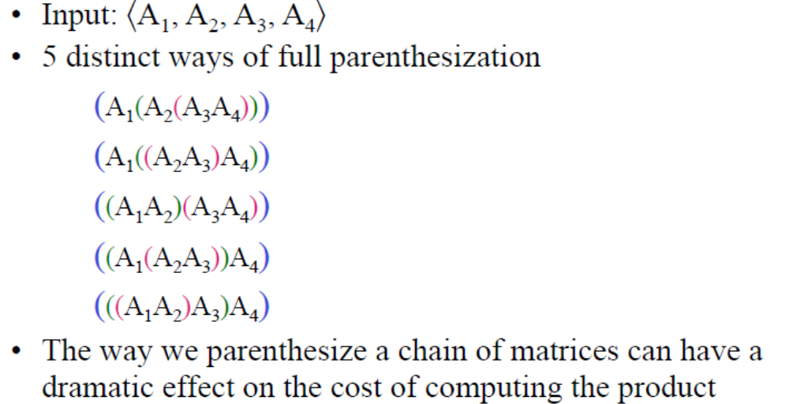
Matrix-chain Multiplication: An Example
Parenthesization
Analysis of Algorithms

Slide 6
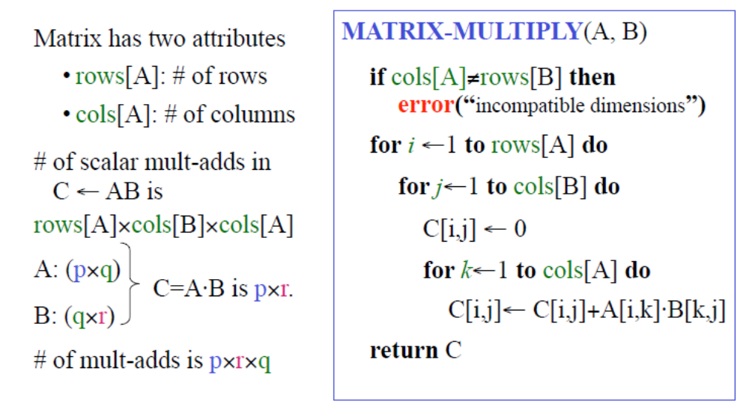
Cost of Multiplying two Matrices
Analysis of Algorithms

Slide 7
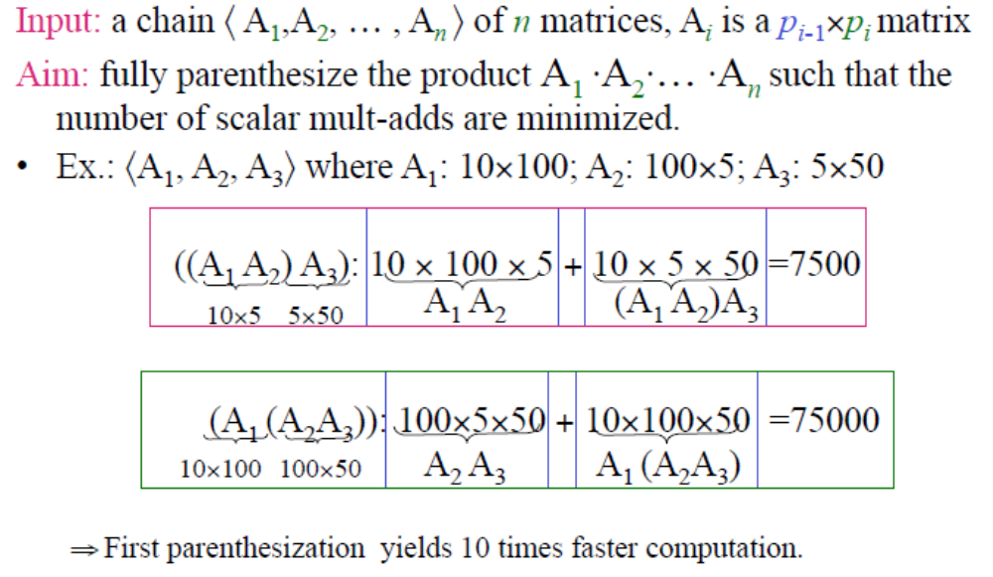
Matrix-chain Multiplication Problem
Analysis of Algorithms

Slide 8
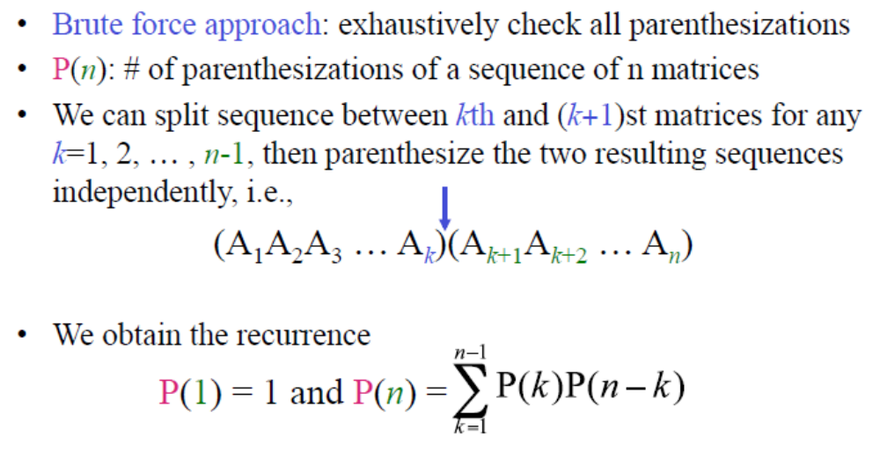
Counting the Number of Parenthesizations
Analysis of Algorithms

Slide 9

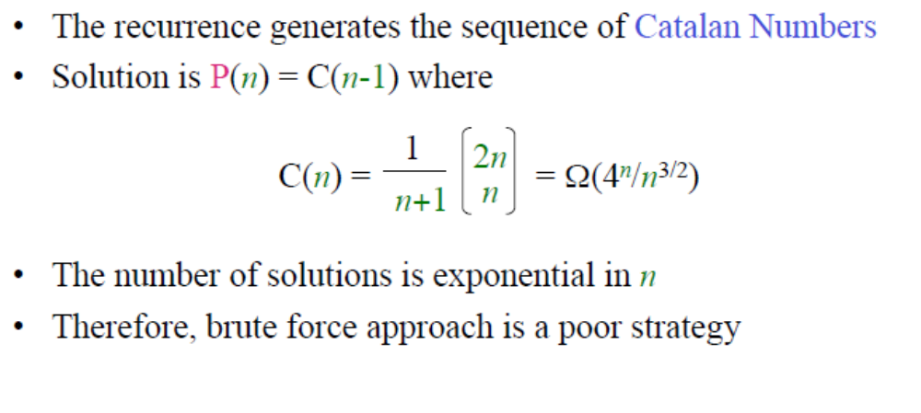
Number of Parenthesizations
Analysis of Algorithms

Slide 10
The Structure of an Optimal Parenthesization
Step 1: Characterize the structure of an optimal solution
A_{i..j} : matrix that results from evaluating the product A_{i} A_{i+1} A_{i+2} ... A_{j}
An optimal parenthesization of the product A₁A₂ ... A_{n}
  – Splits the product between A_{k} and A_{k+1}, for some 1≤k<n
(A₁A₂A₃ ... A_{k}) · (A_{k+1}A_{k+2} ... A_{n})
– i.e., first compute A_{1..k} and A_{k+1..n} and then multiply these two
The cost of this optimal parenthesization
Cost of computing A_{1..k}
+ Cost of computing A_{k+1..n}
+ Cost of multiplying A_{1..k} · A_{k+1..n}
Analysis of Algorithms

Slide 11
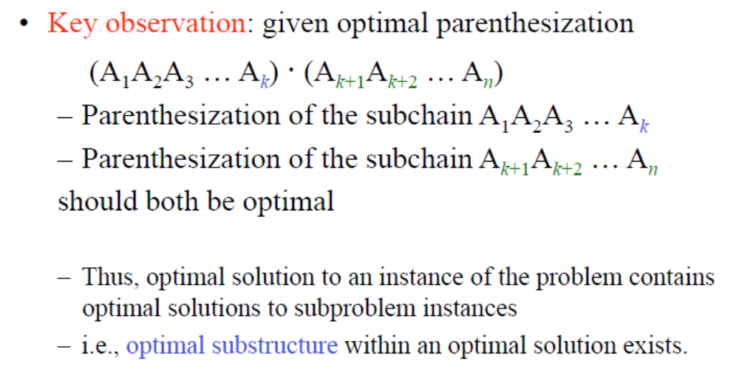
Step 1:
Characterize the Structure of an Optimal Solution
Analysis of Algorithms

Slide 12
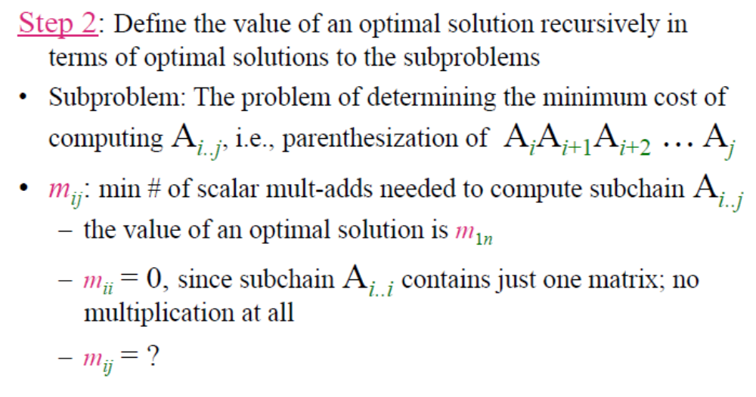
The Structure of an Optimal Parenthesization
Analysis of Algorithms

Slide 13
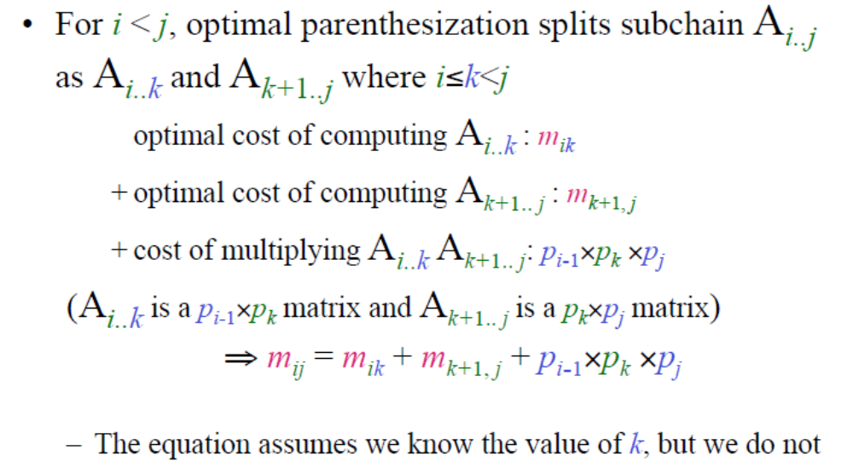
Step 2:
Define Value of an Optimal Sol. Recursively(m_{ij} =?)
Analysis of Algorithms

Slide 14
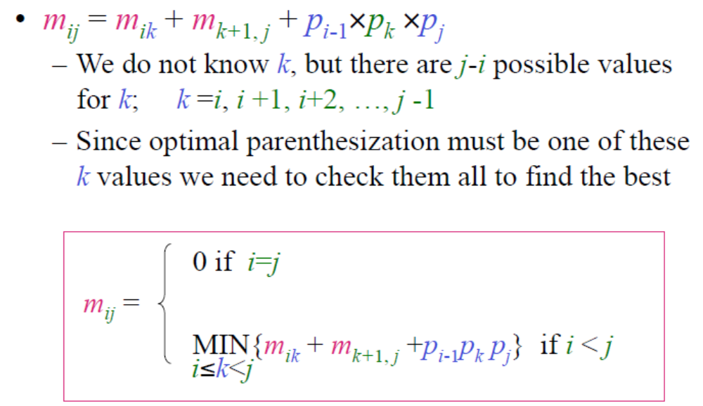
Step 2: Recursive Equation for m_{ij}
Analysis of Algorithms

Slide 15
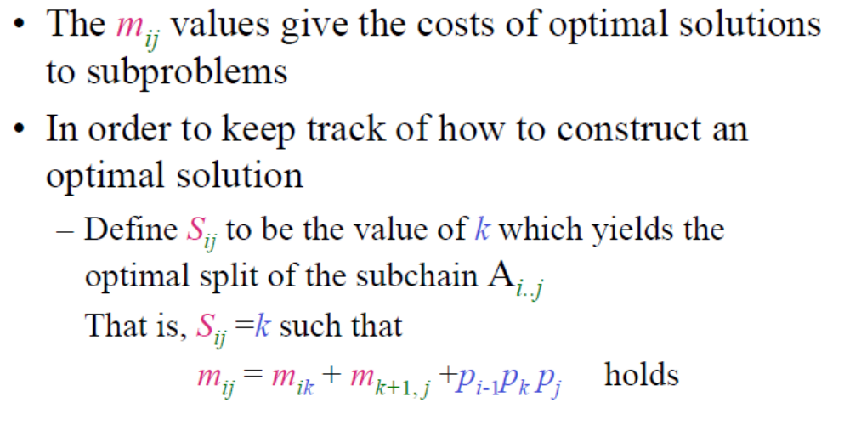
Step 2: mij = MIN{mik + mk+1, j +pi-1pk pj}
Analysis of Algorithms

Slide 16
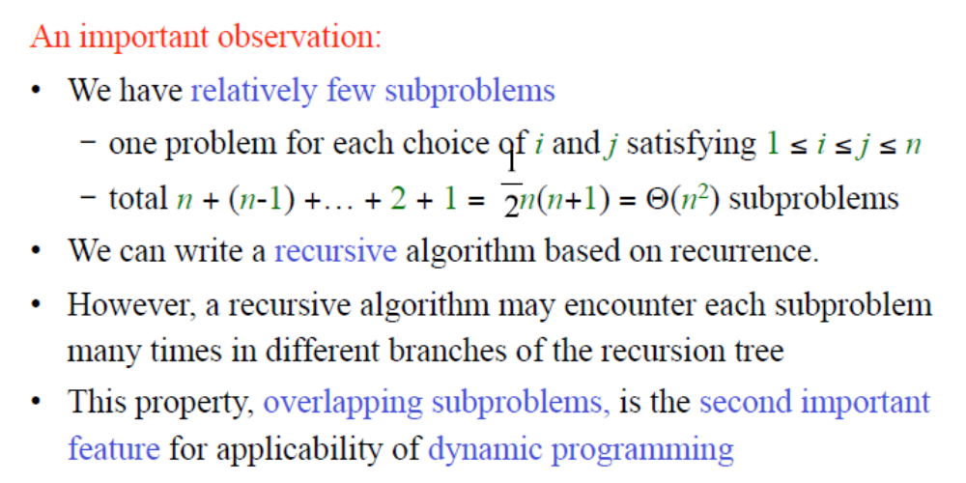
Computing the Optimal Cost
(Matrix-Chain Multiplication)
Analysis of Algorithms

Slide 17
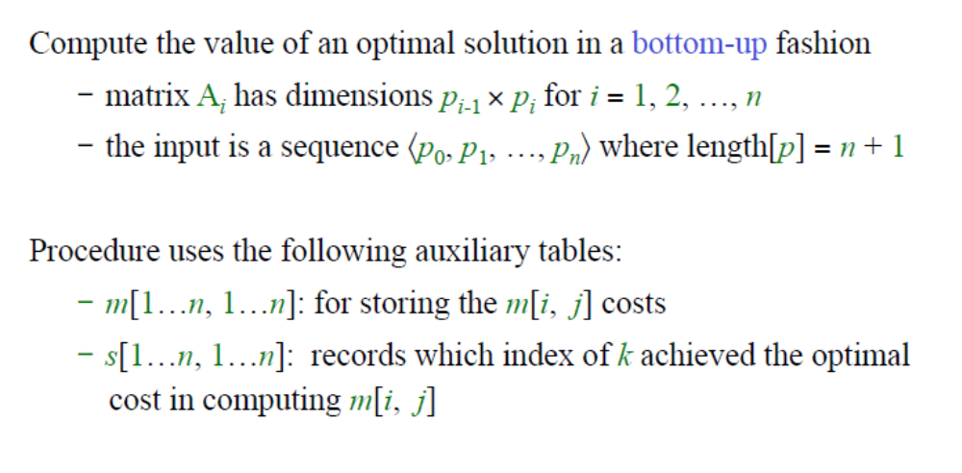
Computing the Optimal Cost
(Matrix-Chain Multiplication)
Analysis of Algorithms

Slide 18
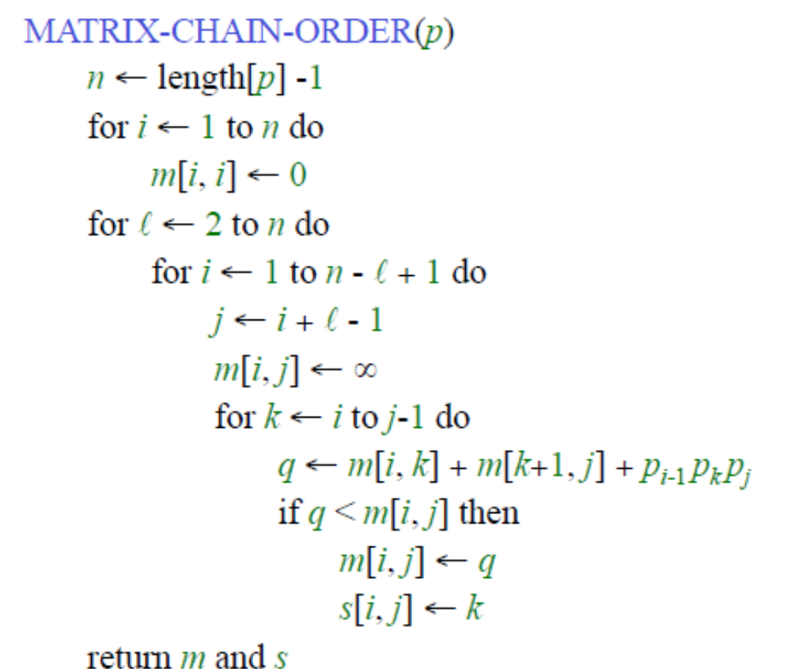
Algorithm for Computing the Optimal Costs
Analysis of Algorithms

Slide 19
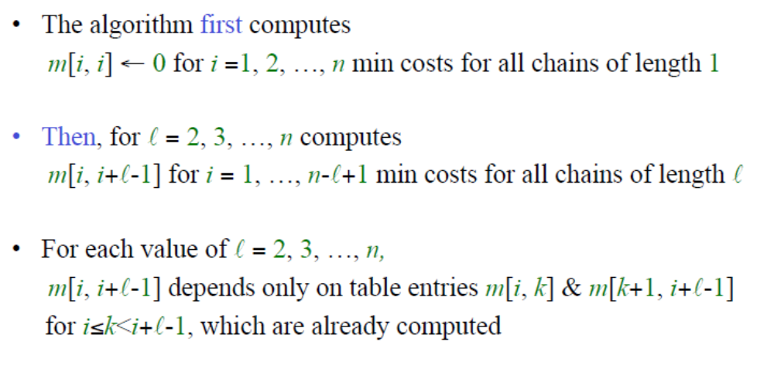
Algorithm for Computing the Optimal Costs
Analysis of Algorithms

Slide 20
Algorithm for Computing the Optimal Costs
l = 2
for i = 1 to n - 1
m[i, i+1] = ∝compute m[i, i+1]
for k = i to i do {m[1, 2], m[2, 3], …, m[n-1, n]}
.
. (n-1) values
l = 3
for i = 1 to n - 2
m[i, i+2] = ∝ compute m[i, i+2]
for k = i to i+1 do {m[1, 3], m[2, 4], …, m[n-2, n]}
.
. (n-2) values
l = 4
for i = 1 to n - 3
m[i, i+3] = ∝ compute m[i, i+3]
for k = i to i+2 do {m[1, 4], m[2, 5], …, m[n-3, n]}
.
. (n-3) values
Analysis of Algorithms

Slide 21
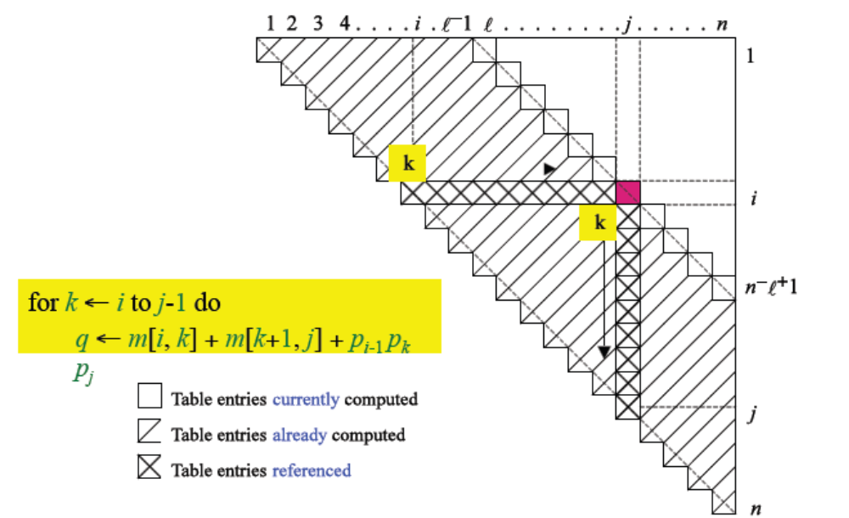
Analysis of Algorithms

Slide 22
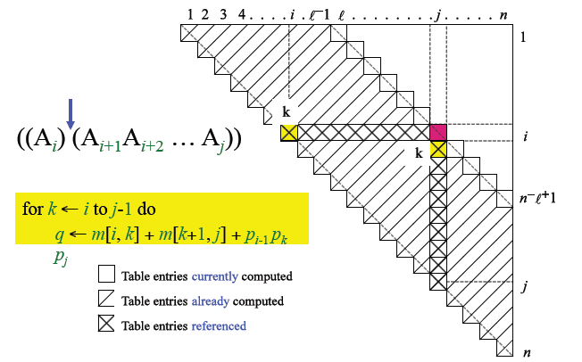
Analysis of Algorithms

Slide 23
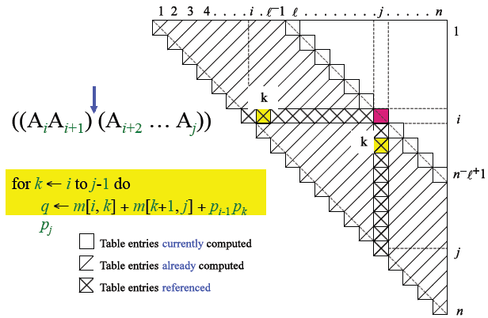
Analysis of Algorithms

Slide 24
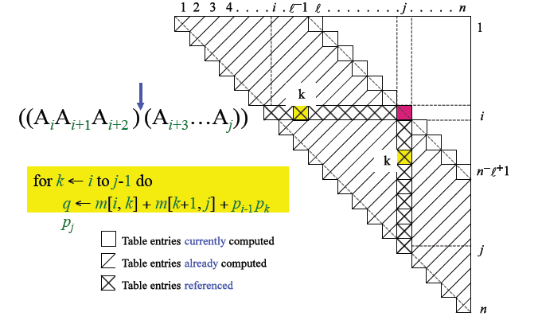
Analysis of Algorithms

Slide 25
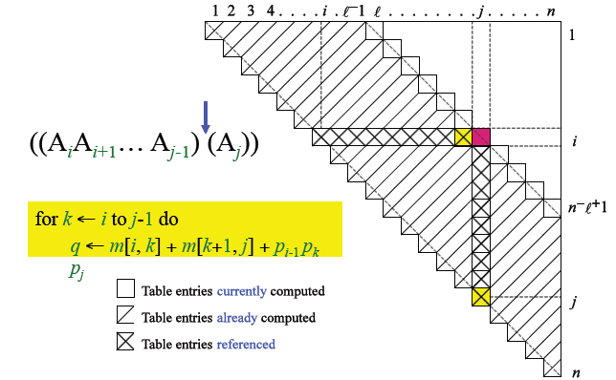
Analysis of Algorithms

Slide 26
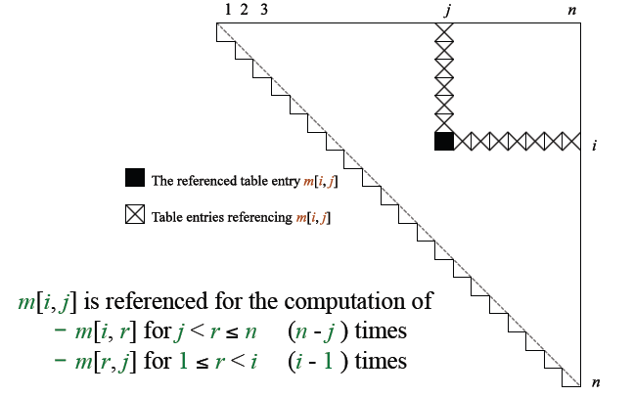
Analysis of Algorithms

Slide 27
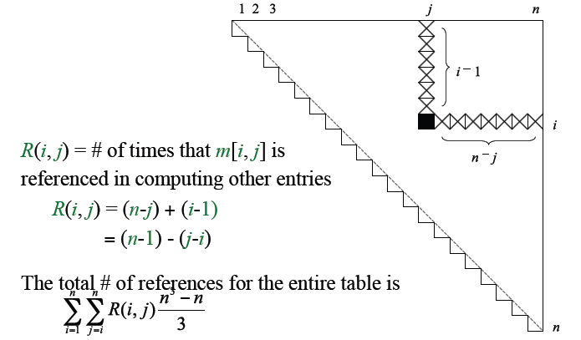
Analysis of Algorithms

Slide 28
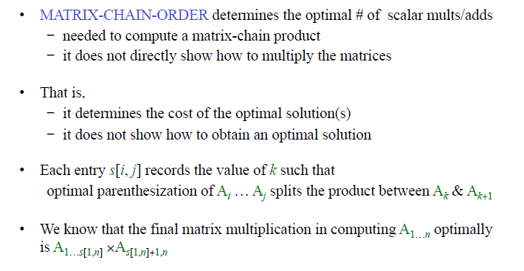
Constructing an Optimal Solution
Analysis of Algorithms

Slide 29
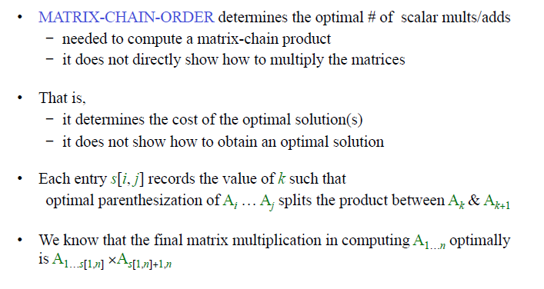
Constructing an Optimal Solution
Analysis of Algorithms

Slide 30
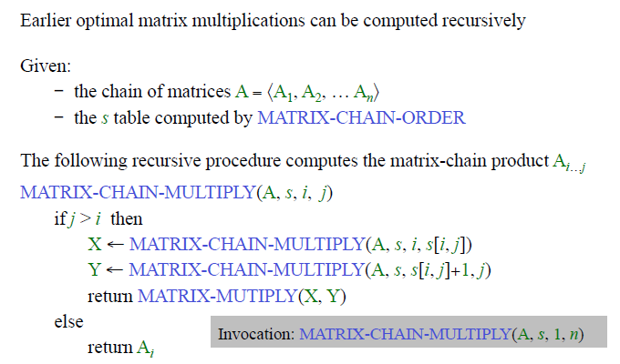
Constructing an Optimal Solution
Analysis of Algorithms

Slide 31
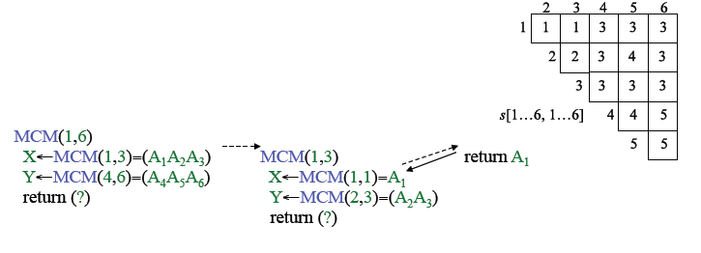
Example: Recursive Construction of an Optimal Solution
Analysis of Algorithms

Slide 32
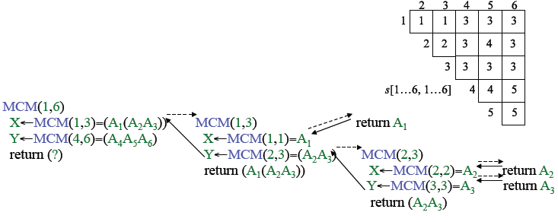
Example: Recursive Construction of an Optimal Solution
Analysis of Algorithms

Slide 33
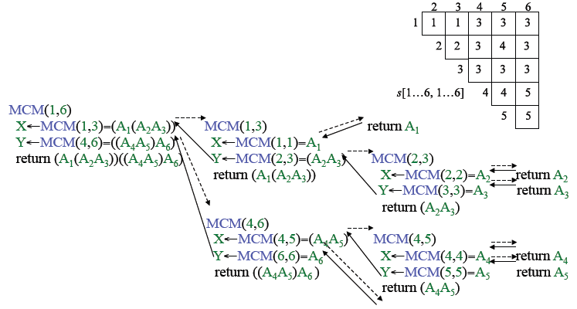
Example: Recursive Construction of an Optimal Solution
return A₆
Analysis of Algorithms

Slide 34
Elements of Dynamic Programming
When should we look for a DP solution to an optimization problem?
Two key ingredients for the problem
  Optimal substructure
  Overlapping subproblems
Analysis of Algorithms

Slide 35
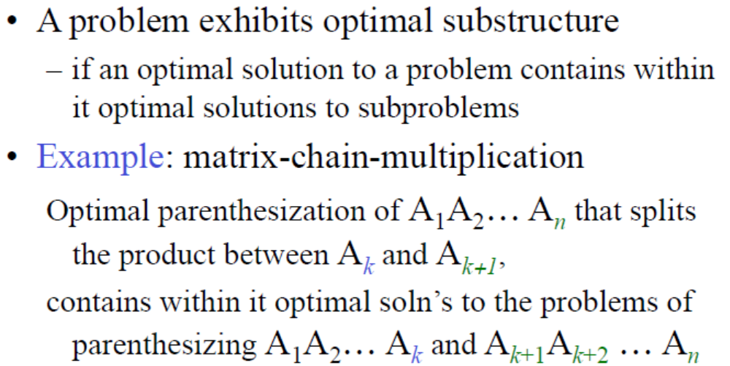
Optimal Substructure
Analysis of Algorithms

Slide 36
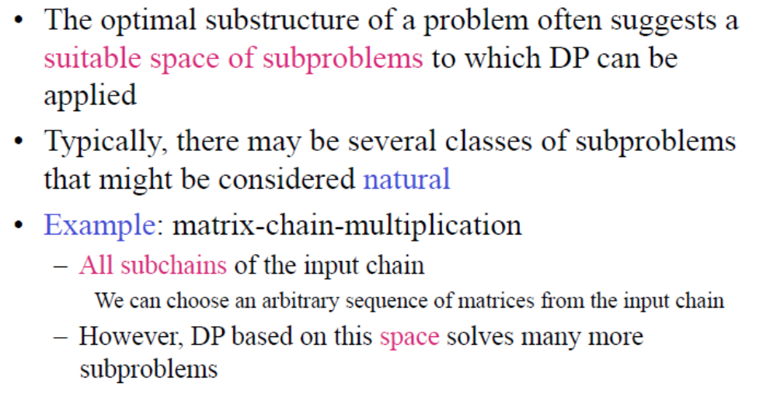
Optimal Substructure
Analysis of Algorithms

Slide 37
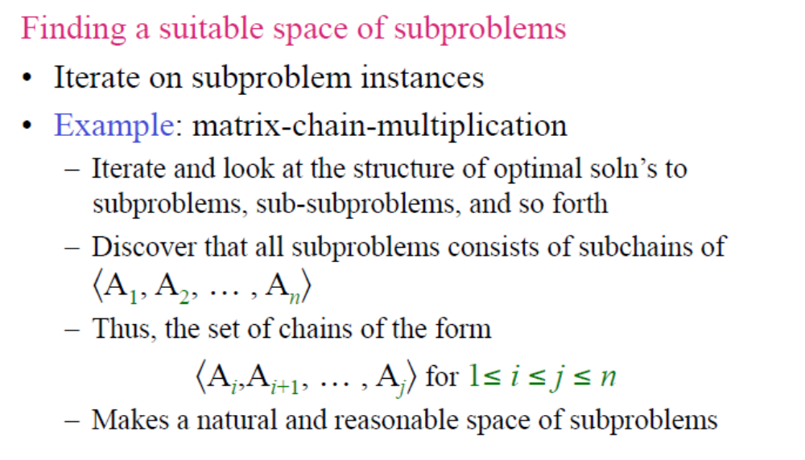
Optimal Substructure
Analysis of Algorithms

Slide 38
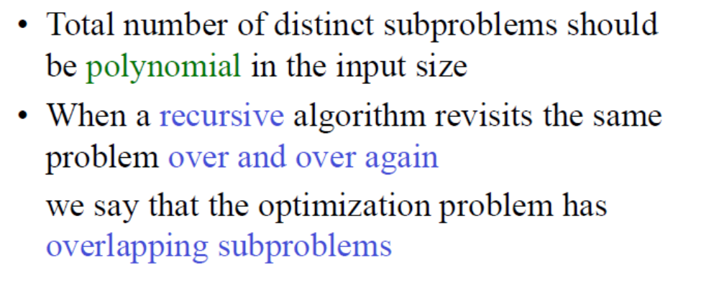
Overlapping Subproblems
Analysis of Algorithms

Slide 39
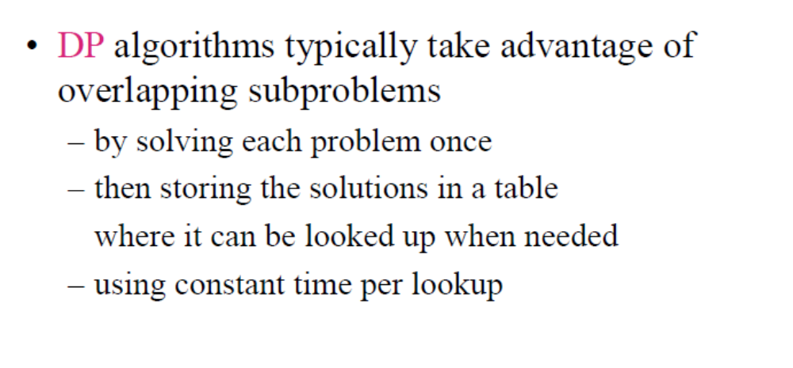
Overlapping Subproblems
Analysis of Algorithms

Slide 40
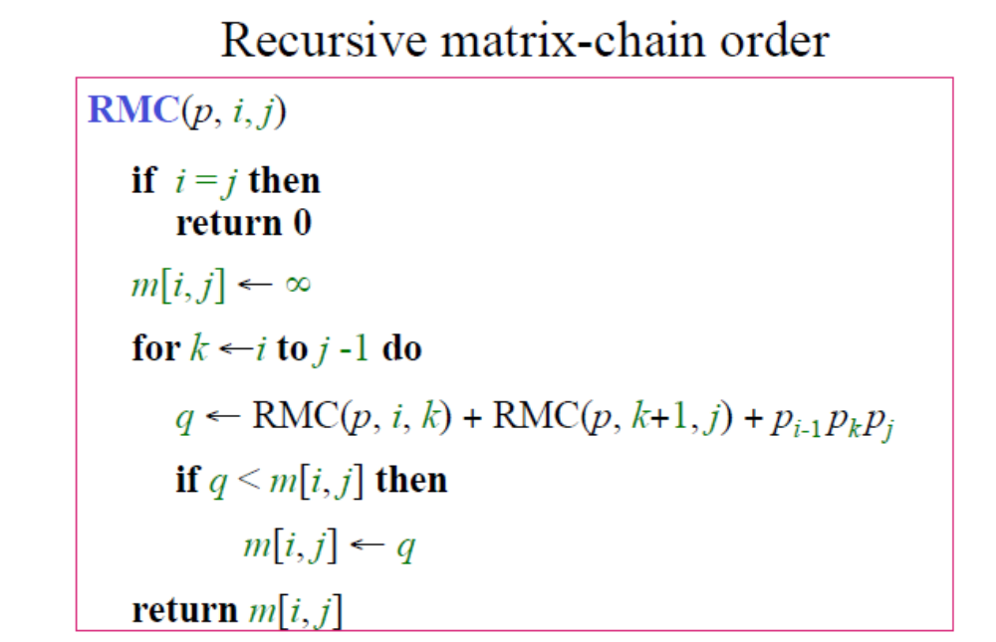
Overlapping Subproblems
Analysis of Algorithms

Slide 41
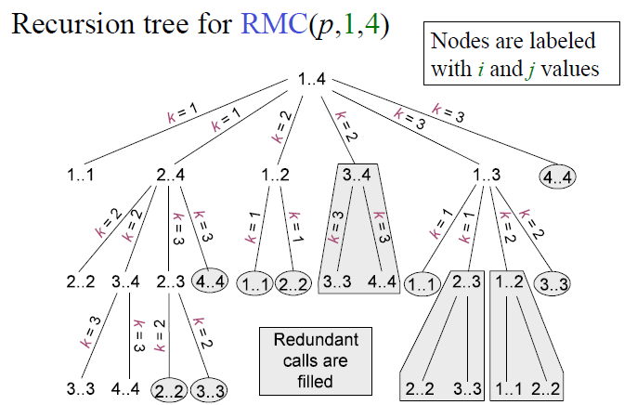
Recursive Matrix-chain Order
Analysis of Algorithms

Slide 42
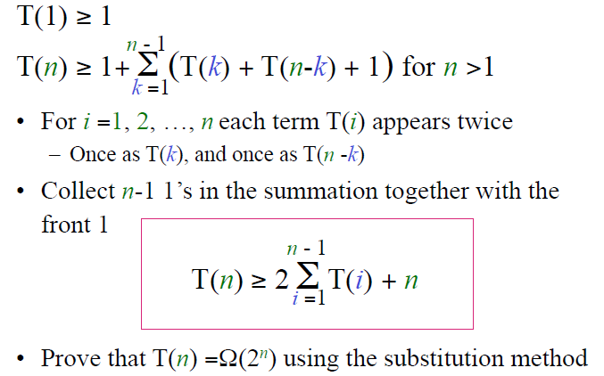
Running Time of RMC
Analysis of Algorithms

Slide 43
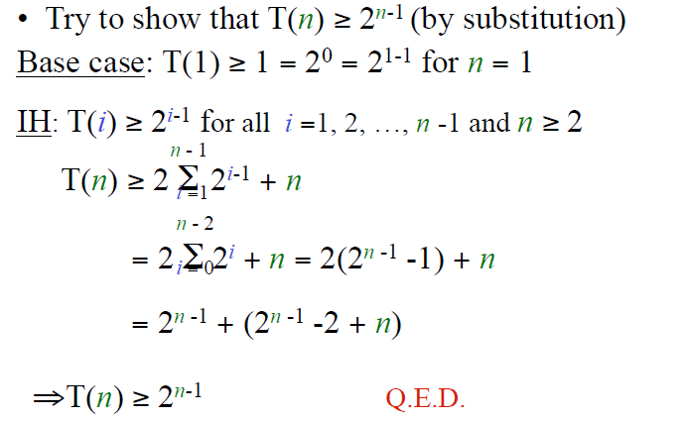
Analysis of Algorithms

Slide 44

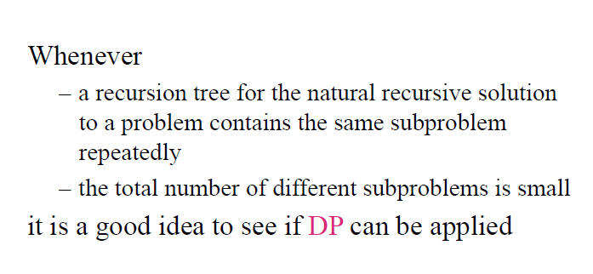
Analysis of Algorithms

Slide 45
Memoized Recursive Algorithm
Offers the efficiency of the usual DP approach while maintaining top-down strategy
Maintains an entry in a table for the soln to each subproblem
Each table entry contains a special value to indicate that the entry has yet to be filled in
When the subproblem is first encountered its solution is computed and then stored in the table
Each subsequent time that the subproblem encountered the value stored in the table is simply looked up and returned
The approach assumes that
  The set of all possible subproblem parameters are known
  The relation between the table positions and subproblems is established
Analysis of Algorithms

Slide 46
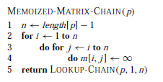
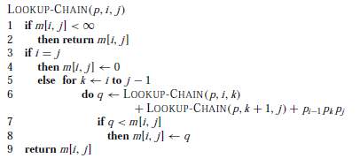
Memoized Recursive Algorithm
Analysis of Algorithms

Slide 47
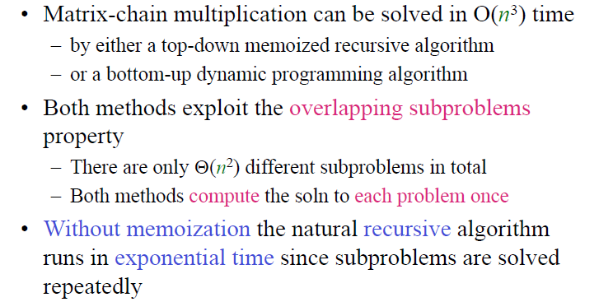
Elements of Dynamic Programming: Summary
Analysis of Algorithms

Slide 48
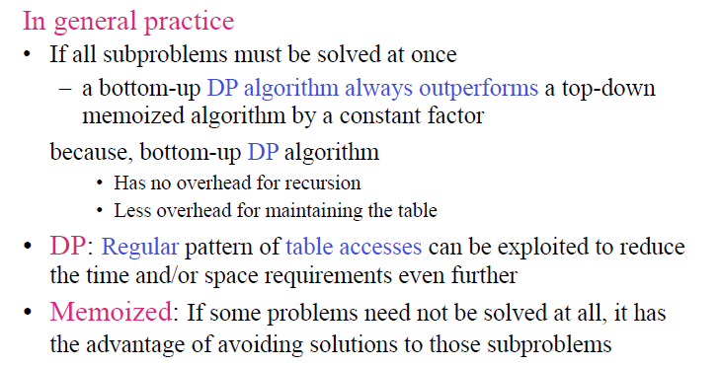
Elements of Dynamic Programming: Summary
Analysis of Algorithms

Slide 49
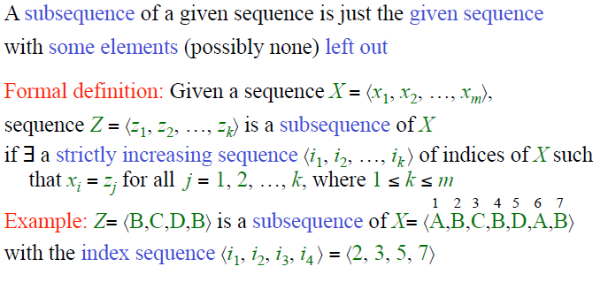
Longest Common Subsequence
Analysis of Algorithms

Slide 50
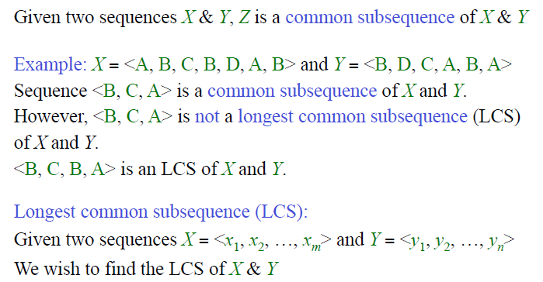
Longest Common Subsequence
Analysis of Algorithms

Slide 51
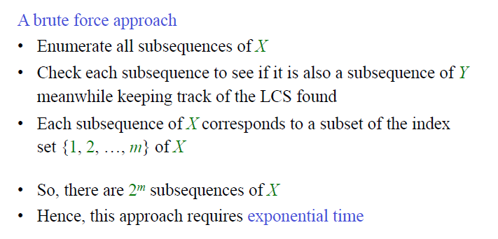
Longest Common Subsequence
Analysis of Algorithms

Slide 52
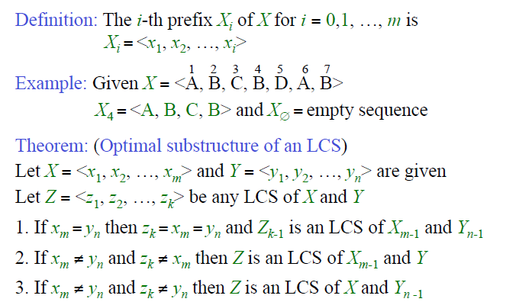
Characterizing a Longest Common Subsequence
Analysis of Algorithms

Slide 53
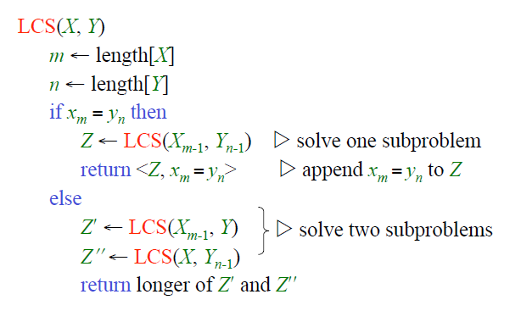
Longest Common Subsequence Algorithm
Analysis of Algorithms

Slide 54
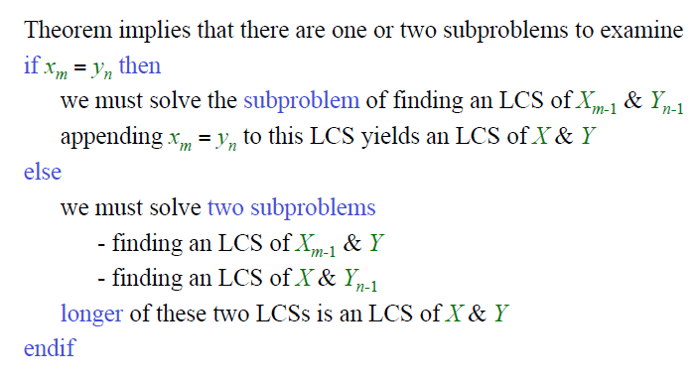
A Recursive Solution to Subproblems
Analysis of Algorithms

Slide 55
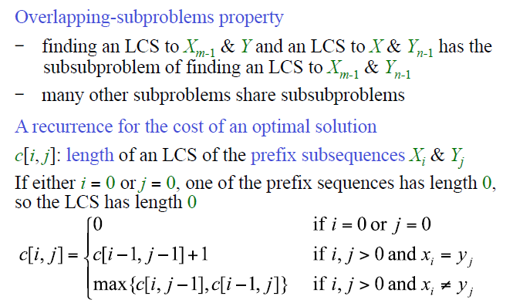
A Recursive Solution to Subproblems
Analysis of Algorithms

Slide 56
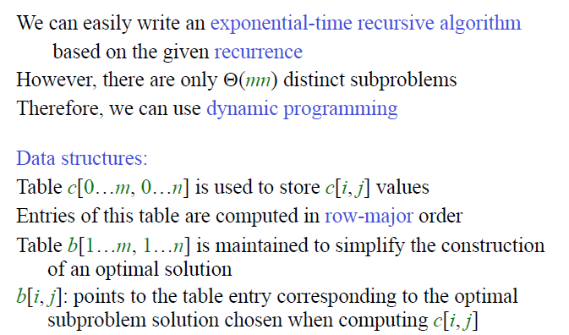
Computing the Length of an LCS
Analysis of Algorithms

Slide 57

Computing the Length of an LCS
Analysis of Algorithms

Slide 58



Computing the Length of an LCS
Analysis of Algorithms

Slide 59

Constructing an LCS
Analysis of Algorithms

Slide 60

Constructing an LCS
Analysis of Algorithms

Slide 61

Longest Common Subsequence
This improvement works if we only need the length of an LCS
Analysis of Algorithms

