Slide 1
Algorithms
Dynamic Programming

Slide 2
Dynamic programming is typically applied to optimization problems. In such problem there can be many solutions. Each solution has a value, and we wish to find a solution with the optimal value.

Slide 3
The development of a dynamic programming
1. Characterize the structure of an optimal solution.
2. Recursively define the value of an optimal solution.
3. Compute the value of an optimal solution in a bottom up fashion.
4. Construct an optimal solution from computed information.

Slide 4
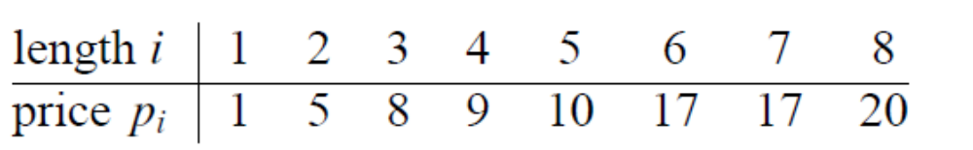
15.1 Rod cutting
Input: A length n and table of prices pi , for i = 1, 2, …, n.
Output: The maximum revenue obtainable for rods whose lengths sum to n, computed as the sum of the prices for the individual rods.

Slide 5
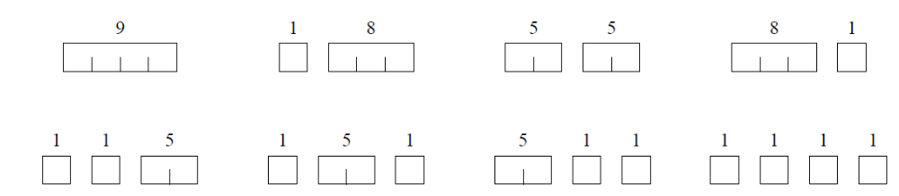

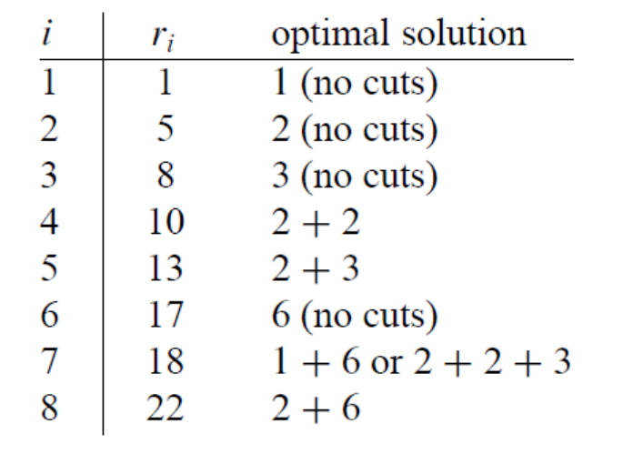
Ex: a rod of length 4

Slide 6
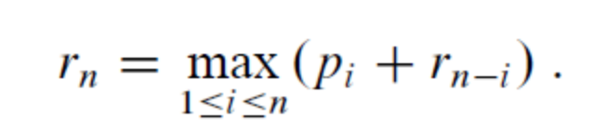
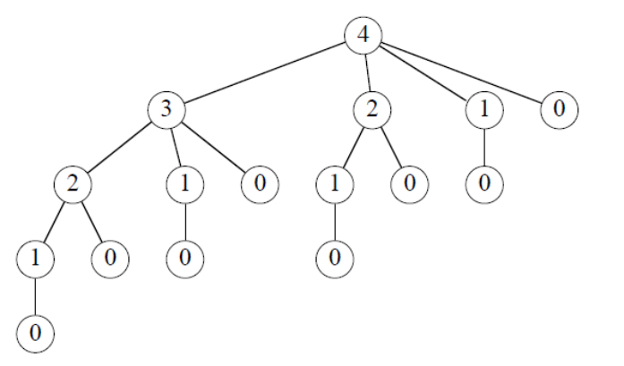
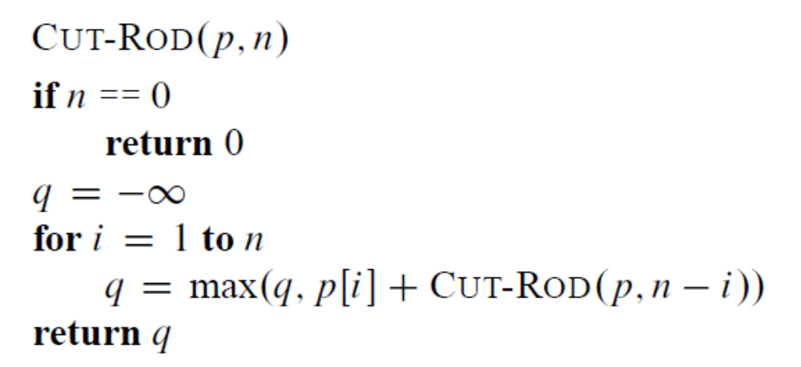
Recursive top-down solution

Slide 7
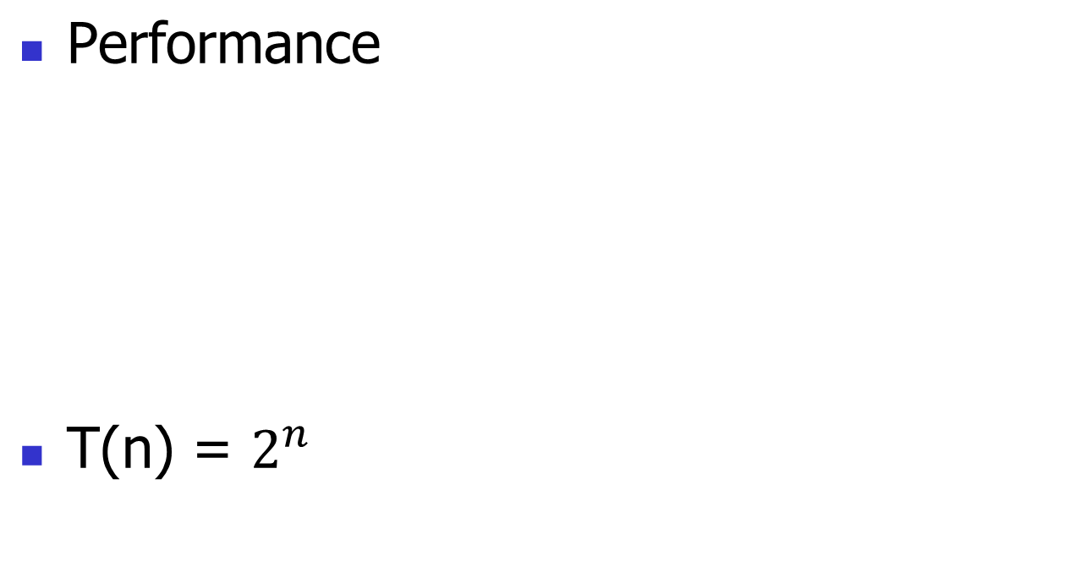
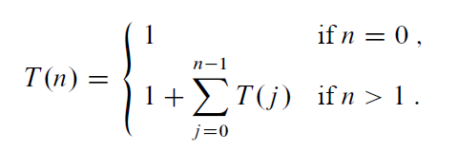

Slide 8
Dynamic-programming solution
Store, don’t recompute
  time-memory trade-off
Turn a exponential-time solution into a polynomial-time solution

Slide 9
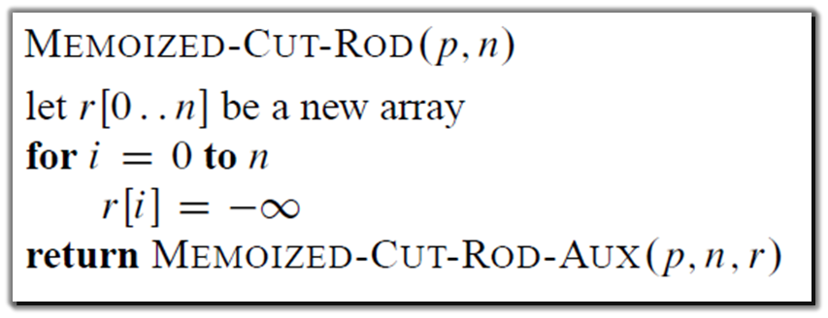
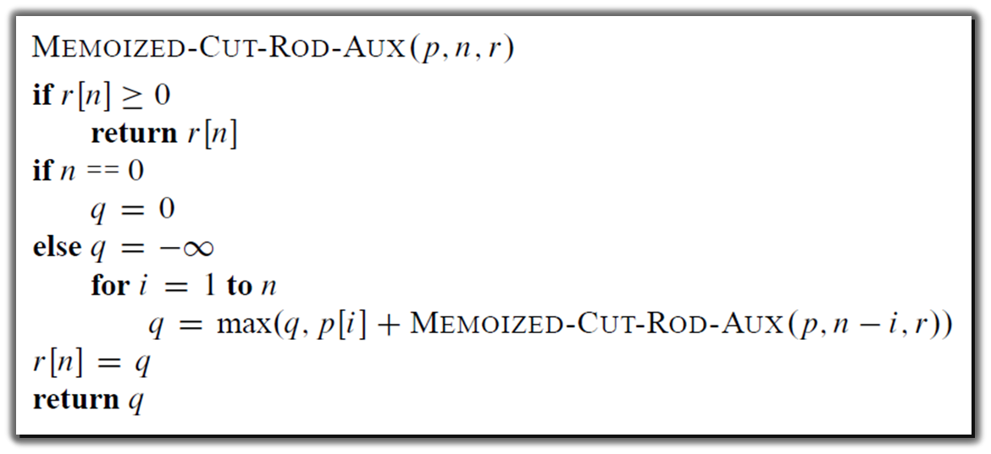
Top-down with memoization

Slide 10
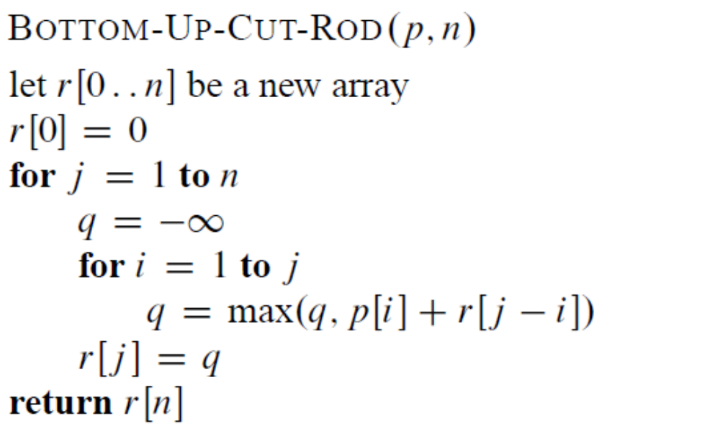
Bottom-up

Slide 11
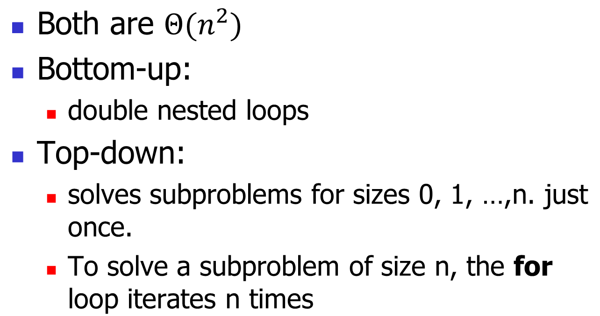

Slide 12
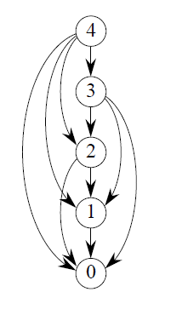
Subproblem graphs
For rod-cutting problem with n = 4
  Directed graph
One vertex for each distinct subproblem.
Has a directed edge (x, y). if computing an optimal solution to subproblem x directly requires knowing an optimal solution to subproblem y.

Slide 13
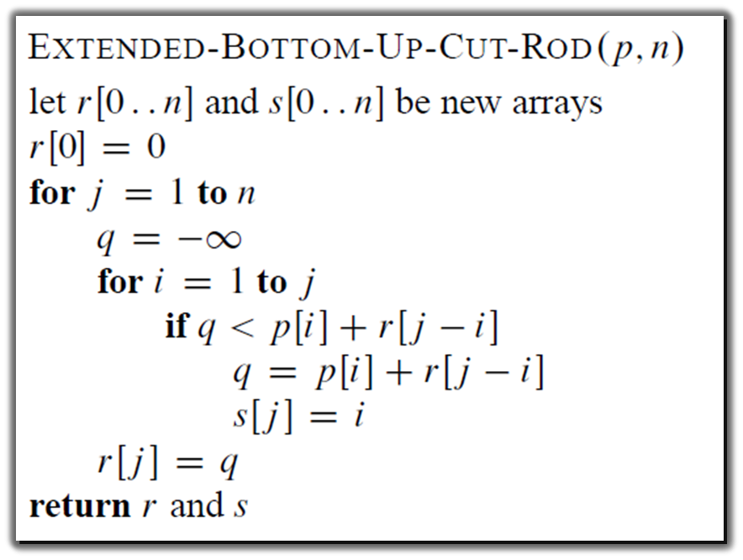
Reconstructing a solution

Slide 14
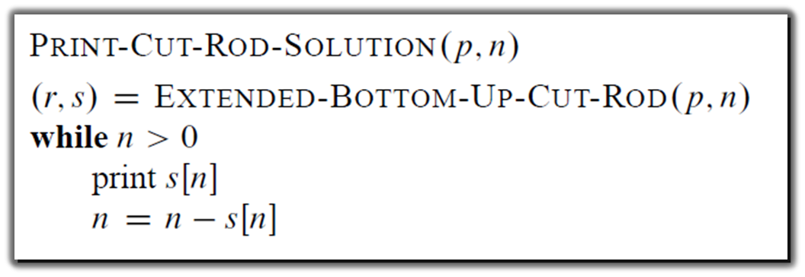
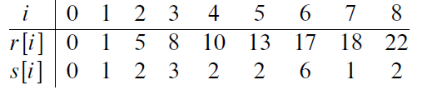

Slide 15
15.2 Matrix-chain multiplication
A product of matrices is fully parenthesized if it is either a single matrix, or a product of two fully parenthesized matrix product, surrounded by parentheses.

Slide 16
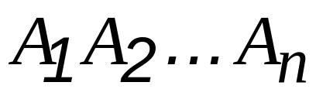


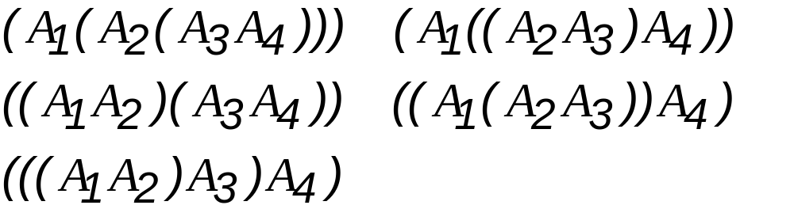
How to compute where is a matrix for every i.
Example:

Slide 17
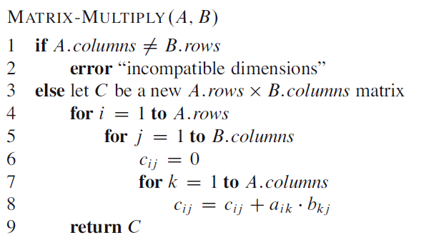
MATRIX MULTIPLY

Slide 18
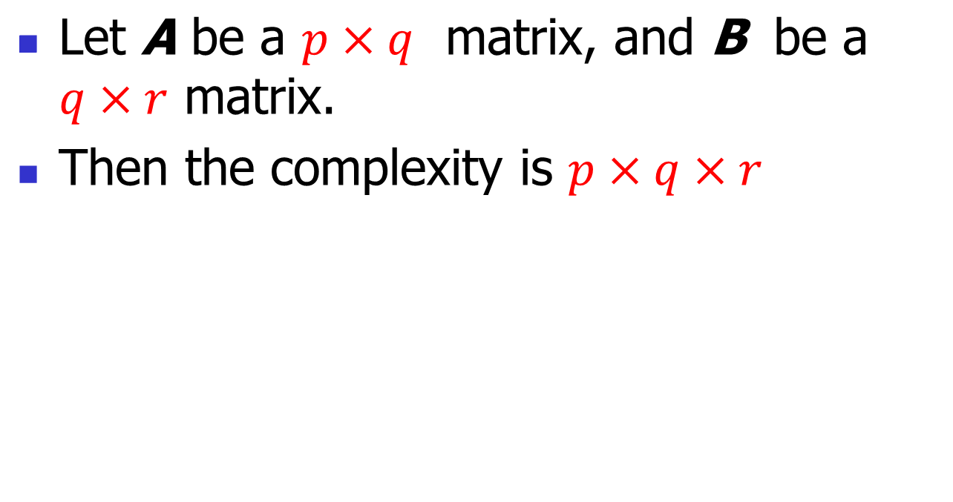
Complexity:

Slide 19
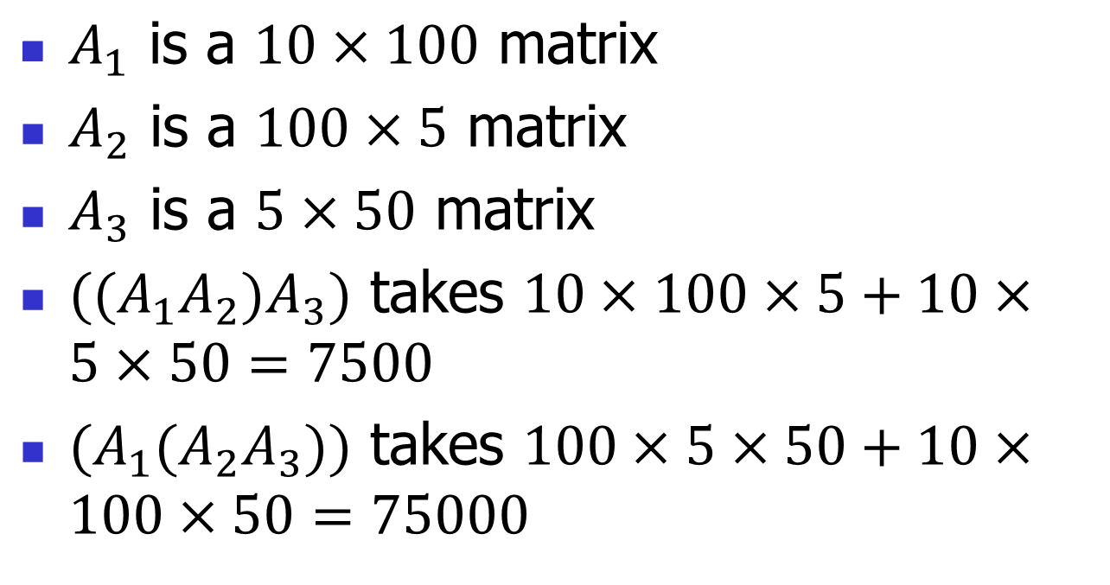
Example:

Slide 20
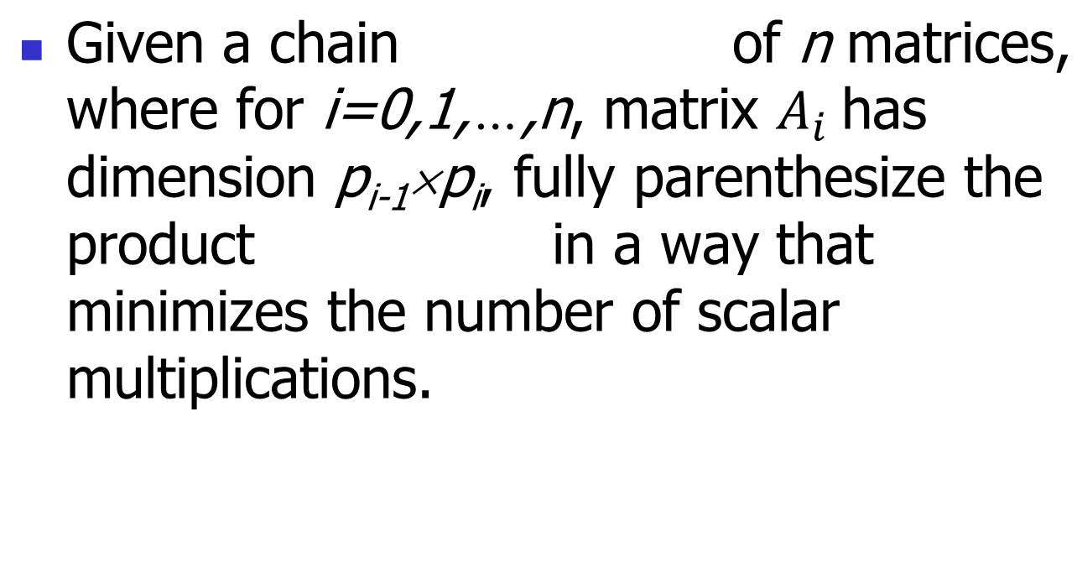
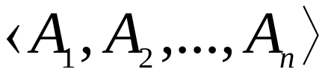
The matrix-chain multiplication problem:

Slide 21
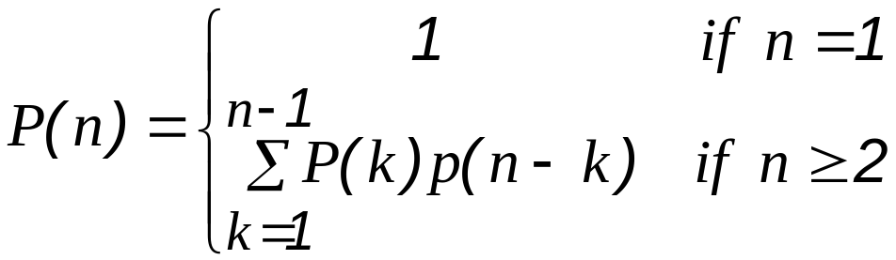
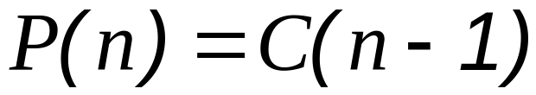
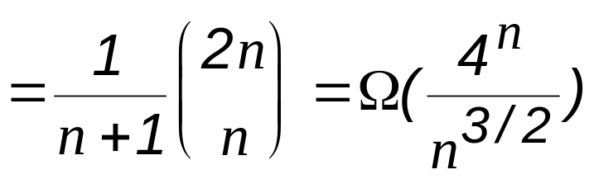
Counting the number of parenthesizations:
[Catalan number]

Slide 22
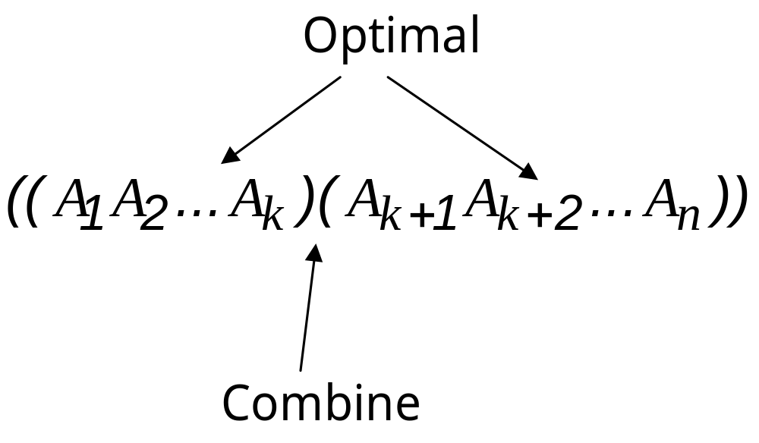
Step 1: The structure of an optimal parenthesization

Slide 23
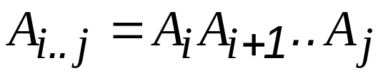
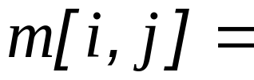
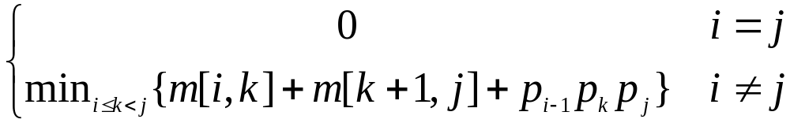
Step 2: A recursive solution
Define m[i, j]= minimum number of scalar multiplications needed to compute the matrix
goal m[1, n]

Slide 24
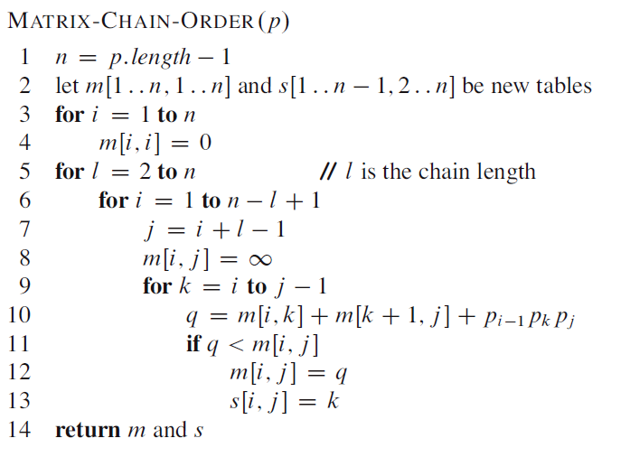
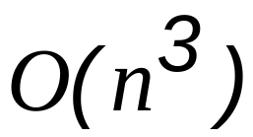
Step 3:
Computing the optimal costs
Complexity:

Slide 25
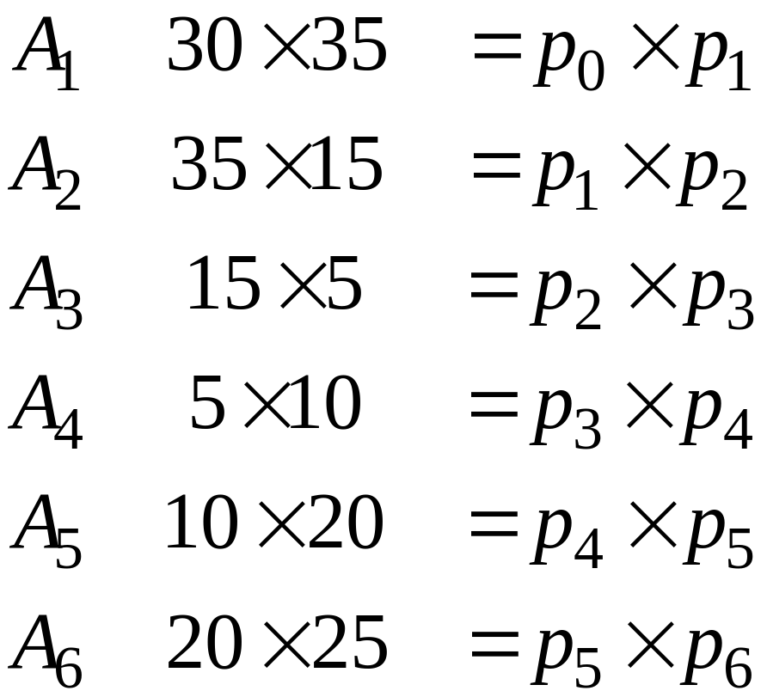
Example:

Slide 26
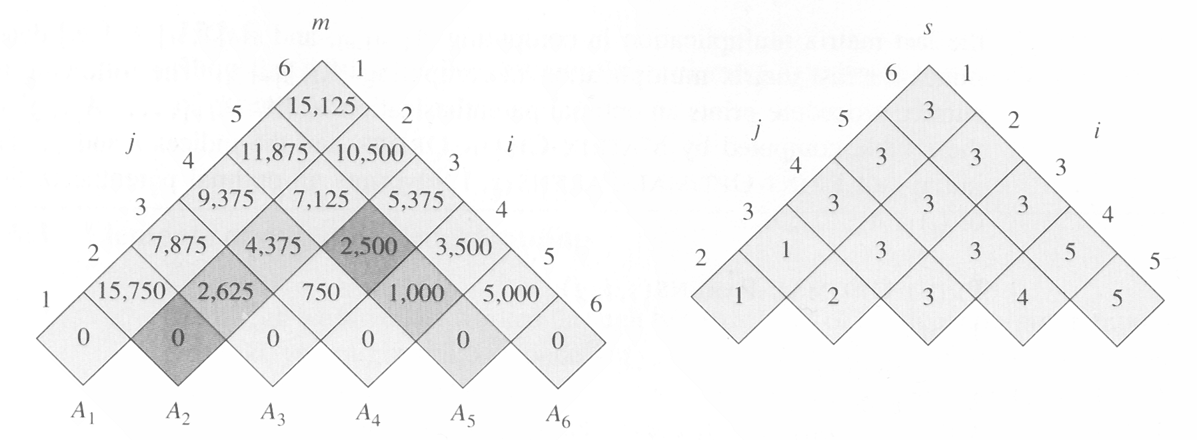
the m and s table computed by
MATRIX-CHAIN-ORDER for n=6

Slide 27
m[2,5]=
min{
m[2,2]+m[3,5]+p₁p₂p₅=0+2500+35×15×20=13000,
m[2,3]+m[4,5]+p₁p₃p₅=2625+1000+35×5×20=7125,
m[2,4]+m[5,5]+p₁p₄p₅=4375+0+35×10×20=11374
}
=7125

Slide 28
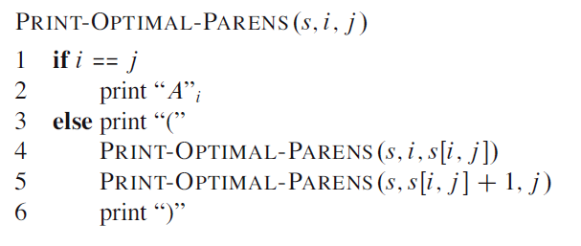

Step 4:
Constructing an optimal solution
example:

Slide 29
16.3
Elements of dynamic programming
Optimal substructure
Overlapping subproblems
How memoization might help

Slide 30
Optimal substructure:
We say that a problem exhibits optimal substructure if an optimal solution to the problem contains within its optimal solution to subproblems.
Example: Matrix-multiplication problem

Slide 31
Common pattern
1. You show that a solution to the problem consists of making a choice. Making this choice leaves one or more subproblems to be solved.
2. You suppose that for a given problem, you are given the choice that leads to an optimal solution.
3. Given this choice, you determine which subproblems ensue and how to best characterize the resulting space of subproblems.
4. You show that the solutions to the subproblems used within the optimal solution to the problem must themselves be optimal by using a “cut-and-paste” technique.

Slide 32
Optimal substructure
1. How many subproblems are used in an optimal solution to the original problem
2. How many choices we have in determining which subproblem(s) to use in an optimal solution.

Slide 33
Subtleties
One should be careful not to assume that optimal substructure applies when it does not. consider the following two problems in which we are given a directed graph G = (V, E) and vertices u, v ∈ V.
  Unweighted shortest path:
    Find a path from u to v consisting of the fewest edges. Good for Dynamic programming.
  Unweighted longest simple path:
    Find a simple path from u to v consisting of the most edges. Not good for Dynamic programming.

Slide 34
Overlapping subproblems
example: MAXTRIX_CHAIN_ORDER

Slide 35
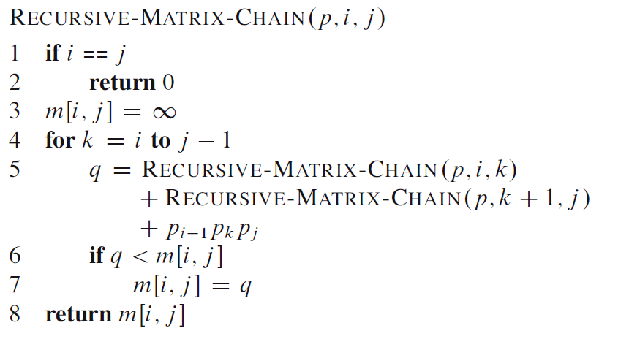
RECURSIVE_MATRIX_CHAIN

Slide 36
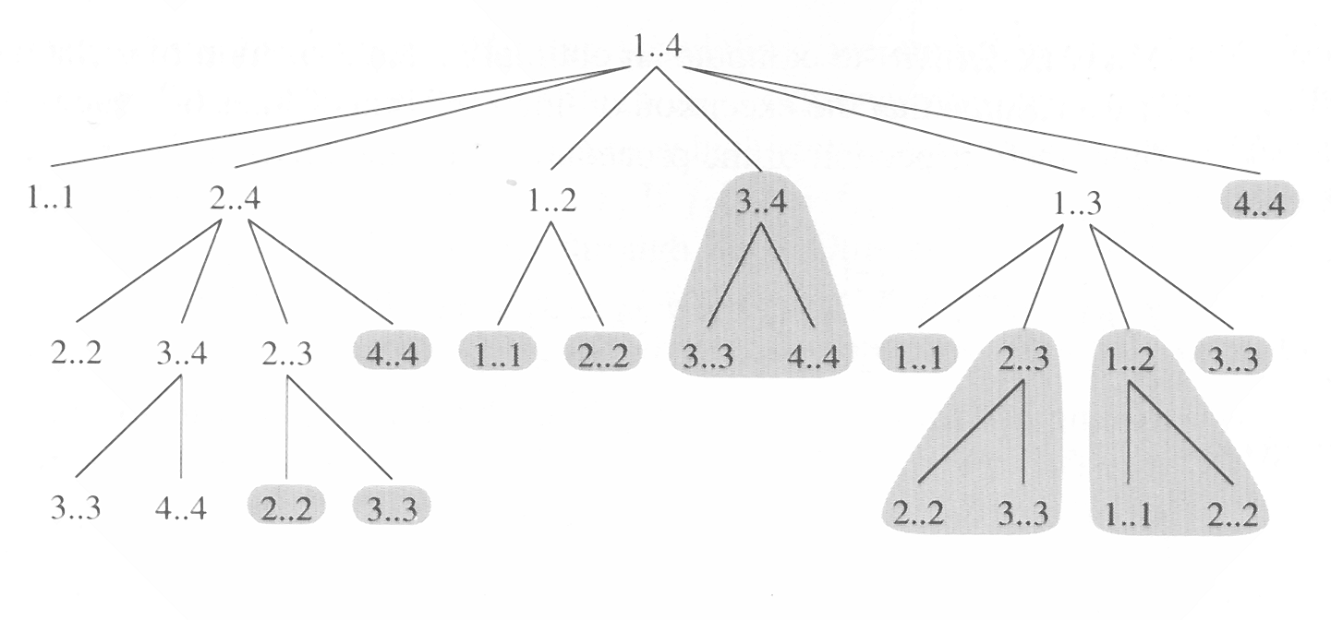
The recursion tree for the computation
of RECURSUVE-MATRIX-CHAIN(P, 1, 4)

Slide 37
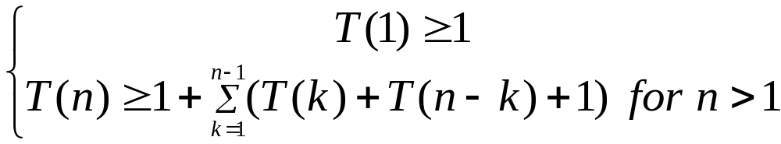
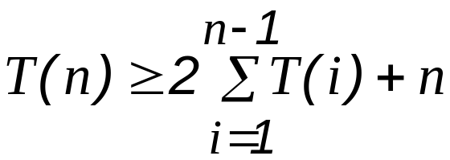
We can prove that T(n) =Ω(2^{n}) using substitution method.

Slide 38
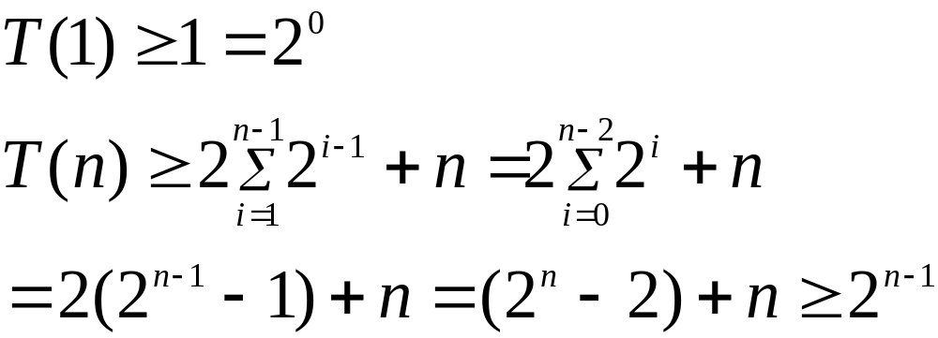
Solution:
1. bottom up
2. memorization (memorize the natural, but inefficient)

Slide 39
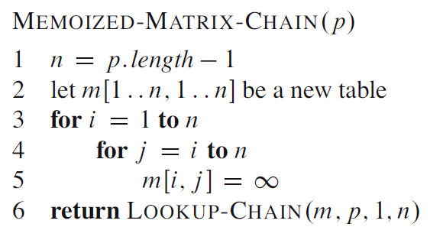
MEMORIZED_MATRIX_CHAIN

Slide 40
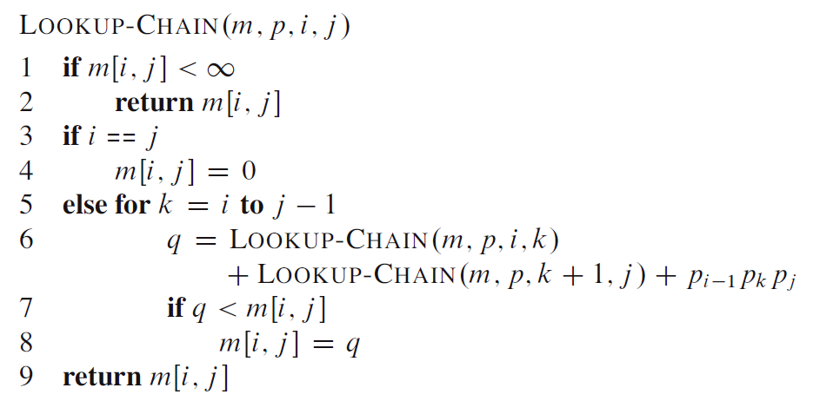

LOOKUP_CHAIN
Time Complexity:

Slide 41
16.4
Longest Common Subsequence
X = < A, B, C, B, D, A, B >
Y = < B, D, C, A, B, A >
< B, C, A > is a common subsequence of both X and Y.
< B, C, B, A > or < B, C, A, B > is the longest common subsequence of X and Y.

Slide 42
Longest-common-subsequence problem:
We are given two sequences X = <x₁,x₂,...,x_{m}> and Y = <y₁,y₂,...,y_{n}> and wish to find a maximum length common subsequence of X and Y.
We Define ith prefix of X,
  X_{i} = < x₁,x₂,...,x_{i} >.

Slide 43
Theorem 16.1.
(Optimal substructure of LCS)
Let X = <x₁,x₂,...,x_{m}> and Y = <y₁,y₂,...,y_{n}> be the sequences, and let Z = <z₁,z₂,...,z_{k}> be any LCS of X and Y.
1. If x_{m} = y_{n}
then z_{k} = x_{m} = y_{n} and Z_{k-1} is an LCS of X_{m-1} and Y_{n-1}.
2. If x_{m} ≠ y_{n}
then z_{k} ≠ x_{m} implies Z is an LCS of X_{m-1} and Y.
3. If x_{m} ≠ y_{n}
then z_{k} ≠ y_{n} implies Z is an LCS of X and Y_{n-1}.

Slide 44
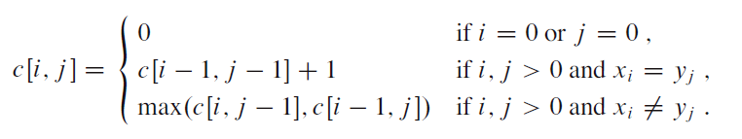
A recursive solution to subproblem
Define c [i, j] is the length of the LCS of X_{i} and Y_{j} .

Slide 45
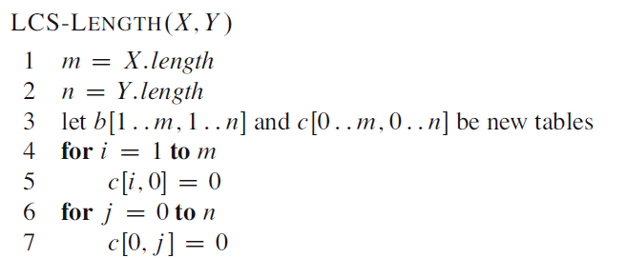
Computing the length of an LCS

Slide 46
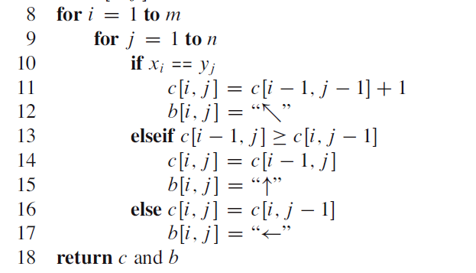

Slide 47
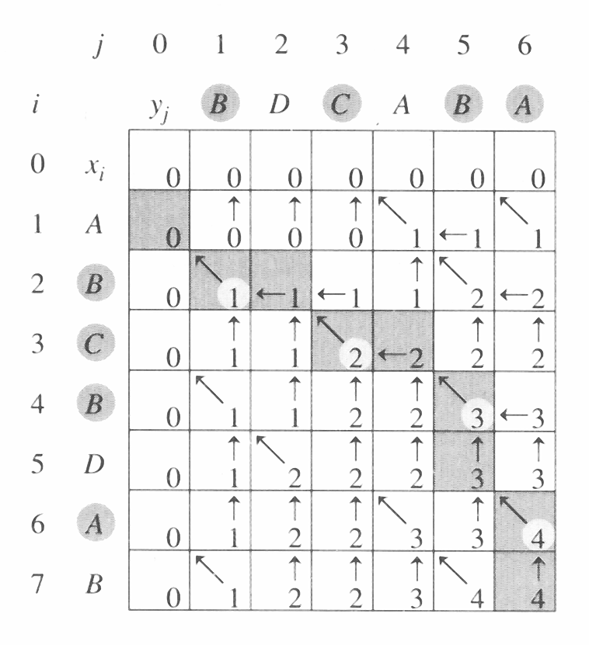
Complexity: O(mn)

Slide 48
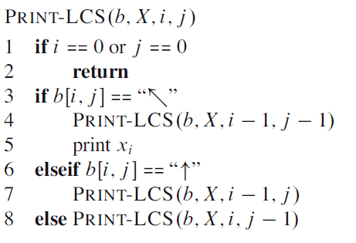
Complexity: O(m+n)

Slide 49
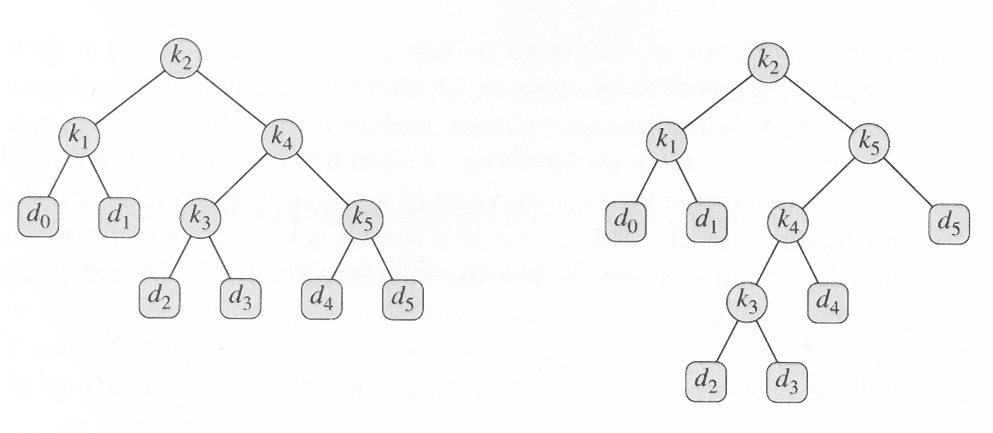
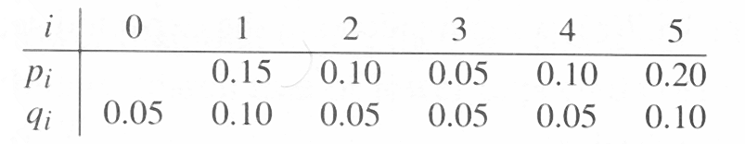
15.5
Optimal Binary search trees
cost:2.75
optimal!!
cost:2.80

Slide 50
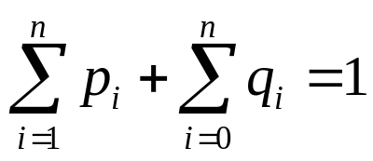

Expected cost
the expected cost of a search in T is

Slide 51

For a given set of probabilities, our goal is to construct a binary search tree whose expected search is smallest. We call such a tree an optimal binary search tree.

Slide 52
Step 1:
The structure of an optimal binary search tree
Consider any subtree of a binary search tree. It must contain keys in a contiguous range k_{i}, ...,k_{j}, for some 1 ≤ i ≤ j ≤ n. In addition, a subtree that contains keys k_{i}, ..., k_{j} must also have as its leaves the dummy keys d_{i-1}, ..., d_{j}.
If an optimal binary search tree T has a subtree T' containing keys k_{i}, ..., k_{j}, then this subtree T' must be optimal as well for the subproblem with keys k_{i}, ..., k_{j} and dummy keys d_{i-1}, ..., d_{j}.

Slide 53


Step 2:
A recursive solution

Slide 54

Step 3:computing the expected search cost of an optimal binary search tree

Slide 55
the OPTIMAL-BST procedure takes Θ(n³), just like MATRIX-CHAIN-ORDER

Slide 56

The table e[i,j], w[i,j], and root[i,j] computer by OPTIMAL-BST on the key distribution.

Slide 57
Knuth has shown that there are always roots of optimal subtrees such that root[i, j –1] ≤ root[i+1, j] for all 1 ≤ i ≤ j ≤ n. We can use this fact to modify Optimal-BST procedure to run in Θ(n²) time.

