Slide 1
MAXIMUM FLOW
Max-Flow Min-Cut Theorem (Ford Fukerson’s Algorithm)

Slide 2
What is Network Flow ?
Flow network is a directed graph G=(V,E) such that each
edge has a non-negative capacity c(u,v)≥0.
Two distinguished vertices exist in G namely :
Source (denoted by s) : In-degree of this vertex is 0.
Sink (denoted by t) : Out-degree of this vertex is 0.
Flow in a network is an integer-valued function f defined
On the edges of G satisfying 0≤f(u,v)≤c(u,v), for every
Edge (u,v) in E.

Slide 3
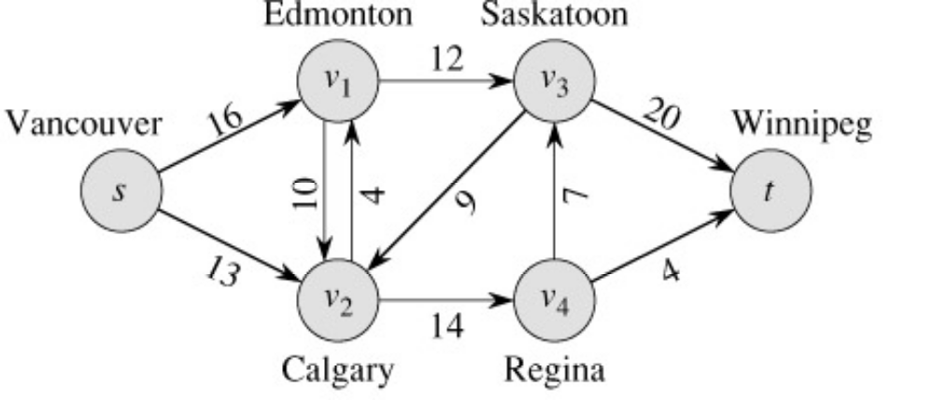
What is Network Flow ?
Each edge (u,v) has a non-negative capacity c(u,v).
If (u,v) is not in E assume c(u,v)=0.
We have source s and sink t.
Assume that every vertex v in V is on some path from s to t.
Following is an illustration of a network flow:
c(s,v1)=16
c(v1,s)=0
c(v2,s)=0 …

Slide 4
Conditions for Network Flow
For each edge (u,v) in E, the flow f(u,v) is a real valued function
that must satisfy following 3 conditions :
Capacity Constraint :∀ u,v ∈V, f(u,v) ≤ c(u,v)
Skew Symmetry : ∀ u,v ∈V, f(u,v)= -f(v,u)
Flow Conservation: ∀ u ∈V – {s,t} Σ f(s,v)=0
v∈V
Skew symmetry condition implies that f(u,u)=0.

Slide 5
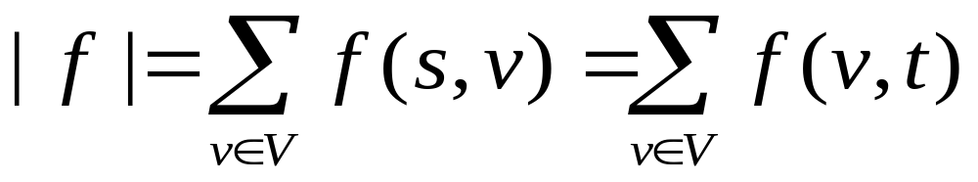
The Value of a Flow.
The value of a flow is given by :
The flow into the node is same as flow going out from the node and
thus the flow is conserved. Also the total amount of flow from source
s = total amount of flow into the sink t.

Slide 6
Example of a flow
Capacity
Flow
1
8,
8
10
,
9
s
1,
1
t
6,
6
10,
7
2
Table illustrating Flows and Capacity across different edges of graph above:
f_{s,1} = 9 , c_{s,1} = 10 (Valid flow since 10 > 9)
f_{s,2} = 6 , c_{s,2} = 6 (Valid flow since 6 ≥ 6)
f_{1,2} = 1 , c_{1,2} = 1 (Valid flow since 1 ≥ 1)
f_{1,t} = 8 , c_{1,t} = 8 (Valid flow since 8 ≥ 8)
f_{2,t} = 7 , c_{2,t} = 10 (Valid flow since 10 > 7)
The flow across nodes 1 and 2 are also conserved as flow into them = flow out.

Slide 7
The Maximum Flow Problem
Given a Graph G (V,E) such that:
x_{i,j} = flow on edge (i,j)
u_{i,j}= capacity of edge (i,j)
s = source node
t = sink node
In simple terms maximize
the s to t flow, while ensuring
that the flow is feasible.
Maximize v
Subject To Σ_{j}x_{ij} - Σ_{j}x_{ji} = 0 for each i ≠s,t
Σ_{j}x_{sj} = v
0 ≤ x_{ij} ≤ u_{ij} for all (i,j) ∈ E.

Slide 8
Cuts of Flow Networks
A Cut in a network is a partition of V into S and T (T=V-S) such that
s (source) is in S and t (target) is in T.
2
9
5
Cut
10
4
15
15
10
s
5
3
8
6
10
t
4
6
15
10
15
4
30
7

Slide 9
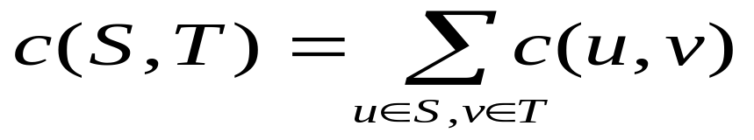
Capacity of Cut (S,T)
2
9
5
Cut
10
4
15
15
10
s
5
3
8
6
10
t
4
6
15
10
15
Capacity = 30
4
30
7

Slide 10
Min Cut
Min s-t cut (Also called as a Min Cut) is a cut of minimum capacity
2
9
5
Min s-t Cut
10
4
15
15
10
s
5
3
8
6
10
t
4
6
15
10
15
Capacity = 28
4
30
7

Slide 11
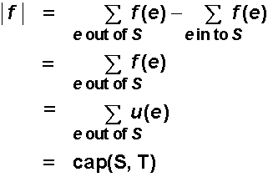
Flow of Min Cut (Weak Duality)
Let f be the flow and let (S,T) be a cut. Then | f | ≤ CAP(S,T).
In maximum flow, minimum cut problems forward edges are full
or saturated and the backward edges are empty because of the
maximum flow. Thus maximum flow is equal to capacity of cut.
This is referred to as weak duality.
Proof :
0
S
T
8
t
s
7

Slide 12
Methods
Max-Flow Min-Cut Theorem
The Ford-Fulkerson Method
The Preflow-Push Method

Slide 13
The Ford-Fulkerson Method
Try to improve the flow, until we reach the maximum value of the flow
The residual capacity of the network with a flow f is given by:
The residual capacity (rc) of an edge (i,j) equals c(i,j) – f(i,j) when (i,j)
is a forward edge, and equals f(i,j) when (i,j) is a backward edge.
Moreover the residual capacity of an edge is always non-negative.
1
8,
8
1
1
0
10
,
9
1,
1
9
1
0
8
s
t
s
t
6
7
6,
6
10,
7
0
2
2
3
Original Network
Residual Network

Slide 14
The Ford-Fulkerson Method
Begin
x := 0; // x is the flow.
create the residual network G(x);
while there is some directed path from s to t in G(x) do
begin
let P be a path from s to t in G(x);
Δ:= δ(P);
send Δunits of flow along P;
update the r's;
end
end {the flow x is now maximum}.
Click To See Ford Fulkerson’s Algorithm In Action (Animation)

Slide 15
Augmenting Paths ( A Useful Concept )
Definition:
An augmenting path p is a simple path from s to t on a residual network
that is an alternating sequence of vertices and edges of the form
s,e₁,v₁,e₂,v₂,...,e_{k},t in which no vertex is repeated and no forward edge
is saturated and no backward edge is free.
Characteristics of augmenting paths:
We can put more flow from s to t through p.
The edges of residual network are the edges on which residual capacity
is positive.
We call the maximum capacity by which we can increase the flow on p
the residual capacity of p.

Slide 16
The Ford-Fulkerson’s Algorithm
FORDFULKERSON(G,E,s,t)
FOREACH e ∈ E
f(e) ← 0
G_{f} ← residual graph
WHILE (there exists augmenting path P)
f ← augment(f, P)
update G_{f}
ENDWHILE
RETURN f
AUGMENT(f,P)
b ← bottleneck(P)
FOREACH e ∈ P
IF (e ∈ E)
// backwards arc
f(e) ← f(e) + b
ELSE
// forward arc
f(e^{R}) ← f(e) - b
RETURN f
Click To See Ford Fulkerson’s Algorithm In Action (Animation)

Slide 17
Proof of correctness of the algorithm
Lemma: At each iteration all residual capacities are integers.
Proof: It’s true at the beginning. Assume it’s true after the first
k-1 augmentations, and consider augmentation k along path P.
The residual capacity Δ of P is the smallest residual capacity
on P, which is integral.
After updating, we modify the residual capacities by 0 or Δ,
and thus residual capacities stay integers.
Theorem: Ford-Fulkerson’s algorithm is finite
Proof: The capacity of each augmenting path is atleast 1. The
augmentation reduces the residual capacity of some edge (s,j)
and doesn’t increase the residual capacity for some edge (s,i)
for any i.
So the sum of residual capacities of edges out of s keeps decr-
easing, and is bounded below 0.
Number of augmentations is O(nC) where C is the largest of the
capacity in the network.

Slide 18
When is the flow optimal ?
A flow f is maximum flow in G if :
The residual network G_{f} contains no more augmented paths.
| f | = c(S,T) for some cut (S,T) (a min-cut)
Proof:
Suppose there is an augmenting path in G_{f} then it implies that
the flow f is not maximum, because there is a path through which
more data can flow. Thus if flow f is maximum then residual n/w
G_{f} will have no more augmented paths.
(2) Let v=Fx(S,T) be the flow from s to t. By assumption v=CAP(S,T)
By Weak duality, the maximum flow is at most CAP(S,T). Thus the
flow is maximum.

Slide 19
15.082 and 6.855J (MIT OCW)
The Ford-Fulkerson Augmenting Path Algorithm for the Maximum Flow Problem

Slide 20
Ford-Fulkerson Max Flow
4
2
5
3
1
1
1
2
2
s
4
t
3
2
1
3
This is the original network, plus reversals of the arcs.

Slide 21
Ford-Fulkerson Max Flow
4
2
5
3
1
1
1
2
2
s
4
t
3
2
1
3
This is the original network, and the original residual network.

Slide 22
Ford-Fulkerson Max Flow
4
2
5
3
1
1
1
2
2
s
4
t
3
2
1
3
Find any s-t path in G(x)

Slide 23
Ford-Fulkerson Max Flow
4
2
5
3
1
1
1
2
1
2
s
4
t
2
1
3
2
1
1
1
3
Determine the capacity Δ of the path.
Send Δ units of flow in the path.
Update residual capacities.

Slide 24
Ford-Fulkerson Max Flow
4
2
5
3
1
1
1
2
1
2
s
4
t
2
1
3
2
1
1
1
3
Find any s-t path

Slide 25
Ford-Fulkerson Max Flow
4
2
5
3
1
1
1
2
1
1
1
s
4
t
2
1
1
3
2
2
1
1
1
1
3
1
Determine the capacity Δ of the path.
Send Δ units of flow in the path.
Update residual capacities.

Slide 26
Ford-Fulkerson Max Flow
4
2
5
3
1
1
1
2
1
1
1
s
4
t
2
1
1
3
2
2
1
1
1
1
3
1
Find any s-t path

Slide 27
Ford-Fulkerson Max Flow
4
2
5
3
1
1
1
1
1
1
s
4
t
1
2
1
2
2
3
1
1
1
1
3
1
Determine the capacity Δ of the path.
Send Δ units of flow in the path.
Update residual capacities.

Slide 28
Ford-Fulkerson Max Flow
4
2
5
3
1
1
1
1
2
1
1
s
4
t
1
2
1
2
2
3
1
1
1
1
3
1
Find any s-t path

Slide 29
Ford-Fulkerson Max Flow
4
2
5
3
1
1
1
1
2
1
1
s
4
t
1
2
1
1
2
2
1
1
1
2
1
2
3
1
Determine the capacity Δ of the path.
Send Δ units of flow in the path.
Update residual capacities.

Slide 30
Ford-Fulkerson Max Flow
4
2
5
3
1
1
1
1
2
1
1
s
4
t
1
2
1
1
2
2
1
1
2
1
2
3
1
Find any s-t path

Slide 31
Ford-Fulkerson Max Flow
4
3
2
5
1
3
1
2
1
1
1
1
s
4
t
1
2
1
1
2
2
1
1
2
1
2
3
1
Determine the capacity Δ of the path.
Send Δ units of flow in the path.
Update residual capacities.

Slide 32
Ford-Fulkerson Max Flow
4
3
2
5
1
3
1
2
1
1
1
1
s
4
t
1
2
1
1
2
2
1
1
2
1
2
3
1
There is no s-t path in the residual network. This flow is optimal

Slide 33
Ford-Fulkerson Max Flow
4
3
2
2
5
5
1
3
1
2
1
1
1
1
s
s
4
4
t
1
2
1
1
2
2
1
1
2
1
2
3
1
3
These are the nodes that are reachable from node s.

Slide 34
Ford-Fulkerson Max Flow
1
2
5
1
1
2
2
s
4
t
2
2
3
Here is the optimal flow

