Slide 1
The
Maximum Network Flow Problem

Slide 2
Types of Networks
Internet
Telephone
Cell
Highways
Rail
Electrical Power
Water
Sewer
Gas
…

Slide 3
Maximum Flow Problem
How can we maximize the flow in a network from a source or set of sources to a destination or set of destinations?
The problem reportedly rose to prominence in relation to the rail networks of the Soviet Union, during the 1950's. The US wanted to know how quickly the Soviet Union could get supplies through its rail network to its satellite states in Eastern Europe.
In addition, the US wanted to know which rails it could destroy most easily to cut off the satellite states from the rest of the Soviet Union. It turned out that these two problems were closely related, and that solving the max flow problem also solves the min cut problem of figuring out the cheapest way to cut off the Soviet Union from its satellites.

Slide 4
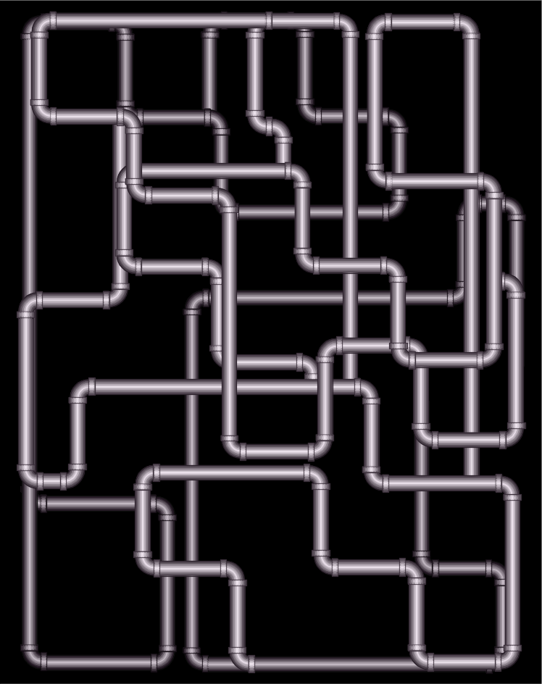




Network Flow
Instance:
  A Network is a directed graph G
  Edges represent pipes that carry flow
  Each edge (u,v) has a maximum capacity c(u,v)
  A source node s in which flow arrives
  A sink node t out which flow leaves
Goal:
Max Flow

Slide 5
The Problem
Use a graph to model material that flows through conduits.
Each edge represents one conduit, and has a capacity, which is an upper bound on the flow rate, in units/time.
Can think of edges as pipes of different sizes.
Want to compute max rate that we can ship material from a designated source to a designated sink.

Slide 6
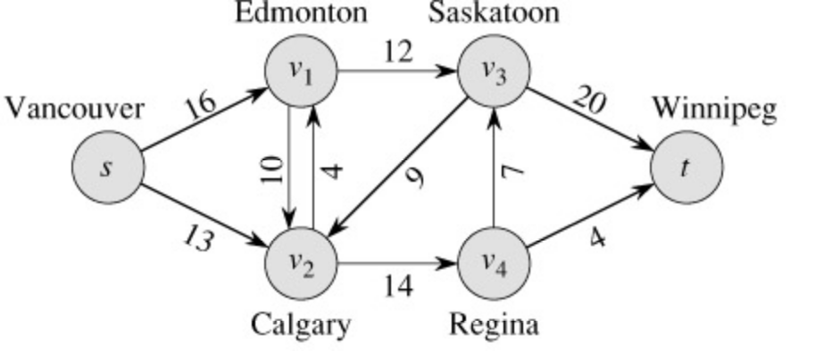
What is a Flow Network?
Each edge (u,v) has a nonnegative capacity c(u,v).
If (u,v) is not in E, assume c(u,v)=0.
We have a source s, and a sink t.
Assume that every vertex v in V is on some path from s to t.
e.g., c(s,v₁)=16; c(v₁,s)=0; c(v₂,v₃)=0

Slide 7
What is a Flow in a Network?
For each edge (u,v), the flow f(u,v) is a real-valued function that must satisfy 3 conditions:
Notes:
  The skew symmetry condition implies that f(u,u)=0.
  We show only the positive flows in the flow network.

Slide 8
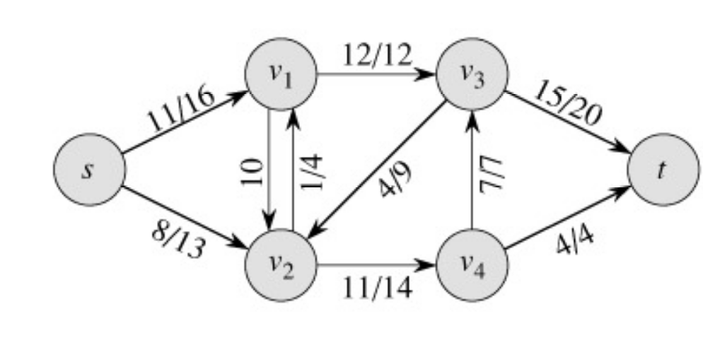
Example of a Flow:
capacity
flow
capacity
f(v₂, v₁) = 1, c(v₂, v₁) = 4.
f(v₁, v₂) = -1, c(v₁, v₂) = 10.
f(v₃, s) + f(v₃, v₁) + f(v₃, v₂) + f(v₃, v₄) + f(v₃, t) =
0 + (-12) + 4 + (-7) + 15 = 0

Slide 9
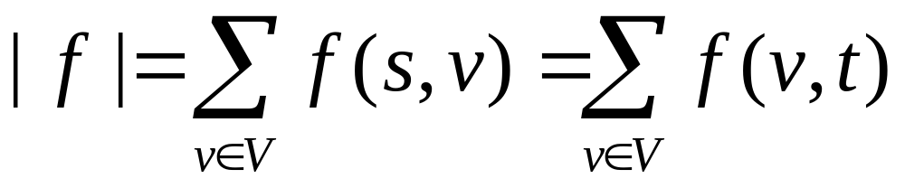
The Value of a flow
The value of a flow is given by
This is the total flow leaving s = the total flow arriving in t.

Slide 10
Example:
|f| = f(s, v₁) + f(s, v₂) + f(s, v₃) + f(s, v₄) + f(s, t) =
11 + 8 + 0 + 0 + 0 = 19
|f|= f(s, t) + f(v₁, t) + f(v₂, t) + f(v₃, t) + f(v₄, t) =
0 + 0 + 0 + 15 + 4 = 19

Slide 11
A flow in a network
We assume that there is only flow in one direction at a time.
Sending 7 trucks from Edmonton to Calgary and 3 trucks from Calgary to Edmonton has the same net effect as sending 4 trucks from Edmonton to Calgary.

Slide 12
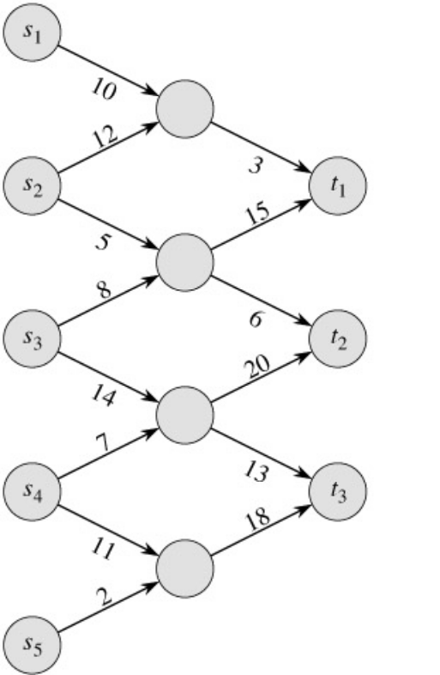
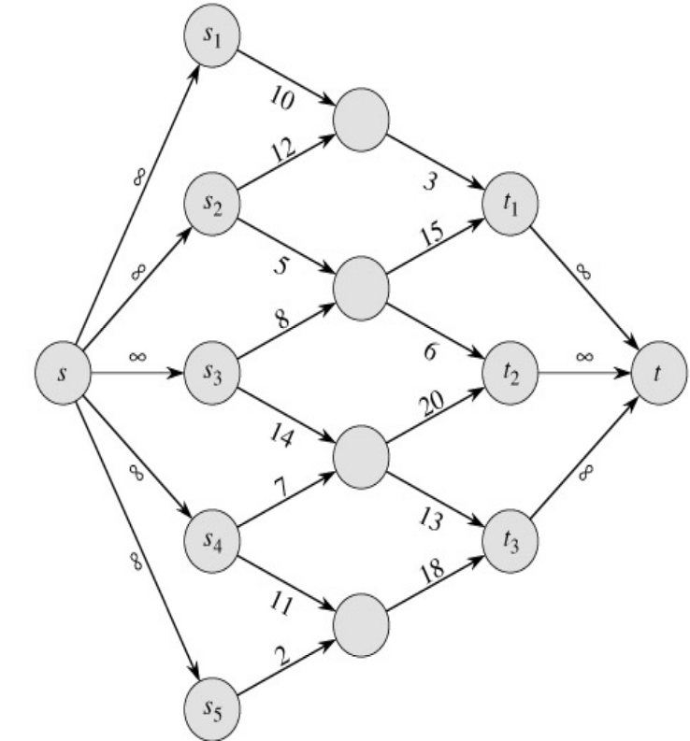
Multiple Sources Network
We have several sources and several targets.
Want to maximize the total flow from all sources to all targets.
Reduce to max-flow by creating a supersource and a supersink:

Slide 13
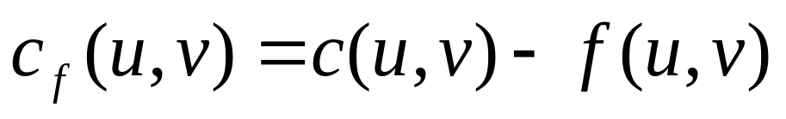


Residual Networks
The residual capacity of an edge (u,v) in a network with a flow f is given by:
The residual network of a graph G induced by a flow f is the graph including only the edges with positive residual capacity, i.e.,

Slide 14
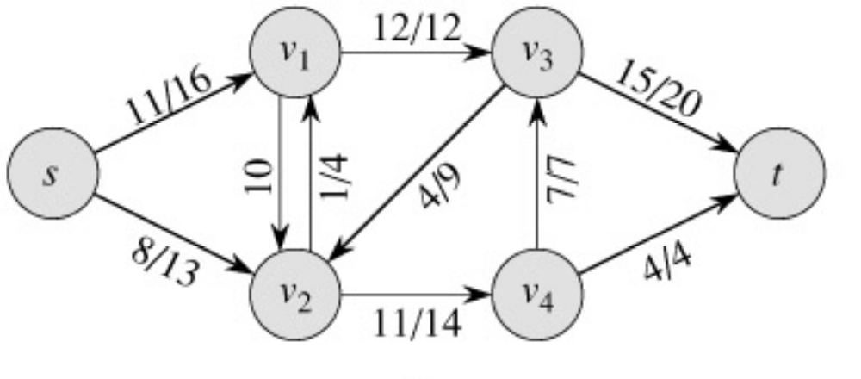
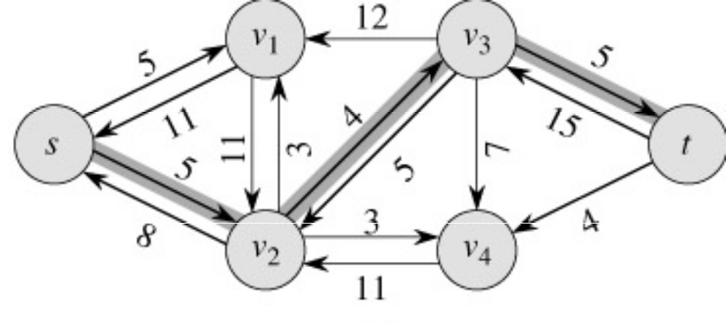
Example of Residual Network
Flow Network:
Residual Network:

Slide 15
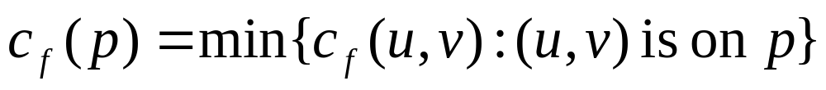
Augmenting Paths
An augmenting path p is a simple path from s to t on the residual network.
We can put more flow from s to t through p.
We call the maximum capacity by which we can increase the flow on p the residual capacity of p.

Slide 16
End of Lecture 14
April 22, 2009

Slide 17
Augmenting Paths
Network:
Residual Network:
Augmenting path
The residual capacity of this augmenting path is 4.

Slide 18
Computing Max Flow
Classic Method:
  Identify augmenting path
  Increase flow along that path
  Repeat

Slide 19
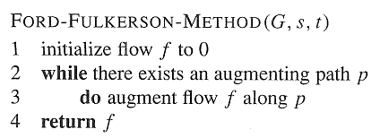
Ford-Fulkerson Method

Slide 20
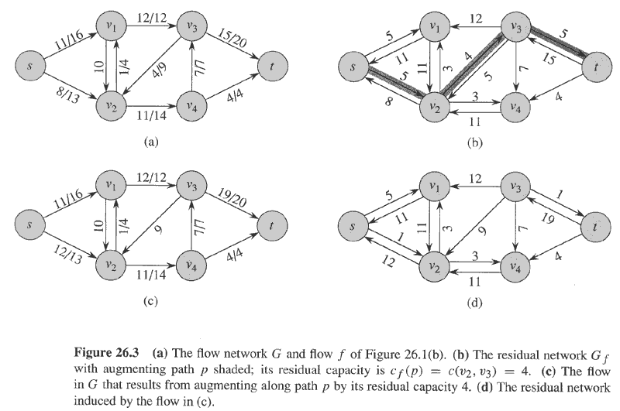
Example
Flow(1)
Residual(1)
No more augmenting paths → max flow attained.
Flow(2)
Residual(2)
Cut

Slide 21
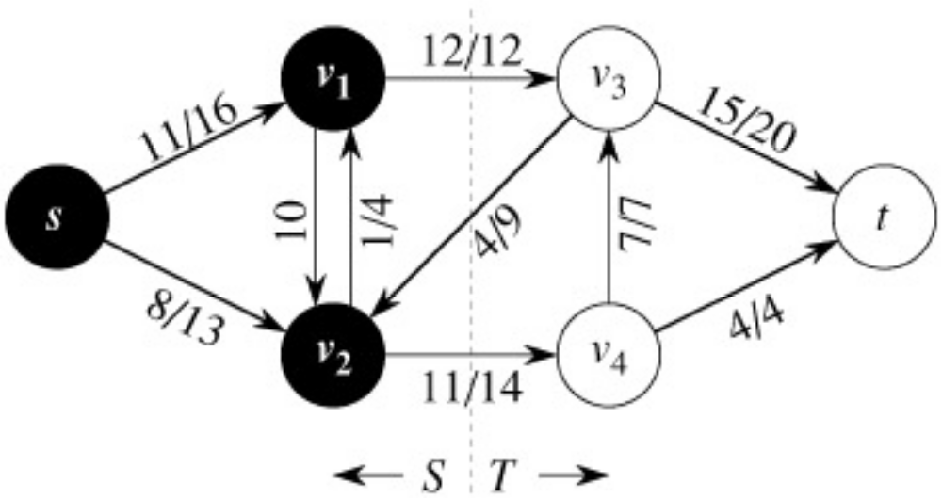
Cuts of Flow Networks

Slide 22
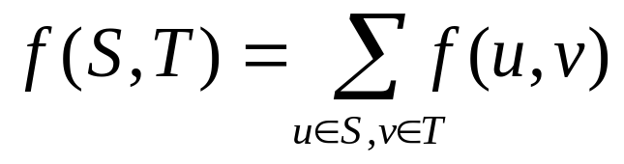
The Net Flow through a Cut (S,T)
f(S,T) = 12 – 4 + 11 = 19

Slide 23
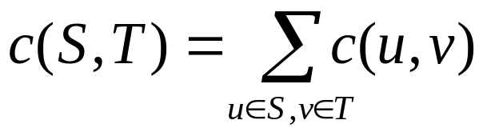
The Capacity of a Cut (S,T)
c(S,T)= 12+ 0 + 14 = 26

Slide 24
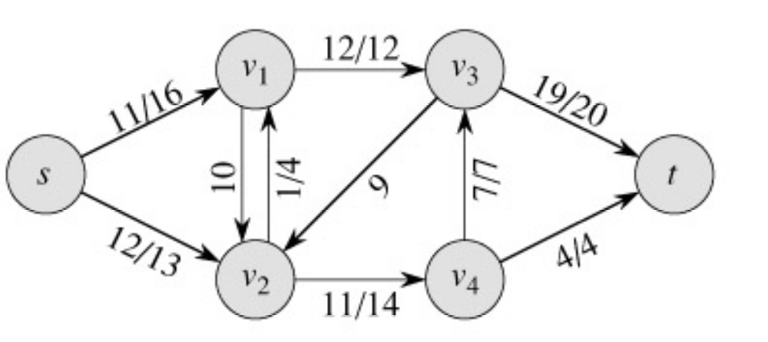
Augmenting Paths – example
Capacity of the cut
= maximum possible flow through the cut
= 12 + 7 + 4 = 23
Flow(2)
cut
The network has a capacity of at most 23.
In this case, the network does have a capacity of 23, because this is a minimum cut.

Slide 25
Net Flow of a Network
The net flow across any cut is the same and equal to the flow of the network |f|.

Slide 26
Bounding the Network Flow
The value of any flow f in a flow network G is bounded from above by the capacity of any cut of G.

Slide 27
Max-Flow Min-Cut Theorem
If f is a flow in a flow network G=(V,E), with source s and sink t, then the following conditions are equivalent:
  f is a maximum flow in G.
  The residual network G_{f} contains no augmented paths.
  |f| = c(S,T) for some cut (S,T) (a min-cut).

Slide 28
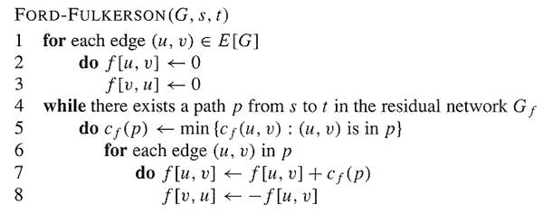
The Basic Ford-Fulkerson Algorithm

Slide 29
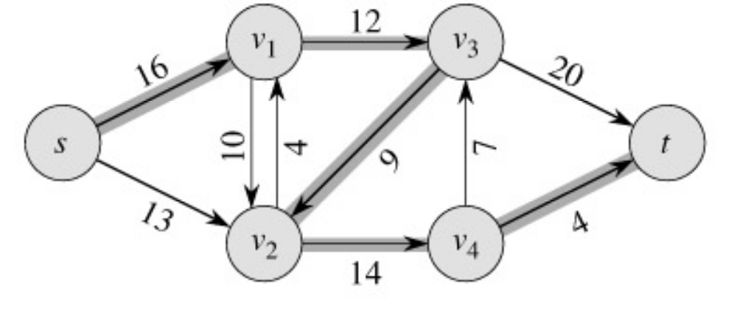
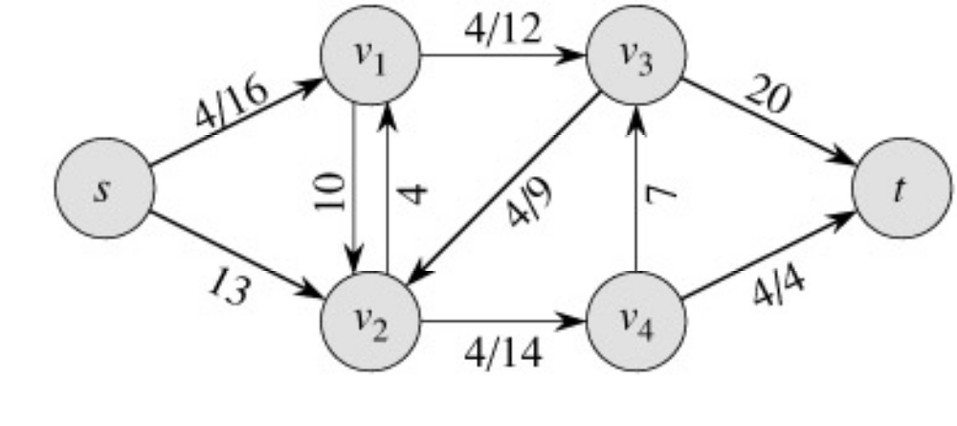
Example
augmenting path
Original Network
Flow Network
Resulting Flow =
4

Slide 30
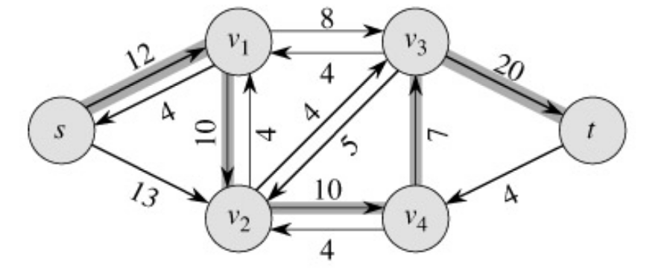
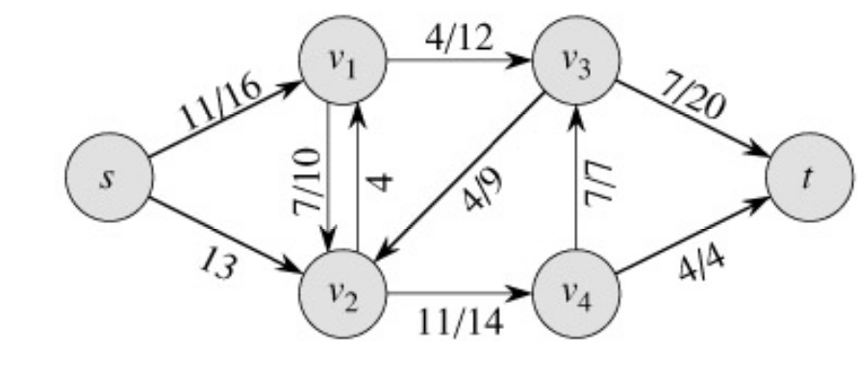
Example
Resulting Flow =
Flow Network
4
augmenting path
Residual Network
Flow Network
Resulting Flow =
11

Slide 31
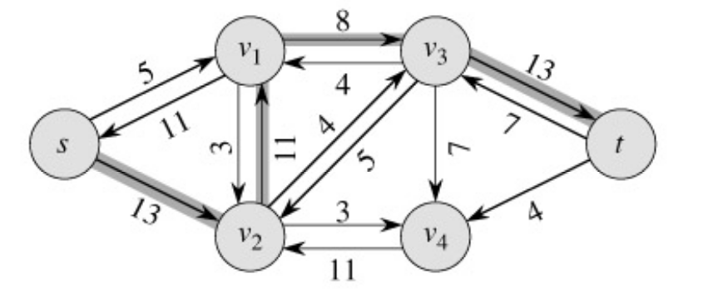
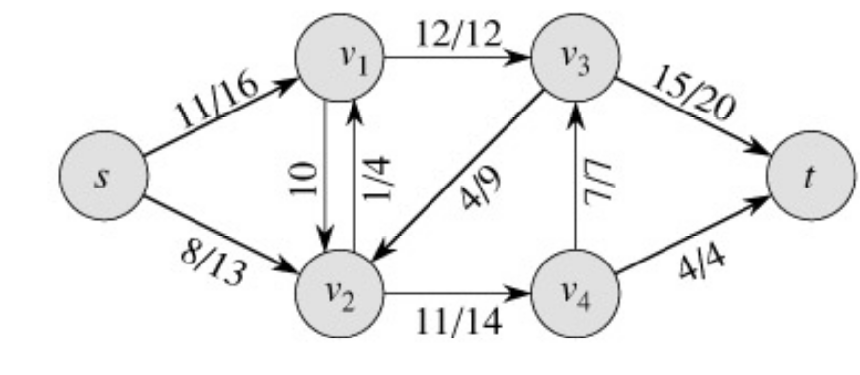
Example
Flow Network
Resulting Flow =
11
augmenting path
Residual Network
Flow Network
Resulting Flow =
19

Slide 32
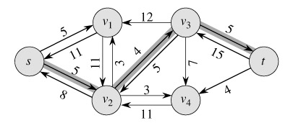
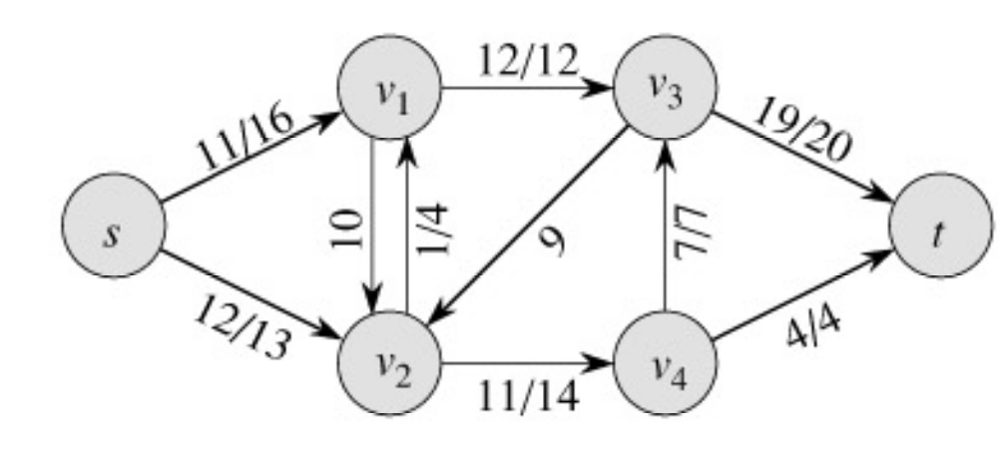
Example
Flow Network
Resulting Flow =
19
augmenting path
Residual Network
Flow Network
Resulting Flow =
23

Slide 33
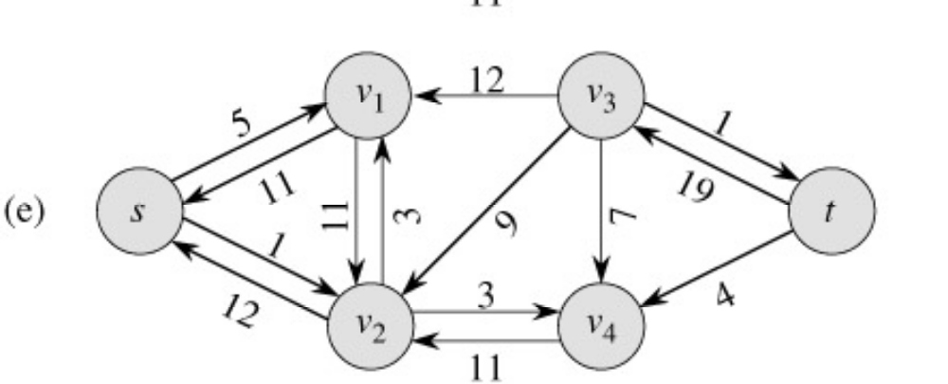
Example
Resulting Flow =
23
No augmenting path:
Maxflow=23
Residual Network

Slide 34
Analysis
O(E)
?
O(E)

Slide 35
Analysis
If capacities are all integer, then each augmenting path raises |f| by ≥ 1.
If max flow is f*, then need ≤ |f*| iterations → time is O(E|f*|).
Note that this running time is not polynomial in input size. It depends on |f*|, which is not a function of |V| or |E|.
If capacities are rational, can scale them to integers.
If irrational, FORD-FULKERSON might never terminate!

Slide 36
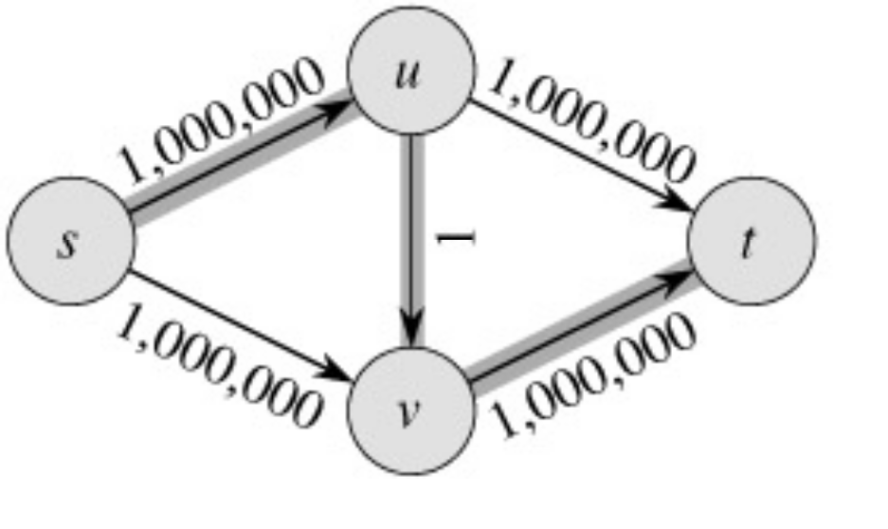
The Basic Ford-Fulkerson Algorithm
With time O ( E |f*|), the algorithm is not polynomial.
This problem is real: Ford-Fulkerson may perform very badly if we are unlucky:
|f*|=2,000,000

Slide 37
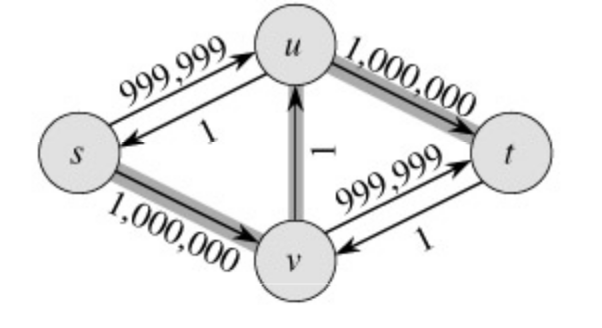
Run Ford-Fulkerson on this example
Augmenting Path
Residual Network

Slide 38
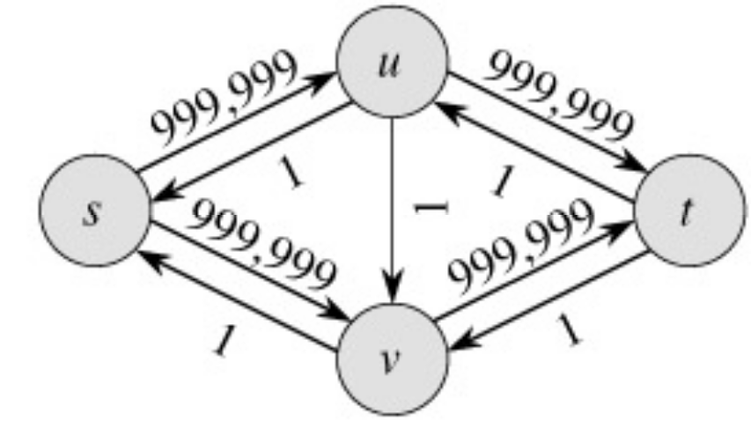
Run Ford-Fulkerson on this example
Augmenting Path
Residual Network

Slide 39

Run Ford-Fulkerson on this example
Repeat 999,999 more times…
Can we do better than this?

Slide 40
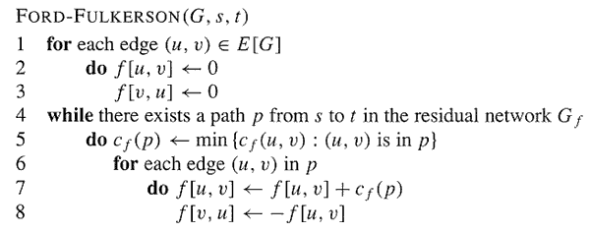
The Edmonds-Karp Algorithm
A small fix to the Ford-Fulkerson algorithm makes it work in polynomial time.
Select the augmenting path using breadth-first search on residual network.
The augmenting path p is the shortest path from s to t in the residual network (treating all edge weights as 1).
Runs in time O(V E²).

Slide 41
The Edmonds-Karp Algorithm - example
The Edmonds-Karp algorithm halts in only 2 iterations on this graph.

Slide 42
Further Improvements
Push-relabel algorithm ([CLRS, 26.4]) – O(V² E).
The relabel-to-front algorithm ([CLRS, 26.5) – O(V³).
(We will not cover these)

Slide 43
An Application of Max Flow:
Maximum Bipartite Matching

Slide 44
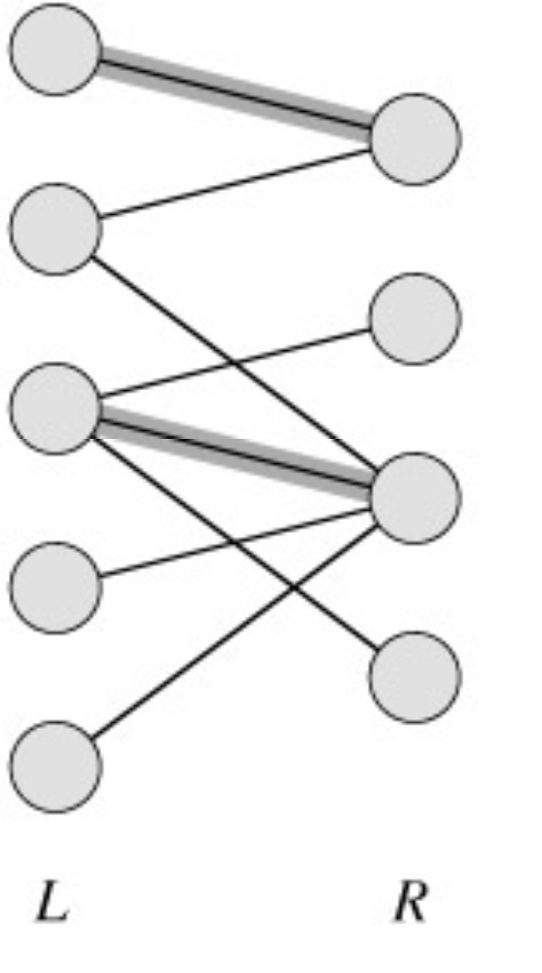
Maximum Bipartite Matching
A bipartite graph is a graph G=(V,E) in which V can be divided into two parts L and R such that every edge in E is between a vertex in L and a vertex in R.
e.g. vertices in L represent skilled workers and vertices in R represent jobs. An edge connects workers to jobs they can perform.

Slide 45
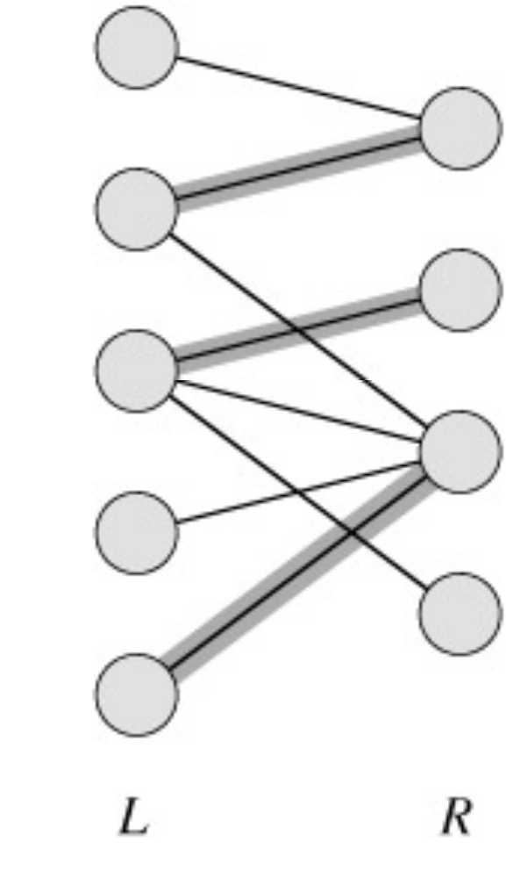
A matching in a graph is a subset M of E, such that for all vertices v in V, at most one edge of M is incident on v.

Slide 46
A maximum matching is a matching of maximum cardinality (maximum number of edges).
not maximum
maximum

Slide 47
A Maximum Matching
No matching of cardinality 4, because only one of v and u can be matched.
In the workers-jobs example a max-matching provides work for as many people as possible.
v
u

Slide 48
Solving the Maximum Bipartite Matching Problem
Reduce the maximum bipartite matching problem on graph G to the max-flow problem on a corresponding flow network G’.
Solve using Ford-Fulkerson method.

Slide 49
Corresponding Flow Network
To form the corresponding flow network G' of the bipartite graph G:
  Add a source vertex s and edges from s to L.
  Direct the edges in E from L to R.
  Add a sink vertex t and edges from R to t.
  Assign a capacity of 1 to all edges.
Claim: max-flow in G’ corresponds to a max-bipartite-matching on G.
G
→G’
1
1
1
1
1
1
1
1
1
s
1
1
t
1
1
1
1
L
R

Slide 50


Solving Bipartite Matching as Max Flow

Slide 51
Does this mean that max |f| = max |M|?
Problem: we haven’t shown that the max flow f(u,v) is necessarily integer-valued.

Slide 52
Integrality Theorem
If the capacity function c takes on only integral values, then:
  The maximum flow f produced by the Ford-Fulkerson method has the property that |f| is integer-valued.
  For all vertices u and v the value f(u,v) of the flow is an integer.
So max|M| = max |f|

Slide 53
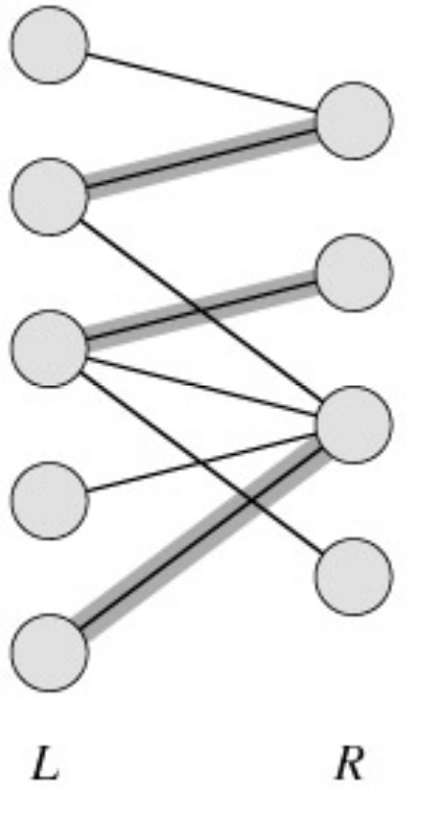
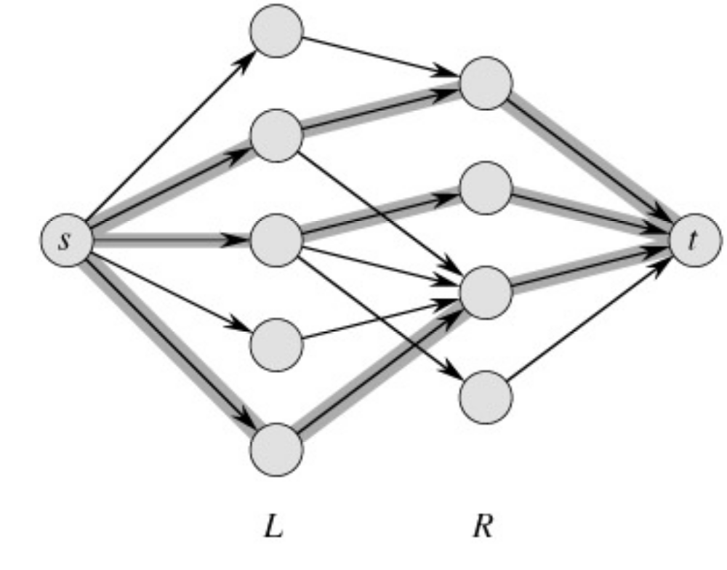
Example
min cut
|M| = 3 ←→ max flow =|f|= 3

Slide 54
Conclusion
Network flow algorithms allow us to find the maximum bipartite matching fairly easily.
Similar techniques are applicable in other combinatorial design problems.

Slide 55
Example
In a department there are n courses and m instructors.
Every instructor has a list of courses he or she can teach.
Every instructor can teach at most 3 courses during a year.
The goal: find an allocation of courses to the instructors subject to these constraints.

