Slide 1
Network Flow

Slide 2
Network Flow
A flow network is a directed graph G = (V,E)
Each edge in the graph has an associated capacity – c(e)
  This capacity is non-negative ( >= 0 )
Graph has a source node (s) and a destination node (t)
  The destination node is referred to as the sink node
Flow comes out of s, but does not enter into it.
Flow enters into t, but does not leave it.

Slide 3
Definition of Flow
Each edge can carry an entity called “flow”.
For flow on an edge to be valid, it must satisfy three conditions:
  Capacity constraint: The flow can not be greater than the capacity of the edge
    f ( u,v ) <= c ( u,v )
  Skew symmetry: The flow on the edge (u,v) is equal to the negation of the flow on the edge (v,u)
  Flow conservation: The total flow entering a vertex (excluding the source or sink) must equal the total positive flow leaving that vertex.

Slide 4
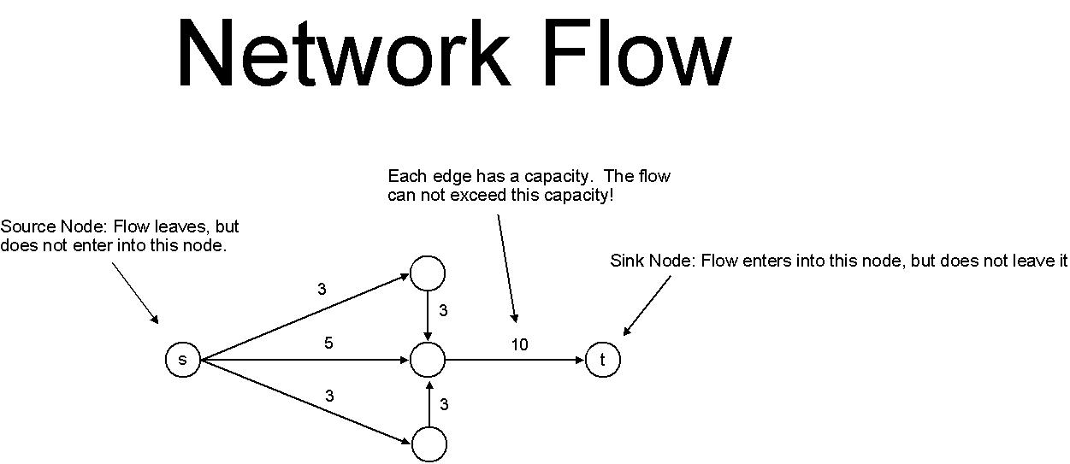

Slide 5
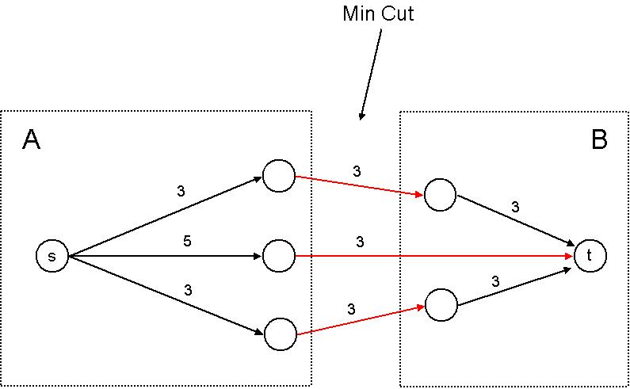
Maximum Flow
Want to maximize the amount of flow sent from the source node to the sink node while adhering to the definition of flow.
We can think of dividing the graph into two sets, A & B.
  One set contains the source node.
  The other set contains the sink node.

Slide 6
Minimum Cut
In the graph on the previous slide, two sets were shown with red edges connecting them.
These edges constitute a cut of the graph, and place a bound on the maximum flow that can travel from s to t.
The maximum flow is denoted through the capacity of the edges in the cut.
Through different arrangements of the sets(1), one can produce multiple cuts in a graph.
The cut which has the smallest capacity indicates the maximum flow of the graph.
1. The source node must always be in set A and the sink node must always be in set B.

Slide 7
Ford-Fulkerson Algorithm
Finds the maximum flow of a network flow graph
This is accomplished by adding flow in increments of the smallest available capacity of the edges contained in a path from s to t.
Assuming capacities of edges are expressed as integers, the algorithm has a run time of O(mC)
  C is the amount of flow leaving the source
  m is the number of edges in the graph
Algorithm with comments shown on next slide.

Slide 8
Ford-Fulkerson Algorithm
Max-Flow
Initially f(e) = 0 for all e in G
//Start out with all edges having no flow
While there is an s-t path in the residual graph Gf
//While we can still add flow from s-t without violating any of the flow definitions
Let P be a simple s-t path in Gf
//Select a path P on which we can still add flow
f’ = augment(f,P);
//Augment finds the smallest remaining capacity of the edges in the path P //and adds that amount (f’) in flow to each edge in the path.
Update f to be f’
//Update the global amount of flow we are sending from s to t
Update the residual Graph Gf to be Gf’
//Update our graph with the new flow we’ve just added.
Endwhile
Return f // ← This is the maximum flow

Slide 9
Bipartite Matching
A graph G = (V,E) is a bipartite graph if the set of vertices V can be partitioned into two sets A and B
The bipartition - No edge E can connect two vertices in the set of the bipartition.
A matching M is a set of edges E such that every vertex of set V appears in at most one edge in M.
A vertex V whose edge is not in M is called exposed (or unmatched)
A matching is perfect if no vertex V in graph G is exposed
  Cardinality is equal to |A| = |B|

Slide 10
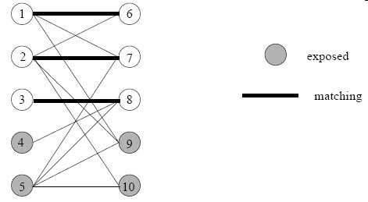
Bipartite Matching Example
* M = {(1, 6), (2, 7), (3, 8)}
* Exposed Vertices = {4, 5, 9, 10}

Slide 11
Preflow-Push Algorithm
First developed by A. V. Goldberg in 1985
Pre-flow means a flow without flow conversation
Algorithm maintains a feasible pre-flow (at all levels) that has a saturated cut
Pre-flow is changed at every step until the flow conversation is satisfied
Push flows on individual arcs instead of augmenting paths
Resulting flow will have a saturated cut, therefore it is a maximum flow
Algorithm described on next slide

Slide 12
Preflow-Push Algorithm
Preflow-Push
Initailly h(v) = 0 for all v != s and h(s)=n and f(e)=ce for all e=(s,v) and f(e)=0 for all other edges
while there is a node v!=t with excess ef(v) > 0
Let v be a node with excess
If there is w such that push(f, h, v, w) can be applied then
push(f, h, v, w)
else
relabel(f, h, v)
EndWhile
Return(f)
Push from node u to node v means send a part of the excess flow from u onto v
Relabel on node u is increases its height until its height becomes higher than at least one of the nodes in which it has available capacity to.

Slide 13
Disjoint Paths
Two paths are considered to be edge-disjoint if they have no edge in common, but multiple paths may go through the same nodes
Problem is to find the maximum number of edge-disjoints s-t paths in graph G
Menger's Theorem
  Maximum number of edge-disjoint s-t paths equals the min number of edges whose removal disconnects t from s.
  Proving Menger’s Theorem
    Let v = max number of edge-disjoint paths ➔ v = maximum s-t flow
    Max-flow minimum-cut = cut (set A, set B) of k capacity
    Let F = edges connecting A to B (paths)
    Each edge has a capacity of 1
    Therefore, |F| = v and, by definition, removing these v edges from G will disconnect t from s

