Slide 1
Design & Analysis of Algorithms

Slide 2
Today’s Tasks
Divide and Conquer
  Binary search
  Powering a number
  Fibonacci numbers
  Matrix multiplication
  Strassen’s algorithm
  VLSI tree layout

Slide 3
The divide-and-conquer Design Paradigm
Divide the problem into subproblems.
Conquer the subproblems by solving them recursively.
Combine subproblem solutions.
Many algorithms use this paradigm.
  give me an example, please?

Slide 4
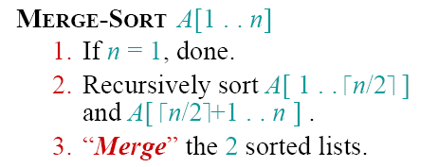


Merge Sort
How to express the cost of merge sort?

Slide 5
Merge Sort
1.Divide:Trivial.
2.Conquer:Recursively sort subarrays.
3.Combine:Linear-time merge.
# subproblems
cost of dividing and combining
subproblem
size

Slide 6



Recall Master Method
Case 1:
  Case 2:

Slide 7




Recall Master Method
Case 3:

Slide 8
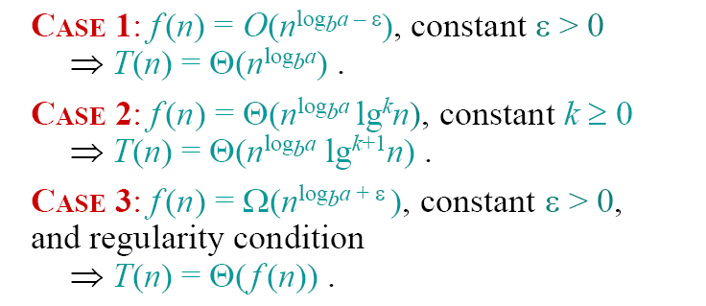


Conclusion of Master Method
Merge Sort
a=2, b=2,
case 2( k=0)
So,

Slide 9
Binary search
Find an element in a sorted array:
  Divide: Check middle element.
  Conquer: Recursively search 1 sub array.
  Combine: Trivial.
  Example: Find 9
  3 5 7 8 9 12 15

Slide 10

Binary search
Find an element in a sorted array:
  Divide: Check middle element.
  Conquer: Recursively search 1 sub array.
  Combine: Trivial.
  Example: Find 9

Slide 11

Binary search
Find an element in a sorted array:
  Divide: Check middle element.
  Conquer: Recursively search 1 sub array.
  Combine: Trivial.
  Example: Find 9

Slide 12

Binary search
Find an element in a sorted array:
  Divide: Check middle element.
  Conquer: Recursively search 1 sub array.
  Combine: Trivial.
  Example: Find 9

Slide 13

Binary search
Find an element in a sorted array:
  Divide: Check middle element.
  Conquer: Recursively search 1 sub array.
  Combine: Trivial.
  Example: Find 9

Slide 14

Binary search
Find an element in a sorted array:
  Divide: Check middle element.
  Conquer: Recursively search 1 sub array.
  Combine: Trivial.
  Example: Find 9

Slide 15

Binary search
Find an element in a sorted array:
  Divide: Check middle element.
  Conquer: Recursively search 1 sub array.
  Combine: Trivial.
  Example: Find 9

Slide 16


Recurrence for binary search
T(n) = 1T(n/2) + Θ(1)
  b=2, a=1
  Case 2 (k=0)
# subproblems
cost of dividing and combining
subproblem
size

Slide 17
Powering a Number
Problem: Compute a^{n}, where n∈N.
Naive algorithm:
  How?
  Complexity ?
The Spot Creativity:
  Is this the only and the best algorithm?
  Any Suggestions on using divide-and-conquer strategy?
  Θ(n)

Slide 18
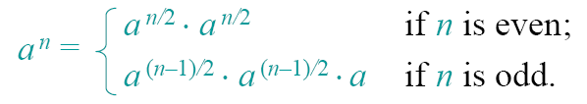

Powering a Number
Divide-and-conquer:
Complexity:
T(n) = T(n/2) + Θ(1)
a=1,b=2
=n⁰=1
case 2(k=0)
T(n) = Θ(lgn)

Slide 19
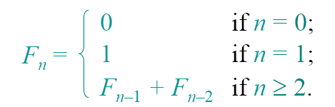
Wonderful Fibonacci numbers
Background of Fibonacci
0 1 1 2 3 5 8 13 21 34….
Give me the recursive definition of Fibonacci Numbers?
Give me an application of Fibonacci numbers.

Slide 20
Application of Fibonacci
There is a staircase of 10 steps, and you can step across one or two steps as you like each time . How many ways we have to step on the stage?
What’s the ratio of the two adjacent numbers in the Fibonacci Sequence, that’s to say, what’s the value of F(n-1)/F(n) when n tends to ∞ ?

Slide 21
Analyze of Fibonacci
To computer Fibonacci number F(n), How much time does it take?
  Substitution method
  Recursion-tree method
  Principal method
  Substitution method
  Guess O(2^{n})
  Guess = T(n)=
In fact, T(n) = Θ(1.618)^{n} (Not required)

Slide 22
Questions?
Why this recursive algorithm takes so much time?
  Building out the recursion tree for F(n), we can see that there are lots of common subtrees.
  Too many duplications that waste time
  Important in Recursion
  Compound Interest Rule

Slide 23
Can we improve the Algorithm?
Think about the bottom-up implantation of this recursive algorithm
  Compute the Fibonacci numbers in order.
  Iterative
  To computer Fibonacci number F(n), How much time does it take?
  T(n) = Θ(n)
Notes:
Recursion 递归
Regression 回归
Iterative 迭代

Slide 24


Is that the best we can do?
Any ideas on how we could compute Fibonacci of n faster than linear time?
  Using mathematical properties of Fibonacci numbers
  rounded to the nearest integer, where
  What we call Naive recursive squaring.
Time Complexity:
Does this work well?
  This method is unreliable, since floating-point arithmetic is prone to round-off errors.

Slide 25

Recursive Squaring
Another mathematical property of Fibonacci numbers
How to prove that theorem?
  Induction on n.
What’s the cost of computing F_{n} ?

Slide 26

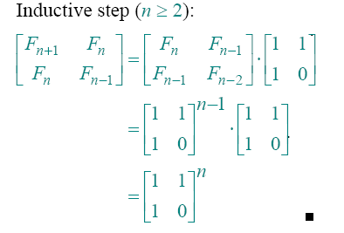
Proof of Theorem

Slide 27
Homework
Code to implement the four algorithms of computing Fibonacci numbers.
  Recursive
  Iterative
  Approximation
  Recursive Squaring
Titled with your student number and your name
Submit your runnable source code to my mailbox
Deadline：before next class

Slide 28

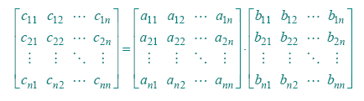


Matrix Multiplication of n*n

Slide 29


Code for Matrix Multiplication
for i=1 to n
for j=1 to n
c_{ij}=0
for k=1 to n
c_{ij}=c_{ij} + a_{ik}*b_{kj}
Running Time= ?

Slide 30
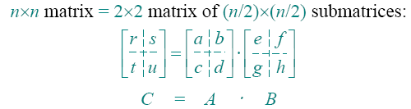
Let’s do better
How to divide-and-conquer?
  Recall what we have done before.
  n->n/2
  Idea:
  r=ae+bg; s=af+bh;
  t=ce+dg; u=cf+dh;

Slide 31
Cost of Matrix Multiplication
We need:
  8 recursive multiplications of matrix in size (n/2)*(n/2)
  4 add operations of matrix in size (n/2)*(n/2)
  Cost of adding two matrix in size n*n?
So, multiplication of matrix in size n*n takes T(n)=8 * T(n/2) + Θ(n²)
# subproblems
cost of dividing and combining
subproblem
size

Slide 32
Cost of Matrix Multiplication
T(n)=8 * T(n/2) + Θ(n²)
a=8,b=2
=n³
case 1(ε=1)
T(n) = Θ(n³)
OOPS! No better than the ordinary algorithm !

Slide 33
Strassen’s Idea
How Strassen came up with his magic idea?
  We should try get rid of as more multiplications as possible. We could do a hundred additions instead.
  We can reduce the numbers of subproblems in T(n)=8 * T(n/2) + Θ(n²)
  He must be very clever.

Slide 34
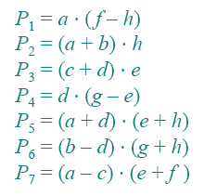

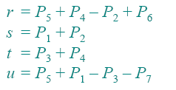
Strassen’s Idea
Multiply 2*2 matrices with only 7 recursive multiplications.
Notes: plus of matrices is commutative , but multiplication is not.

Slide 35
Strassen’s Algorithm
1.Divide: Partition A and B into (n/2)*(n/2) submatrices. And form terms to be multiplied using + and –.
2.Conquer: Perform 7 multiplications (P₁ to P₇) of (n/2)×(n/2) submatrices recursively.
3.Combine:Form C (r,s,t,u) using + and –on (n/2)×(n/2) submatrices.
Write down cost of each step
We got T(n)=7 * T(n/2) + Θ(n²)

Slide 36
Cost of Strassen’s Algorithm
T(n)=7 * T(n/2) + Θ(n²)
a=7,b=2
=n^{lg7}
case 1
T(n) = Θ(n^{lg7}) =O(n^{2.81})
Not so surprising?
Strassen’s Algorithm is not the best. The best one has O(n^{2.376}) (Be of theoretical interest only).
But it is simple and efficient enough compared with the naïve one when n>=32.

Slide 37
VLSI Layout
VLSI: Very Large Scale Integrated circuits.
Layout of chips is a very important problem in cost control.
Problem: layout n chips in a grid, the control lines forms a binary tree, no cross and with minimum area.
Embed a complete binary tree with n leaves in a grid using minimal area.

Slide 38
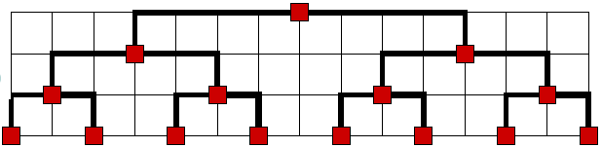
VLSI Layout
Naïve Layout
How much area it takes?
  Height : H(n) ?
  Width: W(n) ?
Θ(lgn)
Θ(n)

Slide 39
Naïve Layout
In fact, we can express using divide-and-conquer strategy.
  Height : H(n) = H(n/2) + Θ(1) = Θ(lgn)
  Width: W(n) = 2W(n/2)+ Θ(1) = Θ(n)
  Area = Θ(nlgn)

Slide 40

Improvements
How can we reduce the height or the weight to take less area?
Hint: Our goal is O(n).
What are two functions whose product is n?
  Height : H(n) =
  Width: W(n) =

Slide 41
Improvements
  What is a recurrence in the usual master method form whose solution is root n?
  log_{b}a=1/2

Slide 42
Improvements
  When log_{b}a=1/2 ?
  Guess: b=4, a=2
  What form the cost should take?
  T(n)=2T(n/4)+f(n)
  How should we aligned the nodes on a grid?
  Imagine H layout.

Slide 43
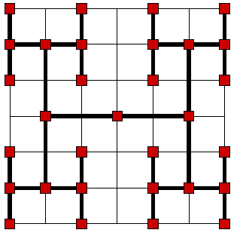
Here we are
H-tree embedding
Height : H(n) = 2H(n/4) + Θ(1)
Weigh W(n) = 2W(n/4)+ Θ(1)
H(n) = W(n)=
(case 1)
Area = Θ (n)

Slide 44
Conclusion
Divide and conquer often leads to efficient algorithms, but it is just one of several powerful techniques for algorithm design.
Divide-and-conquer algorithms can be analyzed using recurrences and the master method.
If we know what running time we are aiming for, think about the recurrence that will get us there. And that’s so-called inspiration.

