Slide 1
Design & Analysis of Algorithms

Slide 2
Today’s Tasks
Quicksort
  Divide and conquer
  Partitioning
  Worst-case analysis
  Intuition
  Randomized quicksort
  Analysis

Slide 3
Quick Sort
Proposed by Tony Hoare in 1962.
Divide-and-conquer algorithm.
Sorts “in place”
(like insertion sort, but not like merge sort)
Very practical.

Slide 4

Divide and conquer
Quicksort an n-element array:
Divide: Partition the array into two subarrays around a pivot x such that elements in lower subarray ≤ x ≤ elements in upper subarray.
Conquer: Recursively sort the two subarrays.
Combine: Trivial.
Key: ?
partitioning subroutine.

Slide 5
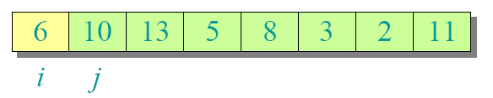
Example of Partition

Slide 6
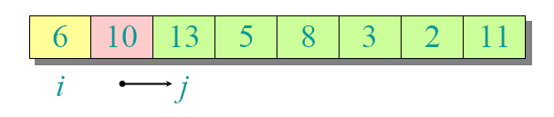
Example of Partition

Slide 7
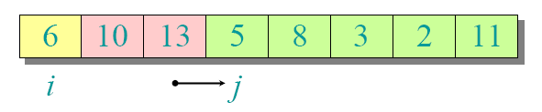
Example of Partition

Slide 8
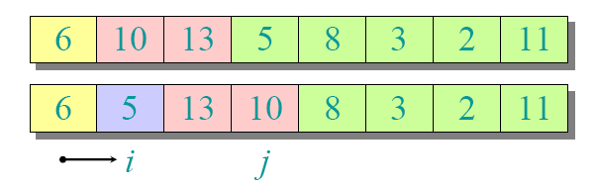
Example of Partition

Slide 9
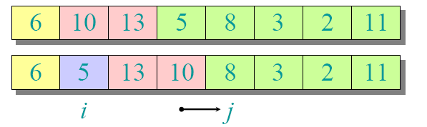
Example of Partition

Slide 10
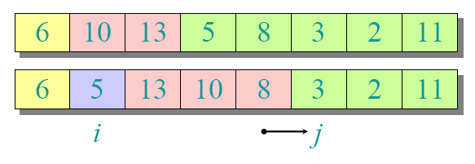
Example of Partition

Slide 11
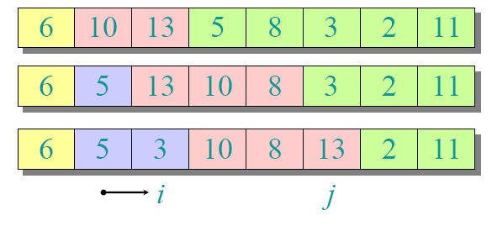
Example of Partition

Slide 12
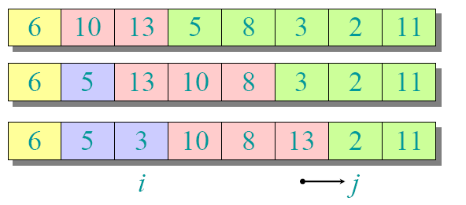
Example of Partition

Slide 13
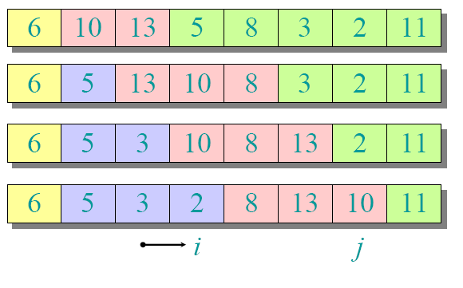
Example of Partition

Slide 14
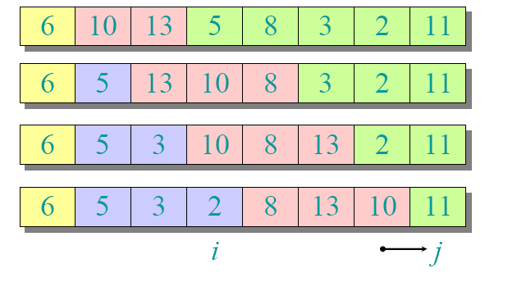
Example of Partition

Slide 15
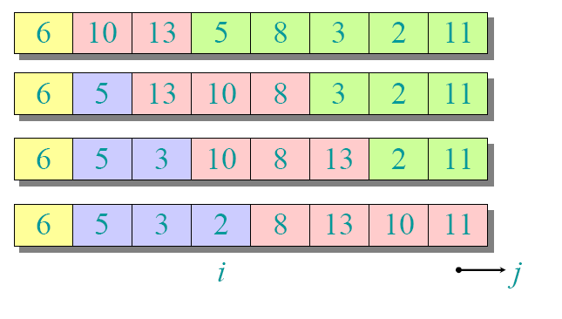
Example of Partition

Slide 16
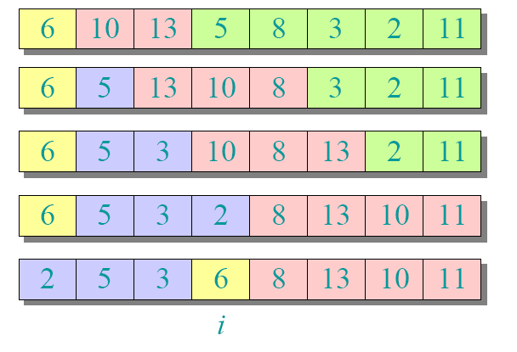
Example of Partition

Slide 17
Example of Partition
Please write down the algorithm of partition an array A between index p and q.

Slide 18
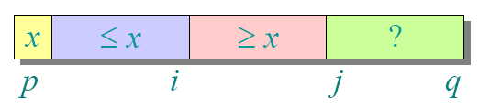
Partitioning subroutine
PARTITION(A, p, q) //A[p. . q]
x←A[p] //pivot= A[p]
i←p
for j← p+1 to q
do if A[j] ≤x
    then i←i+ 1
    exchange A[i] ↔ A[j]
exchange A[p] ↔ A[i]
return i
Running Time = ?
Θ(n)

Slide 19
Pseudo-code for Quick Sort
QUICKSORT(A, p, r)
if p << r
then q←PARTITION(A, p,r)
QUICKSORT(A, p, q–1)
    QUICKSORT(A, q+1, r)
Initial call: QUICKSORT(A, 1, n)
Boundary case: there are zero or one elements.
Optimizations: Use another special-purpose sorting routine for small numbers of elements. (tail recursion )

Slide 20
Analysis of Quicksort
Let T(n) = worst-case running time on an array of n elements.
  What is the worst case?
  The input is sorted or reverse sorted.
  Partition around min or max element.
  One side of partition always has no elements.

Slide 21
The Worst Case
Under the worst case, how can we compute T(n)?
T(n) = T(0)+T(n-1)+Θ(n)
= Θ(1)+T(n-1)+Θ(n)
= T(n-1)+Θ(n)
= ?
Can you guess it ?

Slide 22
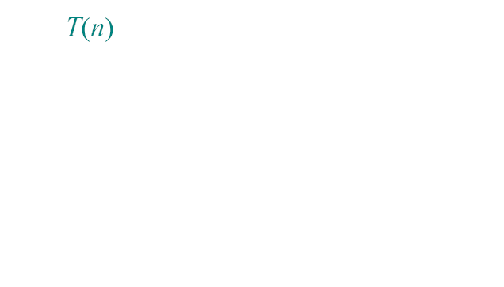
Recursion Tree
T(n) = T(0)+ T(n-1)+ cn

Slide 23
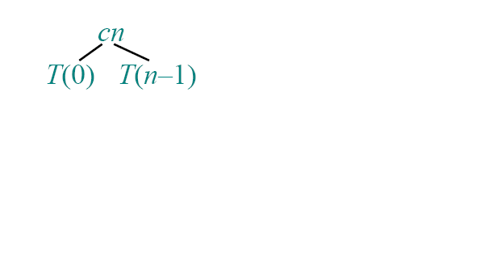
Recursion Tree
T(n) = T(0)+ T(n-1)+ cn

Slide 24
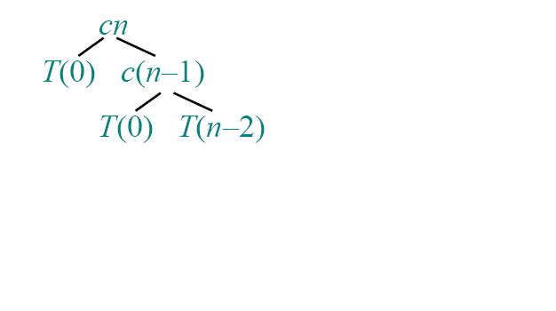
Recursion Tree
T(n) = T(0)+ T(n-1)+ cn

Slide 25
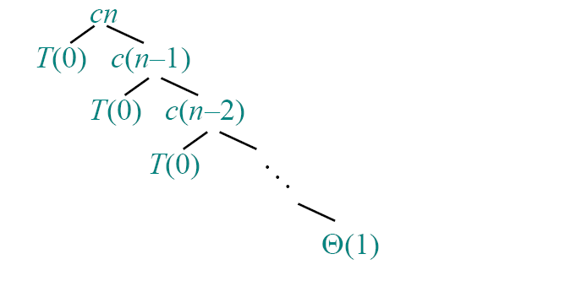
Recursion Tree
T(n) = T(0)+ T(n-1)+ cn

Slide 26
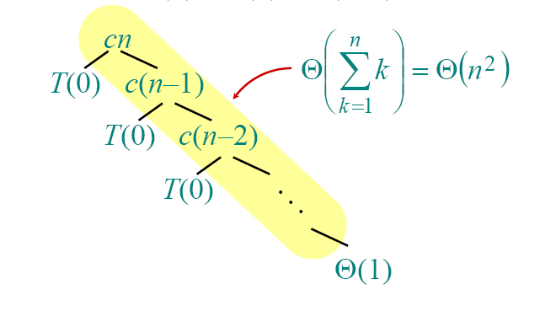
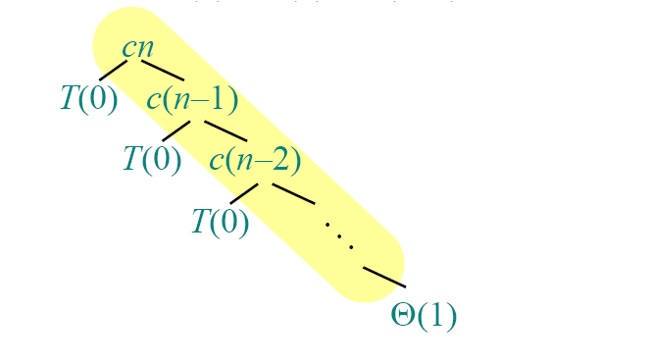
Recursion Tree
T(n) = T(0)+ T(n-1)+ cn

Slide 27
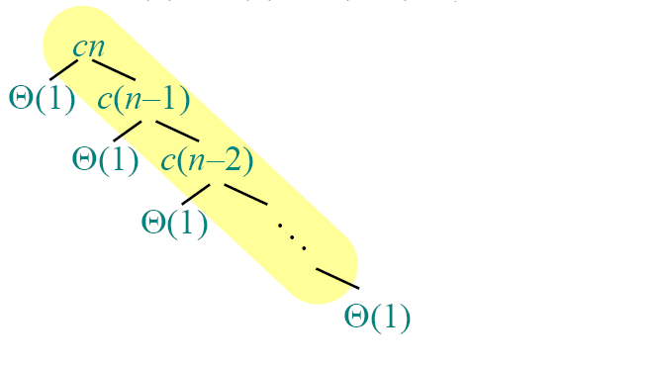
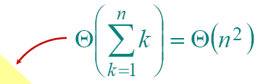
Recursion Tree
T(n) = T(0)+ T(n-1)+ cn
T(n) = Θ(n²)+n * Θ(1)
= Θ(n²)+Θ(n)
= Θ(n²)
Height
=
？
n

Slide 28

Best-case analysis
(For intuition only!) What’s the best case?
If we’re lucky, PARTITION splits the array evenly:
T(n)= 2T(n/2) + Θ(n)
= Θ(nlgn)
What if the split is always1/10:9/10?
What is the solution to this recurrence?

Slide 29
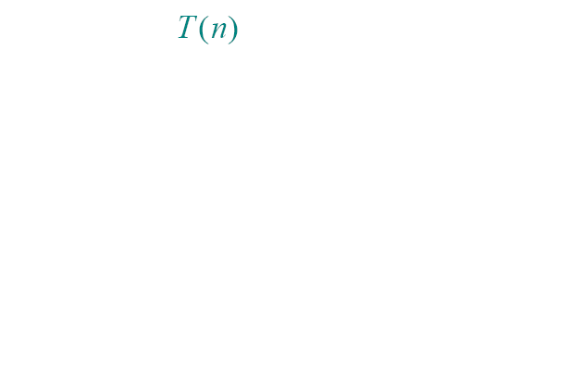
Analysis of this asymmetric case

Slide 30
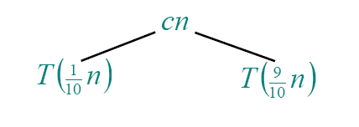
Analysis of this asymmetric case

Slide 31
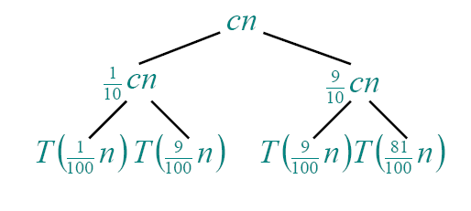
Analysis of this asymmetric case

Slide 32
Analysis of this asymmetric case

Slide 33
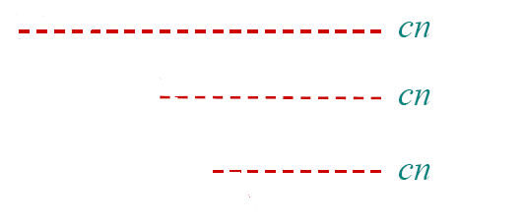
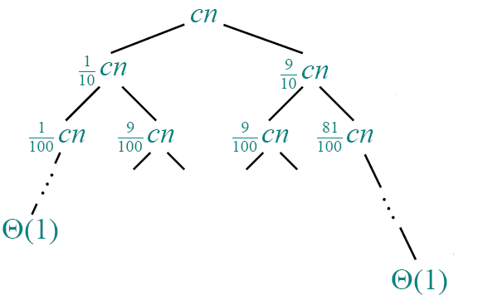


Analysis of this asymmetric case
T(n) ≥ cnlog₁₀n
Height
=
？
…

Slide 34

Analysis of this asymmetric case
T(n) ≤ cnlog_{10/9}n+O(n)
∴
Height
=
？
…

Slide 35
Another case
Suppose we alternate lucky, unlucky, lucky, unlucky, lucky, ….
  L(n)= 2U(n/2) + Θ(n) lucky
  U(n)= L(n –1) + Θ(n) unlucky
  Solving:
  L(n) = 2(L(n/2-1) + Θ(n/2)) + Θ(n)
  = 2L(n/2 –1) + Θ(n)
  = Θ(nlgn)

Slide 36
Analysis of Quicksort
  How can we make sure we are usually lucky?
  As far as the input is not well sorted, we are lucky.
  We can arrange the elements randomly.
  We can choose a random element as pivot.

Slide 37
Randomized quicksort
IDEA: Partition around a random element.
Running time is independent of the input order.
No assumptions need to be made about the input distribution.
No specific input elicits the worst-case behavior.
The worst case is determined only by the output of a random-number generator.

Slide 38
Randomized Quicksort
Basic Scheme: pivot on a random element.
In the code for partition, before partitioning on the first element, swap the first element with some other element in the array chosen at random.
So that, all the elements are all equally to be pivoted on.

Slide 39
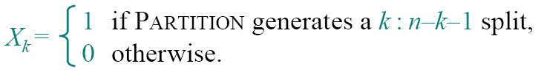
Randomized Quicksort Analysis
Let T(n) = the random variable for the running time of randomized quicksort on an input of size n, assuming random numbers are independent.
For k= 0, 1, …, n–1, define the indicator random variable

Slide 40
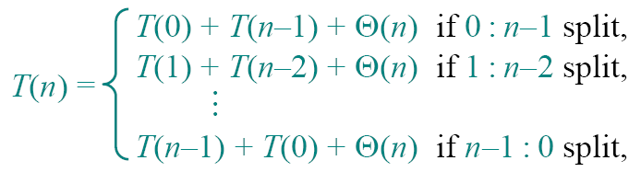
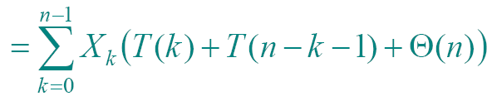
Randomized Quicksort Analysis
E[X_{k}] = 1* Pr {X_{k} = 1} +0* Pr {X_{k} = 0}
= Pr {X_{k} = 1}
= 1/n
  since all splits are equally likely.

Slide 41





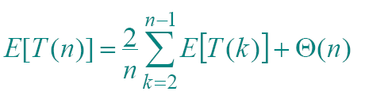
Randomized Quicksort Analysis
By linearity of expectation:
  The expectation of a sum is the sum of the expectations.
By independence of X_{k} from other random choices.
Summations have identical terms.
The k = 0, 1 terms can be absorbed in the Θ(n).

Slide 42
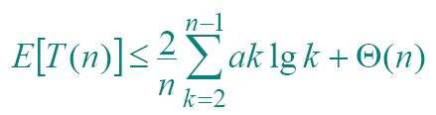
Our Objective
Prove:E[T(n)] ≤ anlgn for constant a > 0.
  Choose a big enough so that anlgn dominates E[T(n)] for sufficiently small n ≥2.
  That’s why we absorb k = 0, 1 terms
  How to prove that?
  Substitution Method

Slide 43
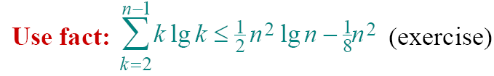



To prove
we are going to
if a is chosen large enough so that an/4 dominates the Θ(n).
desired
residual

Slide 44
Advantages of Quicksort
Quicksort is a great general-purpose sorting algorithm.
Quicksort is typically over twice as fast as merge sort.
Quicksort can benefit substantially from code tuning.
Quicksort behaves well even with caching in virtual memory.

Slide 45
The Birthday Paradox
How many people must there be in a room if there are two of them were born on the same day of the year?
How many people must there be in a room if there is a big chance that two of them were born on the same day? Such as probability of more than 50%?

Slide 46

Indicator Random Variable
We know that the probability of i's birthday and j's birthday both fall on the same day r is
  1/n, n=365
We define the indicator random variable X_{ij} for 1 ≤ i < j ≤ k, by

Slide 47

Indicator Random Variable
Thus we have
E [X_{ij}] = Pr {person i and j have the same birthday}
= 1/n.
Letting X be the random variable that counts the number of pairs of individuals having the same birthday

Slide 48
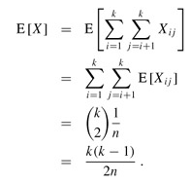
The Birthday Paradox
If we have at least individuals in a room, we can expect two to have the same birthday.
For n = 365, if k = 28, the expected number of pairs with the same birthday is (28 · 27)/(2 · 365) ≈ 1.0356.

Slide 49
Expanded Content:
The hiring problem
The employment agency send you one candidate each day. You will interview that person and then decide to either hire that person or not.
  You must pay the employment agency fee to interview an applicant.
  To actually hire an applicant is more costly.
  You are committed to having, at all times, the best possible person for the job.
  Now we wish to estimate what that price will be.

Slide 50
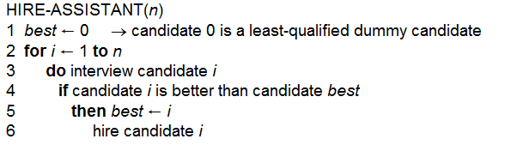
Algorithm of hiring problem
We are not concerned with the running time of HIRE-ASSISTANT, but instead with the cost incurred by interviewing and hiring.
The analytical techniques used are identical whether we are analyzing cost or running time. That’s to counting the number of times certain basic operations are executed

Slide 51
Worst Case of hiring problem
In the worst case, we actually hire every candidate that we interview.
  This situation occurs if the candidates come in increasing order of quality, in which case we hire n times, for a total hiring cost of O(nc_{h}).
we have no idea about the order in which they arrive, nor do we have any control over this order.

Slide 52
Probabilistic analysis
Probabilistic analysis is the use of probability in the analysis of problems.
  In order to perform a probabilistic analysis, we must make assumptions about the distribution of the inputs.
  Then we analyze our algorithm, computing an expected running time.
  The expectation is taken over the distribution of the possible inputs.

Slide 53
Randomized algorithms
By making the behavior of part of the algorithm random, we can use probability and randomness as a tool for algorithm design and analysis.
More generally, we call an algorithm randomized if its behavior is determined not only by its input but also by values produced by a random-number generator.

Slide 54


Using indicator random variables
Assume that the candidates arrive in a random order.
Let X be the random variable that indicates the number of times we hire a new office assistant.
We use indicator random variables to simplify the calculation.

Slide 55
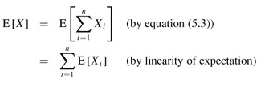

Using indicator random variables
(P655 harmonic series)

Slide 56
Probabilistic Analysis and Randomized Algorithms
With Probabilistic Analysis and Randomized Algorithms
  Your enemy cannot produce a bad input array, since the random permutation makes the input order irrelevant.
  The randomized algorithm performs badly only if the random-number generator produces an "unlucky" permutation.
  A₁ = <1, 2, 3, 4, 5, 6, 7, 8, 9, 10>
  A₂ = <10, 9, 8, 7, 6, 5, 4, 3, 2, 1>
  A₃= <5, 2, 1, 8, 4, 7, 10, 9, 3, 6>

