Slide 1
Design & Analysis of Algorithms

Slide 2
Today’s Tasks
Sorting Lower Bounds
  Decision trees
Linear-Time Sorting
  Counting sort
  Radix sort

Slide 3
How fast can we sort?
how fast can we sort?
  Θ(nlgn) for merge sort and quick sort.
  Θ(n²) for insertion sort and bubble sort, if all we're allowed to do is swap adjacent elements.
It depends on the computational model, that’s to say, what you're allowed to do with the elements.
All of these 4 algorithms have something in common in terms of computational model. What’s that?

Slide 4
How fast can we sort?
All the sorting algorithms we have seen so far are comparison sorts: only use comparisons to determine the relative order of elements.
The best running time that we’ve seen for comparison sorting is ?
  O(nlgn).
Is O(nlgn)the best we can do with comparison sorting?
  Yes, and Decision Trees can help us answer this question.

Slide 5
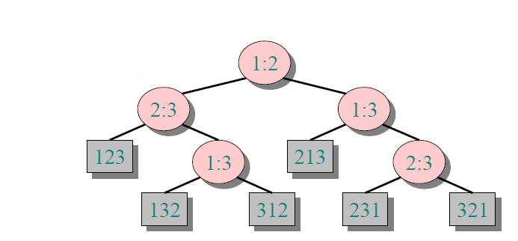
Decision-tree example
Sort 〈a₁, a₂, a₃〉

Slide 6
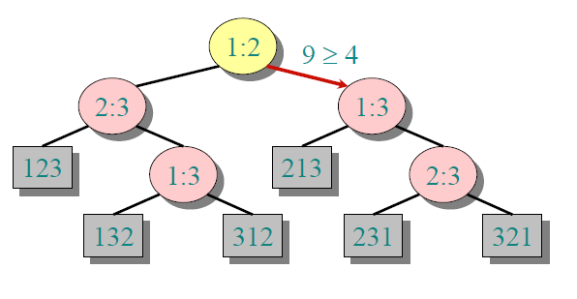
Decision-tree example
Sort 〈a₁, a₂, a₃〉= 〈9, 4, 6〉

Slide 7
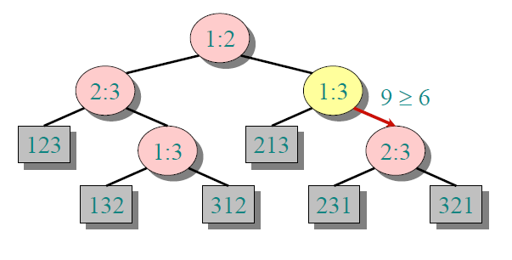
Decision-tree example
Sort 〈a₁, a₂, a₃〉= 〈9, 4, 6〉

Slide 8
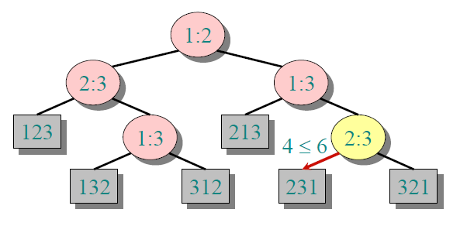
Decision-tree example
Sort 〈a₁, a₂, a₃〉= 〈9, 4, 6〉

Slide 9
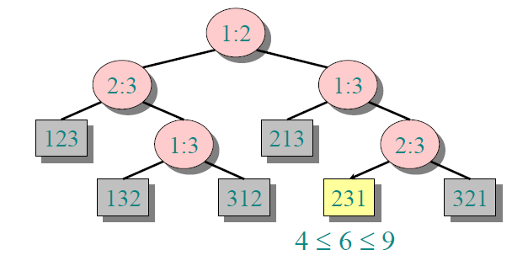
Decision-tree example
Sort 〈a₁, a₂, a₃〉= 〈9, 4, 6〉

Slide 10
Decision-tree Model
Sort 〈a₁, a₂, …, a_{n}〉
  Each internal node is labeled i:j for i, j∈{1, 2,…, n}.
  The left subtree shows subsequent comparisons
  if a_{I} ≤ a_{J}.
  The right subtree shows subsequent comparisons
  if a_{I} > a_{J}.
  Each leaf contains a permutation to indicate that the ordering a₁'≤ a₂' ≤…≤ a_{n}' has been established.

Slide 11
Decision-Tree and Algorithm
  In fact, a decision-tree represents all possible executions of a comparison sort algorithm.
  Each comparison sort algorithm can be represented as a decision tree.
  One tree for each input size n.
  View the algorithm as splitting whenever it compares two elements.
  The tree contains the comparisons along all possible instruction traces.

Slide 12
Scale of Decision Tree
  How big the decision tree will be roughly?
  Number of leaves?
    n! Because it should give the right answer in possible inputs.
  What signifies the running time of the algorithm taken?
    Length of a path
  What denotes the worst-case running time？
    The longest path, height of the tree
  Height of the tree is what we care about.

Slide 13
Lower Bound for Decision-tree Sorting
Theorem. Any decision tree that can sort n elements must have height Ω(nlgn).
Proof. _{(not strict)}
  The tree must contain at least n! leaves, since there are n! possible permutations.
  A height-h binary tree has at most how many leaves?
  Thus this gives us a relation .
  How to solve this?
2^{h}
n! ≤ 2^{h}

Slide 14





Proof of Lower Bound
Because lg() is a monotonically increasing function.
By Stirling's Formula

Slide 15
Corollary of decision tree
Conclusion: all comparison algorithms require at least nlgn comparisons.
For a randomized algorithm, this lower bound still applies.
Randomized quicksort and Merge sort are asymptotically optimal comparison sorting algorithms.
Can we burst out this lower bound and sort in linear time?

Slide 16
Sort in linear time : Counting sort
We need some more powerful assumption: the data to be sorted are integers in a particular range.
Input: A[1 . . n], where A[i]∈{1, 2, …, k}.
  The running time actually depends on k.
Output: B[1 . . n], sorted.
Auxiliary storage (not in place) : C[1 . . k].

Slide 17
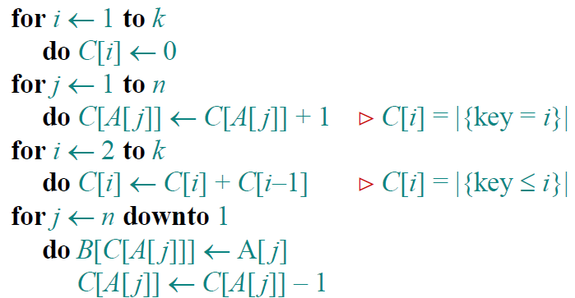
Counting sort

Slide 18
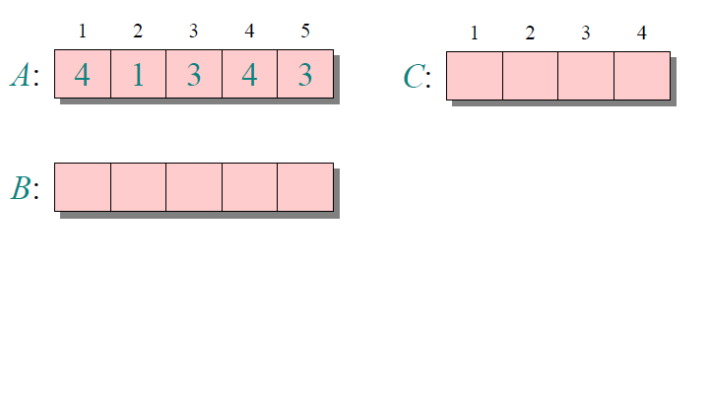
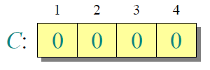
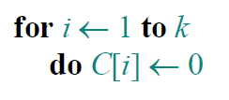
Counting sort Example

Slide 19



Counting sort Example

Slide 20


Counting sort Example

Slide 21


Counting sort Example

Slide 22


Counting sort Example

Slide 23


Counting sort Example

Slide 24
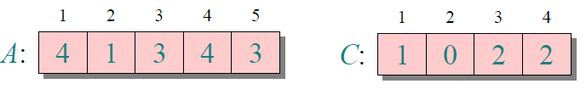


Counting sort Example

Slide 25

Counting sort Example

Slide 26

Counting sort Example

Slide 27
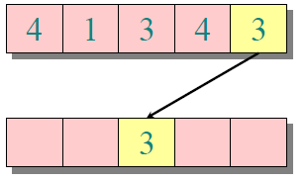


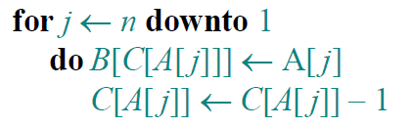
Counting sort Example

Slide 28
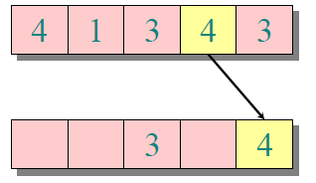


Counting sort Example

Slide 29
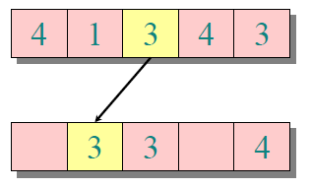



Counting sort Example

Slide 30
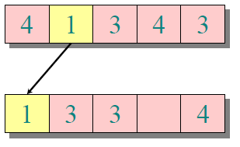



Counting sort Example

Slide 31
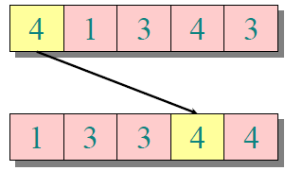



Counting sort Example

Slide 32
Counting sort Example
All the elements appear and they appear in order, so that's the counting sort algorithm!
What’s the running time of counting sort?

Slide 33

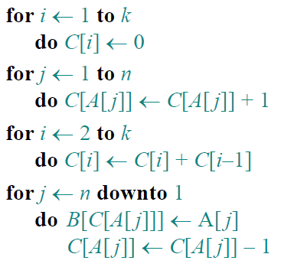


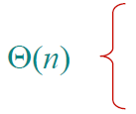

Analysis

Slide 34
Running Time
We have Θ(n+k):
  If k is relatively small, like at most n, Counting Sort is a great algorithm.
  If k is big like n² or 2^{n}, it is not such a good algorithm.
  If k= O(n), then counting sort takes Θ(n) time.
  Not only do we need assume that the numbers are integers, but also the range of the integers is small for our algorithm to work.

Slide 35
Running Time
If we're dealing with numbers of one byte long.
  k is 2⁸=256.We need auxiliary array of size 256, and our running time is Θ(256 + n).
  If we're dealing with integers in 32 bit.
  We need auxiliary array of size 2³²
  Which is 4g. It is not a practical algorithm.

Slide 36
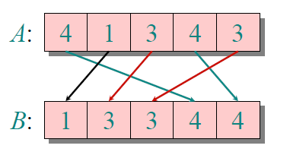
An important property of counting sort
Counting sort is a stable sort.
  it preserves the input order among equal elements.
Question:
  What other sorts have this property?

Slide 37
Stable Sort
Bubble Sort
Insertion Sort
Merge Sort
Randomized QuickSort

Slide 38
Radix sort
One of the oldest sorting algorithms.
  It's probably the oldest implemented sorting algorithm.
  It was implemented around 1890 by Herman Hollerith.
  Radix Sort still have an assumption about range of numbers, but it is a much more lax assumption.

Slide 39
Herman Hollerith (1860-1929)
The 1880 U.S. Census took almost 10 years to process.
While a lecturer at MIT, Hollerith prototyped punched-card technology.
His machines, including a “card sorter,” allowed the 1890 census total to be reported in 6 weeks.
He founded the Tabulating Machine Company in 1911, which merged with other companies in 1924 to form International Business Machines.

Slide 40
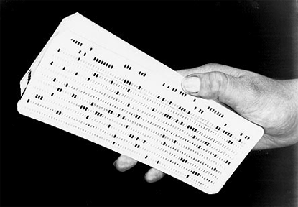
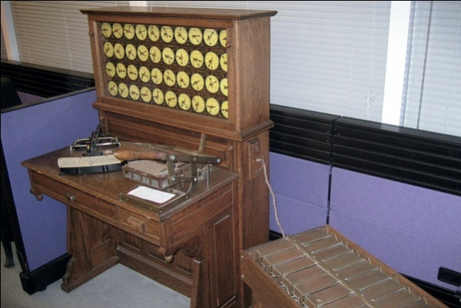
Punched cards
Punched card =data record.
Hole =value.
Algorithm =machine +human operator.
Punched card by IBM Hollerith's tabulating system, punch card

Slide 41
Radix Sort
Origin: Herman Hollerith’s card-sorting machine for the 1890 U.S. Census.
Digit by digit sort
Original idea:
  Sort on most-significant digit first.
  Why it is not a good idea?
  It produces too much intermediate results and need many bins while using card-sorting machine.

Slide 42




  Good idea:
  Sort on least-significant digit first with auxiliary stable sort.

Slide 43
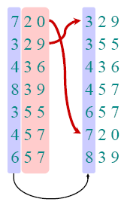
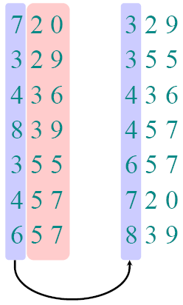
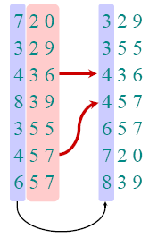
Correctness of radix sort
Induction on digit position
  Assume that the numbers are sorted by their low-order t-1digits.
  Sort on digit t
    Two numbers that differ in digit t
    are correctly sorted.
    Two numbers equal in digit t
    are put in the same order as
    the input ⇒correct order.

Slide 44
Analysis of radix sort
Assume counting sort is the auxiliary stable sort.
  We use counting sort for each digit. Θ(k+n)
Sort n computer words of b bits in binary world.
  Range:0~2^{b}-1
  We need b passes
  Optimization:
  cluster together some bits.

Slide 45

Analysis of radix sort
Notation: Split each integer into b/r pieces, each r bits long.
  b/r is the number of rounds
  Range of each piece is 0~2^{r}-1,that’s the k in counting sort.
  Total running time :
  Recall: Counting sort takes Θ(n + k) time to sort n numbers in the range from 0 to k.
  each pass of counting sort takes Θ(n + 2^{r}) time. So

Slide 46
Analysis of radix sort
We should choose r to minimize T(n,b).
  How could we solve this?
  Mathematician: Minimize T(n,b) by differentiating and setting to 0.
  Intuition: increasing r means fewer passes, but as r >lgn, the time grows exponentially.
  We don’t want 2^{r} >n, and there’s no harm asymptotically in choosing r as large as possible subject to this constraint.
  That’s r=lgn

Slide 47
Analysis of radix sort
Choosing r= lgn implies
  T(n,b) = Θ(bn/lgn).
  Our numbers are integers in the range 0~2^{b}-1, b corresponds to the range of number.
For integers in the range from 0 to n^{d}–1, where d is a constant. Try to work out the running time.
  Radix sort runs in Θ(dn) time.

Slide 48
Comparison of two algorithms
Counting sort handles 0~ n*d in linear time.
  Θ(n+k)
Radix sort can handle 0~n^{d} in linear time.
  Θ(dn)
  As long as d is less than lgn, Radix sort beats other nlgn algorithms.

Slide 49
Further Consideration
Now can we sort an array in which each element takes 32-bits long?
  We can choose r= 8, and b/r=4 passes of counting sort on base-2⁸ digits;
  we need 256 working space.
  The running time is acceptable.

Slide 50
Further Consideration
Linear time is the best we could hope for ?
  Yes, we cannot sort any better than linear time because we've at least got to look at the data.

