Slide 1
Analysis of Algorithms

Slide 2
Time and space
To analyze an algorithm means:
  developing a formula for predicting how fast an algorithm is, based on the size of the input (time complexity), and/or
  developing a formula for predicting how much memory an algorithm requires, based on the size of the input (space complexity)
Usually time is our biggest concern
  Most algorithms require a fixed amount of space

Slide 3
What does “size of the input” mean?
If we are searching an array, the “size” of the input could be the size of the array
If we are merging two arrays, the “size” could be the sum of the two array sizes
If we are computing the n^{th} Fibonacci number, or the n^{th} factorial, the “size” is n
We choose the “size” to be the parameter that most influences the actual time/space required
  It is usually obvious what this parameter is
  Sometimes we need two or more parameters

Slide 4
Characteristic operations
In computing time complexity, one good approach is to count characteristic operations
  What a “characteristic operation” is depends on the particular problem
  If searching, it might be comparing two values
  If sorting an array, it might be:
    comparing two values
    swapping the contents of two array locations
    both of the above
  Sometimes we just look at how many times the innermost loop is executed

Slide 5
Exact values
It is sometimes possible, in assembly language, to compute exact time and space requirements
  We know exactly how many bytes and how many cycles each machine instruction takes
  For a problem with a known sequence of steps (factorial, Fibonacci), we can determine how many instructions of each type are required
However, often the exact sequence of steps cannot be known in advance
  The steps required to sort an array depend on the actual numbers in the array (which we do not know in advance)

Slide 6
Higher-level languages
In a higher-level language (such as Java), we do not know how long each operation takes
  Which is faster, x < 10 or x <= 9 ?
  We don’t know exactly what the compiler does with this
  The compiler probably optimizes the test anyway (replacing the slower version with the faster one)
In a higher-level language we cannot do an exact analysis
  Our timing analyses will use major oversimplifications
  Nevertheless, we can get some very useful results

Slide 7
Average, best, and worst cases
Usually we would like to find the average time to perform an algorithm
However,
  Sometimes the “average” isn’t well defined
    Example: Sorting an “average” array
      Time typically depends on how out of order the array is
      How out of order is the “average” unsorted array?
  Sometimes finding the average is too difficult
Often we have to be satisfied with finding the worst (longest) time required
  Sometimes this is even what we want (say, for time-critical operations)
The best (fastest) case is seldom of interest

Slide 8
Constant time
Constant time means there is some constant k such that this operation always takes k nanoseconds
A Java statement takes constant time if:
  It does not include a loop
  It does not include calling a method whose time is unknown or is not a constant
If a statement involves a choice (if or switch) among operations, each of which takes constant time, we consider the statement to take constant time
  This is consistent with worst-case analysis

Slide 9
Linear time
We may not be able to predict to the nanosecond how long a Java program will take, but do know some things about timing:
  for (i = 0, j = 1; i < n; i++) {
  j = j * i;
  }
  This loop takes time k*n + c, for some constants k and c
  k : How long it takes to go through the loop once
  (the time for j = j * i, plus loop overhead)
  n : The number of times through the loop
  (we can use this as the “size” of the problem)
  c : The time it takes to initialize the loop
  The total time k*n + c is linear in n

Slide 10
Constant time is (usually) better than linear time
Suppose we have two algorithms to solve a task:
  Algorithm A takes 5000 time units
  Algorithm B takes 100*n time units
Which is better?
  Clearly, algorithm B is better if our problem size is small, that is, if n < 50
  Algorithm A is better for larger problems, with n > 50
  So B is better on small problems that are quick anyway
  But A is better for large problems, where it matters more
We usually care most about very large problems
  But not always!

Slide 11
The array subset problem
Suppose you have two sets, represented as unsorted arrays:
  int[] sub = { 7, 1, 3, 2, 5 };
  int[] super = { 8, 4, 7, 1, 2, 3, 9 };
and you want to test whether every element of the first set (sub) also occurs in the second set (super):
  System.out.println(subset(sub, super));
(The answer in this case should be false, because sub contains the integer 5, and super doesn’t)
We are going to write method subset and compute its time complexity (how fast it is)
Let’s start with a helper function, member, to test whether one number is in an array

Slide 12
member
static boolean member(int x, int[] a) {
int n = a.length;
for (int i = 0; i < n; i++) {
if (x == a[i]) return true;
}
return false;
}
If x is not in a, the loop executes n times, where
n = a.length
  This is the worst case
If x is in a, the loop executes n/2 times on average
Either way, linear time is required: k*n+c

Slide 13
subset
static boolean subset(int[] sub, int[] super) {
int m = sub.length;
for (int i = 0; i < m; i++)
if (!member(sub[i], super) return false;
return true;
}
The loop (and the call to member) will execute:
  m = sub.length times, if sub is a subset of super
    This is the worst case, and therefore the one we are most interested in
  Fewer than sub.length times (but we don’t know how few)
    We would need to figure this out in order to compute average time complexity
The worst case is a linear number of times through the loop
But the loop body doesn’t take constant time, since it calls member, which takes linear time

Slide 14
Analysis of array subset algorithm
We’ve seen that the loop in subset executes m = sub.length times (in the worst case)
Also, the loop in subset calls member, which executes in time linear in n = super.length
Hence, the execution time of the array subset method is m*n, along with assorted constants
  We go through the loop in subset m times, calling member each time
  We go through the loop in member n times
  If m and n are similar, this is roughly quadratic

Slide 15
What about the constants?
Forget the constants!
An added constant, f(n)+c, becomes less and less important as n gets larger
A constant multiplier, k*f(n), does not get less important, but...
  Improving k gives a linear speedup (cutting k in half cuts the time required in half)
  Improving k is usually accomplished by careful code optimization, not by better algorithms
  We aren’t that concerned with only linear speedups!

Slide 16
Simplifying the formulae
Throwing out the constants is one of two things we do in analysis of algorithms
  By throwing out constants, we simplify 12n² + 35 to just n²
Our timing formula is a polynomial, and may have terms of various orders (constant, linear, quadratic, cubic, etc.)
  We usually discard all but the highest-order term
    We simplify n² + 3n + 5 to just n²

Slide 17
Big O notation
When we have a polynomial that describes the time requirements of an algorithm, we simplify it by:
  Throwing out all but the highest-order term
  Throwing out all the constants
If an algorithm takes 12n³+4n²+8n+35 time, we simplify this formula to just n³
We say the algorithm requires O(n³) time
  We call this Big O notation
  (More accurately, it’s Big Ω, but we’ll talk about that later)

Slide 18
Big O for subset algorithm
Recall that, if n is the size of the set, and m is the size of the (possible) subset:
  We go through the loop in subset m times, calling member each time
  We go through the loop in member n times
Hence, the actual running time should be k*(m*n) + c, for some constants k and c
We say that subset takes O(m*n) time

Slide 19
Can we justify Big O notation?
Big O notation is a huge simplification; can we
justify it?
  It only makes sense for large problem sizes
  For sufficiently large problem sizes, the
  highest-order term swamps all the rest!
Consider R = x² + 3x + 5 as x varies:
  x = 0 x² = 0 3x = 0 5 = 5 R = 5
  x = 10 x² = 100 3x = 30 5 = 5 R = 135
  x = 100 x² = 10000 3x = 300 5 = 5 R = 10,305
  x = 1000 x² = 1000000 3x = 3000 5 = 5 R = 1,003,005
  x = 10,000 x² = 10⁸ 3x = 3*10⁴ 5 = 5 R = 100,030,005
  x = 100,000 x² = 10¹⁰ 3x = 3*10⁵ 5 = 5 R = 10,000,300,005

Slide 20
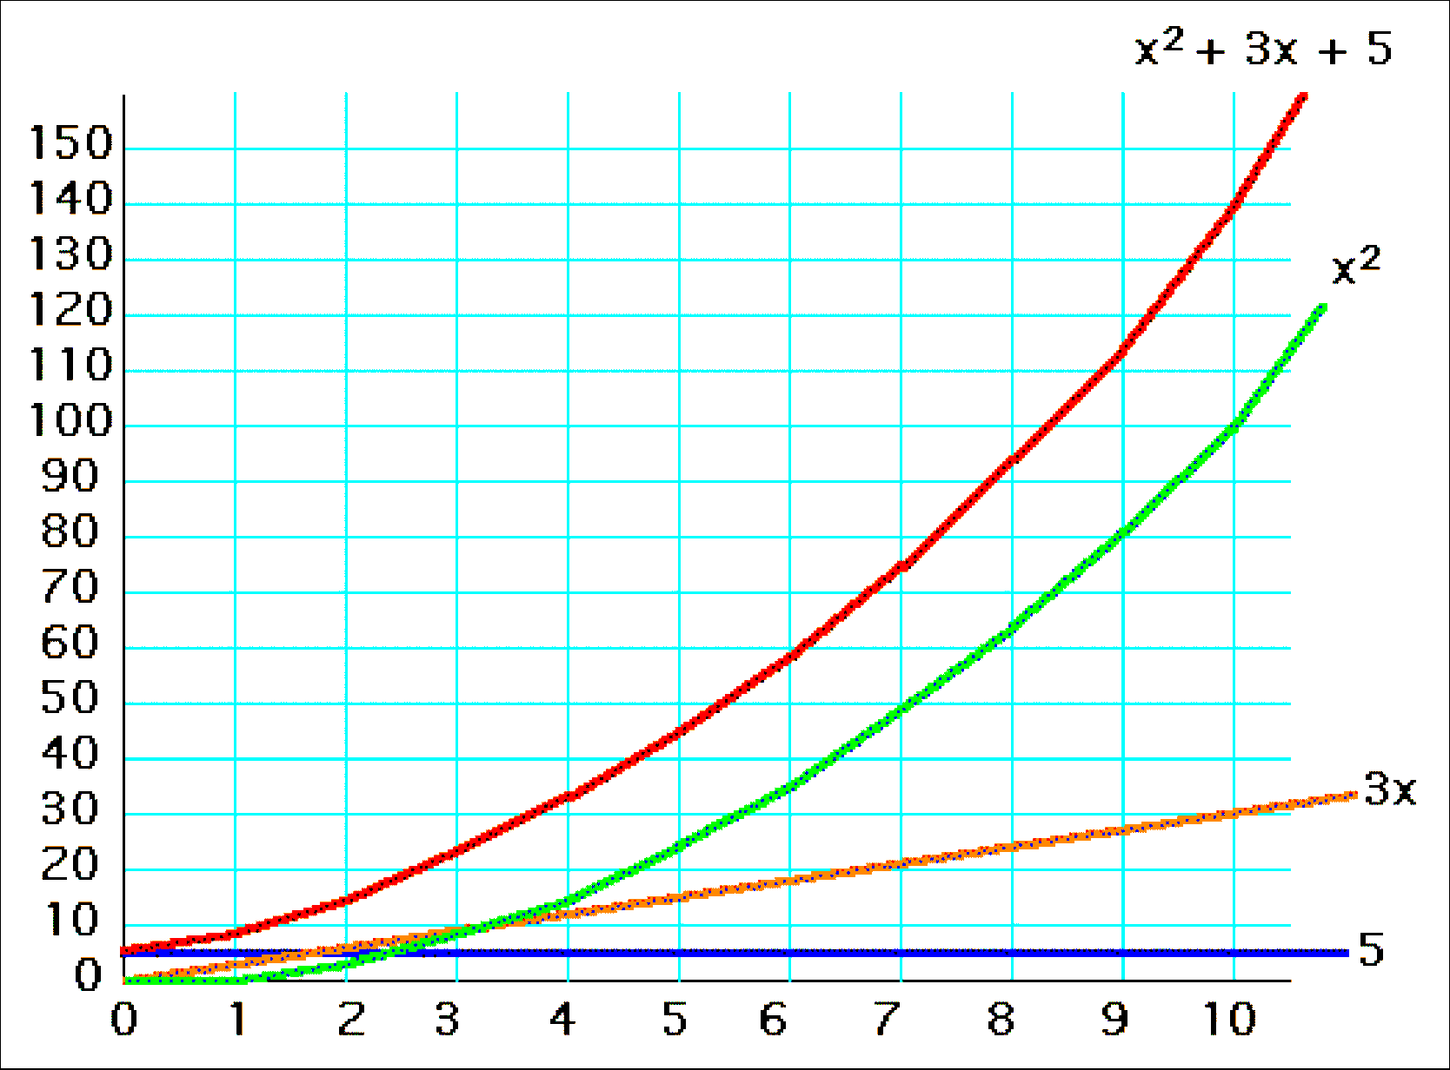
y = x² + 3x + 5, for x=1..10

Slide 21
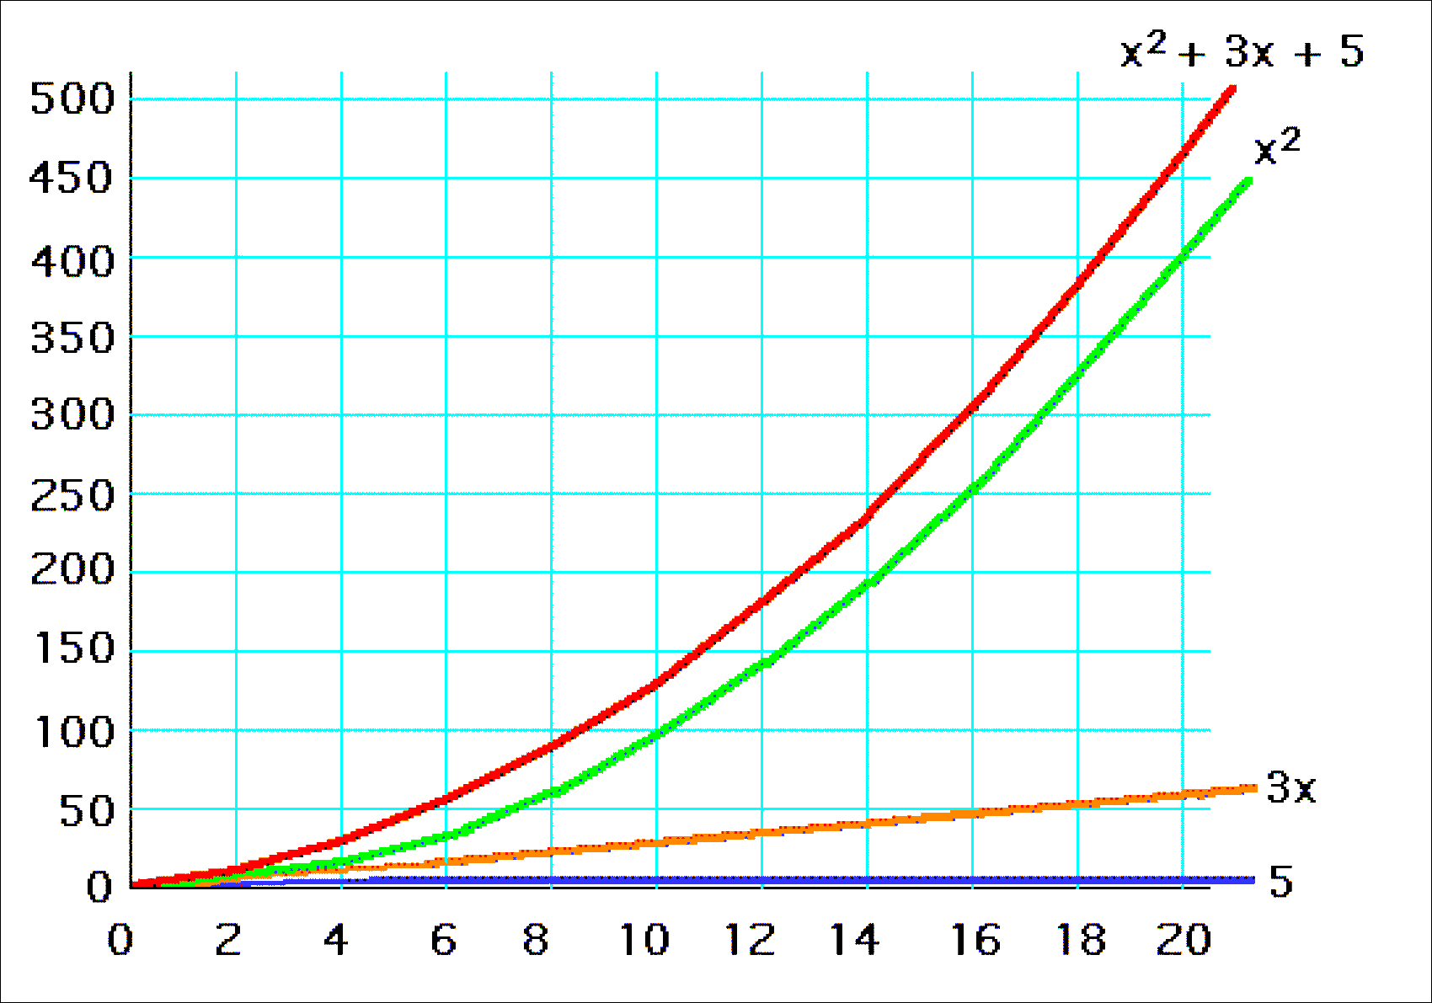
y = x² + 3x + 5, for x=1..20

Slide 22
Common time complexities
BETTER
WORSE
O(1) constant time
O(log n) log time
O(n) linear time
O(n log n) log linear time
O(n²) quadratic time
O(n³) cubic time
O(2^{n}) exponential time

