Slide 1
Complexity of Algorithms

Slide 2
Rationale
What is Algorithm?
What is need for analysis?
What is complexity?
Types of complexities
Methods of measuring complexity

Slide 3
Algorithm
A clearly specified set of instructions to solve a problem.
Characteristics:
  Input: Zero or more quantities are externally supplied
  Definiteness: Each instruction is clear and unambiguous
  Finiteness: The algorithm terminates in a finite number of steps.
  Effectiveness: Each instruction must be primitive and feasible
  Output: At least one quantity is produced

Slide 4
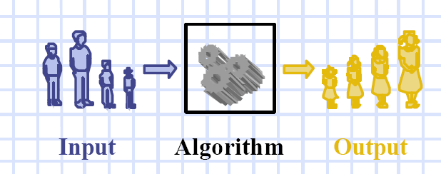
Algorithm

Slide 5
Need for analysis
To determine resource consumption
  CPU time
  Memory space
Compare different methods for solving the same problem before actually implementing them and running the programs.
To find an efficient algorithm

Slide 6
Complexity
A measure of the performance of an algorithm
An algorithm’s performance depends on
  internal factors
  external factors

Slide 7
External Factors
Speed of the computer on which it is run
Quality of the compiler
Size of the input to the algorithm

Slide 8
Internal Factors
The algorithm’s efficiency, in terms of :
Time required to run
Space (memory storage)required to run
Note:
Complexity measures the internal factors (usually more interested in time than space)

Slide 9
Two ways of finding complexity
Experimental study
Theoretical Analysis

Slide 10
Experimental study
Write a program implementing an algorithm
Run the program with inputs of varying size and composition
Get an accurate measure of the actual running time;
Use a method like System.currentTimeMillis()
Plot the results

Slide 11
Example
a. Sum=0;
for(i=0;i<N;i++)
for(j=0;j<i;j++)
Sum++;

Slide 12
Java Code – Simple Program
import java.io.*;
class for1
{
public static void main(String args[]) throws Exception
{
int N,Sum;
N=10000; // N value to be changed.
Sum=0;
long start=System.currentTimeMillis();
int i,j;
for(i=0;i<N;i++)
for(j=0;j<i;j++)
Sum++;
long end=System.currentTimeMillis();
long time=end-start;
System.out.println(" The start time is : "+start);
System.out.println(" The end time is : "+end);
System.out.println(" The time taken is : "+time);
}
}

Slide 13
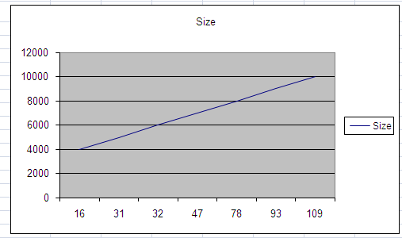
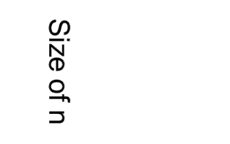
Example graph
Time in millisec

Slide 14
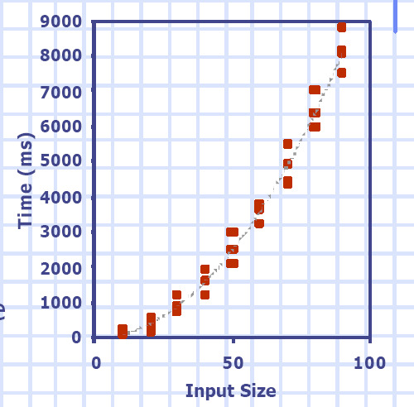
Example graph

Slide 15
Limitations of Experiments
It is necessary to implement the algorithm, which may be difficult
Results may not be indicative of the running time on other inputs not included in the experiment.
In order to compare two algorithms, the same hardware and software environments must be used
Experimental data though important is not sufficient

Slide 16
Theoretical Analysis
Uses a high-level description of the algorithm instead of an implementation
Characterizes running time as a function of the input size, n.
Takes into account all possible inputs
Allows us to evaluate the speed of an algorithm independent of the hardware/software environment

Slide 17
Space Complexity
The space needed by an algorithm is the sum of a fixed part and a variable part
The fixed part includes space for
  Instructions
  Simple variables
  Fixed size component variables
  Space for constants
  Etc..

Slide 18
Space Complexity
The variable part includes space for
  Component variables whose size is dependant on the particular problem instance being solved
  Recursion stack space
  ……

Slide 19
Time Complexity
The time complexity of a problem is
  the number of steps that it takes to solve an instance of the problem as a function of the size of the input (usually measured in bits), using the most efficient algorithm.
The exact number of steps will depend on exactly what machine or language is being used.
To avoid that problem, the Asymptotic notation is generally used.

Slide 20
Asymptotic Notation
Running time of an algorithm as a function of input size n for large n.
Expressed using only the highest-order term in the expression for the exact running time.

Slide 21
Example of Asymptotic Notation
f(n)=1+n+n²
Order of polynomial is the degree of the highest term
O(f(n))=O(n²)

Slide 22
Common growth rates
Time complexity | Example
O(1) constant | Adding to the front of a linked list
O(log N) log | Finding an entry in a sorted array
O(N) linear | Finding an entry in an unsorted array
O(N log N) n-log-n | Sorting n items by ‘divide-and-conquer’
O(N²) quadratic | Shortest path between two nodes in a graph
O(N³) cubic | Simultaneous linear equations
O(2^{N}) exponential | The Towers of Hanoi problem

Slide 23
Growth rates
O(N²)
O(Nlog N)
Time
For a short time N² is
better than NlogN
Number of Inputs

Slide 24
Best, average, worst-case complexity
In some cases, it is important to consider the best, worst and/or average (or typical) performance of an algorithm:
E.g., when sorting a list into order, if it is already in order then the algorithm may have very little work to do
The worst-case analysis gives a bound for all possible input (and may be easier to calculate than the average case)

Slide 25
Comparision of two algorithms
Consider two algorithms, A and B, for solving a given problem.
T_{A}(n),T_{B}( n) is time complexity of A,B respectively (where n is a measure of the problem size. )
One possibility arises if we know the problem size a priori.
    For example, suppose the problem size is n₀ and T_{A}(n₀)<T_{B}(n₀). Then clearly algorithm A is better than algorithm B for problem size .
In the general case,
  we have no a priori knowledge of the problem size.

Slide 26
Comparision of two algorithms
Limitation:
  don't know the problem size beforehand
  it is not true that one of the functions is less than or equal the other over the entire range of problem sizes.
we consider the asymptotic behavior of the two functions for very large problem sizes.

Slide 27
Asymptotic Notations
Big-Oh
Omega
Theta
Small-Oh
Small Omega

Slide 28
Big-Oh Notation (O)
f(x) is O(g(x)) iff there exists constants ‘c’and ‘k’ such that f(x)<=c.g(x) where x>k
This gives the upper bound value of a function

Slide 29
Examples
x=x+1 -- order is 1
for i← 1 to n
x=x+y -- order is n
for i← 1 to n
for j← 1 to n
x=x+y -- order is n²

Slide 30
Time Complexity Vs Space Complexity
Achieving both is difficult and best case
There is always trade off
If memory available is large
  Need not compensate on Time Complexity
If speed of execution isn’t the concern, but memory availability is less
  Can’t compensate on space complexity

Slide 31
Example
Size of data = 10 MB
Check if a word is present in the data or not
Two ways
  Better Space Complexity
  Better Time Complexity

Slide 32
Example
Load the entire data into main memory and check one by one
  Faster Process but takes a lot of space
Load data word–by-word into main memory and check
  Slower Process but takes less space

Slide 33
Run these algorithms
For loop
a. Sum=0;
for(i=0;i<N;i++)
for(j=0;j<i*i;j++)
for(k=0;k<j;k++)
Sum++;
Compare the above "for loops" for different inputs

Slide 34
Example
3. Conditional Statements
Sum=0;
for(i=1;i<N;i++)
for(j=1;j<i*i;j++)
if(j%i==0)
for(k=0;k<j;k++)
Sum++;
Analyze the complexity of the above algorithm for different inputs

