Slide 1
Randomized Algorithms

Slide 2


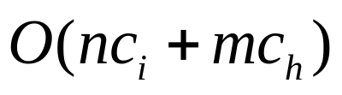
The Hiring Problem
Job candidates are numbered 1…n
HIRE-ASSISTANT(n)
best 0 candidate 0 is a least-qualified dummy candidate
for i 1 to n
do interview candidate i
if candidate i is better than candidate best
then best i
hire candidate i
Analysis Goal:
Analyze interview & hiring cost instead of running time
Interviewing Cost = c_{i} << Hiring Cost = c_{h}
Assume m people are hired
Total Cost:

Slide 3
Analyzing the Hiring Problem
Worst-Case Analysis:
  Hire every candidate interviewed
  How can this occur?
    If candidates come in increasing quality order
    Hire n times: total hiring cost = O(nc_{h})
Probabilistic Analysis:
  Appropriate if information about random distribution of inputs is known
  Use a random variable to represent cost (or run-time)
  Find expected (average) cost (or run-time) over all inputs
  We’ll use this technique to analyze hiring cost…
    First need to introduce indicator random variables to simplify analysis

Slide 4
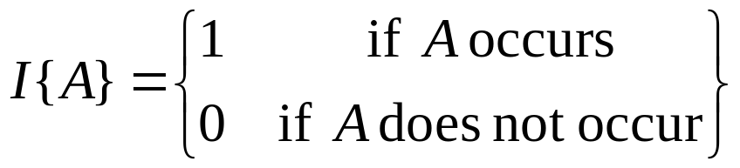
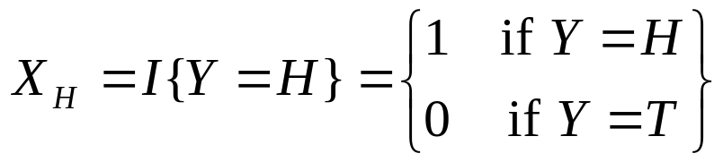


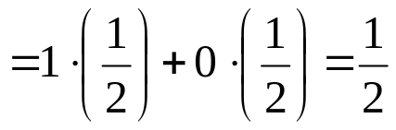
Indicator Random Variables
Indicator random variable I{A} associated with event A:
Example: Find expected number of heads when flipping a fair coin
  Sample space S = {H, T }
  Random variable Y takes on values H, T
    Prob(H ) = Prob(T ) = 1/2
  X_{H} counts number of heads in a single flip
  Expected number of heads in a single coin flip = expected value of X_{H}

Slide 5
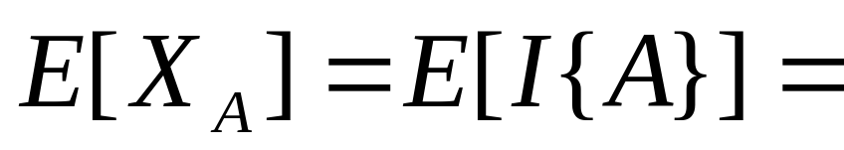
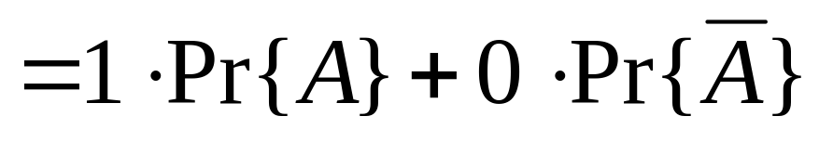
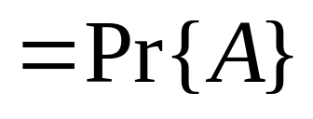
Indicator Random Variables
(continued)
Lemma 5.1: Given sample space S and an event A in S. Let X_{A} = I{A}. Then E[X_{A}] = Pr{A}.
Proof: By definitions of indicator random variable and expectation:
Useful for analyzing sequence of events…

Slide 6
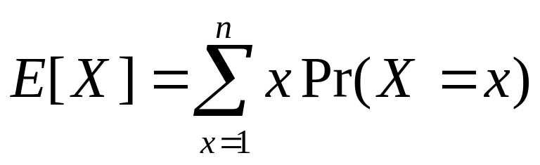

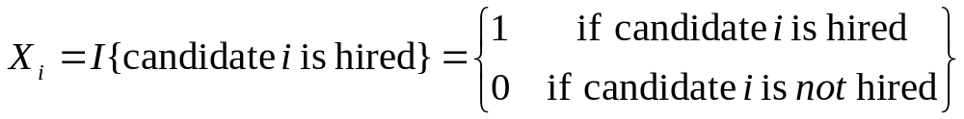

Analyzing the Hiring Problem using Indicator Random Variables
Assume candidates arrive in random order
X = random variable modeling number of times we hire
Without indicator random variables:
With indicator random variables:
by
Lemma 5.1
Need to find this

Slide 7

Analyzing the Hiring Problem using Indicator Random Variables (continued)
HIRE-ASSISTANT(n)
best 0 candidate 0 is a least-qualified dummy candidate
for i 1 to n
do interview candidate i
if candidate i is better than candidate best
then best i
hire candidate i
Need to calculate probability that these lines are executed
Candidate i is hired when candidate i is better than each of candidates 1…i-1
Randomness assumption: any of first i candidates is equally likely to be best-qualified so far
Candidate i has probability of 1/i of being better than each of candidates 1…i-1
  Probability candidate i will be hired is therefore: 1/i

Slide 8
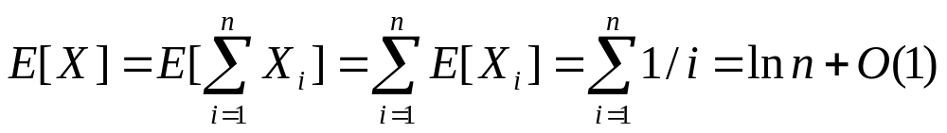
Analyzing the Hiring Problem using Indicator Random Variables (continued)
HIRE-ASSISTANT(n)
best 0 candidate 0 is a least-qualified dummy candidate
for i 1 to n
do interview candidate i
if candidate i is better than candidate best
then best i
hire candidate i
Assuming that candidates are presented in random order, total hiring cost is in O(c_{h} ln n)
by
Linearity of Expectation

Slide 9
And now for something different…
Randomized Algorithm:
  Put randomness into algorithm itself
  Make choices randomly (e.g. using coin flips)
    Use pseudorandom-number generator
  Algorithm itself behaves randomly
  Different from using probabilistic assumptions about inputs to analyze average-case behavior of a deterministic (non-random) algorithm
  Randomized algorithms are often easy to design & implement & can be very useful in practice
H

Slide 10


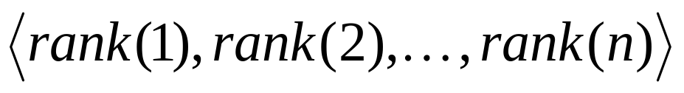
Randomized Hiring Algorithm
RANDOMIZED-HIRE-ASSISTANT(n)
randomly permute the list of candidates
best 0 candidate 0 is a least-qualified dummy candidate
for i 1 to n
do interview candidate i
if candidate i is better than candidate best
then best i
hire candidate i
random
deterministic
Represent an input using candidate ranks:
Randomly permuting candidate list creates a random list of candidate ranks.
The expected cost of RANDOMIZED-HIRE-ASSISTANT is in O(c_{h} ln n).
Note: We no longer need to assume that candidates are presented in random order!

Slide 11
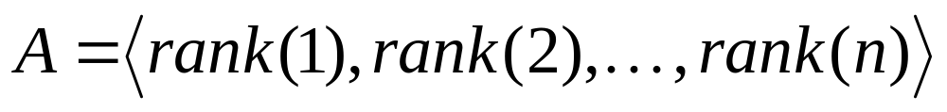
Nothing is ever really free…
RANDOMIZED-HIRE-ASSISTANT(n)
randomly permute the list of candidates
best 0 candidate 0 is a least-qualified dummy candidate
for i 1 to n
do interview candidate i
if candidate i is better than candidate best
then best i
hire candidate i
How do we do this well?
How much time does it take?
Goal: permute array A
Approach: assign each element A[ i ] a random priority P[ i ]

Slide 12
Randomized Permutation Algorithm
Approach: assign each element A[ i ] a random priority P[ i ]
PERMUTE-BY-SORTING(A)
n length[A]
for i 1 to n
do P[ i ] RANDOM(1,n³)
sort A, using P as sort keys
return A
Choose a random number between 1 and n³
(makes it more likely that all priorities are unique)
This step dominates the running time. It takes Ω(n lg n) time if pairs of values are compared while sorting
Now we need to show that PERMUTE-BY-SORTING produces a uniform random permutation of the input, assuming all priorities are distinct…

Slide 13
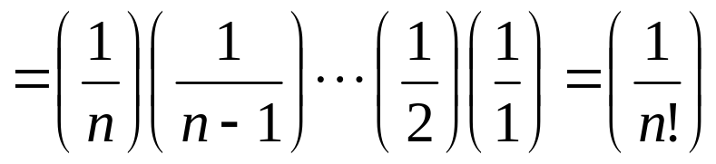
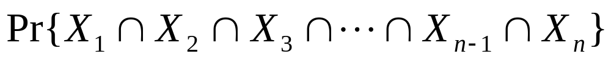
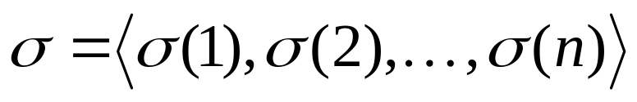
Randomized Permutation Algorithm Analysis
Claim: PERMUTE-BY-SORTING produces a uniform random permutation of the input, assuming all priorities are distinct.
Proof Sketch: Consider permutation in which each A[ i ] has i th smallest priority
To show this permutation occurs with probability 1/n! …
Let X_{i} be event that element A[ i ] receives i th smallest priority.
Probability that, for all i, event X_{i} occurs is :
To complete the proof, now apply the argument above to any fixed permutation of {1,2,…,n}:

Slide 14

Randomized Permutation Algorithm Improvement
RANDOMIZE-IN-PLACE(A)
n length[A]
for i 1 to n
do swap A[ i ] A[RANDOM(i,n)]
Claim: RANDOMIZE-IN-PLACE produces a uniform random permutation of the input.
Proof uses a loop invariant for the for loop. See p. 103 of text for detais.

