Slide 1
Probabilistic Analysis and Randomized Algorithms

Slide 2
Outline
Explain the differences between probabilistic analysis and randomized algorithms
Present the technique of indicator random variables
Give another example of the analysis of a randomized algorithm (permuting an array in place)

Slide 3
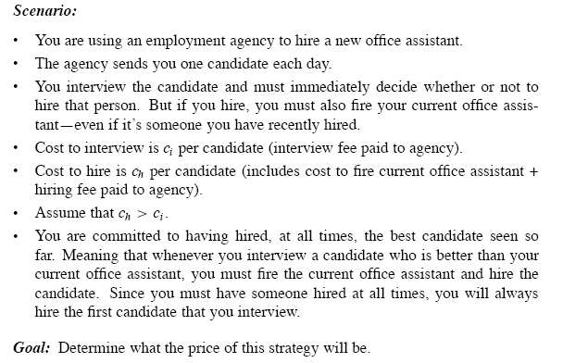
The hiring problem

Slide 4
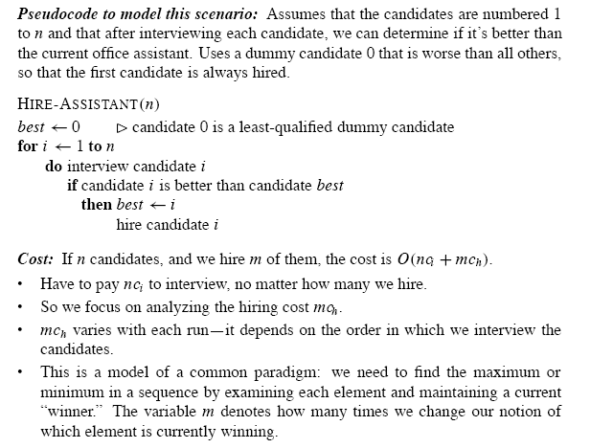

Slide 5
The hiring problem O(nc_{i}+mc_{h})
  - Interview & hire
  - Point: after interviewing candidate i, determine if candidate i is the best candidate you have seen so far
Worst-case analysis
- We hire every candidate that we interview
- Hiring cost: O(nc_{h})
- We neither have any idea nor have any control over the order of candidates
What we expect to happen in a typical or average case?

Slide 6
Probabilistic Analysis(1)
The use of probability in the analysis of problems
Use knowledge (make assumption) about the distribution of the inputs
Expected cost/running time
Not applicable to all problems
Random order (imply a total order)-> uniform random permutation: n!

Slide 7
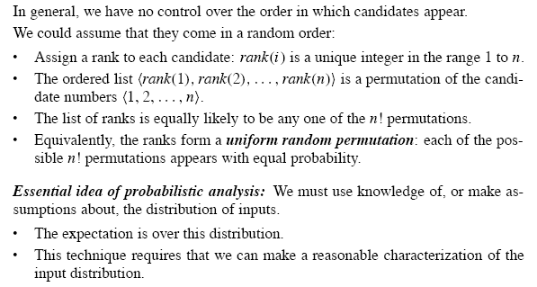
Probabilistic Analysis(2)

Slide 8
Randomized Algorithms(1)
Algorithms that make random decisions
That is
  Can generate a random number x from some range {1, 2…R}.
  Make decisions based on the value of x
  Instead of guessing whether the order is in a random order, we impose a random order
  Its behavior is determined not only by its input but also by values produced by a random-number generator

Slide 9
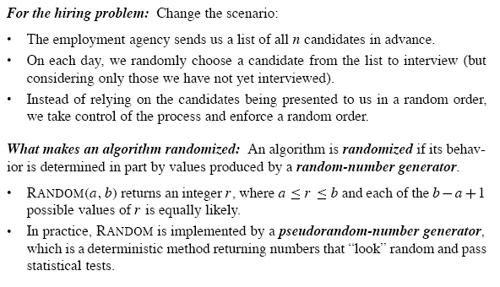
Randomized Algorithms(2)

Slide 10
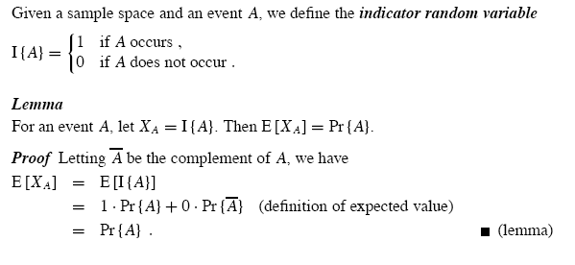
Indicator Random Variables(1)

Slide 11
Indicator Random Variables(2)
Provide a convenient method for converting between probabilities and expectations
Sample space and event A, associated with a indicator random variable I{A}
Lemma:
- The expected value of an indicator random variable associated with an event A is equal to the probability that A occurs
Is very useful and convenient for analyzing situations in which we perform repeated trials

Slide 12
Analysis of the hiring problem using indicator random variable
Assume the candidates arrive in a random order
X: number of times we hire a new office assistant
X=X₁ +X₂+…+X_{n}-→X_{i}={candidate i is hired}
E[X_{i}]=Pr {candidate i is hired}=1/i
E[X]=lnn+O(1)
Conclusion: Even though we interview n candidates, we only actually hire lnn of them

Slide 13
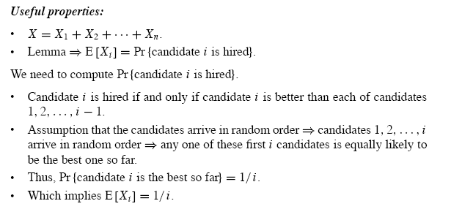

Slide 14
Hiring Problem
Lemma 5.2
Assuming that the candidates are presented in a random order, algorithm HIRE has a total hiring cost of O(C_{h}lnn)
Worst-case Running time
The worst-case hiring cost is O(nC_{h}). The expected interview cost is a significant improvement over the worst-case cost

Slide 15
Random Algorithms
Explore the distinction between probabilistic analysis and randomized algorithms
Instead of assuming a distribution, we impose a distribution
For probabilistic analysis, the algorithm is deterministic.
The number of times we hire differs for different inputs (expensive, inexpensive and moderately expensive inputs)
For randomized algorithm, the randomization is in the algorithm not in the input distribution
For a given input, each time we run the randomized algorithm, we get different updates so as to get different cost
No particular input elicits its worst-case behavior

Slide 16
Randomly Permuting arrays
Randomize the input by permuting the given input array
Assign each element of the array a random priority p[i] and then sort the array according to these priorities
Randomly permuting produces a uniform random permutation
Permute the given array in place

Slide 17
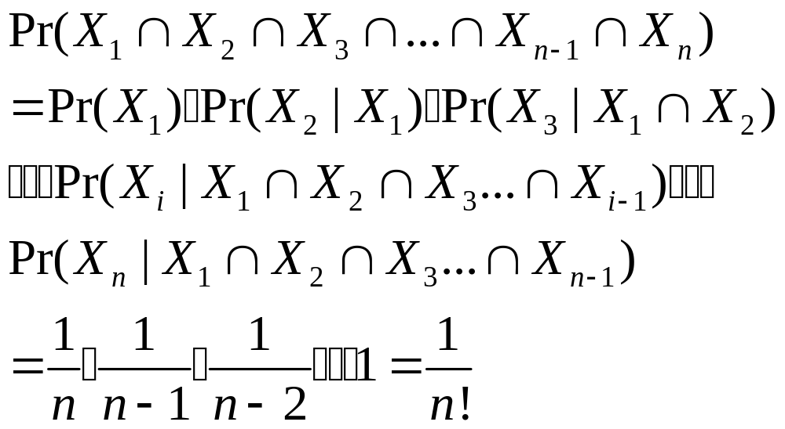
Permute-By-Sorting
Permute-By-Sorting (A)
1 n ← length [A]
2 for i← 1 to n
do P [i] =RANDOM (1, n³)
4. sort A, using P as sort keys
5. return A
Procedure Permute-By-Sorting produces a uniform random permutation of the input in Θ(nlgn), assume all priorities are unique
There are total n! permutations and each permutation appears with 1/n! probability.

Slide 18
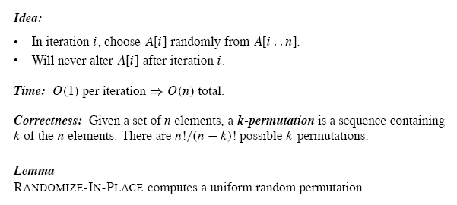
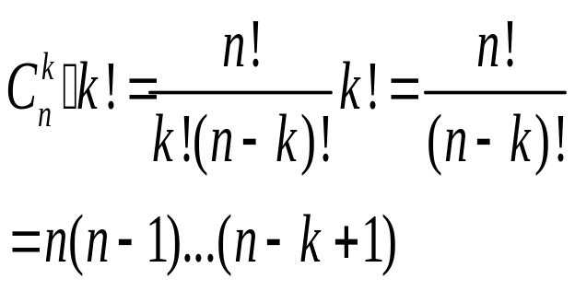
Randomize in Place
1. n ←length [A]
2. for i ←1 to n
3. do swap A [i] ←→A[RANDOM (i,n)]

Slide 19
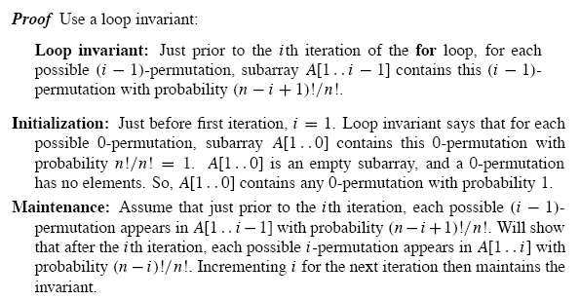
Proof of Lemma 5.5

Slide 20
