Slide 1
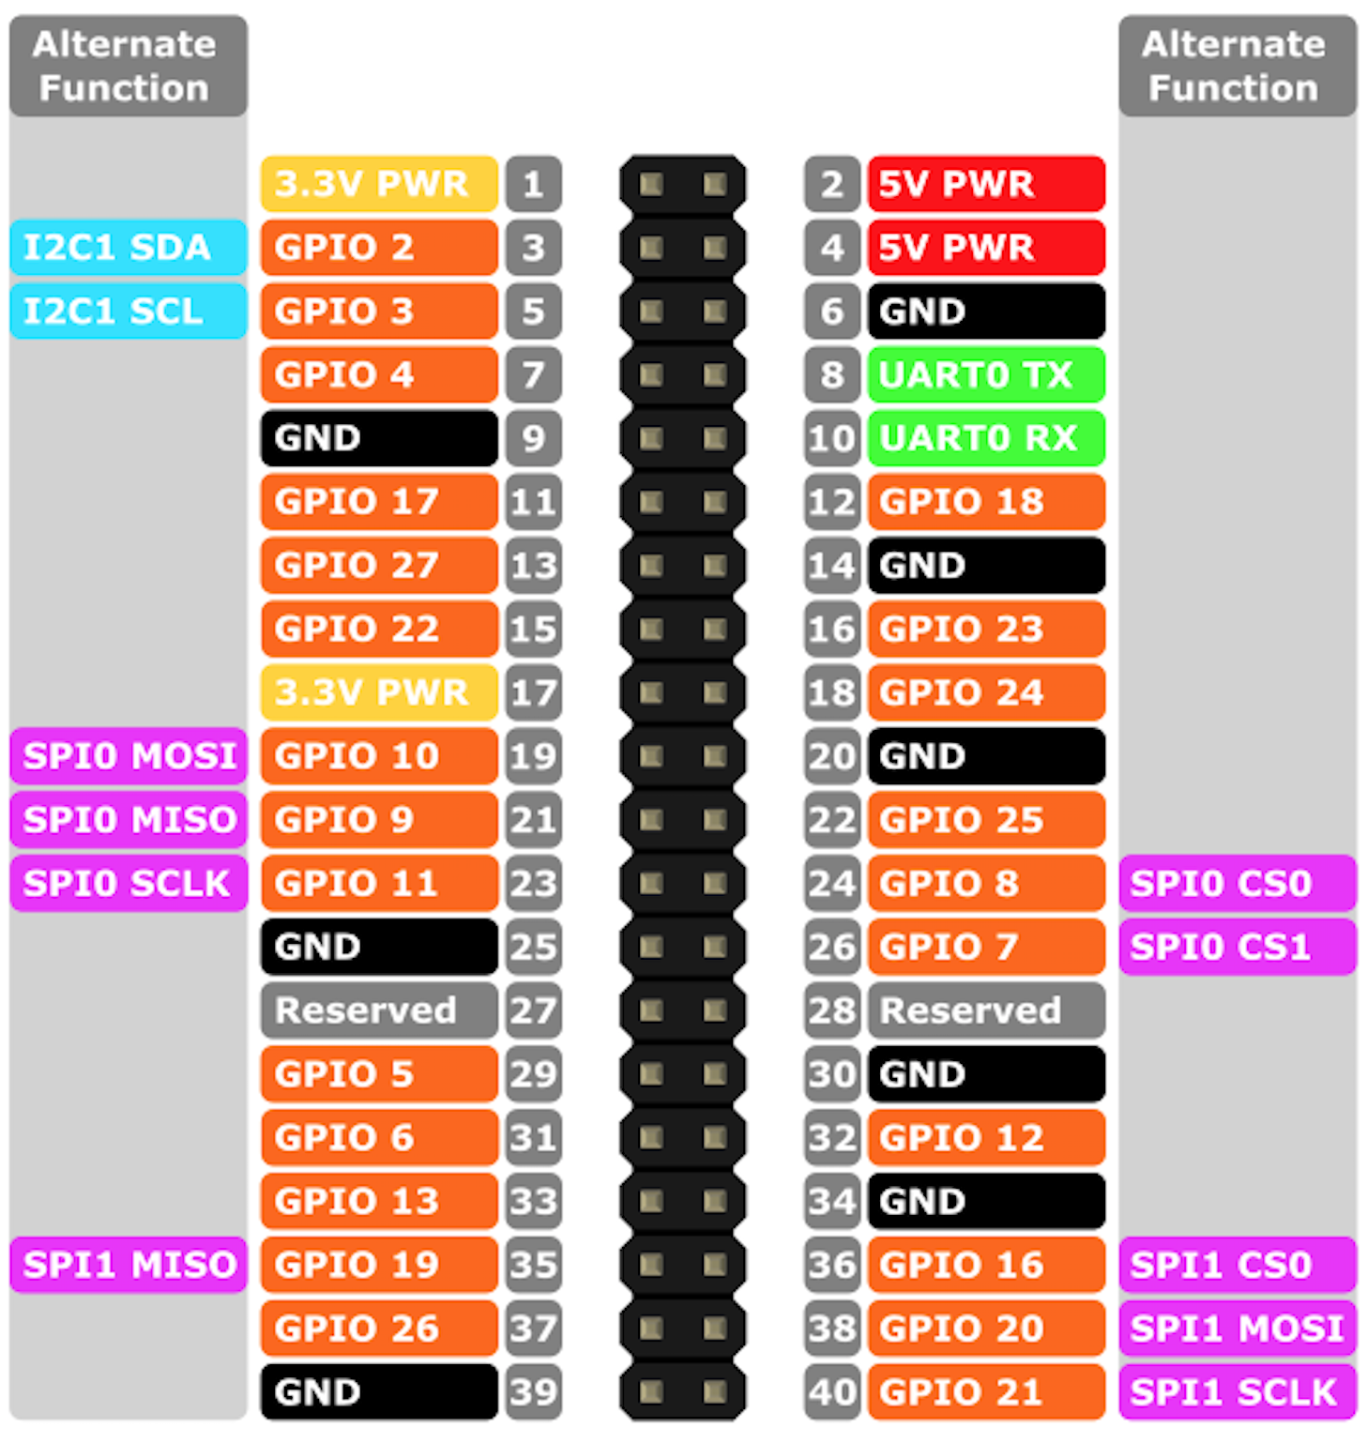
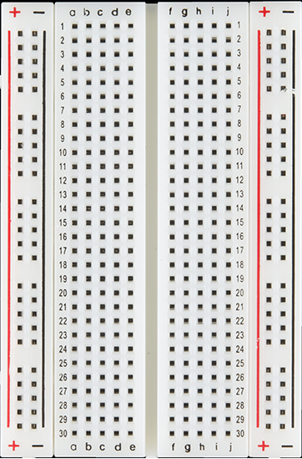
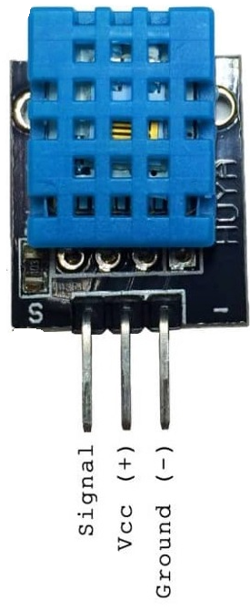
Raspberry Pi GPIO Pins
DHT Sensor : VCC / 5V pin To Pi’s : GPIO Pin 2 = 5 V
DHT Sensor : Ground pin To Pi’s : GPIO Pin 5 = Ground
DHT Sensor : Signal To Pi’s : GPIO Pin 7 = GPIO 4

