Slide 1
November 2nd 2016
IBM Cloud Architecture Center
IoT Diagram Template
Using the Diagram Template
This template is for use in creating a visual representation of IOT Domain Overview.
You may add numbers (which are provided on page 3) to the diagram to correspond to the runtime flow steps in your architecture.
See instructions on how to gray out icons and lines on Page 4

Slide 2





















USER
LAYER
PROXIMITY
NETWORK
PUBLIC
NETWORK
PROVIDER CLOUD
ENTERPRISE
NETWORK
PHYSICAL ENTITY
DEVICE
REGISTRY
DEVICE
MANAGEMENT
DEVICE IDENTITY
SERVICE
USER DIRECTORY
IOT
USER
DEVICE
PEER
CLOUD
API MANAGEMENT
TRANSFORMATION &
CONNECTIVITY
ENTERPRISE
DATA
EDGE SERVICES
IoT
GATEWAY
IoT TRANSFORMATION
&CONNECTIVITY
ENTERPRISE
APPLICATION
APPLICATION
LOGIC
APPLICATION
VISUALIZATION
ANALYTICS
PROCESS
MANAGEMENT
DATA STORE
LEGEND
Application
Infrastructure
Data Store
Management
Scalable
SECURITY
INFORMATION
GOVERNANCE
Security
Analytics

Slide 3
IBM Cloud Architecture Center
Runtime numbers
1
2
3
4
5
6
7
8
9
10
11
12
13
14
15
16
17
18
19
20

Slide 4

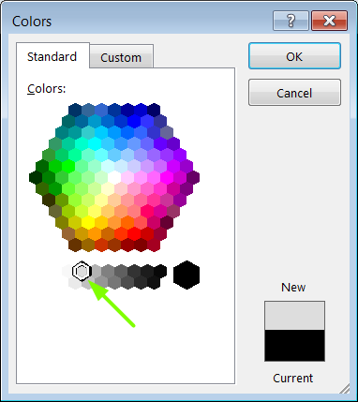
IBM Cloud Architecture Center
Gray Icons and Arrows for Background
OFFLINE
CAPABILITIES
Select icon and ungroup.
Select the icon background and change the fill color to R221, G221, B221. This is a standard color. See the picture.
Change the text to the same color.
Regroup the icon.
Change background arrows to the same color.

