Slide 1
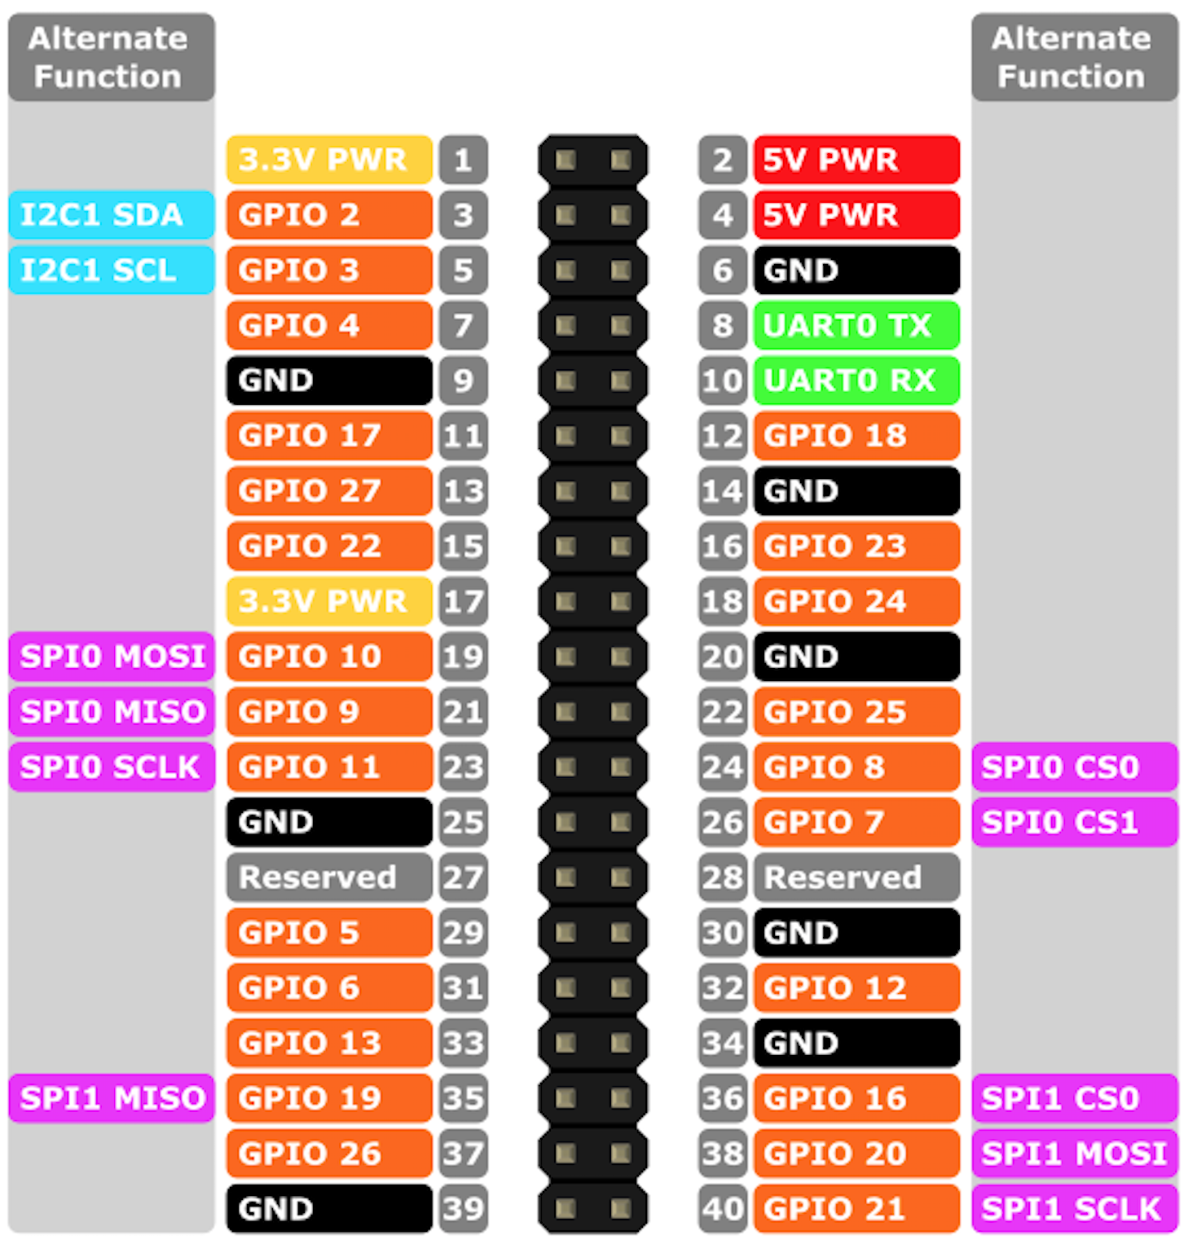
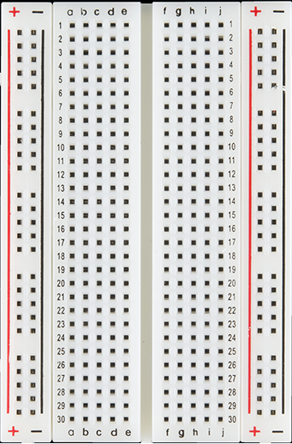
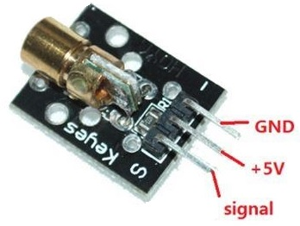
Raspberry Pi GPIO Pins
KY008 Sensor : VCC / 5V pin To Pi’s : GPIO Pin 2 = 5 V
KY008 Sensor : Ground pin To Pi’s : GPIO Pin 5 = Ground
KY008 Sensor : Signal To Pi’s : GPIO Pin 7 = GPIO 4

