Slide 1
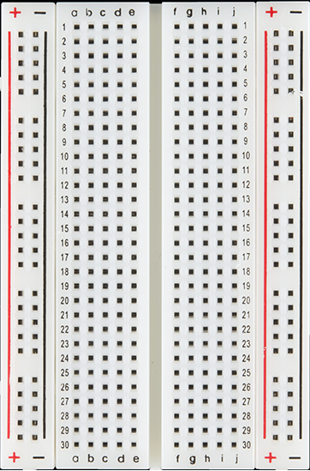
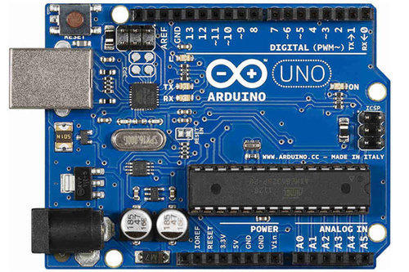
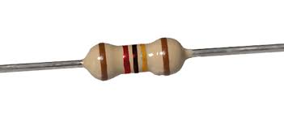
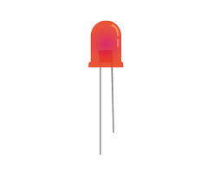
USB B to Raspberry
Arduino Pins
LED +ve ( Long Pin ) : Connect Resistor and to Adruino : Pin 7
LED –ve (Short Pin ): Ground pin To Adruino Ground Pin

