Slide 1
Recent Trends of Software Engineering and Testing in Real Time.
- John Sylvester

Slide 2
Topics :
1. Software Engineering & Continuous Integration
2. Latest Developments.

Slide 3
Software
Software Engineering & Continuous Integration
I . How it is developed ?
II. How to build & deploy?

Slide 4
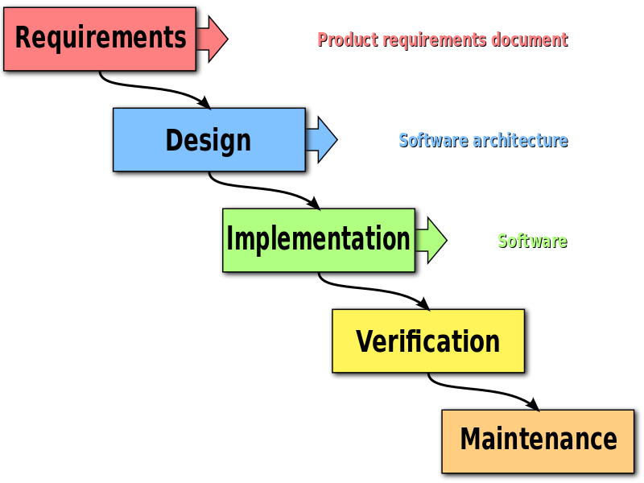
Software : How it is developed ?
Old methodology - Waterfall model

Slide 5
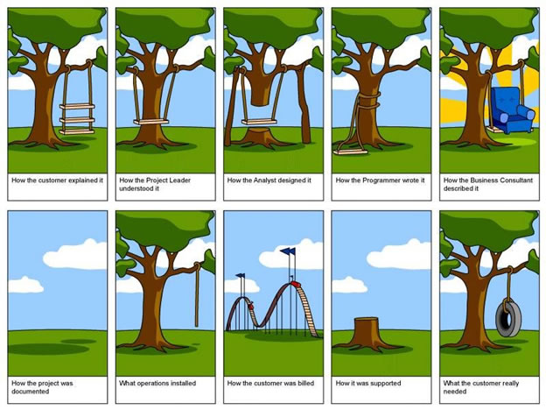
Software Development : Drawbacks due to traditional model

Slide 6
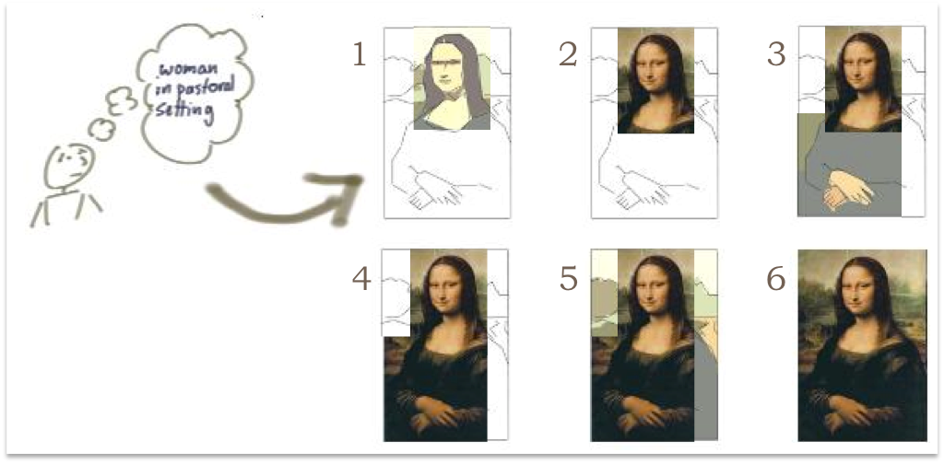
Software Development : Agile

Slide 7
Software : How it is developed ?
Approach : Agile
Agile is a group of software development methods in which requirements and solutions evolve through collaboration between self-organizing , cross-functional teams.

Slide 9
Software : How it is developed ?
Approach : Agile Principles
Early and continuous delivery
Changing requirements
Deliver frequently
Work together daily
Trust the team
Face to face conversation
Working software
Technical excellence, good design
Team reflects and then tunes.
Source : http://agilemanifesto.org/principles.html

Slide 10
Software : How it is developed ?
Approach : Agile Advantages
Team Engagement
Transparency
Frequent Delivery
Predictability
Allows for change
Business Focus
Customer Focus
High Quality

Slide 11
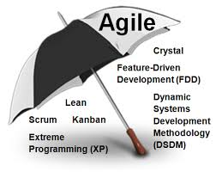
Software : How it is developed ?
Agile Umbrella :
Scrum
Kanban
SAFe
XP

Slide 12
Software : How it is developed ?
Agile : Scrum
Best when small ( 7 +/- 2)
Dedicated and persistent
Cross functional
Collaborative

Slide 13
Video Time : Turtle and Hare story.

Slide 14
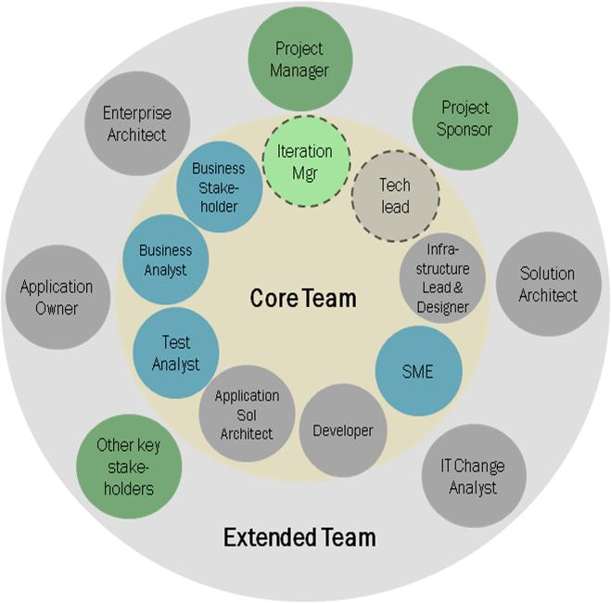
A
G
I
L
E
T
E
A
M

Slide 15
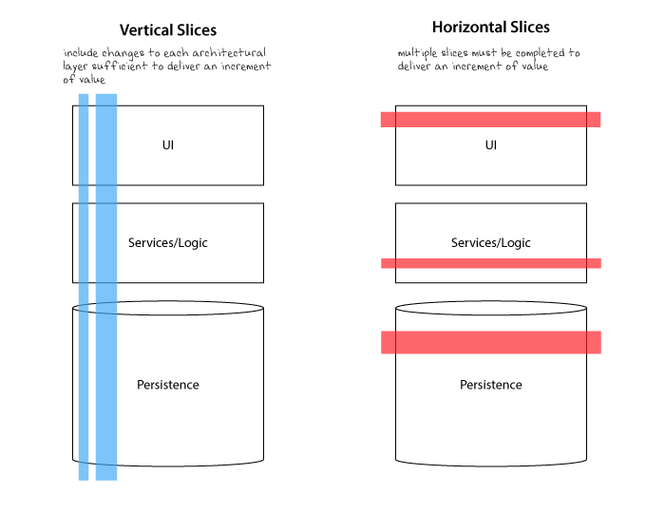
A
G
I
L
E
D
E
L
I
V
E
R
Y

Slide 16
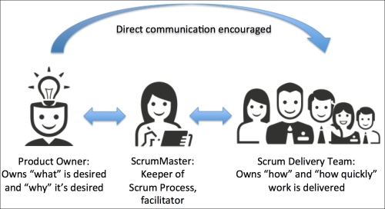
Software : How it is developed ?
Agile : Scrum : Key Roles
Scrum Master
Product Owner
Team Member

Slide 17
Software : How it is developed ?
Agile :
Events :
Sprint Planning
Daily Scrum
Sprint Review
Sprint Retrospective
EPIC
Feature
User Story
Task
Task
Task
Task

Slide 18
Software : How it is developed ?
Estimation :
Using Story points
Eg :
Fibonacci series
1 2 3 5 8 13
b) Shirt Sizes
XS , S , M , L , XL
c) Cricket scores
1, 2, 4 ,6
User Story
Task
Task
Task
Task
User Story :
User Story should be short and should be in the following format :
As a <Role> , I need < Request> , So that <why?>

Slide 19
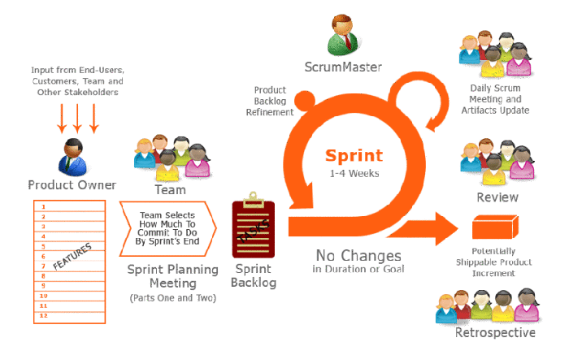
Software : How it is developed ?

Slide 20
II.Software :How to Deploy:Environments
DEV
M
A
N
U
A
L
D
E
P
L
O
Y
M
E
N
T
SIT ( System Integration Testing )
UAT ( User Acceptance Testing )
Performance Testing
Pre Production Testing
Production Environment

Slide 21
II.Software :How to Deploy:Environments
DEV
A
U
T
O
M
A
T
I
O
N
SIT ( System Integration Testing )
UAT ( User Acceptance Testing )
Performance Testing
Pre Production Testing
Production Environment

Slide 22
II.Software:How to Deploy:Environments
Continuous Integration / DevOps
CI helps to realize the following benefits:
a) Build Automation.
b) Code Stability
c) Faster Releases
d) Cost saving
e) Improved Productivity
f) Improved Code Quality

Slide 23
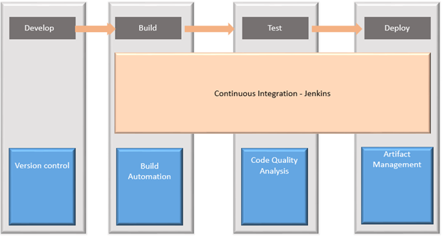
II.Software:How to Deploy:Environments
Continuous Integration / DevOps

Slide 24
II.Software:How to Deploy:Environments
Continuous Integration / DevOps
Types of testing methods :
Black Box Testing
White Box Testing
Grey Box Testing - expectation of IT industry.
For Security related testing :
https://www.owasp.org/
The following tools can be used for automation testing:
HP Quick Test Professional
Selenium
IBM Rational Functional Tester
SilkTest
TestComplete
Testing Anywhere
WinRunner
LoadRunner
Visual Studio Test Professional
WATIR

Slide 25
Software : Latest Developments
Latest trends :
Moving to Cloud
Private Cloud
Public Cloud
Hybrid Cloud
2. Social Mobile Analytics Cloud - SMAC
3. IoT - Internet of Things.
4. API Economy

Slide 26
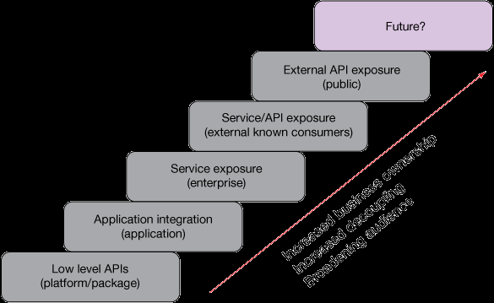
Software : Latest Developments
API Economy :
Increased business ownership, broading audience, decoupling.

Slide 27
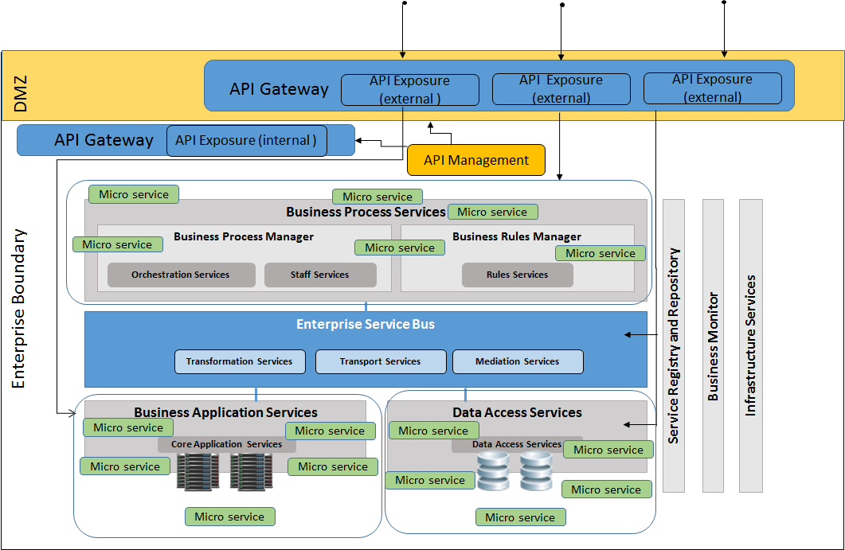
Software : Latest Developments
API Economy :

Slide 28
Software : Latest Developments Demo
Latest trends :
About BlueMix
https://console.au-syd.bluemix.net/

Slide 29
References :
http://scrumreferencecard.com/
Story of Turtle and Rabbit (new version ) - https://www.youtube.com/watch?v=GXTeFa43730

Slide 30
Thank you

