Slide 1
Software Testing and DevOps
- John Sylvester

Slide 2
Software :How testing done
DEV
M
A
N
U
A
L
T
E
S
T
I
N
G
SIT ( System Integration Testing )
UAT ( User Acceptance Testing )
Performance Testing
Pre Production Testing
Production Environment

Slide 3
II. Testing tools
The following tools can be used for testing:
SOAP UI - Webservices , REST API
Jmeter - Ability to load and performance test many different applications/server/protocol types:
Web - HTTP, HTTPS (Java, NodeJS, PHP, ASP.NET, …)
SOAP / REST Webservices
FTP
Database via JDBC
LDAP
Message-oriented middleware (MOM) via JMS
Mail - SMTP(S), POP3(S) and IMAP(S)
Native commands or shell scripts
TCP
Java Objects
Watir, Selenium - Browser based automated testing.
CA Dev Test.
Junit , XMLUnit - unit testing
RFHTUIL - IBM’s Message oriented middleware

Slide 4
II. Testing tools contd..
The following tools can be used for testing:
HP Quick Test Professional
IBM Rational Functional Tester
SilkTest
TestComplete
Testing Anywhere
WinRunner
LoadRunner
Visual Studio Test Professional

Slide 5
Functional testing :
Functional testing which relies heavily on domain knowledge :
Banking & Finance
Insurance ( Health , General etc … )
Functional testing which needs LESS domain knowledge :
Retail
Manufacturing
Energy & Utilities

Slide 6
SOAPUI Demo for a webservice :
https://www.soapui.org/functional-testing/getting-started.html
https://www.soapui.org/tutorials/
Web service :
http://banka.mybluemix.net/services/AccountService
http://www.webservicex.net/CurrencyConvertor.asmx

Slide 7
II.Software :How to Deploy:Environments
DEV
A
U
T
O
M
A
T
I
O
N
SIT ( System Integration Testing )
UAT ( User Acceptance Testing )
Performance Testing
Pre Production Testing
Production Environment

Slide 8
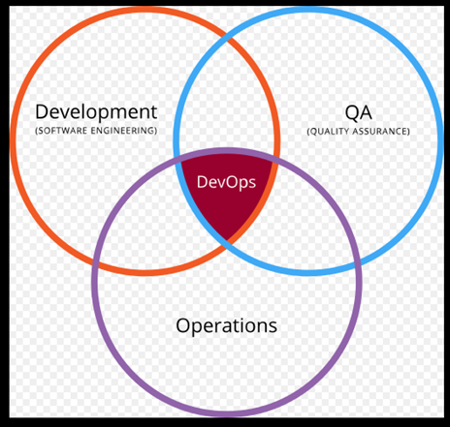
DevOps
DevOps is the practice of operations, testing and development engineers participating together in the entire service lifecycle, from design through the development process to production support.

Slide 9
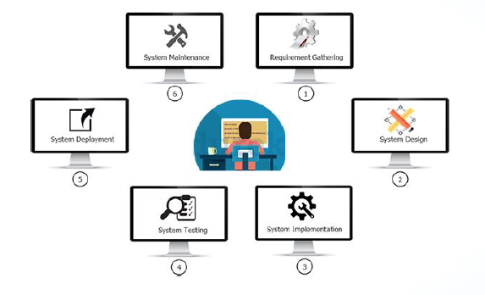
Prior to DevOps : Waterfall

Slide 10
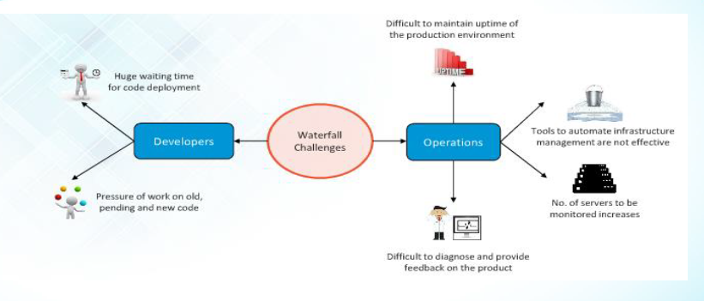
Some of the Challenges

Slide 11
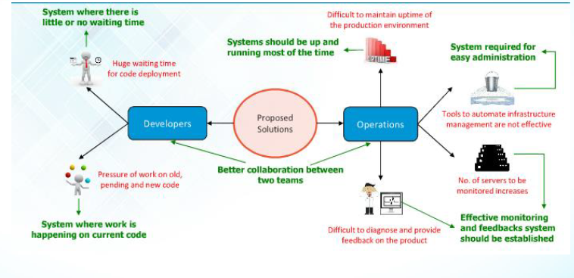
Solution for issues:

Slide 12
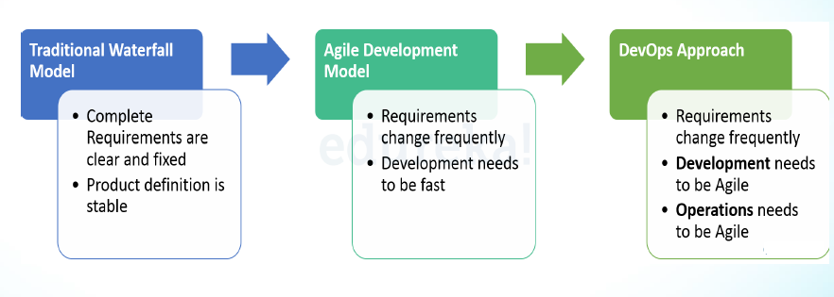
How DevOps Evolved :

Slide 13
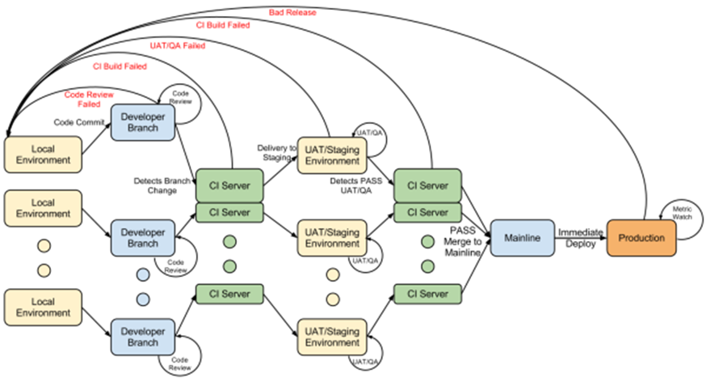
DevOps Life cycle

Slide 14
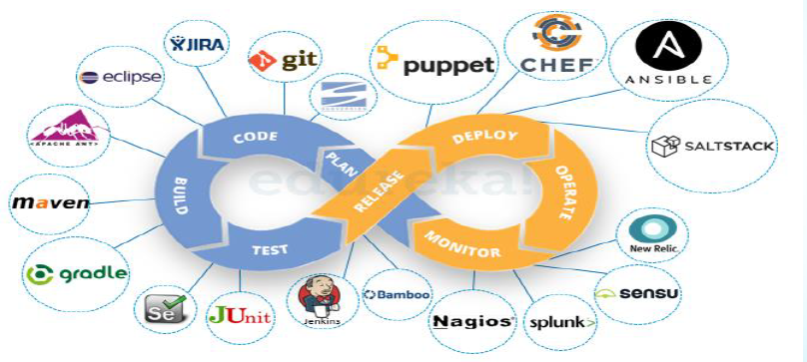
DevOps Life cycle

Slide 15
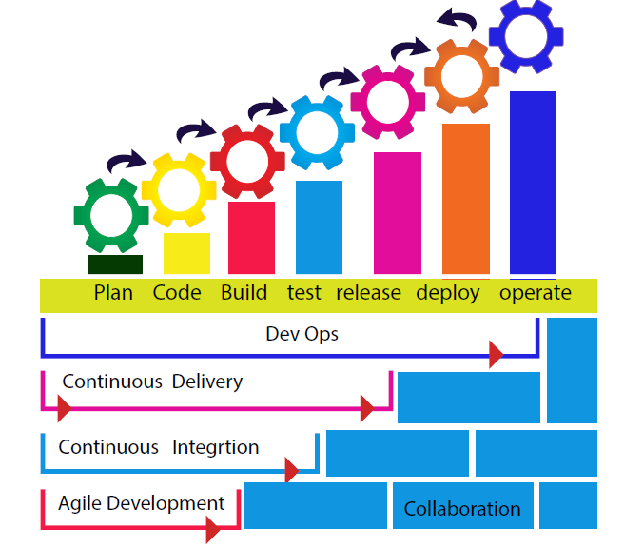

Slide 16
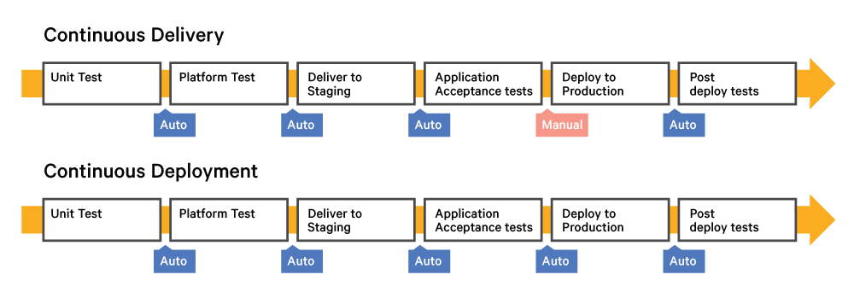

Slide 17
Thank you

