Slide 1
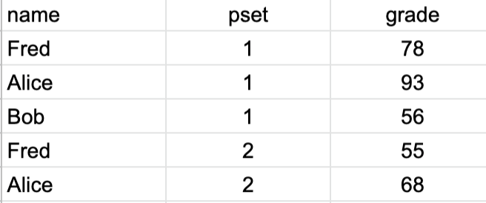
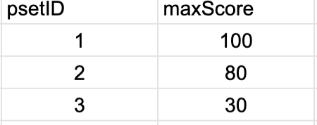
Excel spreadsheet for Course
Typical queries
Fred’s total for all psets
Fred’s average percentage for all psets
Average score for pset 1
Average weighted percentage score( out of 100) for all psets

Slide 2
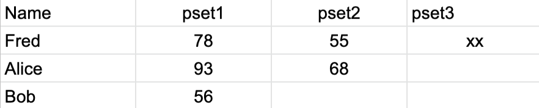
Another possible spreadsheet

Slide 3
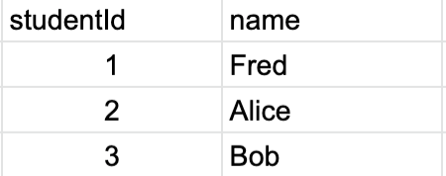
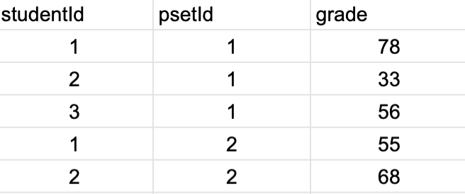
Relational Data Structure
Students
Problem sets
Grades

Slide 4
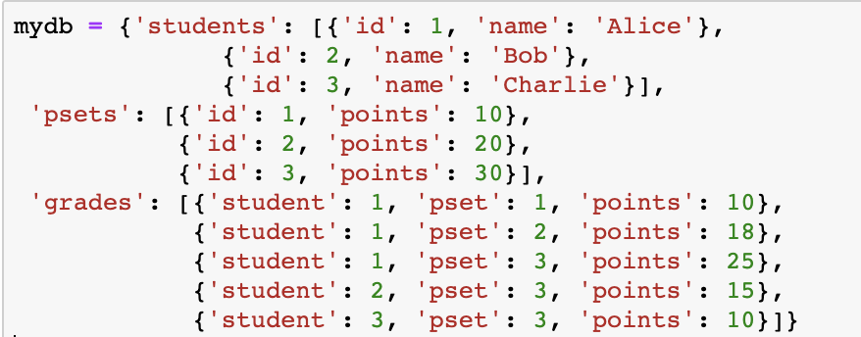
Data as Dictionary of Arrays mydb[”grades”][0]

Slide 5
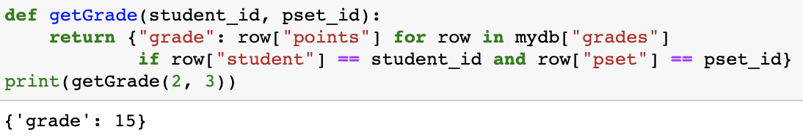
We need to loop over all rows in grades to get a student’s grade ( Nstudents * Npsets)

Slide 6
Use lists/array to store eg grades
student
Id:001
name: ‘john’
pset
id:001
maxGrade: 100
pset is dictionary {id: 001, maxGrade:100}
grade
student: 002
psetId: 001
value:76
students
s1
s2
Students is list of student objects/dictionaries
psets
p1
p2
psets is list of pset objects
grades
g1
g2
grades is list of grade objects

Slide 7
Student takes psets and has grades using lists
student
Id:001
name: ‘john’
pset
id:001
maxGrade: 100
total: 1190
grade
value:76
pset: 001
student: 002
students
s1
s2
psets
p1
p2
grades
g1
g2

Slide 8
We can use objects or use dictionaries Here we embed a dictionary within a dictionary
student
id:001
name: ‘john’
pset
id:001
maxGrade: 100
grades
sid: 001
psetId: 001
value:76
psetId: 002
value:83
sid: 002
psetId: 002
value:79

Slide 9
Option 1 key = [sid,psetid]
student
Id:001
name: ‘john’
pset
id:001
maxGrade: 100
grades
sid: 001
psetId: 001
value:76
sid: 001
psetId: 002
value:83
sid: 002
psetId: 001
value:79

