Slide 1
Ideate. Iterate. Implement.
SUMMER INSTITUTE 2026
AI-Assisted Interactive Learning Design
ACCESS THE PRESENTATION RESOURCE SITE AND PROMPT BUILDER APP
Visit the resource site to view and print presentation handouts and case studies at your leisure.
Your also welcome to use this prompt and context builder app that’s based on the workflow and model discussed in this same presentation.
Hillsborough College | Summer Institute 2026
Notes:
PURPOSE Open with a calm promise: this is a workflow workshop, not a coding spectacle. TALK TRACK Today we will use AI to shorten the distance between an instructional idea and something students can actually use. The faculty member still supplies the purpose, expertise, and judgment. TRANSITION Introduce the recurring Ideate → Iterate → Implement workflow.

Slide 2
Everything is retrieval-augmented (RAG) now
BRASS TACKS
Expert content becomes organized, retrievable working context—not an enormous prompt
4
3
+ CONNECTED SOURCES
Institutional resources, current sources, APIs, and search—when appropriate
2
+ PROJECT MEMORY
Design records, previous prompts, archived iterations, and verified decisions
1
+ PROJECT MATERIALS
Uploads, course documents, local folders, examples, images, and data
PROMPT ONLY
Hillsborough College | Summer Institute 2026
Notes:
PURPOSE Help faculty understand RAG without turning the session into infrastructure training. TALK TRACK Retrieval means the model can work with material beyond the words in the current prompt. Build outward from project materials to a durable project record, then to connected sources when useful. Quality depends on whether information is trustworthy, relevant, organized, and retrievable. TRANSITION Move from production context into lens-based testing and troubleshooting.

Slide 3
Use SCORM as a media container
BRASS TACKS
Keep assessment in intentional Canvas tools
SCORM PACKAGE
index.html
ZIP
UPLOAD
LAUNCH
LINK / EMBED
imsmanifest.xml
assets / media
The interactive supports thinking. Canvas manages the course workflow.
Hillsborough College | Summer Institute 2026
Notes:
PURPOSE Present SCORM calmly as packaging, not as the center of the session. TALK TRACK We are using SCORM as a portable media container. Unless there is a separate assessment design, do not make it the gradebook. Package the files, upload, launch, then place the launch where it supports the synthetic object. TRANSITION Troubleshoot by identifying which layer failed.

Slide 4
Preserve the project as you iterate
BRASS TACKS
Conversations are temporary; editable sources, decisions, and versions are durable
KEEP SOURCE + PACKAGE SEPARATE
RECORD THE FOUR CATEGORIES
Save editable HTML, CSS, scripts, and original media apart from the deployable zip or SCORM package.
Keep the current Learning Context, Interaction Design, Expert Content, and Artifact Specification decisions.
VERSION + CHECKPOINT
ARCHIVE PROMPTS, ASSETS + OPEN ISSUES
Use meaningful names such as v01-structure, v02-behavior, v03-keyboard, and record what changed.
Keep useful chats, prompts, sources, credits, generated assets, test results, and unresolved problems together.
The chat is not the project. The project is the durable design record.
Companion handout · A Simple Project Workflow
Hillsborough College | Summer Institute 2026
Notes:
PURPOSE Normalize versioning and archiving as part of faculty AI literacy. TALK TRACK Save editable sources, generated assets, the four-category design record, successful prompts, verified content, test results, and a short change history. Keep the deployable package separate. When a conversation loses context, restart from the durable project record. TRANSITION Point participants to A Simple Project Workflow, then use the next slide to model recovery from a lost chat.

Slide 5
Caution: every idea has a different cost profile
BRASS TACKS
Asset demand, AI suitability, and expected effort and time investment • 1 = low, 5 = high
INTERACTION
TEXT
GRAPHICS
MEDIA
LOGIC
TESTING
AI FIT
EFFORT
Knowledge check
2
1
1
2
2
5
2
Timeline
3
2
1
2
2
5
2
FAQ chatbot
4
1
1
3
3
5
2
Case study
5
2
1
3
3
5
3
Interactive diagram
3
4
2
3
4
4
4
Gamification
4
3
2
5
5
3
5
Simulation / lab
3
5
4
5
5
3
5
AI can reduce implementation effort. It cannot erase missing content, media, validation, or testing.
Hillsborough College | Summer Institute 2026
Notes:
PURPOSE Set realistic expectations about production effort without discouraging experimentation. TALK TRACK The numbers are heuristic, not a universal score. Use them to ask where the cost lives. A simulation may need custom graphics, domain logic, and heavy testing. A timeline can often derive much of its presentation from simple HTML and structured text. AI leverage is uneven. TRANSITION Once cost is visible, choose the experience that fits the assets and purpose.

Slide 6
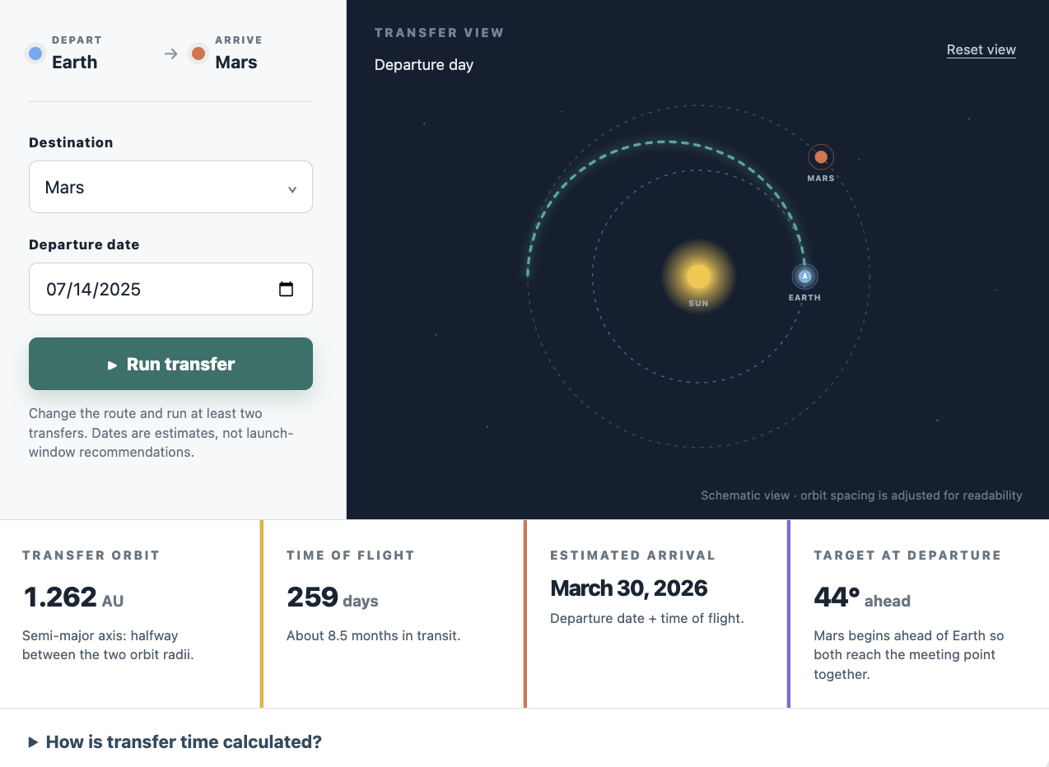
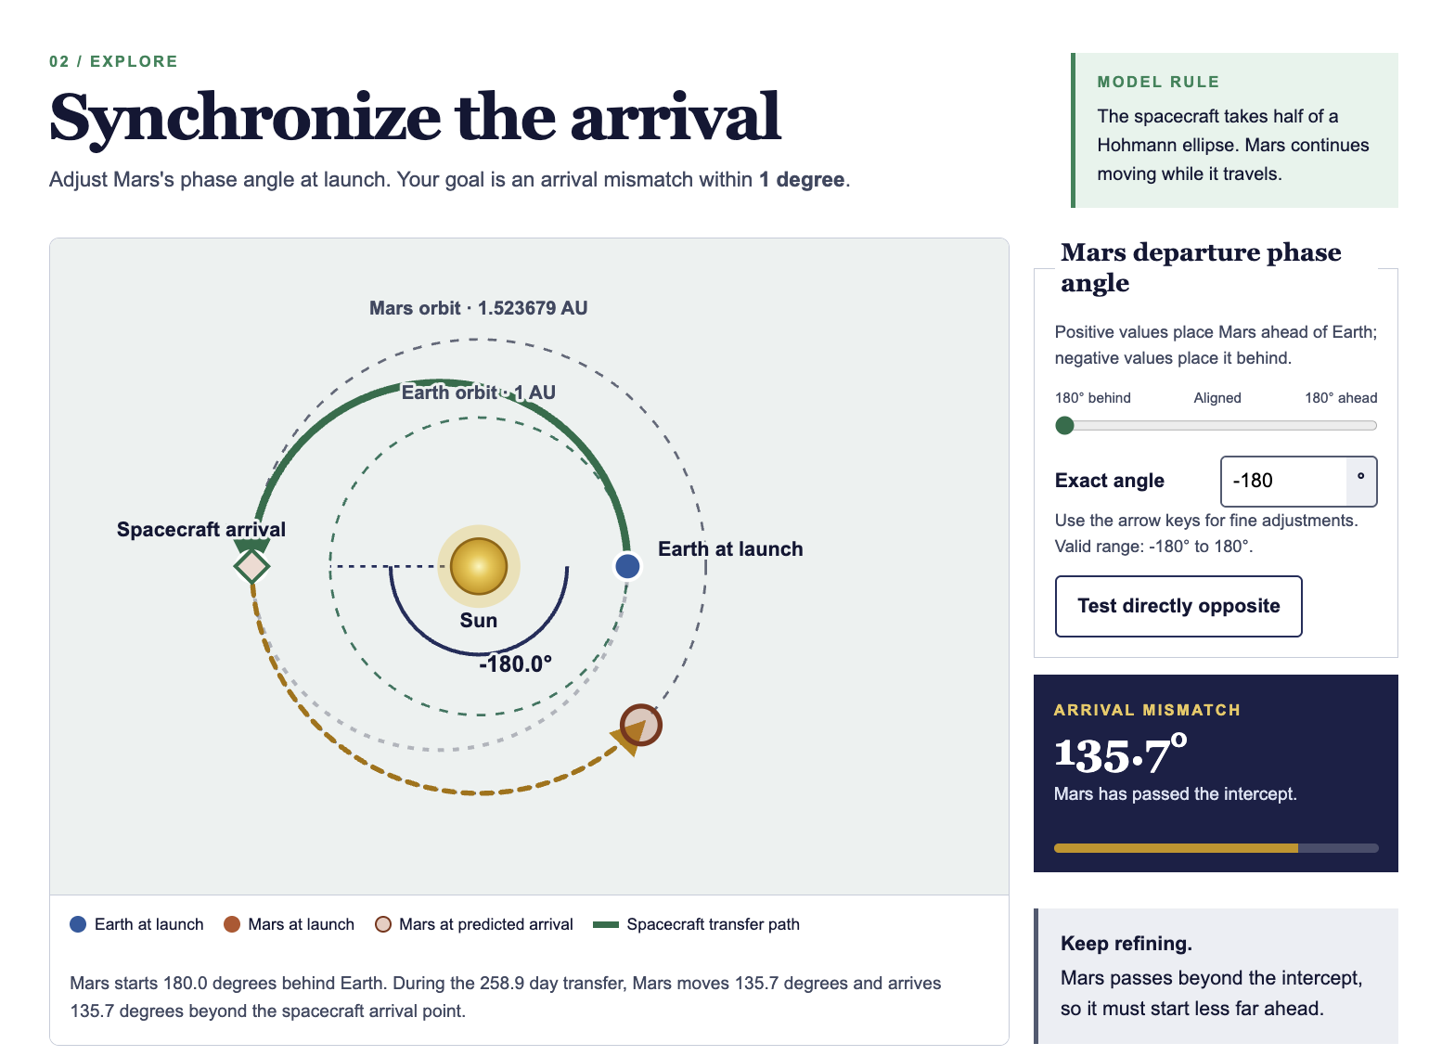
Which one required more prompting?
BRASS TACKS
Two polished using frontier models results can hide two very different processes
Ask for a vote before revealing the process.
Hillsborough College | Summer Institute 2026
Notes:
PURPOSE Create productive uncertainty and surface the myth that the best result requires the cleverest single prompt. TALK TRACK Replace the two placeholders with the Fable examples you referenced. Ask: Which one do you think required more prompting? Take a quick show of hands. Do not reveal the answer immediately. TRANSITION Reveal that the iterative example needed less clever prompting and more deliberate process.

Slide 7
Where one-shot prompting works—and where it breaks
BRASS TACKS
Use it for possibility; switch to iteration for production
ONE-SHOT IS USEFUL FOR
ONE-SHOT BREAKS DOWN WHEN
• Brainstorming
• Idea generation
• Quick drafts
• Rough outlines
• Exploring possible directions
• Decisions depend on one another
• Sources and assets matter
• Accuracy and accessibility must be tested
• The artifact must integrate with an LMS
USE IT TO OPEN POSSIBILITIES
ITERATE WHEN THE WORK BECOMES PRODUCTION
Hillsborough College | Summer Institute 2026
Notes:
PURPOSE Avoid treating one-shot prompting as universally bad; place it where it is genuinely useful. TALK TRACK One-shot work is excellent for opening the field of possibility. It becomes fragile when the deliverable contains interdependent instructional, content, visual, technical, accessibility, and delivery decisions. TRANSITION Use the mansion analogy to explain why production needs iteration.

Slide 8
One workflow, three recurring phases
BRASS TACKS
Ideate → Iterate → Implement → repeat
01
02
03
IDEATE
ITERATE
IMPLEMENT
Frame the possibility and gradually fill four design buckets.
Review the first build through the same four categories as lenses.
Test, package, place, preserve, deploy—and learn what to revise next.
Implementation produces new evidence—so the cycle begins again.
Hillsborough College | Summer Institute 2026
Notes:
PURPOSE Establish the recurring instructional design workflow that organizes the workshop. TALK TRACK Ideate frames a worthwhile possibility and gradually fills the four buckets. Iterate reviews the generated artifact through those same four categories as lenses. Implement tests, packages, places, preserves, and deploys the learning experience. New evidence can send us back into either earlier phase. TRANSITION Begin Ideate with the Fable comparison.

Slide 9
Evaluate your ideas with your available assets.
BRASS TACKS
Production effort changes when the artifact can be generated from code versus dependent on custom media
DYNAMIC / CODE-GENERATED
CUSTOM / MEDIA-DEPENDENT
Often efficient when the learning value comes from behavior
Often costly when the learning value depends on custom media
HTML/CSS layouts
SVG diagrams
Illustration / photos
Animation
Canvas plots
JavaScript state
Audio / video
3D or complex art
Data visualizations
Low external-media dependence
Rights + captions
Editing + production time
Ask early: Can the learning goal be met with behavior and simple visual systems—or does it truly require custom media?
Hillsborough College | Summer Institute 2026
Notes:
PURPOSE Add asset dependence to the early production decision. TALK TRACK A sophisticated interaction may still be relatively low-asset if it relies on code-generated state and simple visual systems. A seemingly simple idea can become expensive when it depends on custom illustration, animation, audio, video, or 3D assets. Consider the interaction and asset profile together. TRANSITION Use the Interaction Design Guide to choose the form and instructional role.

Slide 10
Four Lenses for Interactive Design
IDEATE
Four lenses make the important design decisions visible
1
LEARNING CONTEXT
2
INTERACTION DESIGN
3
EXPERT CONTENT
4
ARTIFACT SPECIFICATION
Why this exists
Who the learner is
What success means
What the learner does
What changes
What feedback means
Sources and claims
Models and examples
Accuracy boundaries
Deliverable and behavior
Accessibility
Technical delivery
Begin with what you know. Let missing information become the subject of the conversation with AI.
Hillsborough College | Summer Institute 2026
Notes:
PURPOSE Introduce the complete Interactive Design Map before explaining individual fields. TALK TRACK During Ideate, the four categories are buckets that we gradually fill before and during the first build. They are not a rigid form. Faculty may begin with a partially formed idea—or only an outcome, assessment, and possible source asset. TRANSITION Zoom into learning context through backward design.

Slide 11
Bucket 1 — Learning Context
IDEATE
What instructional situation is this artifact being designed to serve?
ALIGNMENT + SEQUENCE
LEARNER + PURPOSE
Course
Unit / module
Learning purpose
Instructional role
Course outcomes
Module outcomes
Student audience
Prerequisite knowledge
Related assessment
Course placement
Anticipated difficulty
Time available
Before / after
OUTCOME
ASSESSMENT
INTERACTION
Companion handout · Learning Context Guide
Hillsborough College | Summer Institute 2026
Notes:
PURPOSE Give Learning Context a complete, dedicated treatment and connect it to backward design. TALK TRACK Capture where the artifact lives, which outcomes and assessment it supports, who the students are, what they already know, and how much time the experience can reasonably take. Backward design still governs the sequence: outcome, assessment evidence, then interaction. TRANSITION Use the Learning Context Guide, then move to the learner experience itself.

Slide 12
Bucket 2 — Interaction Design
IDEATE
What should the learner do, notice, decide, practice, or produce?
DEFINE THE EXPERIENCE
PLACE IT IN THE SEQUENCE
• Interaction species or form
• Instructional role
• Student action + learner control
• Feedback behavior
• Exploration versus guided progression
• Replay, reset, or retry behavior
• Individual versus collaborative use
• Alignment with outcome and assessment
Simulation · Narrative · Case Study · Visual Stimulus · Decision Tree · Timeline · Interactive Diagram · Guided Conversation · Game · Reflection · Data Visualization · Practice Activity
Ask: What comes before it? What comes after it? What role does it play in the larger learning experience?
Companion handout · Interaction Design Guide
Hillsborough College | Summer Institute 2026
Notes:
PURPOSE Make Interaction Design more than a list of formats by connecting species, alignment, learner action, and ecological role. TALK TRACK A simulation, narrative, case study, visual stimulus, timeline, decision tree, guided conversation, game, or reflection is only useful when its learner action supports the objective. Then ask what role it plays inside the larger synthetic object. TRANSITION Visualize the synthetic object on the next slide.

Slide 13
Bucket 3 — Expert Content
IDEATE
What knowledge and source material must the artifact represent accurately?
WHAT CAN BECOME EXPERT CONTENT?
FILES ARE ONLY PART
Expert content also includes tacit knowledge: judgment, preferred explanations, corrections, authentic practice, and interpretive emphasis.
Instructor expertise
Explanations + notes
Textbook excerpts
PDFs + research
Diagrams + images
Photos + data sets
Worked examples
Case materials
Rubrics + assignments
PRODUCTION IMPACT
Low-asset starts leave more gaps for AI to fill. Verified examples, visuals, data, terminology, and misconceptions create tighter boundaries.
Visual references
Vocabulary + conventions
Misconceptions + errors
Professional practice
Corrections + judgment
Preferences + emphasis
Companion handout · Expert Content Guide
Hillsborough College | Summer Institute 2026
Notes:
PURPOSE Broaden expert content beyond textbook excerpts and explain its production implications. TALK TRACK Expert content includes notes, PDFs, diagrams, images, data, examples, rubrics, research, assignments, vocabulary, and known misconceptions. A low-asset start is possible, but AI will fill more gaps. A high-asset start usually improves specificity and makes verification easier. TRANSITION Use the Expert Content Guide, then specify the deliverable.

Slide 14
Bucket 4 — Artifact Specification
IDEATE
What must the finished artifact look like, do, support, and comply with?
DELIVERABLE + BEHAVIOR
ACCESS + AESTHETICS
DELIVERY + RESTRICTIONS
✓
Type + technical format
✓
Keyboard + equivalent text
✓
SCORM + LMS + iframe
✓
Tone + visual style
✓
Contrast + motion
✓
Export + file organization
✓
Navigation + feedback
✓
Mobile responsiveness
✓
Local / hosted or linked assets
✓
Completion criteria
✓
Brand + palette + type
✓
Integrations + constraints
✓
Reset / replay behavior
✓
Usability + polish
✓
Privacy + account limits
Companion handout · Artifact Specification Guide
Hillsborough College | Summer Institute 2026
Notes:
PURPOSE Give Artifact Specification equal status with the other three buckets. TALK TRACK Specify the deliverable, learner experience, accessibility, responsive behavior, brand and visual system, navigation, completion, feedback, export, technical constraints, LMS placement, and integrations. These details make the output testable rather than merely attractive. TRANSITION Transition from buckets to the same four categories used as iteration lenses.

Slide 15
The same four lenses, used differently
IDEATE → ITERATE
Ideation fills the buckets. Iteration reviews the build through those same lenses.
IDEATE
ITERATE
FILL THE BUCKETS
REVIEW THROUGH LENSES
1 Learning Context
Does it fit the learning?
2 Interaction Design
Does the learner act meaningfully?
3 Expert Content
Is the content trustworthy?
4 Artifact Specification
Does the artifact work as required?
Iteration can reopen ideation. A mismatch may reveal that an earlier decision needs to change.
Hillsborough College | Summer Institute 2026
Notes:
PURPOSE Make the conceptual turn from ideation to iteration explicit. TALK TRACK The framework does not acquire a fifth category during review. We use the same four categories differently: first to make decisions, then to inspect what was built. Accessibility and quality assurance remain within Artifact Specification. TRANSITION Introduce each review lens with a concrete targeted revision prompt.

Slide 16
Lens 1 — Learning Context
ITERATE
Does this artifact serve the intended learning, learners, and course moment?
REVIEW FOR
TARGETED REVISION
Outcome alignment
“Revise the activity so that students compare the two models rather than merely identify their parts. Preserve the existing visual layout and controls.”
Course and module placement
Relationship to assessment
Learner readiness and prerequisites
Purpose before and after the activity
Appropriate difficulty and duration
Value relative to the surrounding lesson
Names the learning mismatch • requests one change • preserves what works
Hillsborough College | Summer Institute 2026
Notes:
PURPOSE Demonstrate that a useful revision prompt begins with a diagnosed learning mismatch. TALK TRACK Learning Context asks whether the artifact belongs in this course moment and advances the stated outcome. The example changes the cognitive demand while explicitly preserving the functioning layout and controls. TRANSITION Move to the Interaction Design lens.

Slide 17
Lens 2 — Interaction Design
ITERATE
What does the learner do, and how does the artifact respond?
REVIEW FOR
TARGETED REVISION
Meaningful learner action
“Add one branching decision in which each option produces a visible consequence and concise feedback. Preserve the current scenario, tone, and visual style.”
Choice, change, comparison, or explanation
Consequences and feedback
Progression rather than repetition
Useful challenge and cognitive effort
Clear relationship between form and role
A reason to interact rather than only read
Targets the learner action • defines response behavior • protects the design language
Hillsborough College | Summer Institute 2026
Notes:
PURPOSE Distinguish a functioning interface from a meaningful interaction. TALK TRACK Interaction Design reviews the learner action, the consequence, and the feedback loop. The prompt asks for one branch and makes the expected behavior visible without reopening the entire scenario or visual design. TRANSITION Move to the Expert Content lens.

Slide 18
Lens 3 — Expert Content
ITERATE
Are the claims, examples, models, and explanations trustworthy and instructionally useful?
REVIEW FOR
TARGETED REVISION
Accuracy and source authority
“Correct the explanation of orbital eccentricity using the supplied course notes. Preserve the current calculations, controls, and layout. Add one sentence naming the model’s simplifying assumption.”
Disciplinary language and conventions
Appropriate simplification
Examples, nonexamples, and edge cases
Assumptions and limitations
Tacit expert reasoning made visible
Consistency across labels, data, and feedback
Anchors the correction • limits collateral change • makes an assumption visible
Hillsborough College | Summer Institute 2026
Notes:
PURPOSE Show why disciplinary review cannot be delegated to surface polish. TALK TRACK Expert Content includes accuracy, examples, reasoning, language, assumptions, and limits. The targeted prompt supplies an authority and narrows the correction while preserving validated calculations and interface behavior. TRANSITION Move to Artifact Specification, where accessibility and delivery are tested.

Slide 19
Lens 4 — Artifact Specification
ITERATE
Does the artifact work visually, accessibly, technically, and in its delivery environment?
REVIEW FOR
TARGETED REVISION
Aesthetics, Visual clarity, and hierarchy
“Make every control keyboard operable and expose the current visual state as status text for screen readers. Preserve the calculations, instructional sequence, and visual composition.”
Keyboard and assistive-technology access
Labels, focus, and announced state
Responsive and screen-size behavior
Navigation, reset, and completion
Files, paths, packaging, and SCORM
Performance, rights, captions, and credits
Accessibility and QA are part of the artifact specification—not a fifth bucket
Hillsborough College | Summer Institute 2026
Notes:
PURPOSE Keep accessibility, visual quality, and technical testing inside the fourth category. TALK TRACK Artifact Specification is broader than file format. It governs visual behavior, access, responsive layout, navigation, packaging, media requirements, and delivery constraints. The prompt names a testable repair and preserves validated content and structure. TRANSITION Combine the four lenses into a repeatable loop.

Slide 20
The iteration loop
ITERATE
Start with the most important mismatch. The order is flexible; the discipline is not.
LEARNING
CONTEXT
INTERACTION
DESIGN
EXPERT
CONTENT
ARTIFACT
SPECIFICATION
TEST
REPEAT
One pass may be enough. Another build may need several passes through one lens before moving on.
Use the Iteration Checklist to record the mismatch, requested change, preserved strengths, and test result.
Hillsborough College | Summer Institute 2026
Notes:
PURPOSE Give participants a compact visual they can reuse after the workshop. TALK TRACK The lenses are not a mandatory waterfall. Begin where risk or mismatch is greatest. Record the requested change, what must remain unchanged, and how the revision will be tested. Continue until the artifact is fit for implementation. TRANSITION Apply the loop to the two case studies.

Slide 21
Testing and troubleshooting through the lenses
IMPLEMENT
A symptom points to the design dimension that should change next
SYMPTOM
LIKELY LAYER
NEXT MOVE
Explanation is incorrect
Expert Content
Correct it from a verified source; preserve the working interface.
Learner task is weak
Interaction Design
Specify a more meaningful action, consequence, or feedback loop.
Activity misses the outcome
Learning Context
Reconnect the task to the outcome, assessment, and course placement.
Keyboard or status fails
Artifact Specification
Repair focus order, controls, labels, and announced state.
SCORM or asset path breaks
Artifact Specification
Check manifest, zip root, launch file, and relative paths.
Mobile or reset behavior fails
Artifact Specification
Test required viewports, state, reset, and completion behavior.
Prompt drifts or forgets
Four-category record
Reload the durable design record and the current verified build.
Implementation is too complex
Interaction + Artifact
Reduce to the smallest convincing learner action and retest.
Hillsborough College | Summer Institute 2026
Notes:
PURPOSE Give practical failure language without turning the workshop into a debugging clinic. TALK TRACK When something fails, classify it using the same four lenses used for review. Accessibility, visual behavior, navigation, files, and packaging belong within Artifact Specification—not in a fifth category. Change the smallest responsible dimension and retest. TRANSITION Protect progress so starting over is a choice, not a loss.

Slide 22
Intentional placement completes the synthetic object
IMPLEMENT
Implementation does not end when the interactive works
THE INTERACTIVE
PLACEMENT QUESTIONS
1
Where does it appear?
2
What introduces it?
ONE COMPONENT
OF THE
SYNTHETIC OBJECT
3
What instructions are needed?
4
What follows it?
5
How is completion understood?
6
Does it prepare another task?
7
Is it central or supporting?
8
What should remain native in Canvas?
Canvas provides framing, instructions, sequencing, reflection, assessment, and continuation.
Use the Canvas Placement Guide to design the whole learning object—not only the embedded media.
Hillsborough College | Summer Institute 2026
Notes:
PURPOSE Reconnect deployment to the synthetic-object definition. TALK TRACK The artifact is only one component. Decide what Canvas should introduce, instruct, sequence, assess, and preserve. Keep course workflow and graded assessment in intentional Canvas tools unless the design requires otherwise. TRANSITION Move into the live eight-step build.

Slide 23
Now that we have a process, let’s push the envelope
IMPLEMENT
Audience suggestions → bounded first build → visible iteration
BUILD SOMETHING THAT FEELS IMPOSSIBLE
1
Choose a learning purpose
2
Choose the interaction form + role
3
Fill the four categories
4
Build the smallest convincing slice
5
Review through one lens
6
Request a targeted revision
7
Test the result
8
Name placement + preservation
Hillsborough College | Summer Institute 2026
Notes:
PURPOSE Frame the live demo as application of the process, not entertainment. TALK TRACK Invite an ambitious idea, then bound it. Narrate the decision-making aloud. The memorable moment should be that an impossible idea becomes manageable when the group chooses one learner action and one testable slice. TRANSITION Use the next slide to collect inputs without losing structure.

Slide 24
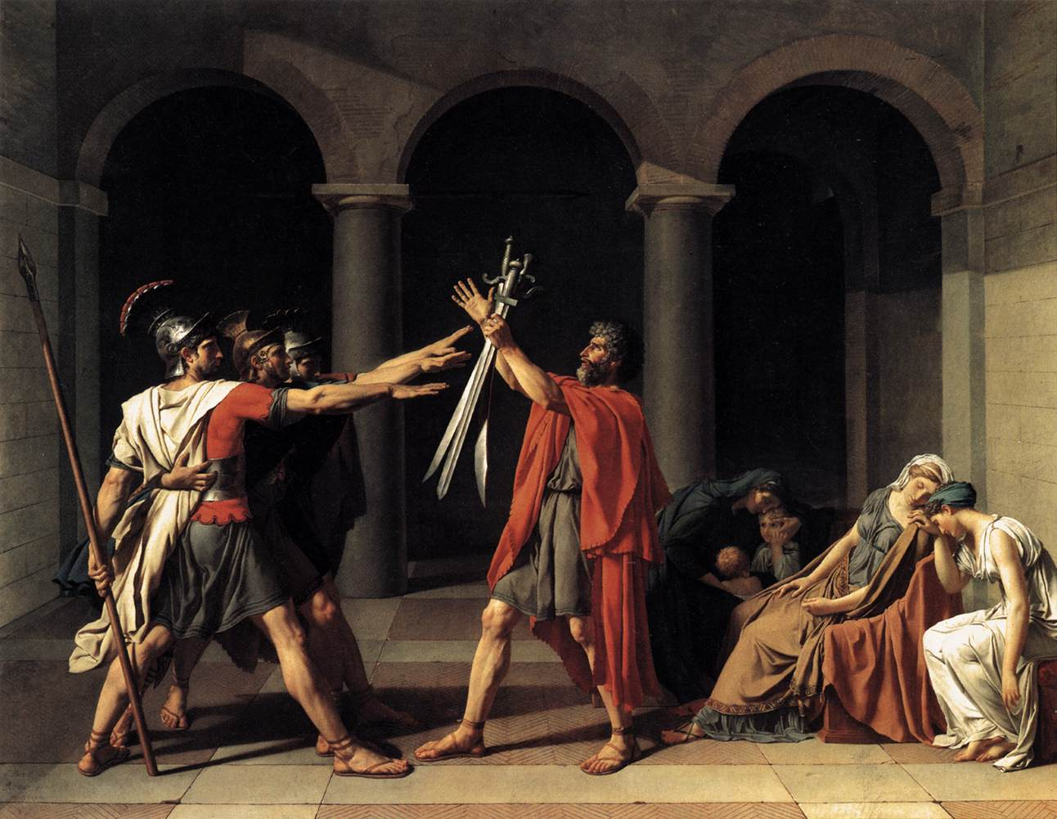
Art history: from one image to guided visual analysis
CASE STUDIES
Starting materials, uncertainties, and four-bucket design direction
WHAT THE INSTRUCTOR BRINGS
Outcome
Analyze how formal visual elements contribute to meaning.
Resource
One public-domain image: Oath of the Horatii (1784).
Need
Help novices use visible evidence to support an interpretation.
Hillsborough College | Summer Institute 2026
Notes:
PURPOSE Show that low-asset does not mean low-value. TALK TRACK The instructor does not start with a fully designed activity. They have one outcome and one image. The design challenge is to move learners from naming visual elements to using evidence in an interpretive claim. TRANSITION Complete the design map before generating.

Slide 25
Art history: diagnose, revise, test, and place
CASE STUDIES
The first build becomes evidence for the next design decision
CONTEXT
Novices prepare for discussion and visual-analysis writing
FROM FIRST BUILD TO COURSE PLACEMENT
1
Mismatch: recognition only
INTERACTION
Select details that support a claim; compare evidence
2
Lens: Interaction Design
EXPERT CONTENT
Verified vocabulary + observable features + interpretive limits
3
Target: compare evidence
SPECS
5–8 min, keyboard accessible, no drag-and-drop, SCORM 1.2
4
Test + place before writing
AI builds a component of the synthetic object—not “the lesson.”
Hillsborough College | Summer Institute 2026
Notes:
PURPOSE Show how each bucket constrains a different kind of variation. TALK TRACK Show the first build, then diagnose the most important mismatch through the Interaction Design lens. A targeted prompt preserves the painting, layout, and verified vocabulary while changing the learner task from recognition to evidence comparison. Test keyboard access and place the artifact before discussion or visual-analysis writing. TRANSITION Contrast this with a high-model, high-testing STEM case.

Slide 26
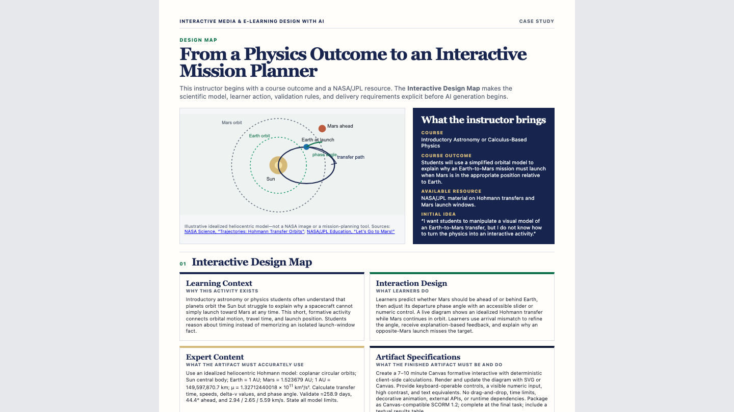
Physics: from a source to an interactive mission planner
CASE STUDIES
A high-asset design direction with explicit model and validation requirements
WHAT THE INSTRUCTOR BRINGS
Outcome
Explain why an Earth-to-Mars mission must launch at the right phase angle.
Resources
NASA/JPL guidance + constants + formulas + expected values.
Responsibility
State assumptions and limits; validate calculations.
Hillsborough College | Summer Institute 2026
Notes:
PURPOSE Show why a visually similar artifact may have a radically different production profile. TALK TRACK This case needs deterministic calculations, explicit assumptions, expected values, accessible controls, and an honest disclaimer that it is not a real mission-planning tool. The source material becomes part of the specification. TRANSITION Show what the prompt can now control and what testing must prove.

Slide 27
Physics: the prompt becomes a test specification
CASE STUDIES
Review through lenses, request targeted corrections, then validate and package
FIRST BUILD
LENS REVIEW
TARGET + TEST
IMPLEMENT
Orbital model works
Explanation drifts
Control lacks status text
Expert Content
Artifact Specification
Interaction Design
Correct from notes
Announce visual state
Validate baseline values
Preserve source
Package SCORM
Place before transfer task
AI can draft the implementation. The specification lets us test whether it is right.
Hillsborough College | Summer Institute 2026
Notes:
PURPOSE Reframe a long prompt as an accountable design and testing document. TALK TRACK The prompt is useful because it controls the model and makes failure visible. If the baseline calculations are wrong, the artifact is wrong even if it looks polished. This is where domain expertise remains indispensable. TRANSITION Synthesize the two cases into rules of thumb.

Slide 28
Let’s build one together
LIVE BUILD
Use the prompts on screen to capture audience suggestions
LEARNING CONTEXT
INTERACTION DESIGN
Who are the learners? What should they be able to do?
What should they change, choose, compare, or explain?
Type notes here during the session…
Type notes here during the session…
EXPERT CONTENT
ARTIFACT SPECIFICATION
What trusted material, examples, models, or claims should it use?
How long? What format? What accessibility and delivery constraints?
Type notes here during the session…
Type notes here during the session…
Hillsborough College | Summer Institute 2026
Notes:
PURPOSE Provide an editable capture surface during the live demo. TALK TRACK Type directly into the four cards in PowerPoint Presenter mode or duplicate this slide for additional ideas. Keep inputs short. When the room offers a feature, translate it into the bucket it belongs to. TRANSITION Close by returning responsibility and judgment to faculty.

Slide 29
If AI became perfect tomorrow, what would still be missing?
BIG QUESTION
The work that remains is the work of educational judgment
✓
Choosing worthwhile learning outcomes
✓
Understanding your students
✓
Designing authentic assessment
✓
Knowing your discipline
✓
Exercising judgment
✓
Deciding when technology should not be used
✓
Creating meaning and belonging
✓
Taking responsibility for consequences
The faster implementation becomes, the more visible your judgment becomes.
Hillsborough College | Summer Institute 2026
Notes:
PURPOSE End the conceptual arc with a reflective question rather than a tool recap. TALK TRACK Invite a few answers before revealing the list. The point is not to reassure by minimizing AI. It is to identify the human responsibilities that become more important as implementation gets easier. TRANSITION Finish with the central affirmation and practical next step.

Slide 30
Conclusion.
CONCLUSION
Ideate. Iterate. Implement.
AI accelerates implementation; instructional design remains fundamentally human
Companion Resources
Interactive Design Map
Interaction Design Guide
Iteration Checklist
Placement Guide
Companion handout · A Simple Project Workflow
AWS Design Map Builder
Questions • Ideas • One more small build?
Hillsborough College | Summer Institute 2026
Notes:
PURPOSE Close with confidence and point participants to reusable artifacts. TALK TRACK The goal is not to leave with a perfect prompt. Leave with a design process you can repeat: define the learning context, choose the interaction, supply expert content, constrain the artifact, and improve one thing at a time. TRANSITION Invite questions or ask participants to name one small object they want to build next.

