Slide 1

Week 2
Traditional Versus Internet marketing

Slide 2
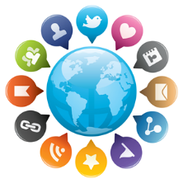
The Future of marketing
How has the digital platform changed how businesses market?
Social Media
Facebook, LinkedIn, Twitter
Content Marketing
Blogs, White Paper, SlideShare, Infographics
Video
YouTube, Vimeo
Can less be more?
Notes:
While this article focuses on CPA firms, we can certainly take some things away from it. And if you are working towards an Accounting degree, this may be something you can keep with you for the future.
What does the future of marketing look like? We touched on this last week ever so slightly, and we all have a notion of where it is headed. However, it is always good to take a look from other’s perspectives and possibly improve our outlook, or reaffirm our observations.
This article briefly introduces the traditional versus digital/internet marketing discussion. To paraphrase the beginning of the article, it says that “most CPA firms use traditional methods of marketing such as obtaining referrals, highlighting location, and being involved in the community.” These tools among other things are considered traditional in the sense that it’s been around for years, and everyone has used them at one point or another. How has the digital platform changed how businesses market? More focus is put on social media, content marketing, and video. I recently consulted with a dental office to improve their marketing direction. In it, we decided to incorporate YouTube videos, client video testimonials, and better use of their Facebook. The office used a third party marketing association to oversee many aspects of its social media, such as monitoring reviews, SEO, and directing traffic to the website. However, the social media aspect needed more control. It’s one thing to have a bunch of posts, but it’s even more important that there is engagement. In most cases, less can be more, especially if the business is getting user participation, engagement, and shares.

Slide 3
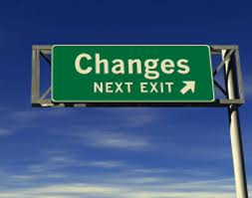
Culture Shift
“We have always done things this way.”
Changing landscape of marketing
Internet marketing is another tool to use
Notes:
Committing to the changing landscape of marketing has more to do with the cultural and mindset shift than the technology to begin with. The “traditional” methods of marketing remain a player in the world of marketing because they have been around for so long and have proven to be effective in many markets. In another experience I had with a law firm several years ago, this culture shift was a tough one for many of the staff to get around. The belief was “we have always done things this way.” To break through that barrier, they had to step out of their frame of mind and embrace the changing world. They had to accept that many of the clients were becoming more in tune with advancements in technology. Long story, short, they eventually moved into the 21st century and upgraded their phone systems, fax technology, and even credit card processing. The office was using dial up, so when one was running, the others couldn’t.
Incorporating internet marketing doesn’t mean getting rid of the other tools. Internet marketing strategy is just another tool in the toolbox. It actually can work in a complimentary role to increase referrals, improve engagement, and expand reach. How many of you google a company, check out the yelp reviews, and look at their website before contacting them? How many create a post on Facebook asking for suggestions or opinions of a business or service?

Slide 4

Why social media?
Builds the right image
Recognition
Trust
Support
Reaches a wider network
Content Marketing
Creates engagement and interaction
Notes:
What does social media do for the business? It helps to build a reputable image. By posting content that is informative and engaging, the business or service is looked upon as an expert in the field, a trustworthy source. In addition, it helps to earn recognition and support through the pool of users and personal networks. When I see a friend of mine “liking” a company page, I usually take a look also and see what it’s all about.
The general perception is that internet marketing is all about Facebook, Twitter, LinkedIn, SEO, and so forth. However, many don’t see what goes on behind the scenes to improve the SEO, to improve engagement on the various social media platforms, and to drive traffic to your website and pages. Content marketing has to do with creating your own and unique content. “Original” is the key word. There are many avenues to take to increase your content marketing. Some companies employ third party marketing firms to create content for them, some hire ghost writers to create blogs, and some hire video production companies to create short videos. The possibilities and opportunities are endless. We will get into these more as the semester goes along. One of the successes that came from the Old Spice campaign was the ability to create original content so quickly.

Slide 5

the old with the new
“Because social media has the ability to engage target audiences in great capacities, social marketers should consider these interactive Internet applications to promote health behavior change.”
Measurable objectives
One way versus Two way communication
Notes:
This article showed the success and importance of having an integrated marketing plan that combined the elements of both traditional and internet marketing. The case study itself was an interesting one but I wanted you to focus more on the elements of marketing that was used. With any marketing tool that is used, having a measurable objective and evaluation method allows for thorough examination of the success or improvements needed.
“Because social media has the ability to engage target audiences in great capacities, social marketers should consider these interactive Internet applications to promote health behavior change.” One of the keys to social media marketing is the ability to engage target audiences. The key word being “engage.” Whereas traditional forms of marketing can reach a broad range of consumers, it is widely considered a one way form of communication. Social media and internet marketing is considered two way communication in the sense that it creates involvement and engagement with the consumer base, especially the target audience. For example, businesses can use Facebook’s target advertising tool to specifically speak to more targeted demographics. This is different than sending a postcard to that demographic because on Facebook, it’s an invitation for them to connect with you, to like your page, to learn more about your company and service offerings.

Slide 6
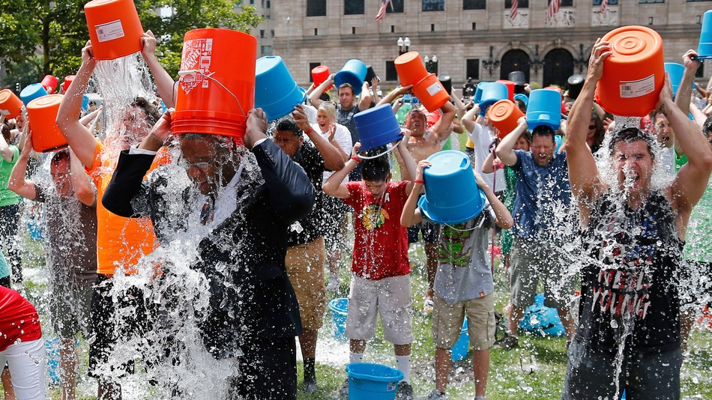
Evaluating the campaign
Quantitative versus Qualitative
What is quality?
Comments
Shares
Creates interaction
Going “viral”
Notes:
The traditional media used in this campaign acted as a complimentary tool, as the poster and magnets were used to direct traffic to the website. The social media aspect created more involvement and interaction on the various platforms used. The YouTube videos gave the mascot a personality to which viewers can associate with the campaign. The study also used mobile apps, which we will touch more on later as we move on through the semester. As you can see, this is just the tip of the iceberg, with internet marketing, there are so many opportunities to explore and utilize.
The difference in the two methods lies in the evaluation methods and key word “quantitative” versus “qualitative.” Why both media offered “quantitative” measurements such as how many posters and magnets were distributed, or how many likes and views were received, the social media campaign offered “qualitative” data also because of the comments and shares from the various social media outlets. This is valuable information because it shows interaction and whether the consumer base was interested or involved in what the company was offering. One of the keys I’ve mentioned before in internet marketing isn’t how many followers, likes, or views your pages or posts get, but the value lies in the engagement and if consumers comment, discuss, and share your media or posts. The “viral” aspect of internet marketing is what makes it so popular. If done effectively and successfully, the idea is to create a viral campaign that can be widespread and shared through the various consumer networks and pool of family and friends. I think a fairly recent example of a viral campaign was the ice bucket challenge. It got users involved, and while it received some criticism in drought stricken areas, the overall campaign did what it was intended to do, and more. The campaign had measurable results that were qualitative as well as quantitative.

Slide 7
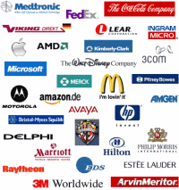
What are the big guys doing?
Are they trendsetters?
What are they doing different?
Corporate Social Responsibility
Customer Service
All this creates a story, a persona.
Also focuses on the consumer and gives them a voice
Notes:
An interesting part of this article is the discussion on how Fortune 500 companies use social media to promote their corporate social responsibility activities. This is an interesting fact and one that can be applied to all businesses not just Fortune 500. What are they essentially doing by promoting their activities? They are creating a story, a personality, for the company and profile in which consumers can interact. Also, they are creating a reputable image especially if the picture or post gets shared virally.
Another interesting nugget was the ability to use social media for customer service. How many consumers take to social media to voice their satisfaction, mainly un-satisfaction, with a product or service? Or issues related to a product? Imagine posting about a problem you are having with your Dyson vacuum, and the next morning a technical expert from Dyson has responded to you regarding the issue. That would make you feel like a valued customer wouldn’t it? Of course, there would need to be protection for privacy and so forth, but customer service can be a valuable path to internet marketing.

Slide 8

Opportunities
What other opportunities exist?
SnapChat, Instagram, Vimeo, Slideshare, Video Streaming
All roads lead to Rome
In this case, the website
So which internet marketing platform should you use?
Notes:
The article was assigned so that we can see what platforms are being used often and what opportunities exist. Most of the ones we already know, but what about opportunities using Instagram, Pinterest, or any of the other platforms? Can you see an opportunity with one? Snapchat, while a fairly new social media platform, has already becoming a marketing tool used by the NBA and NFL. Many companies are using SlideShare as a component of their content marketing strategy.
An additional point to take away from this article is that while all these certain platforms are being used, all the roads lead back to the website. This also applies to the other articles and topics we have discussed regarding traditional marketing methods, all roads seem to lead back to your website, which is the center of your marketing strategy. Here’s the idea, while you use Facebook to promote and educate about your product or service, how does the consumer make the purchase? Many will go to your website, online store, or physical location. If you send out a postcard with a special offer, where do they go to purchase? Again, website, online store, or physical location. All of these marketing methods are then tools to get the customer to the final location.
The implications give us a great look at the opportunities presented with internet marketing. Depending on your industry, some platforms can prove more valuable than others. However, the ones not used often can also prove to be an opportunity to be a pioneer in utilizing that platform. Blogging is often a tool used by companies to improve their search engine optimization. Most consumers don’t go directly to a company’s website and read the blog, many will find it through their research on Google and read it from there. Therefore, many companies don’t promote their blogs, but still see it as a valuable strategy.

