Slide 1
Social Media

Slide 2

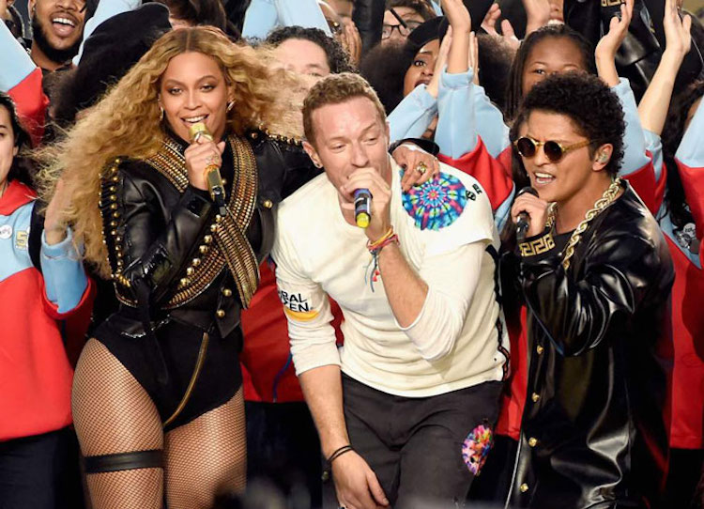
Super Bowl 50
Social media’s impact on advertising
Esurance’s online campaign garnered 1.5 Billion impressions
Conversion is key!
Used Twitter as the main attraction
How do you decide which platform to go with?
Notes:
This week’s materials focused on successfully using strategies to get results. In order to do so, what steps do we need to take? How does one leverage their online presence and use it to drive business? These are questions asked by business owners and marketers every day, and with the growing and changing landscape of internet marketing, it is a challenge that we look forward to as well. Before we dive into the readings, I wanted to point out a few things learned a few years ago, from Super Bowl 50 for a couple different reasons. One, it was one of the better halftime shows in a while, in my opinion, and two, social media marketing was well on display prior to, during, and after the event. While TV ads still dominated, (the average price tag of $5 million per 30 second spot would suggest) many companies were and are using social media as a key component to their marketing strategy.
Here are a couple of examples: Esurance didn’t even advertise on TV during Super Bowl 50 but their internet marketing strategy garnered 1.5 billion impressions. (http://www.adweek.com/news/technology/social-first-mind-set-esurance-entirely-dominated-twitter-super-bowl-169533) Their sweepstakes was implemented a few days before the Super Bowl and it gained much traction over the next few days. Now, the question is will those impressions, tweets, and retweets, turn into actual customers? That’s really the gauge of how effective the plan was, did it or will it result in conversions. In choosing the social media platform to promote their sweepstakes, Esurance used Twitter as the main vehicle, with Facebook being a supplement. The key in developing a marketing plan is to use one platform as the main attraction and the rest as the supporting artists…. kind of like Coldplay at the Super Bowl, with Beyonce and Bruno being the undercards. Or was it the other way around?

Slide 3

Super Bowl 53
Interesting Super Bowl facts.
2019 Super Bowl Ads Were Viewed Massively Online Before And After The Game
Super Bowl Pregame Advertising
Twitter’s #BrandBowl
Notes:
Here are some interesting facts on how impactful social media was on this year’s Super Bowl. (https://www.forbes.com/sites/nelsongranados/2019/02/08/2019-super-bowl-ads-were-viewed-massively-online-before-and-after-the-game/#51e553df41b0) The article points out some interesting facts and numbers regarding the 24 ads that they tracked and the viewership before and after the Super Bowl. Where at one point, advertising during the Super Bowl was the thing to do, these days, it is equally if not more important to take the social media route as well.
Usually, companies will wait until the game to do a big unveiling, but studies over the years have shown that this strategy of using social media to build momentum has paid off. Just ask Hyundai and Kevin Hart how that worked in 2016. (http://www.ibtimes.com/super-bowl-ads-2016-social-media-part-pregame-advertising-impressions-increase-2297387)
Take a look here at how Twitter capitalizes on the trend as well. (https://www.adweek.com/digital/twitters-brandbowl-will-curate-super-bowl-ads-and-dish-out-awards-for-their-social-media-impact/ )

Slide 4


Good Social Media Drives Good Results
Listen by:
Engaging
Collecting data
Analytics
VS.
Is the conversation relevant?
Notes:
It is commonly said that “good social media strategy drives good results.” I would venture to say this is a pretty common idea that any good strategy normally leads to good results. Every now and then, it won’t but the idea of having a strategy in place increases those chances. Herein lies the problem, saying it is always easier than actually doing it. And if you decide you want to do it, implementing a social media marketing strategy, where do you even begin? All these big companies have the resources and finances to pull of an all-encompassing marketing strategy during the Super Bowl, but what about the smaller challenger brands or companies, what can they do? One of the key takeaways from the article by Robert Rippee is that instead of “shouting,” businesses need to do more “listening” when it comes to their social media. How do you listen when the conversation is online? You listen by engaging, collecting data, and using analytics. In my experience, I have seen this happen often where a business posts all kinds of information and overloads the consumer. This is like sitting down in a conversation with a friend or colleague, and they are the ones doing all the talking and often talking over you. If you are making posts or tweets, and they are being ignored…. what does that tell you? If you have over 1000 likes for your fan page, yet your average engagement on a post is 40 likes…what does that tell you? These are things that a marketing person needs to “listen” to when it comes to their social media marketing campaigns. Going back to the discussion above regarding the information or conversation you are trying to engage in, the important thing to consider is relevance. Is it relevant or relatable to your audience?

Slide 5
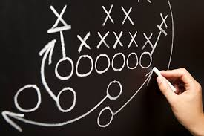
Simple Question
Do you want people to KNOW about your business or TALK about your business?
Must have a solid content strategy
Who, what, where, when?
Who are you targeting?
What are you posting?
Where are you posting?
When are you posting?
Notes:
Social media comes down to a very specific question, and Robert Rippee touched it right on the nose. “Do you want people to know about your business or talk about your business?” How do you achieve this? It has to go back to your strategy. Things to consider are what kind of content are you going to post or promote, will you boost certain content to make them stand out more, when and where are you going to post these different messages? Having a content strategy, including a calendar, will help to maximize your engagement. There are many programs out there designed to assist business people and marketers in scheduling and managing content. One of which I have used often is called HootSuite.

Slide 6

Steps to Creating a Social Media Strategy
Be Realistic!
Social media is very good at:
Building brand awareness
Generate demand
Word of mouth
Customer loyalty
Customer advocacy
Notes:
Paul Cheney’s article talked about the six steps to creating a social media strategy. All the steps are solid recommendations, but I wanted to focus on a couple that really stood out and helps us to understand more how to use social media successfully. The first is being realistic in regards to what social media can do for you. Everyone always says, “you need to be on social media” or “you need to have a Facebook page.” This is all true, but why? What is the reason you need these platforms? What will it do to help your business? Cheney points to 5 areas that social media is exceptional at: building brand awareness, generate demand, word of mouth, customer loyalty, and customer advocacy. Accepting this will allow you to better understand how to use social media strategy successfully. Let’s touch on those areas a little further.

Slide 7

Creating Customer Loyalty
Use social media to make customer aware of your brand, product, or service, and then direct them to your “home” base to complete the transaction.
Awareness -> demand -> engagement -> word of mouth -> purchase and experience -> customer loyalty
Customer advocacy
Notes:
In essence, when you use social media, you aren’t actually converting a sale. The various platforms don’t have a true way of converting the interest into a sale. What I mean is that Instagram doesn’t have a feature where the customer can click on your brand or business and actually make a purchase. They still have to get directed to your website or payment portal of some kind. The idea then is to use social media to make customer aware of your brand, product, or service, and then direct them to your “home” base to complete the transaction. (We will talk about the home base in a bit) Building awareness and generating demand go hand in hand. If your content is engaging and relevant, it creates awareness, which leads to demand for your product or service. Customers become interested or intrigued, they may comment, share, or even contact you for more information. We will skip word of mouth because that is a concept and area we are all well aware of. Here is how all that ties into customer loyalty. When customers become aware of your business, the will often talk about their experiences, your advertisements, share your social media content, and so forth. This creates word of mouth and conversation among the audiences. Good information, good conversations, and good experiences lead to a returning customer, or a loyal customer. Customer advocacy ties into all this because of the idea of 2-way communication. Think of this aspect as the customer service area where you acknowledge, respond to, and engage with your customers. Advocacy is public support, so in this sense, you are putting the customer at the focus and supporting them. The circle is now connected, and you are building a long term relationship, not just a one-time transaction.

Slide 8

Home Base
Content Plan components
Direct customers to your “home base”
Create a “media empire”
Share everything you can!
Notes:
I mentioned earlier about directing your audience to your “home base.” This can be an actual physical location or a website or online store, any place where the customer can go to complete and satisfy their interest in your product or service. This is a part of the content plan in which Paul Cheney talks about as the 3rd step to building a social media plan. From there he says to create a “media empire,” which is basically all your content. It’s like going into a vault of all of Disney’s content, which would be pretty amazing by the way.
The unique thing about social media is that it is advertising, promotions, and public relations all rolled into one tool. And we should use it as such. Anything, whether content or news, that is created internally should be amplified through social media, unless it’s for “internal purposes” only, why shouldn’t it be converted to a shareable content? We are going to talk about creating content in this upcoming week.

Slide 9

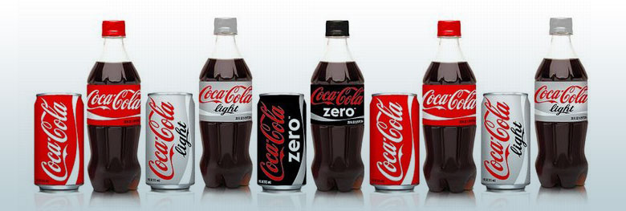
Checkpoints
Ensure alignment
Consistent brand image
Logos, slogans, images, style
Notes:
The Social Media Refresh article provides us with checkpoints along the way. In business, it’s always a smart idea to have checkpoints so that you can ensure you are providing information that is in alignment with your objectives and messages. Checkpoints are great because it allows you to analyze as you go and make adjustments when necessary, rather than waiting until the end of the campaign only to find out some parts of it didn’t work to the best advantage or didn’t resonate with your audience. One of the first checkpoints is that you need to make sure that your brand image is consistent across all the platforms. This includes logos, slogans, and even the style in which the content is presented or written. What are some ways in which you can make sure your branding is consistent? What are some ways you can make your brand more personable?

Slide 10

Negative Reviews
Notes:
One of the other checkpoints I’ll point to because many students have mentioned this in the discussion posts is in responding to negative reviews or comments. This has to do with a SWOT analysis in many ways because it has to do with taking a perceived weakness and turning it into an opportunity. While many frown upon bad reviews, the way in which the matter is handled can actually be a valuable tool to show that you are responsive, human, accountable, and customer service oriented. Instead of deleting or hiding the comment, respond, engage, and see how you can make that customer satisfied. The care and attention will go a long way. To help businesses with handling and managing reviews, there are third party companies that monitor all the sites in which a review or comment is posted, they will notify you, ask you to respond, and the company will then post the response for you. It saves the business owner time in having to research the different platforms and then responding to each one. In this case, you are only dealing with one person or company and they are posting and monitoring the different platforms for you. As far as I know, you can’t delete a negative review or bad comment, you might be able to hide it from your page and so forth, but it can show up on google or other search engines. The best way is to monitor these, respond to them, and solicit more positive reviews in a way to drown it out.

Slide 11
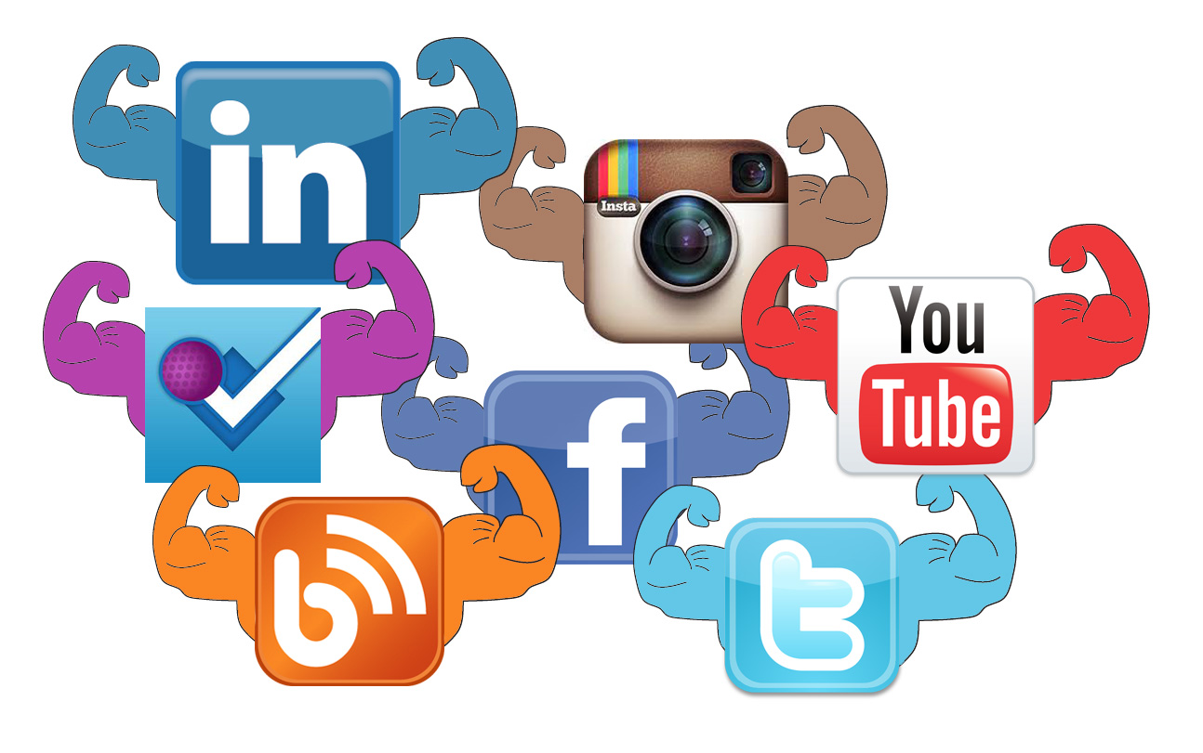
Pick one….
Can you choose just one?
Each one has a strength
Combine them to make a cohesive strategy
Play to the strengths of each platform
Know why you want to use it
What is the purpose or goal?
Notes:
In marketing, each media platform is very strong at certain objectives. For example, advertising is very good at reaching large audiences. Public relations strength lies in making announcements and press releases. Social media is good at creating two-way communication and building relationships with customers. As you can see, focusing on just social media or focusing on just traditional advertising is not as effective as using each for its best strength in a cohesive strategy. Within social media, there are platforms that are strong at specific strategies as well. This goes back to the organizational management idea of specialization. This article here speaks to our discussion board scenario, and many of you are correct when you say it’s hard to choose just one because it depends on what you are trying to accomplish. However, the idea is to choose each platform for its strengths and combine them to send an overall consistent message to your customer. As the article states, “Facebook’s strength is in keeping people connected, Twitter is for news, LinkedIn is for professionals, and so forth.” Keep these ideas in mind as you begin to build your content strategy and management practices. Which platform will you use, for what purpose, and what content will you develop for it?

Slide 12

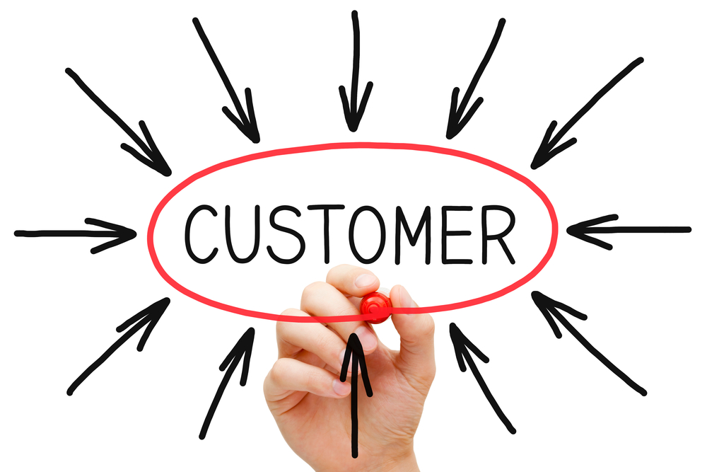
Exclusivity
So what does exclusivity do for you and for the customer?
It helps to build relationships by letting the customer know that you appreciate them
Makes them feel connected
Creates a sense of customer centered focus.
Notes:
The article also mentions the idea of creating exclusive content. Many big companies are using SnapChat as a way to invite “followers” behind the scenes, into exclusive contests and savings, as well as creating intrigue. The NBA and NFL for example began using SnapChat to give fans a behind the scenes look at games and special events. SnapChat has some unique features which can be valuable in marketing, also a reason why Facebook wanted so badly to purchase the app, but they couldn’t, so they decided to create their own…. have you heard of it? It didn’t take off like SnapChat did, which is why some of you probably haven’t heard of it. (I believe it is called SlingShot) So what does exclusivity do for you and for the customer? It helps to build relationships by letting the customer know that you appreciate them, makes them feel connected, and creates a sense of customer centered focus. Each platform allows you to target specific audiences with the same message, you can customize the ad or marketing content for different groups, all the while still sending the same consistent overall message. Facebook has the ability to target specific groups within the platform. It’s amazing what is at our fingertips as marketers, and it doesn’t take a large chunk out of the budget as a commercial or billboard would.
All this leads back to what we talked about already, the social media strategy needs to be customer centered. It’s not about what you want to say, but what the customers are saying, and your job is to listen to them and guide their perceptions and demands.

