Slide 1
Fake News
John Tojo
Data Science Intern

Slide 2
Overview
Introduction
Problem Statement
Exploratory Data Analysis (EDA)
Observations from graphs
Data cleaning
Model Selection
Conclusion
Future Work

Slide 3
Introduction
Definition of fake news:
Fake news refers to information that is intentionally misleading or false, designed to lead people astray.
The spread of fake news:
Fake news has become increasingly prevalent and is easily shared due to the rise of social media.
People often share fake news without verifying its accuracy, leading to its rapid spread.
Motivations behind fake news:
Fake news is often used to promote certain ideas or political agendas.
Media outlets may also use fake news to attract viewers and generate online advertising revenue.
The need for fake news detection:
Given the impact that fake news can have on individuals and society, it is important to have a means of detecting it.
Concluding thoughts:
Fake news is a growing concern that needs to be addressed through better verification and education.
The development of fake news detection tools is crucial in the fight against misinformation.

Slide 4
Problem Statement
Fake news is becoming more prevalent in today's society and is misleading people.
People often share fake news without verifying the information, leading to its widespread spread.
The spread of fake news is often fueled by political agendas and can cause harm to individuals, communities, and society as a whole.
Fake news is also a problem for media outlets as it affects their credibility and reputation.
The need to detect fake news is becoming increasingly important to protect people from being misled and maintain the integrity of the media.

Slide 5
DATA SOURCES AND THEIR FORMATS
The data was provided by FlipRobo in CSV format.
Had two separate file one which contained
only true news (21417 )
only fake news (23481 )
The columns were as follows
Title – headline of the news report
Text – detailed description of the headline
Subject- it says what type of news it relates to
Date – the date on which the news was published

Slide 6
Exploratory Data Analysis (EDA)
A new column named "Target" was added to the data frame that contained fake news and true news.
The values in the "Target" column were filled with "Fake" for fake news and "True" for true news.
The data frame was encoded using get_dummies, where "Fake" was given a value of 1 and "True" was given a value of 0 and stored in the "Label" column.
The information of the data frame was checked and all columns were found to be of object type except for the "Label" column.
The data frame was checked for any null values and no null values were found.
The data frame was checked for duplicates and 209 records were found. The first occurrence was kept and the remaining occurrences were deleted.
The "title" column was selected as the text data, as choosing the entire text would require a high amount of computational power.
The texts present in the "text" column were processed as follows:
Lowercased
Tokenized using "nltk.word_tokenize"
Non-alphanumeric words were removed
Stopwords and punctuation were loaded and removed using the "nltk.corpus.stopwords" and "string.punctuation" libraries
Stemming of words was performed using the "nltk.PorterStemmer" library
The processed words were joined into a single string and stored back in the "transformed_title" column.

Slide 7
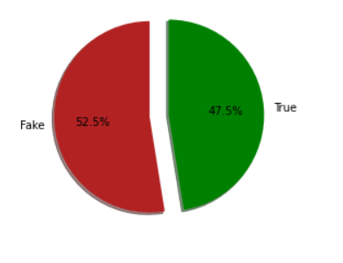
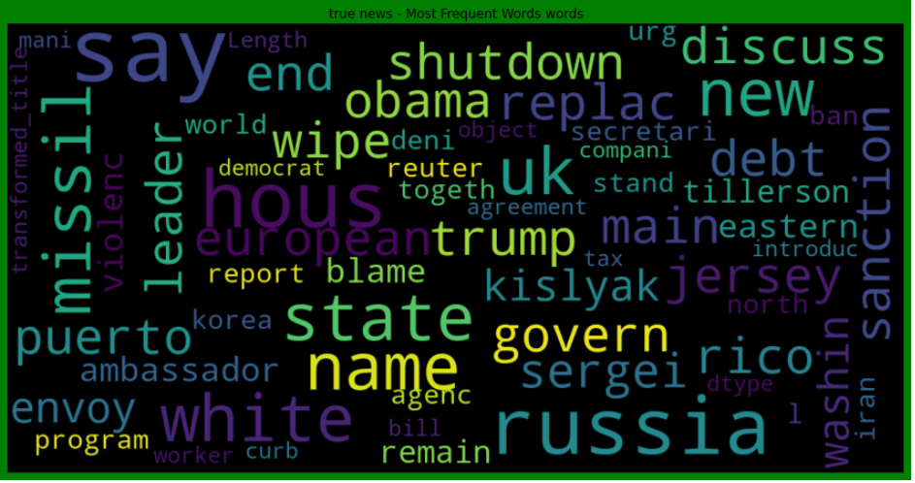
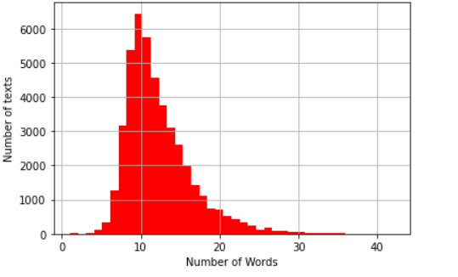
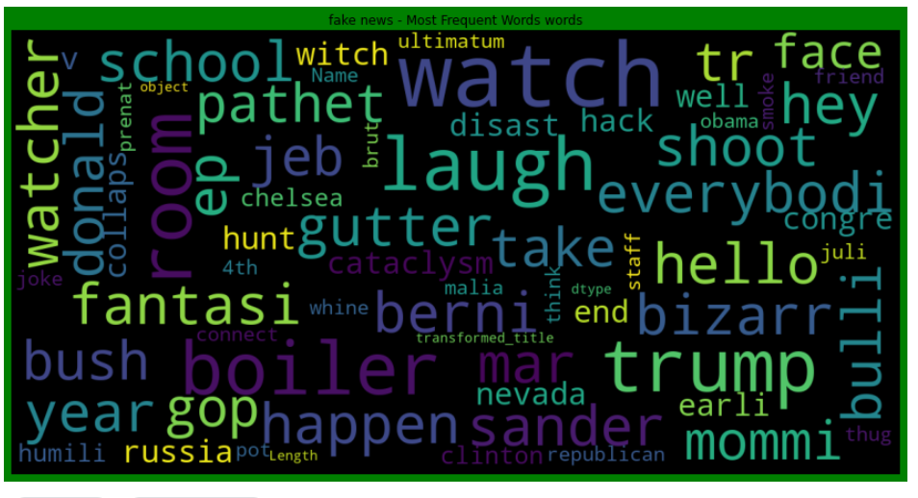
Visualization
Fig1: pie chart showing the distribution of fake and true news present in the dataset it can be seen that data set provided is balanced
Fig3: showing word cloud for true news
Fig2: number of texts vs num_words
it can be seen most of the texts have 15 words and most of the texts are contained within 20 words
Fig4: showing word cloud for fake news

Slide 8
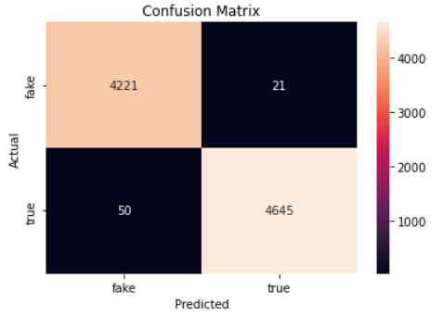
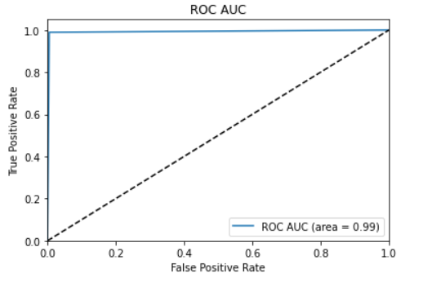

Model Creation
The transformed title text is vectorized using one-hot encoding with a vector length of 5000.
A padding of 20 is used and the result is stored as "embedded_docs". The target labels are stored as "y".
The shapes of "embedded_docs" and "y" are checked to ensure they are the same and then both are converted to arrays.
A sequential model is created and added with Embedding layer with 5000 vocabulary size, 40 feature dimensions and input length of 20.
The model also includes 2 Bidirectional LSTM layers, 2 Dense layers and 2 Dropout layers for regularization.
The model is compiled with binary_crossentropy loss and adam optimizer, and accuracy as evaluation metric.
5-fold cross-validation is performed on the model, using early stopping as a callback to prevent overfitting.
The final result is the mean accuracy of the 5 folds with its standard deviation.
Results:

Slide 9
Conclusion
A model was created to identify fake news in a dataset with the aim of improving accuracy, precision, and f1-score.
The model was trained and tested using a 5-fold cross-validation approach.
The model was trained on the transformed title column of the dataset, which was preprocessed to remove stopwords and punctuation, and then stemmed and vectorized using one-hot encoding.
The model used an Embedding layer, followed by two bidirectional LSTM layers, two dropout layers, and two dense layers, with a sigmoid activation function.
The model was trained using binary cross-entropy loss and Adam optimization.
The model was able to achieve an overall accuracy of 99.21%, with a roc_auc of 99.22%, f1-score of 99.24%, and precision of 99.55%.

Slide 10


