Slide 1
Fast Copy for HDFS
Johnu George & Nitesh Sood
CSCE 662 Class Project

Slide 2
Outline
Problem Formulation
State of Art
Main Ideas
Proposed Solution
Evaluation
Conclusions

Slide 3
Problem Formulation
Goal is to perform fast copy of files within HDFS which eliminates top of the rack data transfers [HDFS-2139
Existing cp command reads data from source( inside HDFS) and writes to the destination( inside HDFS) . This operation is time and bandwidth consuming.

Slide 4
State of Art
cp command is used to copy files inside HDFS which basically reads the source file and writes to new file
The time taken for execution of ‘cp’ command is equivalent to the time needed for reading data with ‘get’ command and time needed to write the data to a new file with ‘put’ command.

Slide 5
State of Art (cont.)
Traditional cp command consumes huge network bandwidth because of its reads and writes to and from HDFS filesystem.
Number of network messages required for traditional cp command depends on size of the file.

Slide 6
Main Ideas
Network traffic can be reduced considerably if copies are made locally.
If copies are made locally, number of network messages required for the operation depends only on number of replicas required for each block

Slide 7
Proposed Solution
Get locations for each block of the source file from namenode
Check if retrieved block locations are good enough to hold new blocks for destination file.
If any of the block location is not a good target (eg: storage size of a datanode might exceed if new block is added), new set of block locations are returned. Traditional copy is performed.

Slide 8
Proposed Solution (cont.)
If block locations of source file are good targets, add the same locations for destination file to the namesystem.
Now, send request to nearest datanode for copying the source block to new block locally with list of replica locations.
Message will be sent in pipeline from client -> datanode-1 -> datanode-2 -> datanode 3 …

Slide 9
Proposed Solution (cont.)
New DataTransfer protocol ‘OP_LOCAL_COPY’ is implemented completely for copying block locally . Present data transfer protocols like ‘OP_WRITE’ and ‘OP_READ’ do not scale for local block copy as it assumes that data is streamed to/from other node.
Wait for the datanodes to complete the copy operation and return status.

Slide 10
Proposed Solution (cont.)
If any one of the target nodes are not good, then fallback to the regular copy.

Slide 11
Evaluation
Multi-node Hadoop cluster setup
1 namenode, 2 datanodes
2 machines connected by wireless
1 datanode in each machine

Slide 12
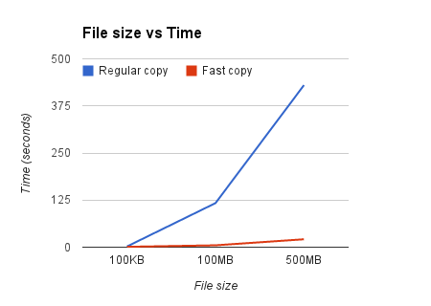
Evaluation (cont.)
 | Regular Copy (seconds) | Fast Copy (seconds)
100KB | 2 | 1
100MB | 117(~2min) | 5
500MB | 430(~7min) | 22

Slide 13
Conclusions
Efficiency of Fast Copy is considerably high when compared to traditional cp command.

