Slide 1
A/B/C Test

Slide 2
Outline
Recommendation
Assumptions of A/B/C Test
Issue with Primary Metric
Solution for Primary Metric
Primary Metric Results
Secondary Metric Results
Appendix

Slide 3
Recommendation
Variant A is the winner and should be deployed as the default email onboarding journey.
Even though “% with +1 Joiner” is an underpowered metric, feature adoption and ACV are both highly statistically significant with adequate power.
The +1 Joiner metric’s non-significance is due to insufficient sample size, not because there is no effect.
Variant A has more teams with a +1 Joiner, more feature adoption among teams, higher conversion, higher ACV
Consistent story of improved engagement and better monetization

Slide 4
# | Assumption | Status | Key Finding | Impact
1 | Random Assignment | ✅ SATISFIED | confirmed equal distribution across variants (33% / 40 teams) | CRITICAL
2 | Sample Independence | ✅ SATISFIED | Each team_id is unique; no network effects observed | Medium
3 | Data Quality & Completeness | ❌ VIOLATED | Variant A and B first joiners occur before creation timestamp | CRITICAL
4 | Temporal Randomization | ❌ VIOLATED | Control Teams created 09-01 to 09-04, variants created 09-04 to 09-10 | Medium
5 | No Interference (SUTVA) | ✅ SATISFIED | Email journeys are individual; no spillover between teams | Low
6 | Sufficient Sample Size | ❌ VIOLATED | 120 total teams (40 per variant); need power analysis | Important
7 | Consistent Treatment | 🔵 TO VERIFY | Need to confirm email delivery success rates | Important
8 | No Selection Bias | 🔵 TO VERIFY | Need to verify sample represents all eligible new teams | Important

Slide 5
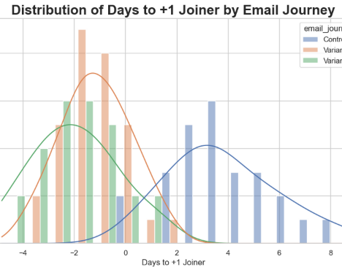
Primary Concern Assumption #4 – Data Quality
The dataset contains logically impossible values since the plus one joiner date occurs BEFORE the creation date for some teams.
Issue occurs Variant A and B
Invalidates “Speed to +1 Joiner” as a primary metric
Suggests data pipeline bug, timezone mismatch, and/or incorrect field mapping

Slide 6
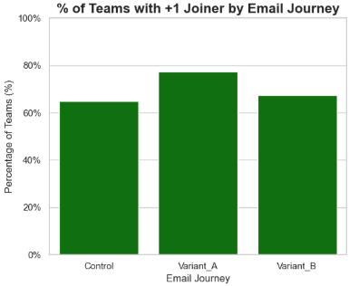
Primary Metric Update
ASSUMPTION:
All teams with “+1 Joiner’s” occurred within the first week of creation date
Primary Metric:
% of Teams with +1 Joiner
Secondary Metrics:
Feature Adoption Rate
Unique features per team (Breadth)
Total Features per team (Depth)
Unique Teams Using Features
Paid Converstion Rate (PCR)
Average Contract Value (ACV)

Slide 7
Primary Metric Results
Journey | % with +1 Joiner | Difference vs Control | Statistical Signficance
Control | 65.0% (26/40) | Baseline | -
Variant A | 77.5% (31/40) | +12.5 points (+19%) | ❌ Not significant (p = 0.22)
Variant B | 67.5% (27/40) | + 2.5 points (+4%) | ❌ Not significant (p = 0.81)
Promising trend for Variant A but underpowered (n=40). Would need about 150 per group to confirm 12.5 point improvement with 80% power. Recommendation: If resources allow, run a larger follow-up test to confirm if this trend is real.

Slide 8
Secondary Metrics
# | Metric | Control | Variant A | Variant B | Winner | Overall Significance | Pairwise Significance
1 | % Teams Using Features | 42.5% | 70.0% ⭐ | 45.0% | Variant A | Chi² = 7.42, p = 0.025 ✅ | VA vs C: p = 0.013 ✅ VB vs C: p = 0.82 ❌
2 | Avg Features per Team | 2.76 | 2.61 | 2.17 ⚠️ | Control | ANOVA: F = 4.30, p = 0.018 ✅ | VA vs C: p = 0.4293 ❌ VB significantly lower (p = 0.009) ❌
3 | PCR | 10.0% | 25.0% | 15.0% | Variant A | Chi² = 3.360, p = 0.1864 ❌ | VA vs C: p = 0.078 ❌ VB vs C: p = 0.50 ❌
4 | ACV | $1,500 (n=4) | $2,450 (n=10) | $4,000 (n=6) | Variant B | ANOVA: F = 81.3, p = 0.000 ✅ | VA vs C: p = 0.001 ✅ VB vs C: p = 0.000 ✅

Slide 9
Additional Confirmation of Variant A Revenue scaled to 1,000 teams
Control
1,000 * 10% Conversion * $1,500 ACV (6 teams)
$150,000
Variant A
1,000 * 25% Conversion * $2,450 ACV (10 teams)
$612,500 ✅
Variant B
1,000 * 15% Conversion * $4,000 ACV (4 teams)
$600,000

Slide 10
Appendix

Slide 11
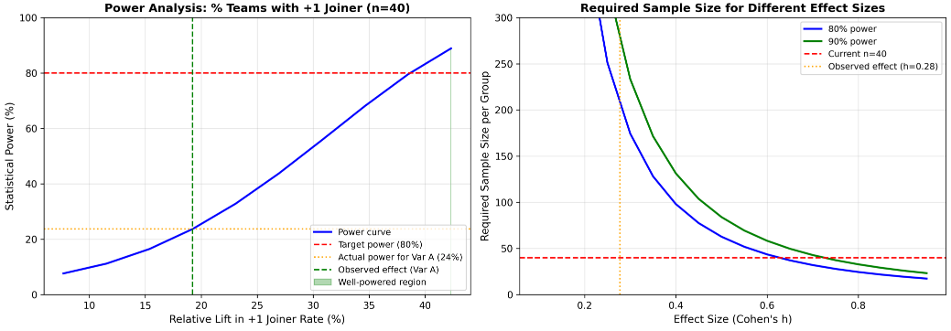
A/B Test Sample Size for Primary metric

