Slide 1

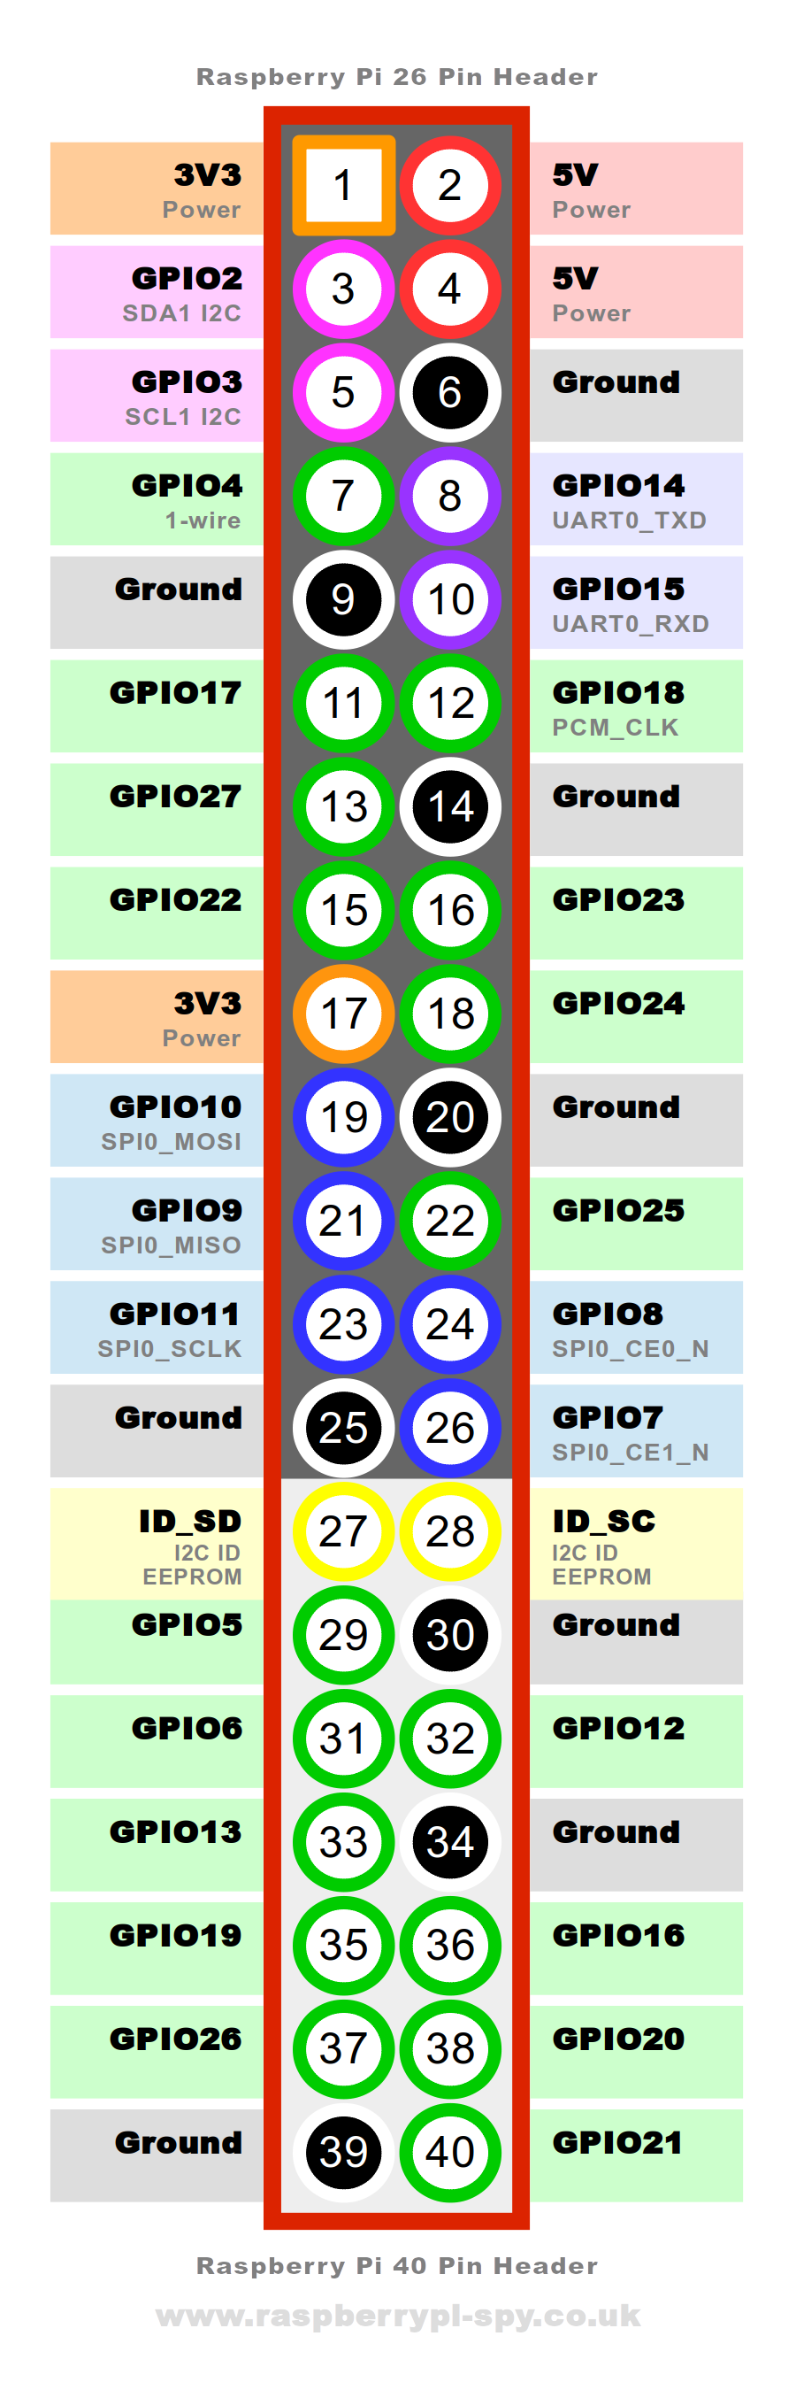
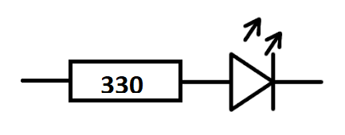
OLED
128*64. SSD 1306
GPS
NEO M-9N
Micro USB in +5V
5V
2+
SCL
5
SDA
3
GND
6+
5V
4+
5V
4+
GND
6+
UART Rx
10
GND
39+
Push button
GND
9
5V
2+
Amp
2.5W
PAM8302A
13
IMU
BNO055
3V3 1
I2S DAC
UDA1334
GND
14
GND 20
SDA
16
BCLK 12
MCO
Microcontroller
Eg Arduino, ATMega328p
UART TX
8
SCL
18
WS 35
3V3
17
6
DIN 40
Button LED
GPIO
15
LED connector
5V
2+
GND
39
GND
25

Slide 2
OLED
128*64. SSD 1306
GPS
NEO M-9N
Micro USB in +5V
5V
2+
SCL
5
SDA
3
GND
6+
5V
4+
5V
4+
GND
6+
UART Rx
10
GND
39+
Push button
GND
9
5V
2+
13
IMU
BNO055
I2S DAC+amp
MAX98357
GND
14
SDA
16
BCLK 12
MCO
Microcontroller
ATMega328p
UART TX
8
SCL
18
WS 35
3V3
17
6
DIN 40
Button LED
GPIO
15
LED connector
5V
2+
GND
39
GND
25

