Slide 1
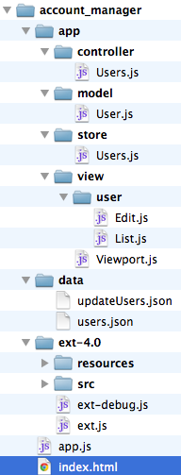


JavaEE
ExtJS4.0
Java Bean
Model,Store
M
Servlet
Controller
C
JSP HTML
Fomr,grid,tree
V
application
HTML

