Slide 1

GitHub and GitLab

Slide 2

CONTENTS
Introduction to GitHub
Features of GitHub
GitHub Demo
Introduction to GitLab
Features of GitLab
GitLab Demo
GitHub vs GitLab

Slide 3
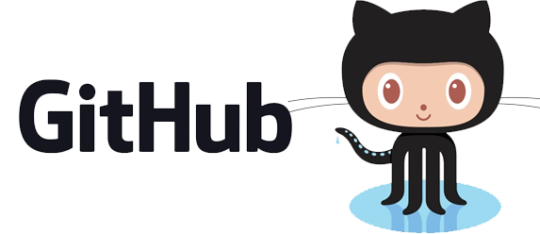

Slide 4

GITHUB
Introduction to GitHub
GitHub is a code hosting platform for version control and collaboration
It lets you and others work together on projects from anywhere
GitHub makes Git easier to use
Launched in April 2008 by Tom Preston-Werner, Chris Wanstrath, and PJ Hyett
Written in Ruby
As of April 2017, GitHub reports having almost 20 million users and 57 million repositories, making it the largest host of source code in the world.

Slide 5
GITHUB
Features of GitHub
Collaboration
Code Review
Project Management
Integrations
Community Management
Documentation
Code Hosting
Serious Security
Notes:
Code Review
-Propose changes
-Request reviews
-See the difference
-Comment in context
-Give clear feedback
-Protect branches (Only merge the highest quality code)
Project Management
-Track and assign tasks (Milestones, Assignee)
Integration
-Extend GitHub
Documentation
-GitHub Pages, Wikis

Slide 6
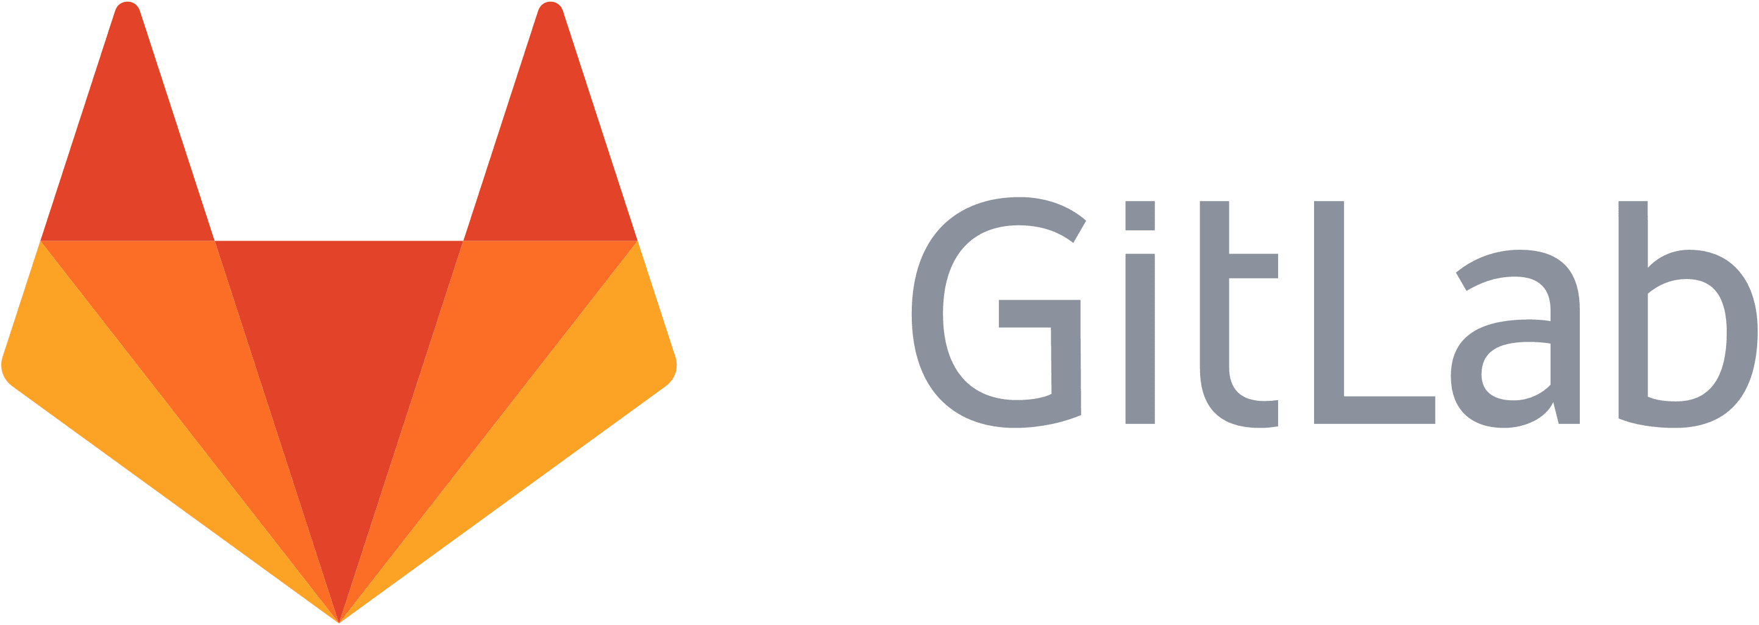

Slide 7
GITLAB
Introduction to GitLab
GitLab is a web-based Git repository manager with wiki and issue tracking features
Using an open source license, developed by GitLab Inc.
The software was written by Dmitriy Zaporozhets and Valery Sizov from Ukraine.
The code is written in Ruby. Later, some parts have been rewritten in Go.
As of December 2016, the company has 150 team members and more than 1400 open source contributors.

Slide 8
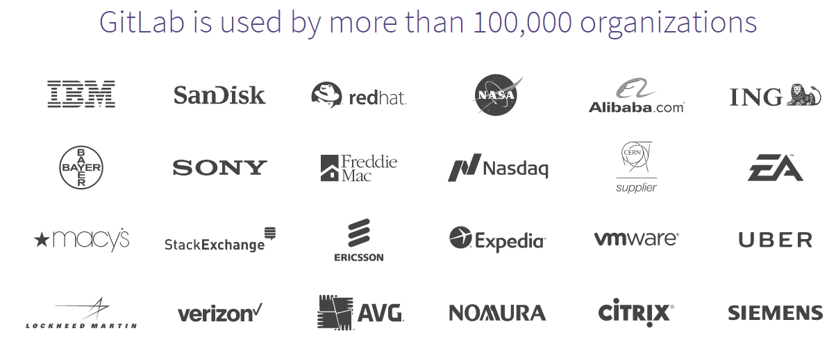
GITLAB

Slide 9
GITLAB
Features of GitLab
Projects and Groups
Permissions
GitLab Pages
File Locking
Wiki
Unlimited Public and Private Repos
Project Importing
Protected Branch
Code Snippets
Powerful APIs
Notes:
Projects and Groups
-Setting up your project's visibility to public, internal, or private
-Organize your projects in groups
Permissions
-Users have different abilities depending on the access level they have in a particular group or project
-On public and internal projects the Guest role is not enforced. All users will be able to create issues, leave comments, and pull or download the project code
-GitLab administrators receive all permissions
GitLab Pages
-Create websites for your GitLab projects, groups, or user account
-Host your static websites on GitLab.com for free, or on your own GitLab instance
File Locking
-File Locking helps you avoid merge conflicts and better manage your binary files. Lock any file or directory, make your changes, and then unlock it so another member of the team can edit it
Wiki
-A separate system for documentation called Wiki, is built right into each GitLab project. It is enabled by default on all new projects and you can find it under Wiki in your project
-Wikis are very convenient if you don't want to keep you documentation in your repository, but you do want to keep it in the same project where your code resides.
Protected Branch
-Permissions in GitLab are fundamentally defined around the idea of having read or write permission to the repository and branches. To prevent people from messing with history or pushing code without review, we've created protected branches.

Slide 10
VS

Slide 11
GITHUB vs GITLAB
Authentication Levels
Attachments
Issue Tracking
Work In Progress Status
Integrations
Notes:
Key differences
According to various sources and our own experience, we identified the following key differences you should know when making the decision: GitLab vs GitHub.
Authentication Levels
With GitLab you can set and modify people’s permissions according to their role. In GitHub you can decide if someone gets a read or write access to a repository. With GitLab you can provide access to the issue tracker (for example) without giving permission to the source code.
Attachments
In GitLab you can attach any file to any issue. You simply can’t do that inside GitHub.
Issue Tracking
If you’re using GitHub issues you might think that it lacks some functionality. GitLab provides a powerful Issue Tracker that lets you change status and assignee for multiple issues at the same time.
GitHub Issues lets you do similar things. And it’s a great issue tracker too. However, I personally prefer the interface of GitLab’s issue tracker over GitHub. (Though this might be a personal matter.)
Work in Progress status
With GitLab, developers can label a project with “Work in progress” which gives collaborators a clear sign that the code is not finished. This might be a minor thing, though it can be really useful. This feature prevents code being merged with other code before it’s actually finished.
Integrations
Both GitLab and GitHub offer a wide range of 3rd party integrations. Integrating your version control system with other application enriches your workflows and can boost productivity for your developers.
In order to check out if your favorite apps are compatible with GitLab and GitHub, I recommend checking out the documentation of GitLab and GitHub.

Slide 12
Demonstration…

