Slide 1
NEXUS
Repository Manager

Slide 2
CONTENTS
OVERVIEW
INSTALLATION & RUNNING
CONFIGURATION

Slide 3

OVERVIEW
Nexus is a software repository manager developed and supported by Sonatype.
It allows you to proxy, collect, and manage your dependencies so that you are not constantly juggling a collection of JARs.

Slide 4
OVERVIEW
COMPONENTS:
A component is a resource like a library or a framework that is used as part of your software application at run-time, integration or unit test execution time or required as part of your build process. It could be an entire application or a static resource like an image.
Components provide all the building blocks and features that allow a development team to create powerful applications by assembling them and adding their own business related components to create a full-fledged, powerful application.
ASSETS:
Assets are the material addition to all this metadata. The actual archive file is an asset associated with the component. Many formats have a one-to-one mapping for component to asset.

Slide 5
OVERVIEW
REPOSITORY MANAGER:
A dedicated server application designed to manage repositories of binary components.
A proxy for remote repositories which caches artifacts saving both bandwidth and time required to retrieve a software artifact from a remote repository
A host for internal artifacts providing an organization with a deployment target for software artifacts
CENTRAL:
You can think of "central" as the global repository manager that stores all open source components
"Central" has millions of users throughout the world, and it is fed by thousands for open source projects

Slide 6
NEXUS BASICS
MAVEN CENTRAL
Nexus Repository Manager
PROXY: CENTRAL
HOSTED: RELEASE
HOSTED: 3RD PARTY
HOSTED: SNAPSHOTS
Group: Internal
download
dependencies
publish
dependencies
DEVELOPERS ☺

Slide 7




WHY USE NEXUS?
STORE
CACHE
ADAPT
SCALE
A warehouse for your components
Nexus Repository OSS is the single warehouse that reliably serves components to every part of your software supply chain.
Save time, increase reliability
Nexus Repository OSS makes it simple to cache remote repositories and eliminate latency in your software supply chain.
Universal package support
Nexus Repository OSS is a universal repository manager with support for all major package formats and types.
Unlimited server installs, for unlimited users
Nexus Repository OSS is used by more than 100,000 development teams just like yours.

Slide 8
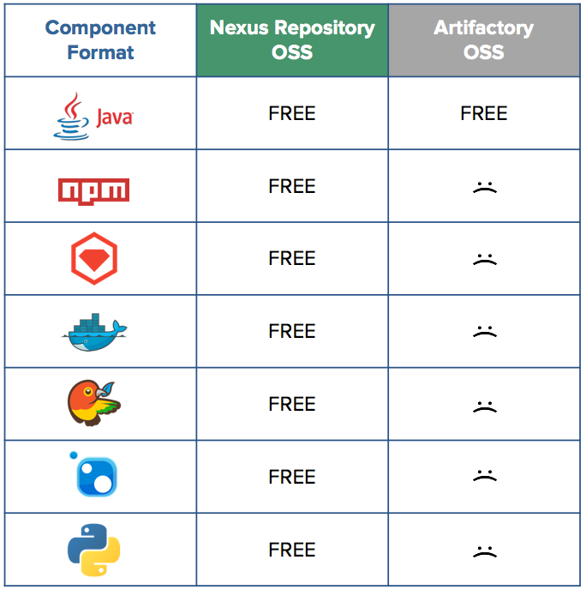
COMPARISON WITH ARTIFACTORY

Slide 9
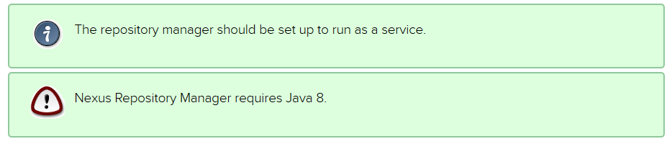
INSTALLATION AND RUNNING
NOTE:

Slide 10
INSTALLATION AND RUNNING
Nexus Repository Manager can be downloaded from Sonatype.
Distributions are available for the 64-bit versions for Apple OSX, Microsoft Windows and Unix/Linux.
nexus-3.0.2-02-mac.tgz
nexus-3.0.2-02-unix.tar.gz
nexus-3.0.2-02-win64.zip
Installing and running Nexus Repository Manager is straightforward. Simply unpack the archive in a directory, to which you have full access.
On Windows you should install the repository manager outside Program Files to avoid problems with Windows file registry virtualization.

Slide 11
INSTALLATION AND RUNNING
The bin folder contains the generic startup scripts for Unix-like platforms called nexus. The Windows platform equivalent is called nexus.exe.
You can install Nexus as a Windows service as follows from the command prompt at the Nexus bin subdirectory:
nexus.exe /install <optional-service-name>
In removing Nexus, use:
nexus.exe /uninstall <optional-service-name>

Slide 12
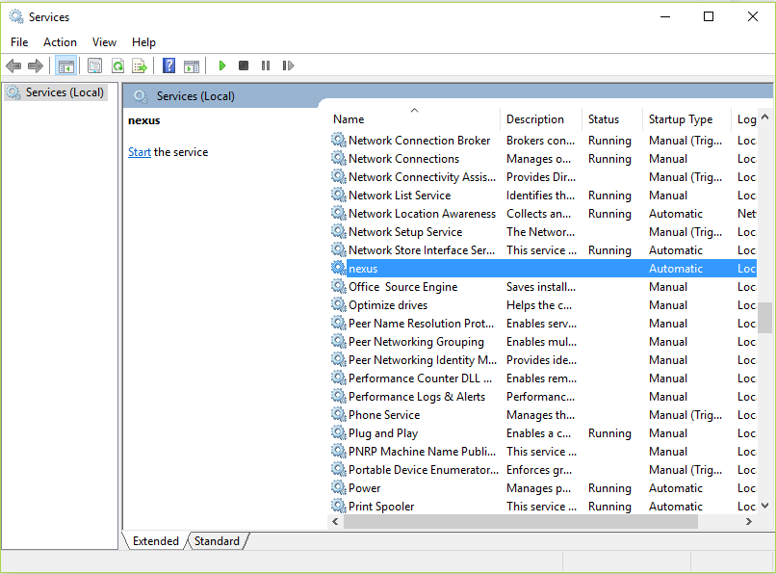
INSTALLATION AND RUNNING
The created service is available named nexus in common console application to manage services such as Windows Services. You can start, stop and restart the service there as well as configure it to start as part of a operating system startup.

Slide 13
INSTALLATION AND RUNNING
Alternatively you can manage the service on the command line:
nexus.exe /start <optional-service-name>
nexus.exe /stop <optional-service-name>
nexus.exe /uninstall <optional-service-name>
The <optional-service-name> parameter with a value of e.g. nexus3 can be used to create a service that does not collide with an existing service established for Nexus Repository Manager 2 running on the same server.

Slide 14
INSTALLATION AND RUNNING
DIRECTORIES
There are two main directories created and used by the repository manager.
Installation directory
This directory is contains the Nexus Repository Manager application and all the required additional components such as Java libraries and configuration files.
Data Directory
This directory contains all the repositories, components and other data that is being stored and managed by the repository manager. It is located within the installation directory by default for archive-based installs and called data.

Slide 15
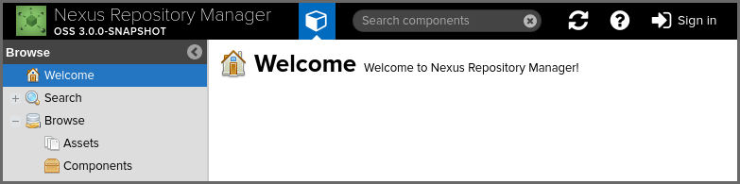
INSTALLATION AND RUNNING
ACCESSING THE USER INTERFACE
To access the web application user interface, fire up a web browser and type in the URL http://serveripaddress:port e.g. http://localhost:8081/. If the repository manager started up successfully and network settings allow you to connect to the server, the user interface looks similar to this:

Slide 16
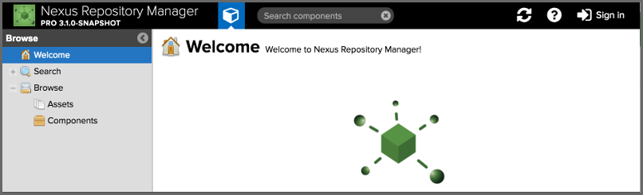
INSTALLATION AND RUNNING
The repository manager provides anonymous access for users who only need to search for components, browse the repositories and access components via client tools such as Maven or NuGet. This anonymous access level is a configurable, read-only mode that includes the main user interface elements

Slide 17
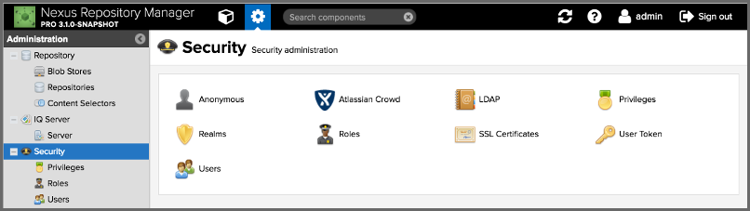


INSTALLATION AND RUNNING
Once a user is logged in further features become available depending on the user’s privileges. An example for the admin user including the Administration menu icon is visible
Browse button
Administration button

Slide 18
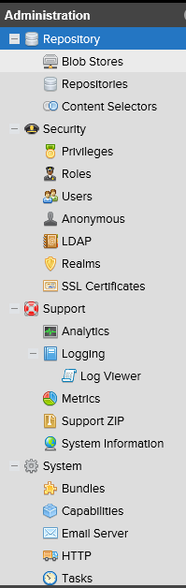
CONFIGURATION
The Administration menu contains the following sections:
Repository
IQ Server (Pro)
Security
Support
System

Slide 19
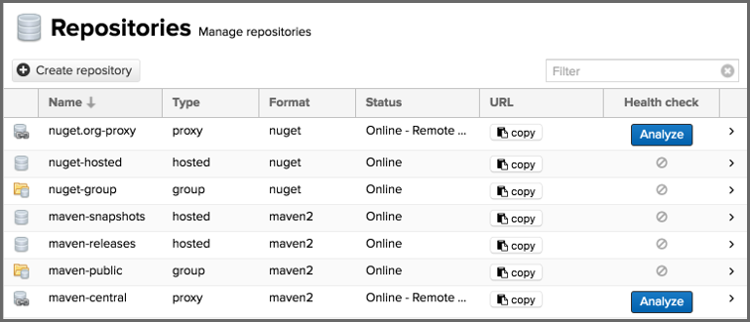
CONFIGURATION
REPOSITORY
The administration user interface for repositories and repository groups is available via the Repositories item in the Repository sub menu of the Administration menu. It allows you to create and configure repositories as well as delete them and perform various maintenance operations. The initial view features a list of all configured repositories and repository groups.

Slide 20
CONFIGURATION
SECURITY
Security-related configuration can be performed with the feature views available via the Security section of the Administration main menu. Many of the features shown in this section are only available to users with the necessary privileges to access them.
The role-based access control system is backed by different authentication and authorizations systems and designed around the following security concepts:
Privileges
Roles
Users

Slide 21
CONFIGURATION
SUPPORT FEATURES
Nexus Repository Manager provides a number of features that allow you to ensure your server is configured correctly and provides you with tools to investigate details about the configuration. This information can be useful for troubleshooting and support activities.
All support features are available in the Support group of the Administration menu in the main menu section and include:
Analytics
Logging and Log Viewer
Metrics
Support ZIP
System Information

Slide 22
CONFIGURATION
SYSTEM
The System section of the Administration menu gives you access to a number of configuration features that you typically need to configure, after successful installation. The following sections detail:
Access information about used Bundles
Advanced configuration with Capabilities
Email/SMTP server configuration
HTTP/HTTPS proxy server configuration
Setting a Base URL for an application
Setting a Base URL for the repository manager
Configuration and management of automated maintenance Tasks

