Slide 1
Selenium
Introduction, Installation and Configuration

Slide 2




CONTENTS
Selenium Overview
Selenium Webdriver
Installation and Configuration
Sample and Demo
Appendix
For Internal Use Only

Slide 3
SELENIUM OVERVIEW

Slide 4

What is Selenium?
Selenium is a suite of tools to automate web browsers across many platforms.
It runs in many browsers and operating systems
It can be controlled by many programming languages and testing frameworks.
It’s open source and has the support of some of the largest browser vendors who have taken (or are taking) steps to make Selenium a native part of their browser.
It is also the core technology in countless other browser automation tools, APIs and frameworks.
It’s FREE!
Tools under Selenium:
Selenium IDE
Selenium RC
Selenium WebDriver
Selenium Grid

Slide 5
Selenium Webdriver
Selenium WebDriver is a Selenium tool which the primary new feature is the integration of the WebDriver API.
It was developed to better support dynamic web pages where elements of a page may change without the page itself being reloaded.
WebDriver’s goal is to supply a well-designed object-oriented API that provides improved support for modern advanced web-app testing problems

Slide 6
Selenium Webdriver Tools
Basic tools to setup a Selenium WebDriver Framework:
Java
It’s the main programming language that will be used for developing the scripts for Selenium WebDriver.
Eclipse
Eclipse is an integrated development environment (IDE). It contains a base workspace and an extensible plug-in system for customizing the environment where the scripts will be created and executed.
Maven
Maven allows a project to build using its project object model (POM) and will download the java bindings (the Selenium WebDriver java client library) and all its dependencies, providing a uniform build system.
TestNG
Is a testing framework inspired from JUnit and NUnit but introducing some new functionalities that make it more powerful and easier to use.
ReportNG
It is a simple HTML reporting plug-in which provides a simple, color-coded view of the test results for the Selenium Tests.

Slide 7

Selenium Webdriver Tools
Most commonly used browsers supported by selenium:
Internet Explorer
Mozilla Firefox
Google Chrome
Opera
Safari

Slide 8
Selenium Webdriver Installation and Configuration

Slide 9
Prerequisites
The following are the required files and applications in order to install, set-up, and configure Selenium Webdriver (using Java as PL):
1. JDK (Java Development Kit)
Download Link: http://www.oracle.com/technetwork/java/javase/downloads/index.html
Note: Accept License Agreement and choose the JDK that corresponds to your OS.
2. Eclipse IDE
Download Link: http://www.eclipse.org/downloads/
Note: Select the correct version based on your OS.
3. Apache Maven
Download Link: https://maven.apache.org/download.cgi
Notes:
This requires JDK 1.7 or above to work.

Slide 10
Prerequisites (continued)
You may choose to download the latest version (as of 01/2016, latest version is 3.3.9) or use the current version 3.3.3 on the compiled installation tools for Selenium Webdriver together with this guide.
This comes up with “repository” folder.
4. TestNG (as an add-on on Eclipse IDE)
5. Webdrivers
Commonly, we can used:
- IE Driver Server - ChromeDriver
- Firefox (no driver server) - HTMLUnit (no driver server)
- OperaDriver - SafariDriver

Slide 11
Installation and Configuration: JDK
REQUIREMENTS:
JDK Installation File
1. Install the Java Application (sample installation file name: jdk-8u51-windows-x64.exe). Use the default path as the installation path.
2. Once installed successfully, navigate to Start → Right-click ‘Computer’ → Properties.

Slide 12
Installation and Configuration: JDK (cont..)
3. Once the ‘System’ screen appears, click ‘Advanced System Settings’.

Slide 13
Installation and Configuration: JDK (cont..)
4. Once the ‘System Properties’ dialog box appears, click ‘Environment Variables…’.

Slide 14
Installation and Configuration: JDK (cont..)
5. Once the ‘Environment Variables’ dialog box appears, click the ‘New…’ button under the ‘System Variables’ section.

Slide 15
Installation and Configuration: JDK (cont..)
6. Once the ‘New System Variable’ dialog box appears, enter the value “JAVA_HOME” as the Variable Name and the file path (e.g. “C:\Program Files\Java\jdk.1.8.0_51”) where the JDK was installed on the Variable Value. Then, click OK button.
7. Look for the variable name “Path” under the system variables section then click the Edit button.

Slide 16
Installation and Configuration: JDK (cont..)
8. Once the “Edit System Variable” dialog box appears, add the “;%JAVA_HOME%” in the end of the Variable Value field. Then, click OK button.
9. Once done, navigate to Start Menu and type “CMD” (or Command Prompt) in the Start Menu search bar. This will open the command prompt.
10. Enter “java -version” and validate if you get the same results as indicated on the screenshot below. Once you’ve get the same results (output includes the java version), this means that the JDK is successfully configured for our set-up of Selenium Webdriver.
11. Close the CMD/Command Prompt.

Slide 17
Installation and Configuration: Maven Configuration
REQUIREMENTS:
o Apache Maven (for this guide, we will use Apache Maven 3.3.3)
o Repository folder contents (available on the compiled installation tools for Selenium Webdriver)
1. Navigate to windows explorer, go to Drive C and create a new folder named as “dev” (current path will look like this: C:\dev).
2. On the “dev” folder, create a new folder named as “maven” (current path will look like this: C:\dev\maven).
3. On the “maven” folder, copy/paste the Apache Maven folder downloaded from the official site (for this tutorial, we will use Apache Maven v3.3.3) inside the maven folder.

Slide 18
Installation and Configuration: Maven Configuration (cont..)
4. Once copied successfully, navigate to Start → Right-click ‘Computer’ → Properties.

Slide 19
Installation and Configuration: Maven Configuration (cont..)
5. Once the ‘System’ screen appears, click ‘Advanced System Settings’.

Slide 20
Installation and Configuration: Maven Configuration (cont..)
6. Once the ‘System Properties’ dialog box appears, click ‘Environment Variables…’.

Slide 21
Installation and Configuration: Maven Configuration (cont..)
7. Once the ‘Environment Variables’ dialog box appears, click the ‘New…’ button under the ‘System Variables’ section.

Slide 22
Installation and Configuration: Maven Configuration (cont..)
8. Once the ‘New System Variable’ dialog box appears, enter the value “M2” as the Variable Name and the “%M2_HOME%\bin” as the Variable Value. Then, click OK button.
9. Click the ‘New…’ button again under the System Variables section.
10. Once the ‘New System Variable’ dialog box appears, enter the value “M2_HOME” as the Variable Name and the file path (e.g. “C:\dev\maven\apache-maven-3.3.3-bin) where the maven was stored on the Variable Value. Then, click OK button.

Slide 23
Installation and Configuration: Maven Configuration (cont..)
11. Click the ‘New…’ button again under the System Variables section.
12. Once the ‘New System Variable’ dialog box appears, enter the value “MAVEN_OPTS” as the Variable Name and the “-Xms256m -Xmx512m” as the Variable Value. Then, click OK button.
13. Look for the variable name “Path” under the system variables section then click the Edit button.

Slide 24
Installation and Configuration: Maven Configuration (cont..)
14. Once the “Edit System Variable” dialog box appears, add the “;%M2%” in the end of the Variable Value field. Then, click OK button.
15. Once done, navigate to Start Menu and type “CMD” (or Command Prompt) in the Start Menu search bar. This will open the command prompt.
16. Enter “mvn --version” and validate if you get the same results as indicated on the screenshot below. Once you’ve get the same results (output includes the maven version and file path and java version), this means that the maven is successfully configured for our set-up of Selenium Webdriver (together with JDK setup).

Slide 25
Installation and Configuration: Maven Configuration (cont..)
17. Close the current cmd/Command prompt session and open it again.
18. Enter “mkdir .m2” and validate if you get the same results as indicated on the screenshot below. Once you’ve get the same results (blank output), this means that the “.m2” folder is successfully created under your user account folder.
19. Verify if “.m2” is now created on your user account folder (sample: C:\Users\<useraccountname>).

Slide 26
Installation and Configuration: Eclipse IDE Configuration
REQUIREMENTS:
o Eclipse IDE (this can be downloaded on the eclipse.org download site; once downloaded, sample file name: eclipse-java-juno-SR1-win32-x86_64.zip depending on the version).
o Sample Project: TestEnv (included on the installation tools).
1. In the Drive C, create a new folder named as “Workspace”.
Note: For this tutorial, you have a choice to create a new project from scratch or use the sample project named as “TestEnv”. This sample project is available on the Selenium Webdriver installation tools.
2. Place the “Test Env” folder inside the newly created folder, “Workspace”.
3. Copy the “Eclipse” folder (the extracted files you’ve downloaded earlier) on the drive C.

Slide 27
Installation and Configuration: Eclipse IDE Configuration (cont..)
4. Launch eclipse application then browse the “Workspace” folder location then click OK button.

Slide 28
Installation and Configuration: Eclipse IDE Configuration (cont..)
5. Close the Welcome tab.
6. Click File on the Menu Bar and select Import.

Slide 29
Installation and Configuration: Eclipse IDE Configuration (cont..)
7. Once the Import dialog box appears, expand the “General” folder and select “Existing Projects into Workspace” then click Next button.

Slide 30
Installation and Configuration: Eclipse IDE Configuration (cont..)
8. Browse for the “TestEnv” folder located on the Workspace folder you’ve created earlier. Ensure that the checkbox for the selected project is ticked.
9. Click Finish button (wait until the workspace has been built successfully).

Slide 31
Installation and Configuration: Eclipse IDE Configuration (cont..)
10. On the “TestEnv” folder on Eclipse IDE (or any project created), right click then Maven → Update Project. This will update the selected project.

Slide 32
Installation and Configuration: TestNG (TestNewGeneration)
REQUIREMENTS:
o Eclipse IDE (has been successfully set-up).
1. On Eclipse IDE, click Help button on the Menu bar then select “Eclipse Marketplace”.
Note: If you can’t see the Eclipse Market place please proceed to the alternate step in installation of TestNG. (Slide 33)
2. Once the Eclipse Marketplace dialog box appears, enter “TestNG” on the search bar and press “Go” button to commence the search.

Slide 33
Installation and Configuration: TestNG (TestNewGeneration) (cont..)
3. Once the Search Results appears, click Install button on the product “TestNG for Eclipse”.
4. Click Confirm button then click finish to complete the installation.

Slide 34
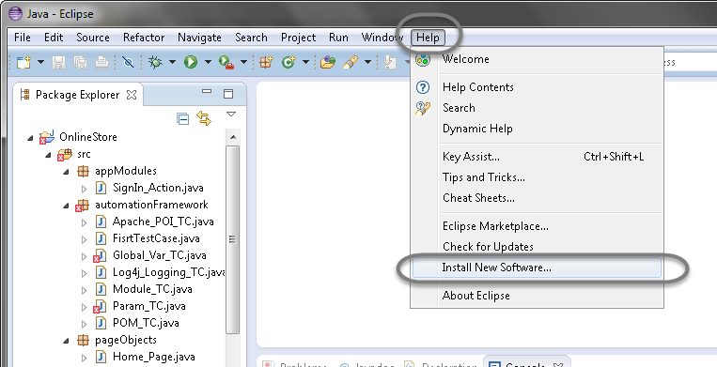
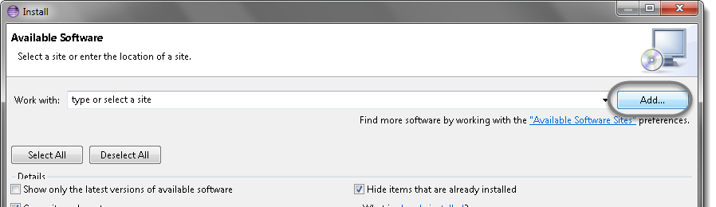
Installation and Configuration: TestNG (TestNewGeneration) (cont..)
Alternate way of Installing and Configuring TestNG
1. Launch the Eclipse IDE and from Help menu, click “Install New Software”.
2. You will see a dialog window, click “Add” button.

Slide 35
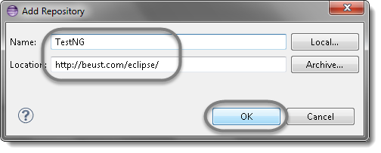
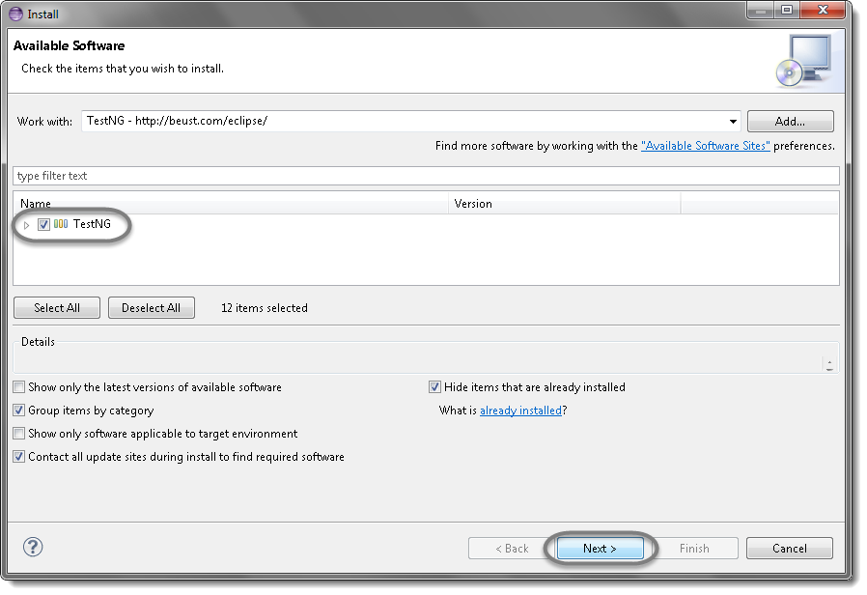
Installation and Configuration: TestNG (TestNewGeneration) (cont..)
3. Type name as you wish, lets take “TestNG” and type “http://beust.com/eclipse/” as location. Click OK.
4. You come back to the previous window but this time you must see TestNG option in the available software list. Just Click TestNG and press “Next” button.

Slide 36
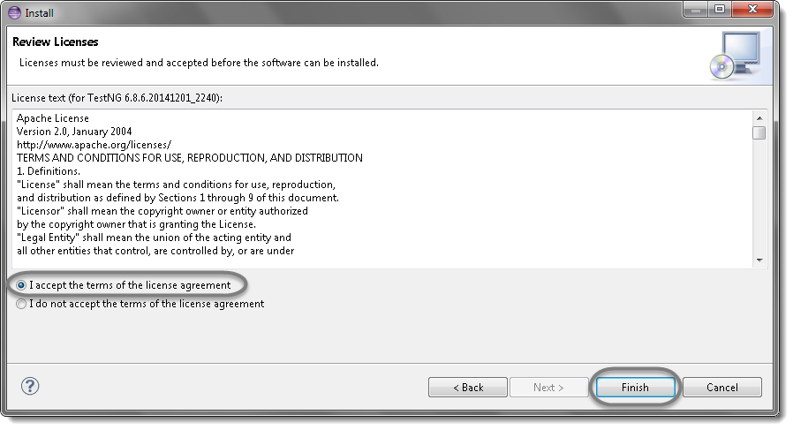
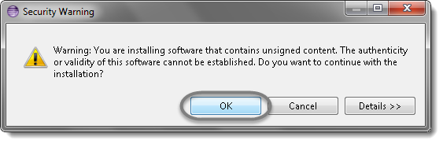
Installation and Configuration: TestNG (TestNewGeneration) (cont..)
5. Click “I accept the terms of the license agreement” then click Finish.
6. You may or may not encounter a Security warning, if in case you do just click OK.
7. Click Next again on the succeeding dialog box until it prompts you to Restart the Eclipse.

Slide 37
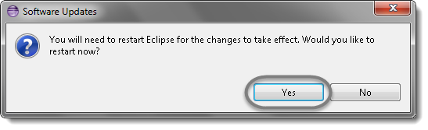
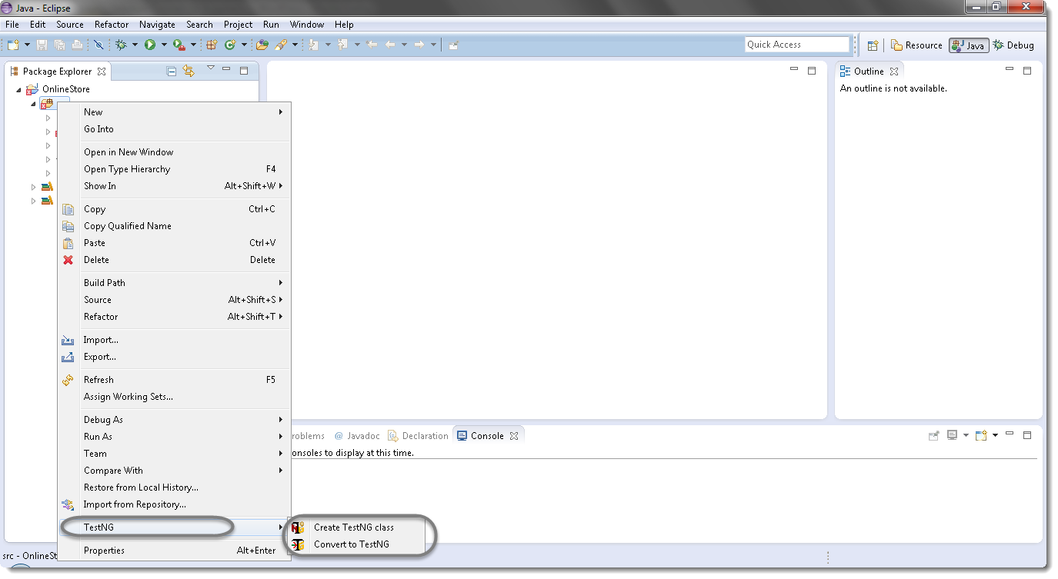
Installation and Configuration: TestNG (TestNewGeneration) (cont..)
8. You are all done now, just Click Yes.
9. Proceed with your workplace.
10. After restart, verify if TestNG was indeed successfully installed. Right click on you project and see if TestNG is displayed in the opened menu.

Slide 38
Installation and Configuration: Webdriver Configuration
REQUIREMENTS:
o Eclipse IDE is successfully configured.
o You already imported a project (e.g. TestEnv sample project) or created a new one.
o Drivers needed for your automation (included on the compiled installation tools for selenium webdriver):
IE Driver Server
ChromeDriver
Firefox (no driver server)
HTMLUnit (no driver server)
OperaDriver
SafariDriver

Slide 39
Installation and Configuration: Webdriver Configuration (cont..)
1. Create a new folder on the Drive C:\\Workspace\\<projectname> and named it as “resources”.
2. Create a new folder again under “resources” folder and named it as “Webdriver”.
3. Copy and paste the drivers you want to used for the automation(Note: Firefox and HTMLUnit have no driver server).

Slide 40
Installation and Configuration: Libraries
Libraries
The Java Class Library (JCL) is a set of dynamically loadable libraries that Java applications can call at run time. Because the Java Platform is not dependent on a specific operating system, applications cannot rely on any of the platform-native libraries. These are often shared via archive files called JAR files (short for "java archive"). A JAR file is not unlike the ZIP files seen frequently in email attachments, in that it is one or more files that have been compressed into a single, "as-small-as-possible" file.
Adding an External Library to an Eclipse Project Folder
To add the functionality provided by this library to one of your projects, simply do the following:
1. Start Eclipse, and locate the project folder to which the library should be added.
2. Right-click this class folder, and select "Properties“

Slide 41
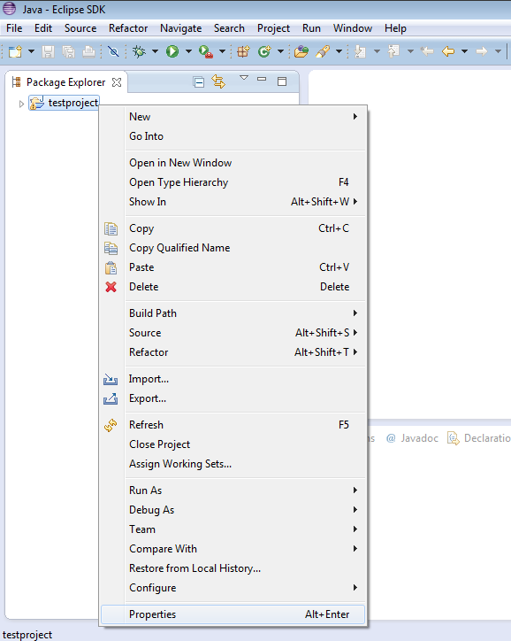
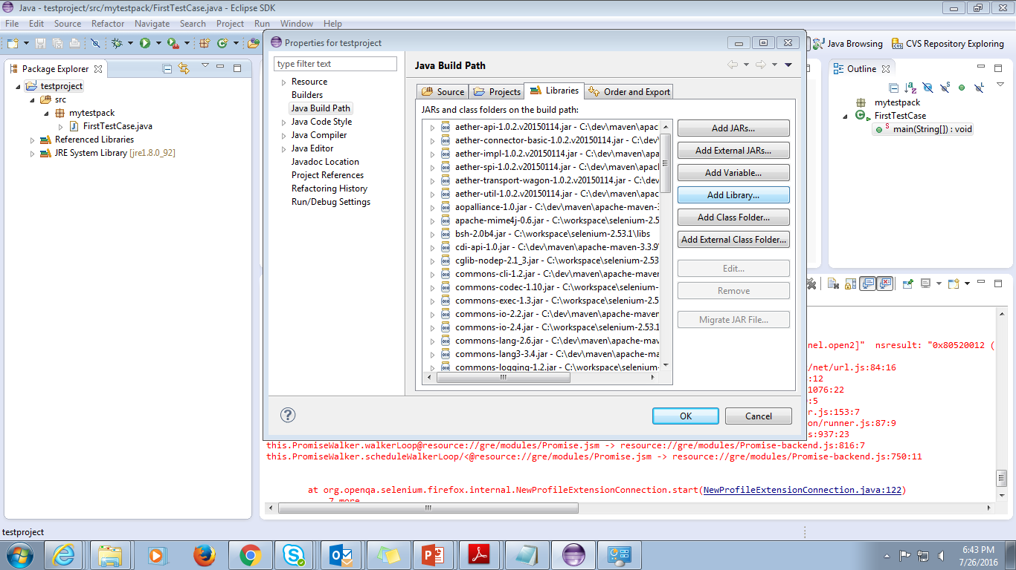
Installation and Configuration: Libraries (Cont..)
3. Select "Java Build Path" on the left, and then the "Libraries" tab. Now, click the "Add Library..." button

Slide 42
Sample and Demo

Slide 43
Sample
Basic Selenese Commands
Initiating the Web Browser
When launching the web browser use the following commands:
Example:
Firefox: WebDriver driver = new FirefoxDriver();
Chrome: WebDriver driver = new ChromeDriver();
IE: WebDriver driver = new InternetExplorerDriver();
Fetching a Page
When navigating to a page you use the “get” command.
Example:
driver.get("http://www.google.com");
driver.navigate().to(" http://www.google.com");

Slide 44
Sample (Cont..)
Closing a Browser
When closing the web browser you use the “quit” command.
Example:
driver.quit();
Locating a Web Element
When finding for a web element you use the “findElement” command.
Example:
WebElement element = driver.findElement(By.id(“sampleElement"));
By ID
This is the most efficient and preferred way to locate an element.
Example:
WebElement element = driver.findElement(By.id(“sb_ifc0"));

Slide 45
Sample (Cont..)
By Class Name
This refers to the attribute on the DOM element
Example:
WebElement element = driver.findElement(By.className(“sbib_b"));

Slide 46
Sample (Cont..)
By Tag Name
The DOM Tag Name of the element.
Example:
WebElement element = driver.findElement(By.tagName(“div"));
By Name
Find the input element with matching name attribute.
Example:
WebElementelement = driver.findElement(By.name(“oq"));

Slide 47
Sample (Cont..)
By Xpath
WebDriver uses a browser’s native XPath capabilities wherever possible. On those browsers that don’t have native XPath support, we have provided our own implementation. This can lead to some unexpected behavior unless you are aware of the differences in the various xpath engines.
Example:
WebElement element = driver.findElement(By.xpath(“//input"));

Slide 48
Sample and Demo

Slide 49
APPENDIX

Slide 50
Appendix
http://www.oracle.com/technetwork/java/javase/downloads/index.html
http://www.eclipse.org/downloads/
https://maven.apache.org/download.cgi
http://toolsqa.com/selenium-webdriver/install-testng/
http://www.oxfordmathcenter.com/drupal7/node/44
https://en.wikipedia.org/wiki/Java_Class_Library
Selenium Installation Guide.pdf by Lenard G. Magpantay
Selenium WebDriver Overview Training.pdf by Lenard G. Magpantay

