Slide 1

SonarQube

Slide 2

CONTENTS
Introduction to SonarQube
SonarQube Features
Some SonarQube Concepts
Installing SonarQube

Slide 3
Introduction to SonarQube
What is SonarQube
Is an open source code quality management tool that allows managing, tracking and improving of source codes
Objective is to make code analysis/quality accessible to everyone with minimal effort
Aims to save developers from committing the Developer’s Seven Deadly Sins
Bugs and Potential Bugs
Coding Standards Breach
Duplications
Lack of Unit Tests
Bad Distribution of Complexity
Spaghetti Design
Not Enough or Too Many Comments

Slide 4
SonarQube Features
Supports various languages
Java (including Android), C/C++, Objective-C, C#, PHP, Flex, Groovy, JavaScript, Python, PL/SQL, COBOL, Swift, etc.
Offers reports on duplicated code, coding standards, unit tests, code coverage, code complexity, comments, bugs, and security vulnerabilities
Records metrics history and provides evolution graphs.
Provides fully automated analysis
integrates with Maven, Ant, Gradle, MSBuild and continuous integration tools (Atlassian Bamboo, Jenkins, Hudson, etc.)
Integrates with Eclipse, Visual Studio and IntelliJ IDEA development environments through the SonarLint plugins
Integrates with external tools
LDAP, Active Directory, GitHub, etc.
Is expandable with the use of plugins

Slide 5
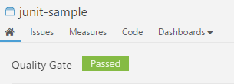
Some SonarQube Concepts
Quality Gates
A quality gate is the best way to enforce a quality policy in your organization. It's there to answer ONE question : can I deliver my project to production today or not?
The current status is displayed prominently at the top of the Project Page
Getting notified when a quality gate fails. To do so, subscribe to the New quality gate status notification either for all projects or a set of projects you're interested in.

Slide 6
Some SonarQube Concepts
Code Viewer
The code viewer is the heart of SonarQube: it displays the source code of a file (both source and test files), and its high-level statistics:
Lines
Issues (generated by the rules activated on the quality profile)
Test coverage by unit or integration tests
Duplications within the same file or in other files
SCM information like who last committed a specific line and when
All tests of a given test file, along with their execution time and their status

Slide 7
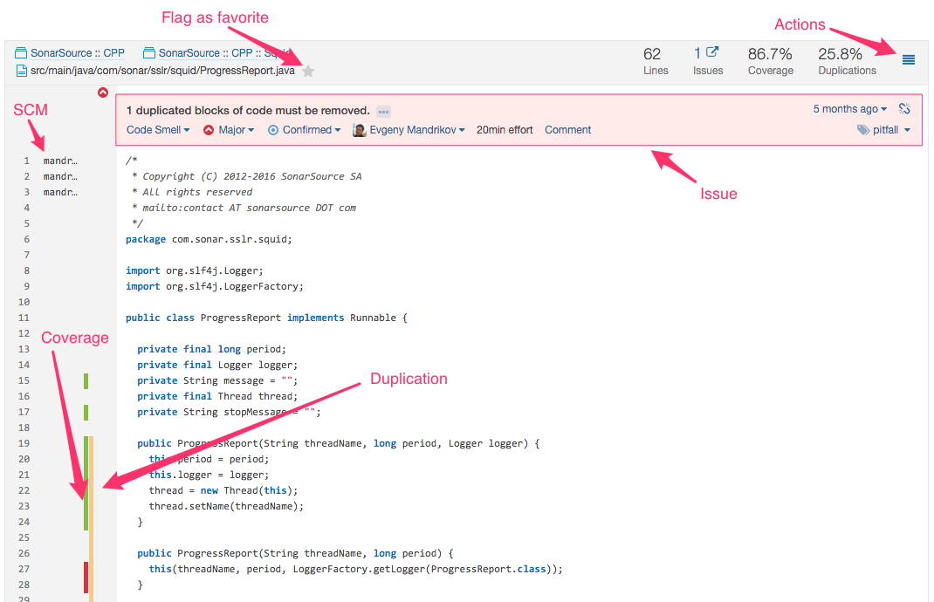
Some SonarQube Concepts
Code Viewer

Slide 8
Some SonarQube Concepts
Issues
When a component does not comply with a coding rule, an issue is logged on the snapshot.
An issue can be logged on a source file or a unit test file.
There are 3 types of issue:
Code Smell : an issue affecting your maintainability rating, preventing you to inject changes as fast as when you start from scratch
Bug : an issue highlighting a real or potential point of failure in your software
Vulnerability : an issue highlighting a security hole that can be used to attack your software

Slide 9
Some SonarQube Concepts
Rules
In the SonarQube platform, plugins contribute rules which are executed on source code to generate issues.
Those issues are used to compute remediation cost and technical debt .
There are three basic types of rules:
Reliability and Maintainability rules, from which zero false positives are expected, and
Security rules, which may produce some false positives.
The Rules page is the entry point where you can discover all the existing rules or create new ones based on provided templates.

Slide 10
Installing SonarQube
Download the latest LTS version of SonarQube: https://www.sonarqube.org/downloads/
Download SonarScanner: https://docs.sonarqube.org/display/SCAN/Analyzing+with+SonarQube+Scanner
Create a directory that will be easy to access using the command prompt (Ideally at C:\sonarqube)
Extract the SonarQube to the C:\sonarqube and rename the new folder as sonarqube-server
Extract the Sonar Scanner to C:\sonarqube and rename the new folder as sonarqube-scanner
Navigate to the bin and open the folder of your corresponding system architecture, then open cmd here
Execute the StartSonar.bat to run the Sonar Server
Sonar server should now be running and open the homepage through localhost:9000

